Slide 1
16.317 Microprocessor Systems Design I
Instructor: Dr. Michael Geiger
Fall 2015
Lecture 14:
Jump and loop instructions

Slide 2
Lecture outline
Announcements/reminders
HW 3 to be posted; due date TBD
Today’s lecture
Jump instructions
Loop instructions

Slide 3
Jump instructions
Used to change flow of program
Next instruction specified by operand
Two general types
Unconditional: JMP <target>
Always goes to address indicated by <target>
Conditional: Jcc <target>
Jump only occurs if condition true
cc replaced by valid condition code
Most codes discussed in previous lecture
Additional codes: CXZ/ECXZ
→ CX/ECX register is zero

Slide 4
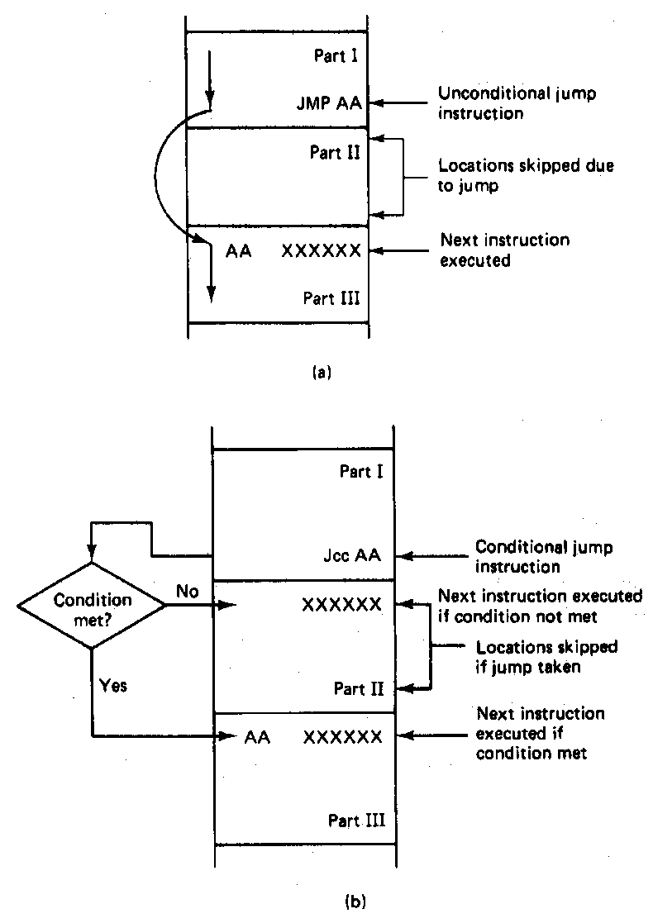
Jump Instructions

Slide 5
Example: program structure 1
Given the instructions below, what are the resulting register values if:
AX = 0010H, BX = 0010H
AX = 1234H, BX = 4321H
What type of high-level program structure does this sequence demonstrate?
Instructions
CMP AX, BX
JE L1
ADD AX, 1
JMP L2
L1: SUB AX, 1
L2: MOV [100H], AX

Slide 6
Example solution
First case: AX = BX = 0010H
CMP AX, BX → Shows AX == BX
JE L1 → Cond. true—jump to L1
ADD AX, 1
JMP L2
L1: SUB AX, 1 → AX = AX – 1 = 000F
L2: MOV [100H], AX → Store 000F at DS:100H

Slide 7
Example solution (cont.)
Second case: AX = 1234H, BX = 4321H
CMP AX, BX → Shows AX < BX
JE L1 → Cond. false—no jump
ADD AX, 1 → AX = AX + 1 = 1235H
JMP L2
L1: SUB AX, 1 → AX = AX – 1 = 000F
L2: MOV [100H], AX → Store 000F at DS:100H

Slide 8
Example solution (cont.)
High-level program structure: if/else statement
If part: compare + jump (if (AX == BX))
Else part: what follows if condition false
Unconditional jump used to skip “if” part
Both parts have same exit (L2)

Slide 9
Example: program structure 2
Given the instructions below, what are the resulting register values if, initially, AX = 0001H?
What type of high-level program structure does this sequence demonstrate?
Instructions
MOV CL, 5
L: SHL AX, 1
DEC CL
JNZ L

Slide 10
Example: program structure 3
Given the instructions below, what are the resulting register values if, initially, AX = 0001H?
What type of high-level program structure does this sequence demonstrate?
Instructions
MOV CX, 5
L: JCXZ END
ADD AX, AX
DEC CX
JMP L
END: MOV [10H], AX

Slide 11
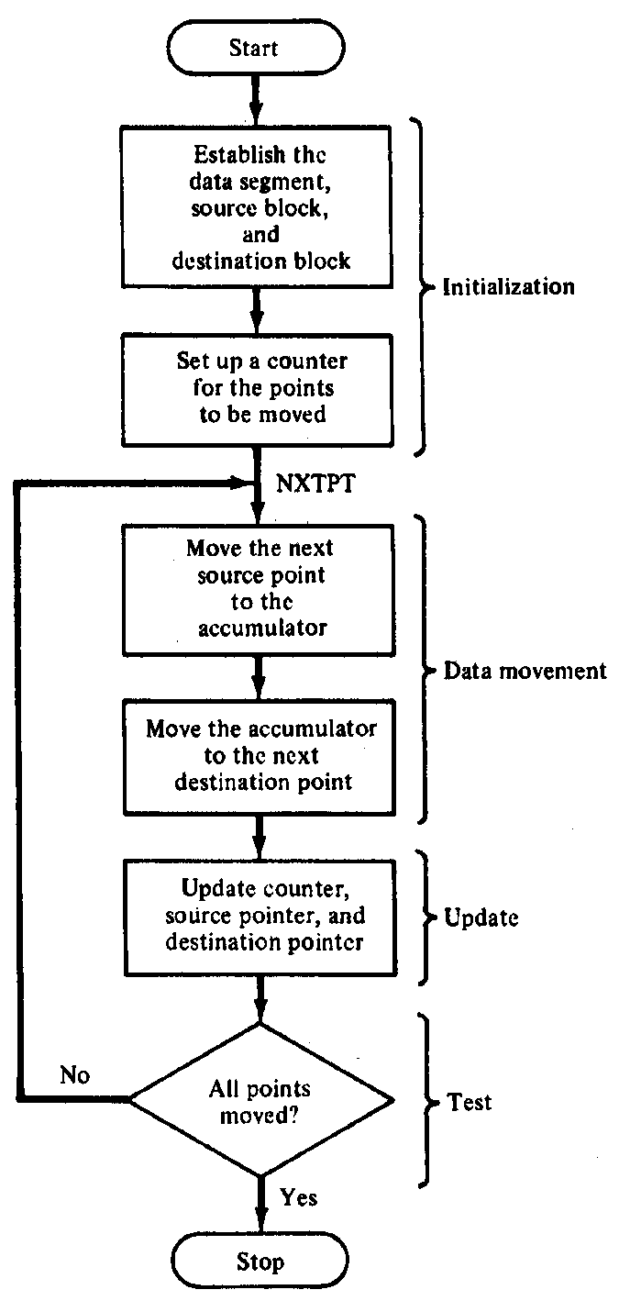
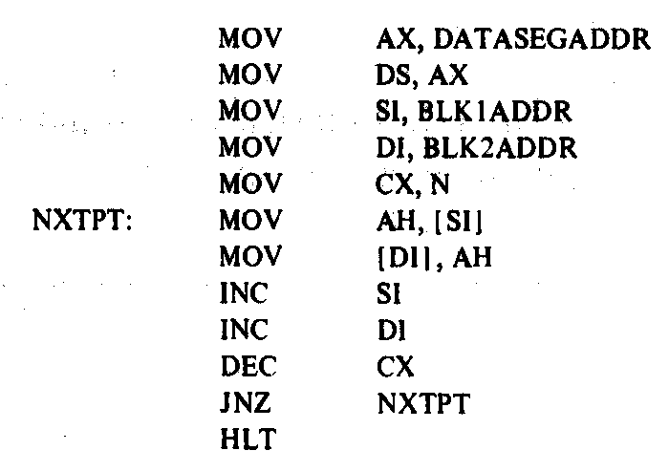
Block Move Program

Slide 12
Loop instructions
Common operations in basic loops
Compare
Conditional jump
Decrement loop counter (CX)
Loop instructions combine all into one op
All decrement CX by 1, then check if CX == 0
<target> must be short-label (8-bit immediate)
LOOP <target>: Return to <target> if CX != 0
LOOPE/LOOPZ <target>: Return to <target> if (CX != 0) && (ZF == 1)
LOOPNE/LOOPNZ <target>: Return to <target> if (CX != 0) && (ZF != 1)

Slide 13
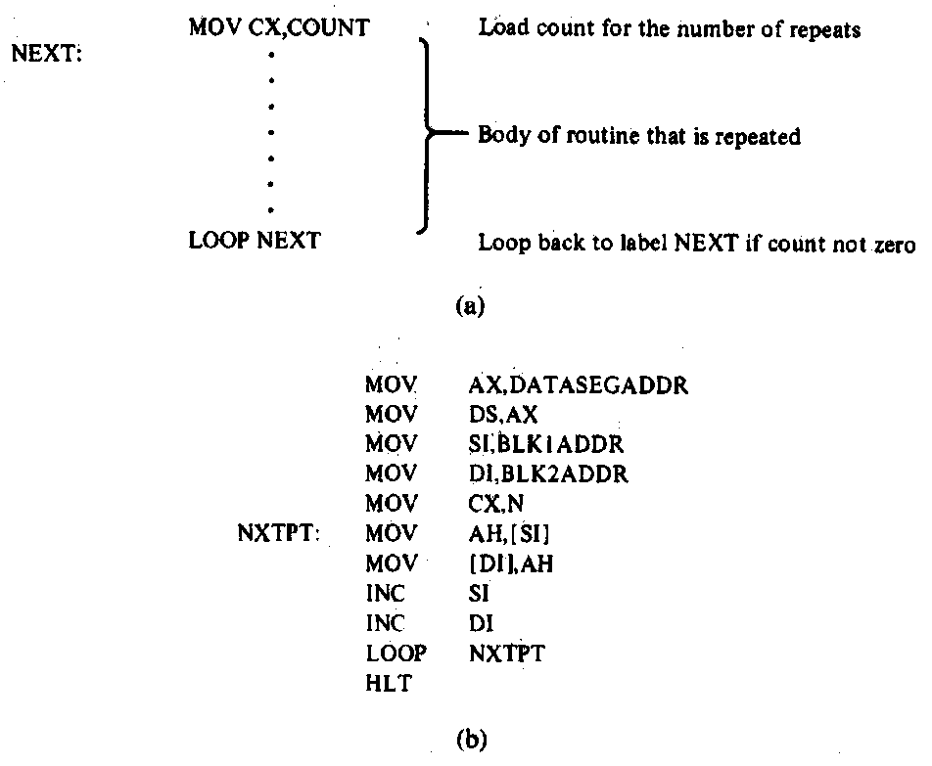
Loop Program Structure
Structure of a loop
CX = initial count
Loop body: code to be repeated
Loop instruction– determines if loop is complete or if the body is to repeat
Example: block move

Slide 14
Loop example 1
Rewrite the post-tested loop seen earlier using a loop instruction:
MOV CL, 5
L: SHL AX, 1
DEC CL
JNZ L
Solution:
MOV CL, 5
L: SHL AX, 1
LOOP L

Slide 15
Loop example 2
Describe the operation of the following program (Example 6.15-6.16).
What is the final value of ESI if the 15 bytes between 0A001 and 0A00F have the following values?
00 01 02 03 04 05 06 07 08 09 0A 0B 0C 0D 0E
MOV DL, 05
MOV EAX, 0000A000h
MOV ESI, 00000000h
MOV CX, 000F
AGAIN:INC SI
CMP [EAX + ESI], DL
LOOPNE AGAIN

Slide 16
Final notes
Next time:
Subroutines
Reminders:
HW 3 to be posted; due date TBD

