Slide 1
16.317 Microprocessor Systems Design I
Instructor: Dr. Michael Geiger
Fall 2015
Lecture 13:
Subroutines

Slide 2
Lecture outline
Announcements/reminders
No lecture Monday (Columbus Day)
Lecture Tuesday, 10/13
HW 3 to be posted
Today’s lecture
Subroutines
Stack details

Slide 3
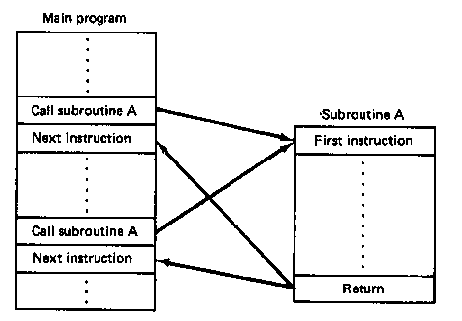
Subroutines
Subroutine: special program segment that can be “called” from any point in program
Implements HLL functions/procedures
Written to perform operation that must be repeated in program
Actual subroutine code only written once

Slide 4
Subroutine operation
When called, address of next instruction saved
State may need to be saved before call
Parameters can be passed
Control of program transferred to subroutine
After subroutine finished, return instruction goes back to saved address

Slide 5
x86 subroutines
Specify starting point with pseudo-op
<name> PROC
May save state/allocate variables at start
If so, will restore at end of subroutine
Last instruction returns to saved address
Always RET
Pseudo-op after RET indicates routine end
<name> ENDP

Slide 6
Subroutine example
SQUARE PROC
PUSH AX ; Save AX to stack
MOV AL, BL ; Copy BL to AL
IMUL BL ; AX = BL * AL
; = original BL squared
MOV BX, AX ; Copy result to BX
POP AX ; Restore AX
RET
SQUARE ENDP

Slide 7
Call/return
Calling subroutine: CALL <proc>
Address of next instruction saved on stack
Either IP (near) or CS, IP (far)
<proc> can be 16- or 32-bit label/immediate, register, memory operand
16-bit immediate added to IP
16-bit register/memory replaces IP
32-bit values replace CS/IP
Ending subroutine: RET
Saved address restored to IP (& CS if needed)

Slide 8
Example
Assuming AX = 2 and BX = 4, show the results of the following sequence (Ex. 6.11):
Assume the addresses of the first three instructions are 0005, 0008, and 0009, respectively
CALL SUM
RET ; End main function
SUM PROC NEAR
MOV DX, AX
ADD DX, BX
RET
SUM ENDP

Slide 9
Example results
CALL SUM
RET ; End main function
SUM PROC NEAR
MOV DX, AX DX = AX = 4
ADD DX, BX DX = DX + BX = 4 + 2 = 6
RET
SUM ENDP

Slide 10
Saving state
May need to save state before routine starts
Overwritten registers (that aren’t return values)
Flags
Placing data on stack: PUSH
Store data “above” current TOS; decrement SP
Stack grows toward lower addresses
New SP points to start of data just stored
Basic PUSH stores word or double word
Directly storing flags: PUSHF
Storing all 16-/32-bit general purpose registers: PUSHA/PUSHAD

Slide 11
Restoring state
Removing data from TOS: POP
Data removed from TOS; SP incremented
Basic POP removes word/double word
Directly removing flags: POPF
Removing all 16-/32-bit general purpose registers: POPA/POPAD
POP instructions generally executed in reverse order of corresponding PUSH instructions

Slide 12
Revisiting subroutine example
SQUARE PROC NEAR
PUSH AX ; Save AX to stack
MOV AL, BL ; Copy BL to AL
IMUL BL ; AL = BL * AL
; = original BL squared
MOV BX, AX ; Copy result to BX
POP AX ; Restore AX
RET
SQUARE ENDP

Slide 13
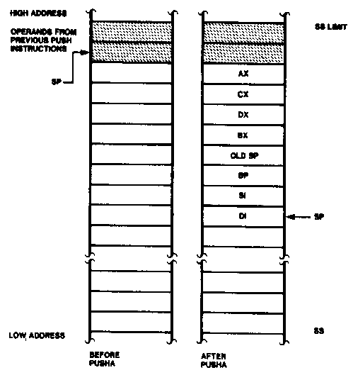
Push All and Pop All Operations

Slide 14
Stack examples
Assume initial state shown in handout
What is the resulting stack state of each of the following sequences?
PUSH BX
PUSH AX
PUSH EBX
PUSH EAX
PUSHA

Slide 15
Solution
What is the resulting stack state of each of the following sequences?
PUSH BX
PUSH AX
4 bytes pushed to stack, so SP decremented by 4 → ESP = 00001FFCH
AX is at top of stack; BX is below that
PUSH EBX
PUSH EAX
8 bytes pushed to stack, so SP decremented by 8 → ESP = 00001FF8H
EAX is at top of stack; EBX is below that
PUSHA
8 words = 16 bytes pushed to stack, so SP decremented by 16 → ESP = 00001FF0H
As shown in slide 13, DI is at top of stack, followed by SI, BP, old SP, BX, DX, CX, and AX

Slide 16
Final notes
Next time:
HLL → assembly (Tuesday, 10/13)
Announcements/reminders
No lecture Monday (Columbus Day)
HW 3 to be posted

