Slide 1
EECE.3170 Microprocessor Systems Design I
Instructor: Dr. Michael Geiger
Spring 2016
Lecture 23
Exam 2 Preview

Slide 2
Lecture outline
Announcements/reminders:
HW 6 due 1:00 PM today—no late submissions accepted
Today’s lecture: Exam 2 Preview

Slide 3
Exam 2 notes
Allowed
One 8.5” x 11” double-sided sheet of notes
Calculator
No other notes or electronic devices (phone, laptop, etc.)
Exam will last 50 minutes
Covers lectures 12-14, 16-22
Format similar to previous exam
1 multiple choice question
2-3 short problems to solve/code sequences to evaluate

Slide 4
Review: compare
CMP D, S
Flags show result of (D) – (S)
Condition codes: mnemonics implying certain flag conditions

Slide 5
Review: conditional instructions
Conditional move
Move performed only if condition is true
SETcc D
Sets single byte destination to 1 (01H) if condition true; all 0s (00H) if condition false
Can be used to build up complex conditions

Slide 6
Review: jump, loop
Two general types of jump
Unconditional: JMP <target>
Always go to target address
Conditional: Jcc <target>
Go to target address if condition true
Loop instructions
Combines CX decrement with JNZ test
May add additional required condition
LOOPE/LOOPZ: loop if ((CX != 0) && (ZF == 1))
LOOPNE/LOOPNZ: loop if (CX != 0) && (ZF == 0))

Slide 7
Review: subroutines
Subroutines: low-level functions
When called, address of next instruction saved
Return instruction ends routine; goes to that point
May need to save state on stack
x86 specifics
CALL <proc>: call procedure
<proc> can be label (16-/32-bit imm), reg, mem
RET: return from procedure
Saving state to stack: push instructions
Store data “above” current TOS; decrement SP
Basic PUSH stores word or double word
Directly storing flags: PUSHF
Storing all 16-/32-bit general purpose registers: PUSHA/PUSHAD
Restoring state: POP/POPF/POPA/POPAD

Slide 8
Review: HLL → assembly
Data accesses
Global variables → static; allocated in data segment
Other variables → dynamic; allocated on stack
Stack frame for each function contains (from top)
Saved variables within function
Local variables for function (starting at EBP – 4)
Saved EBP
Saved EIP
Function arguments (starting at EBP + 8)
Conditional statements (if-then-else)
Evaluate condition (CMP instruction(s))
Conditional jump (often to “else” case)
“If” case ends with unconditional jump to skip “else”
Loops
Initialize variable at start
Test loop condition (similar to if)
Change loop variable

Slide 9
Review: PIC instructions
Four typical instruction formats (+ few special purpose)
Upper bits of all hold opcode
Byte-oriented includes 1 bit destination, 7 bit direct address
Bit-oriented includes 3 bit position (0-7), 7 bit direct address
Literal/control includes 8 bit literal
CALL/GOTO includes 11 bit literal
Variable declarations
cblock <start_address>: start of variable declarations
All names between cblock/endc directives assigned to consecutive bytes starting at <start_address>

Slide 10
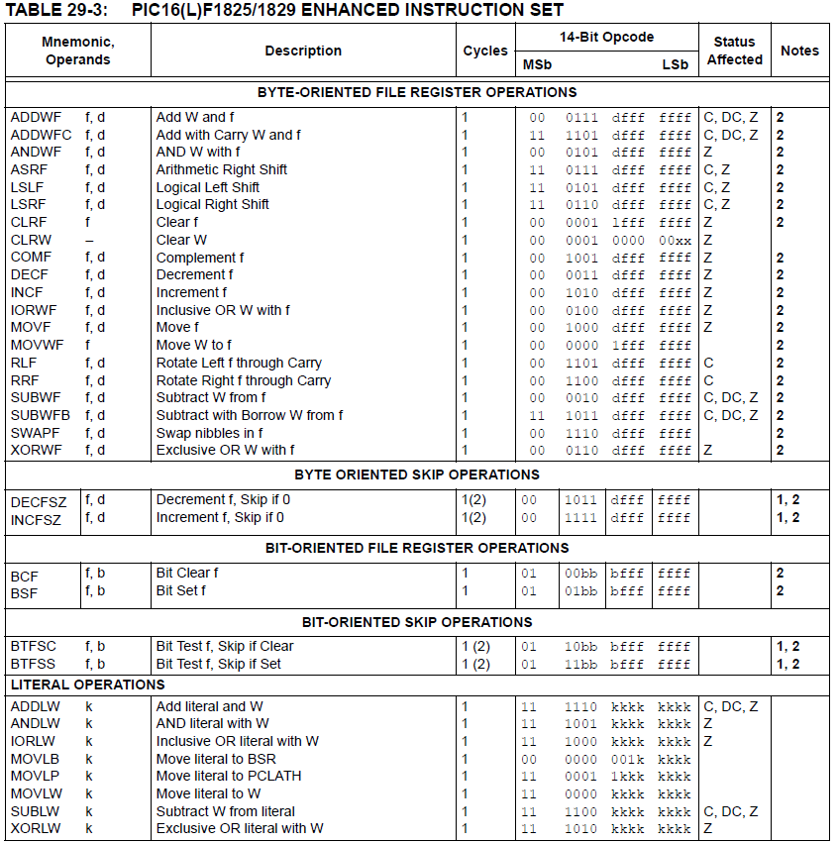

Slide 11
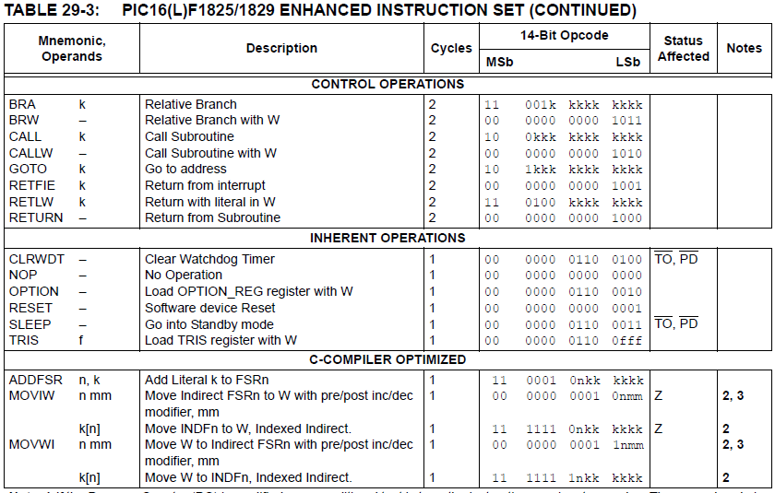

Slide 12
Review: PIC instructions (cont.)
Clearing register: clrw/clrf
Moving values: movlw/movwf/movf
Swap nibbles: swapf
Single bit manipulation: bsf/bcf
Unary operations: incf/decf/comf
Arithmetic: addlw/addwf/addwfc/
sublw/subwf/subwfb

Slide 13
Review: PIC instructions (cont.)
Logical operations
andlw/andwf
iorlw/iorwf
xorlw/xorwf
Rotates/shifts
rrf/lsrf/asrf
rlf/lslf
Jumps/calls/return
goto/bra
call
return/retlw/retfie
Conditional execution
Test bit and skip next instruction if clear/set: btfsc/btfss
Increment/decrement register and skip next instruction if zero: incfsz/decfsz
Example use: combined with goto to create conditional jump

Slide 14
Final notes
Next time:
Exam 2—PLEASE BE ON TIME
Reminders
HW 6 due 1:00 PM today—no late submissions accepted

