Slide 1
16.317 Microprocessor Systems Design I
Instructor: Dr. Michael Geiger
Fall 2015
Lecture 2:
Data storage and addressing

Slide 2
Lecture outline
Announcements/reminders
Sign up for the course discussion group on Piazza
No lecture Monday (Labor Day)
Today’s lecture
Review: instruction set architecture
Data types
Data storage
Addressing modes

Slide 3
Processor architecture
“Architecture” can refer to
High-level description of hardware; could be
Overall system
Microprocessor
Subsystem within processor
Operations available to programmer
Instruction set architecture
Other applications to computing (e.g., “software architecture”) we won’t discuss
Commonly used to discuss functional units and how they work together

Slide 4
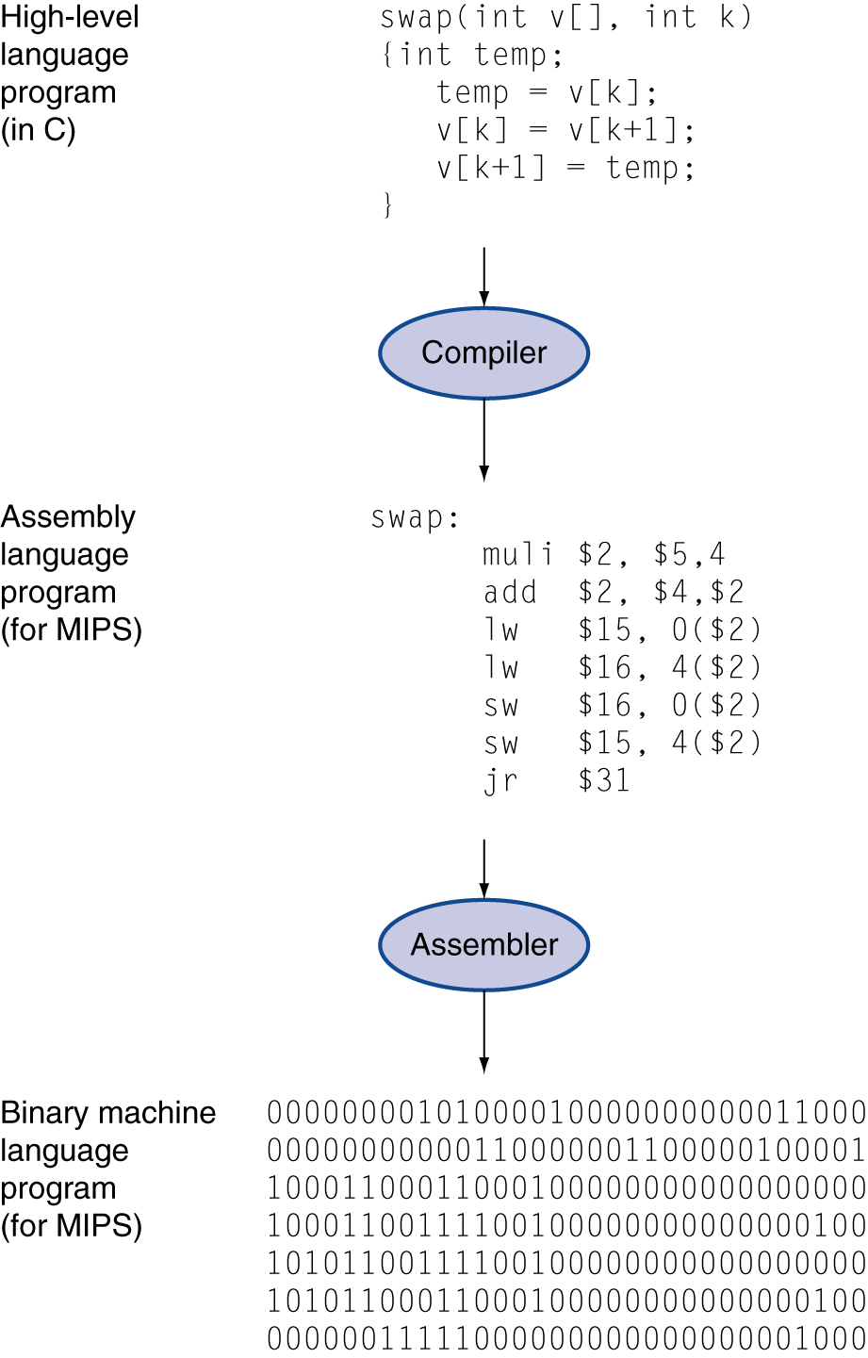
Role of the ISA
User writes high-level language (HLL) program
Compiler converts HLL program into assembly for the particular instruction set architecture (ISA)
Assembler converts assembly into machine language (bits) for that ISA
Resulting machine language program is loaded into memory and run

Slide 5
Abstraction of program control
Easiest for humans to understand high-level languages
Processor interprets machine language
Assembly language: abstraction with intermediate level of detail
Breaks machine code into instructions
Gives some insight into how each instruction behaves
More readable than bit patterns!

Slide 6
ISA design
Think about a HLL statement like
X[i] = i * 2;
ISA defines how such statements are translated to machine code
What information is needed?

Slide 7
ISA design (cont.)
Think about a HLL statement like
X[i] = i * 2;
Questions answered in every ISA (or “software model”)
How will the processor implement this statement?
What operations are available?
How many operands does each instruction use?
Where are X[i] and i?
How do we reference the operands?
What type(s) of data are X[i] and i?
What types of operands are supported?
How big are those operands?
Instruction format issues
How many bits per instruction?
What does each bit or set of bits represent?
Are all instructions the same length?

Slide 8
Operation types
Operations: what should processor be able to do?
Data transfer
Move data between storage locations
Arithmetic operations
Typical: add, subtract, maybe multiply/divide, negation
Logical operations
Typical: AND, OR, NOT, XOR
Often includes bit manipulation: shifts, rotates, test/set/clear single bit
Program control
“Jump” to another part of program
May be based on condition
Used to implement loops, conditionals, function call/return
Typically some processor-specific special purpose ops

Slide 9
Operands
Two major questions when dealing with data
“How” do we store them? → what do the bits represent?
Where do we store them?
… and how do we access those locations?
First question deals with data types
Second question deals with data storage and addressing

Slide 10
Data types
Also seen in high-level languages
Think about C types: int, double, char, etc.
What does a data type specify?
How big is each piece of data?
How do we interpret the bits representing those data?
Data sizes
Smallest addressable unit: byte (8 bits)
Can also deal with multi-byte data: 16, 32, 64 bits
Often deal with words of data
Word size processor-dependent (16 bits on x86, 32 bits on MIPS)
Can have double words, quad words, half words …
Interpreting bits
Numbers: Integers, floating-point; signed vs. unsigned
May treat as characters, other special formats

Slide 11
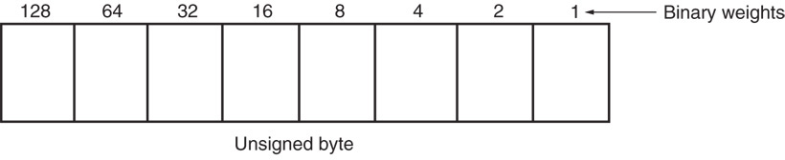
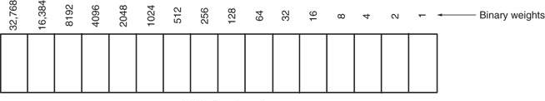
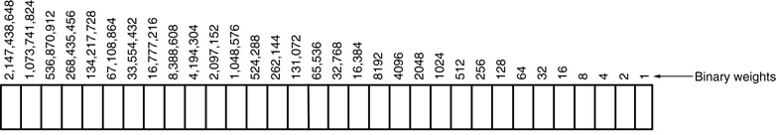
Unsigned Integers
Types:
Sizes Range
8-bit 0H → 255₁₀
16-bit 0H → 65,535₁₀
32-bit 0H → 4,294,967,295₁₀

Slide 12
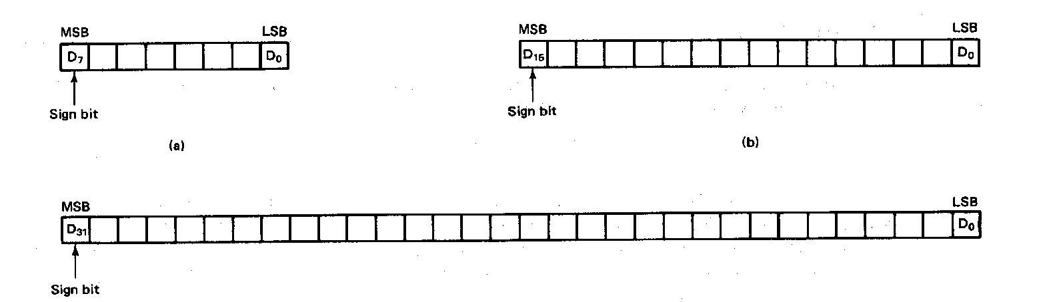
Signed Integers
MSB is sign bit ( 0/1 -> +/-)
Remaining bits represent value
Negative numbers expressed in 2’s complement notation
Types:
Sizes Range
8-bit -128 → +127
16-bit -32,768 → +32,767
32-bit -2,147,483,648 → +2,147,483,647

Slide 13
Integer Examples
Given the 8-bit value: 1001 1111₂
Calculate the decimal value of this integer as
An unsigned integer
A signed integer

Slide 14
Integer example solution
Given the 8-bit value: 1001 1111₂
Calculate the decimal value of this integer as
An unsigned integer
Solution:
(1 x 2⁷) + (1 x 2⁴) + (1 x 2³) + (1 x 2²) + (1 x 2¹) + (1 x 2⁰)
= 128 + 16 + 8 + 4 + 2 + 1 = 159
A signed integer
Solution:
MSB = 1 → negative value
To get magnitude, take 2’s complement:
0110 0001₂ = (1 x 2⁶) + (1 x 2⁵) + (1 x 2⁰)
= 64 + 32 + 1 = 97
→ Result = -97

Slide 15
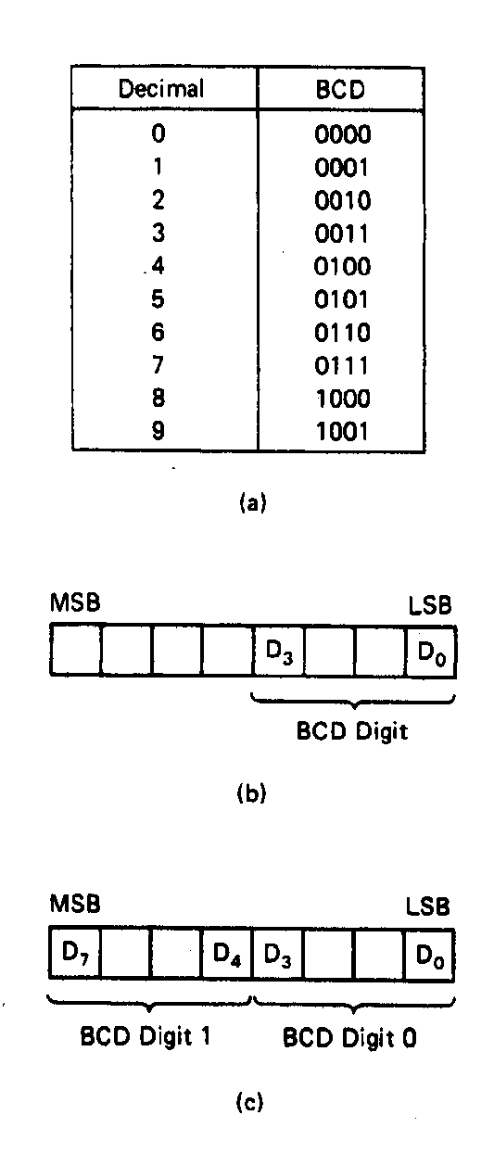
BCD Numbers
Direct coding of numbers as binary coded decimal (BCD) numbers supported
Unpacked BCD [Fig.2.10(b)]
Lower four bits contain a digit of a BCD number
Upper four bits filled with zeros (zero filled)
Packed BCD [Fig. 2.10(c)]
Lower significant BCD digit held in lower 4 bits of byte
More significant BCD digit held in upper 4 bits of byte
Example: Packed BCD byte at address 01000H is 10010001₂, what is the decimal number?
Organizing as BCD digits gives,
1001_{BCD} 0001_{BCD} = 91₁₀

Slide 16
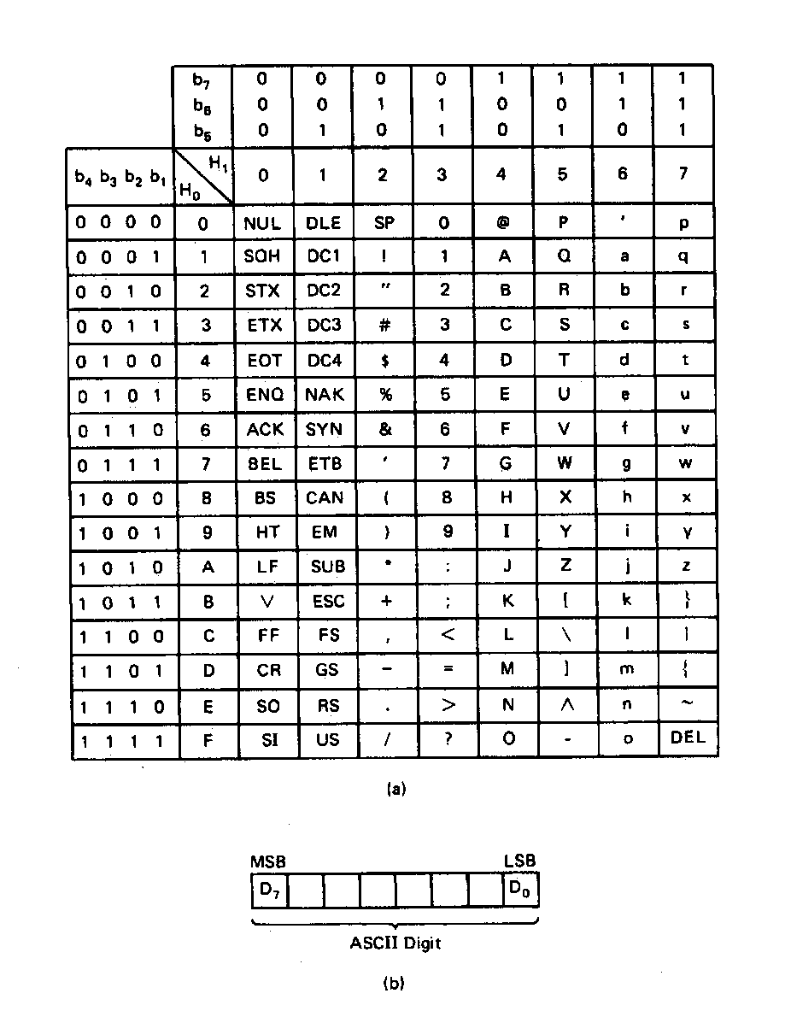
ASCII Data
American Code for Information Interchange (ASCII) code
ASCII information storage in memory
Coded one character per byte
7 LS-bits = b₇b₆b₅b₄b₃b₂b₁
MS-bit filled with 0
Example: Addresses 01100H-01104H contain ASCII coded data 01000001, 01010011, 01000011, 01001001, and 01001001, respectively. What does the data stand for?
0 100 0001_{ASCII} = A
0 101 0011_{ASCI} = S
0 100 0011_{ASCII} = C
0 100 1001_{ASCII} = I
0 100 1001_{ASCII} = I

Slide 17
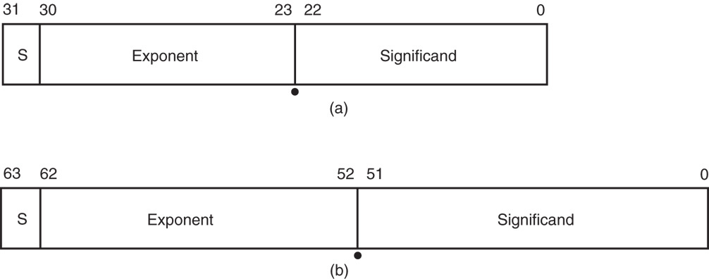
Real Numbers
Floating-point data stored in two parts
Significand (fraction)
Exponent
Single-precision (32 bits) or double-precision (64 bits)

Slide 18
Data storage
What characteristics do we want storage media to have?
Two primary answers
Speed
Capacity
Very difficult to get both in single storage unit
Processors use two different types of storage
Registers
Memory

Slide 19
Registers
Small, fast set of storage locations close to processor
Primarily used for computation, short-term storage
Speed → ideal for individual operations
Lack of capacity → will frequently overwrite
Reference registers by name
Example: ADD EAX, EBX → EAX = EAX + EBX
EAX, EBX are registers in x86 architecture

Slide 20
Memory
Provides enough capacity for all code, data (possibly I/O as well)
Typically organized as hierarchy
Used primarily for long-term storage
Lacks speed of registers
Provides capacity to ensure data not overwritten
Reference memory by address
Example: MOV EAX, DS:[100H]
→ EAX = memory at address DS:[100H]

Slide 21
Memory (continued)
Accessing single byte is easy
Considerations with multi-byte data
Are the data aligned?
Easier/faster to access aligned data
How are the data organized in memory (“endianness”)?
Given 32-bit number: DEADBEEFH or 0xDEADBEEF
Which byte—MSB (0xDE) or LSB (0xEF) gets stored in memory first?

Slide 22
Final notes
Next time (Wednesday, 9/9):
x86 introduction
Reminders:
Sign up for the discussion group on Piazza
No lecture Monday (Labor Day)

