Slide 1
EECE.3170 Microprocessor Systems Design I
Instructor: Dr. Michael Geiger
Spring 2016
Lecture 21:
PIC instruction set (continued)

Slide 2
Lecture outline
Announcements/reminders
HW 5 due 2:30 PM today
HW 6 to be posted; due 1:00 PM, 3/28
No late submissions
Exam 2 in class Wednesday, 3/30
Instruction list to be posted
Allowed one double-sided 8.5” x 11” note sheet; calculator
PICkits to be handed out soon
Will have to work in groups (3 students preferred size)
Review
PIC instruction set basics
Data transfers
Bit manipulation instructions
Today’s lecture
Arithmetic instructions
Logical instructions
Shift/rotate instructions

Slide 3
Review: PIC instructions
Four typical instruction formats (+ few special purpose)
Upper bits of all hold opcode
Byte-oriented includes 1 bit destination, 7 bit direct address
Bit-oriented includes 3 bit position (0-7), 7 bit direct address
Literal/control includes 8 bit literal
CALL/GOTO includes 11 bit literal
Variable declarations
cblock <start_address>: start of variable declarations
All names between cblock/endc directives assigned to consecutive bytes starting at <start_address>

Slide 4
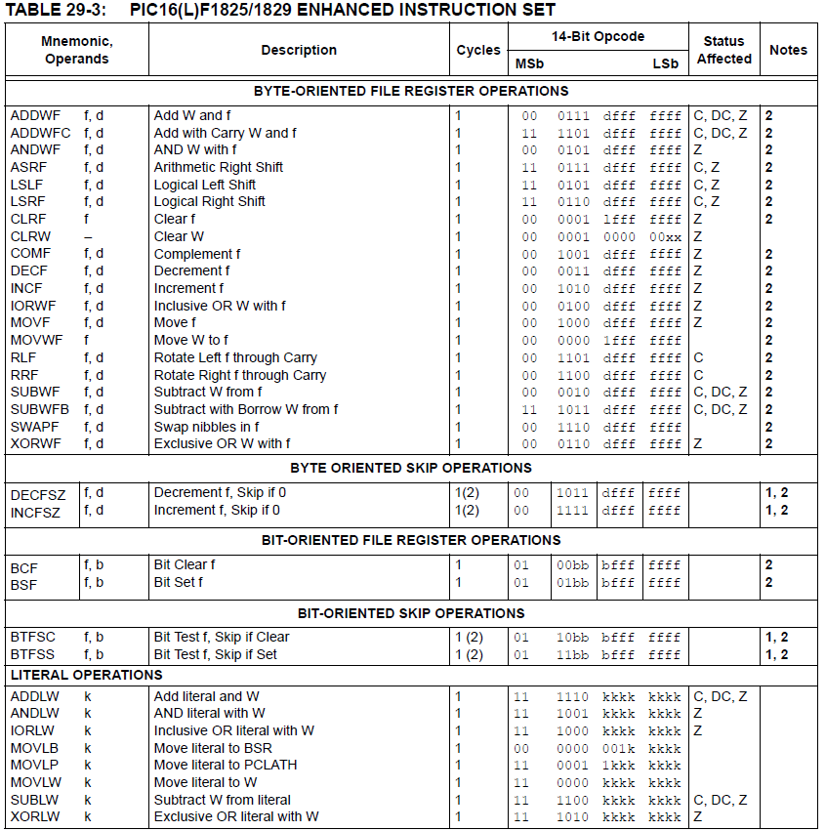

Slide 5
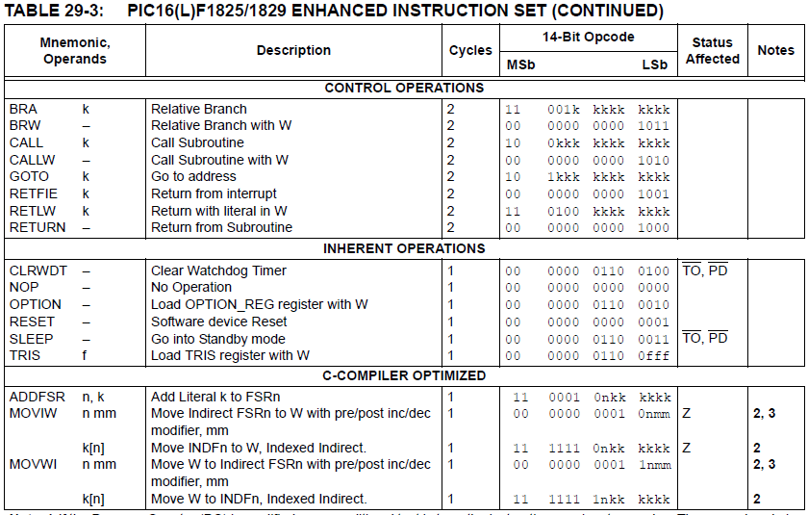

Slide 6
Review: PIC instructions (cont.)
Clearing register: clrw/clrf
Moving values: movlw/movwf/movf
Swap nibbles: swapf
Single bit manipulation: bsf/bcf

Slide 7
Increment/Decrement/ Complement
incf f, F(W) ; increment f, putting result in F or W
decf f, F(W) ;decrement f, putting result in F or W
comf f, F(W) ;complement f, putting result in F or W
STATUS bits:
Z
Examples:
incf TEMP1, F ;Increment TEMP1
incf TEMP1, W ;W <- TEMP1+1; TEMP1 unchanged
decf TEMP1, F ;Decrement TEMP1
comf TEMP1, F ;Change 0s and 1s to 1s and 0s

Slide 8
Addition/Subtraction
addlw k ;add literal value k into W
addwf f, F(W) ;add w and f, putting result in F or W
addwfc f, F(W) ;add w, f, and C, putting result in F or W
sublw k ;subtract W from literal value k, putting
;result in W
subwf f, F(W) ;subtract W from f, putting result in F or W
subwfb f, F(W) ;subtract f – W – (~C), putting result in F or W
STATUS bits:
C, DC, Z
Examples:
addlw 5 ; W = 5+W
addwf TEMP1, F ; TEMP1 = TEMP1+W
sublw 5 ; W = 5-W (not W = W-5 )
subwf TEMP1, F ; TEMP1 = TEMP1 - W

Slide 9
Example
Show the values of all changed registers after the following sequence
cblock 0x20
varA
varB
varC
endc
clrf varA
clrf varB
clrf varC
incf varA, W
sublw 0x0F
addwf varB, F
decf varB, F
comf varB, W
subwf varC, F

Slide 10
Example solution
clrf varA → varA = 0
clrf varB → varB = 0
clrf varC → varC = 0
incf varA, W → W = varA + 1 = 1
sublw 0x0F → W = 0x0F – W = 0x0F – 1
= 0x0E
addwf varB, F → varB = varB + W = 0x0E
decf varB, F → varB = varB – 1 = 0x0D
comf varB, W → W= ~varB = ~0x0D = 0xF2
subwf varC, F → varC = varC – W = 0x0E

Slide 11
Multi-bit Manipulation
andlw k ; AND literal value k into W
andwf f, F(W) ; AND W with f, putting result in F or W
iorlw k ; Inclusive-OR literal value k into W
iorwf f, F(W) ; Inclusive-OR W with f, putting result in F or W
xorlw k ; Exclusive-OR literal value k into W
xorwf f, F(W) ; Exclusive-OR W with f, putting result in F or W
Examples:
andlw B’00000111’ ;force upper 5 bits of W to zero
andwf TEMP1, F ;TEMP1 <- TEMP1 AND W
andwf TEMP1, W ;W <- TEMP1 AND W
iorlw B’00000111’ ;force lower 3 bits of W to one
iorwf TEMP1, F ;TEMP1 <- TEMP1 OR W
xorlw B’00000111’ ;complement lower 3 bits of W
xorwf TEMP1, W ;W <- TEMP1 XOR W
STATUS bits:
Z

Slide 12
Shift/Rotate
asrf f, F(W) ; copy f into F or W; shift F or W right one bit, keeping
; sign intact; shift LSB into C
lsrf f, F(W) ; copy f into F or W; shift F or W right one bit, shifting
; 0 into MSB; shift LSB into C
lslf f, F(W) ; copy f into F or W; shift F or W left one bit, shifting
; 0 into LSB; shift MSB into C
rlf f, F(W) ; copy f into F or W; rotate F or W left through
; the carry bit
rrf f, F(W) ; copy f into F or W; rotate F or W right through
; the carry bit
STATUS bits:
C

Slide 13
Final notes
Next time:
Continue with PIC instruction set
Reminders:
HW 5 due 2:30 PM today
HW 6 to be posted; due 1:00 PM, 3/28
No late submissions
Exam 2 in class Wednesday, 3/30
Instruction list to be posted
Allowed one double-sided 8.5” x 11” note sheet; calculator
PICkits to be handed out soon
Will have to work in groups (3 students preferred size)

