Slide 1

Polars
Fast multi-threaded, hybrid-out-of-core DataFrame library

Slide 2
Intro to Polars
The goal of Polars is to provide a lightning fast DataFrame library that:
Utilizes all available cores on your machine.
Optimizes queries to reduce unneeded work/memory allocations.
Handles datasets much larger than your available RAM.
Has an API that is consistent and predictable.
Has a strict schema (data-types should be known before running the query).
Polars 0.16.10 vs Pandas 2.0
Polars is written in Rust which gives it C/C++ performance and allows it to fully control performance critical parts in a query engine.
As such Polars goes to great lengths to:
Reduce redundant copies.
Traverse memory cache efficiently.
Minimize contention in parallelism.
Process data in chunks.
Reuse memory allocations.
Unlike tools such as Dask - which tries to parallelize existing single-threaded libraries like NumPy and Pandas - Polars is written from the ground up, designed for parallelization of queries on DataFrames.
https://pola-rs.github.io/polars-book/user-guide/introduction.html
Notes:
Polars is lazy and semi-lazy. It allows you to do most of your work eagerly, similar to Pandas, but it also provides a powerful expression syntax that will be optimized and executed on within the query engine.
In lazy Polars we are able to do query optimization on the entire query, further improving performance and memory pressure.
Polars keeps track of your query in a logical plan. This plan is optimized and reordered before running it. When a result is requested, Polars distributes the available work to different executors that use the algorithms available in the eager API to produce a result. Because the whole query context is known to the optimizer and executors of the logical plan, processes dependent on separate data sources can be parallelized on the fly.

Slide 3
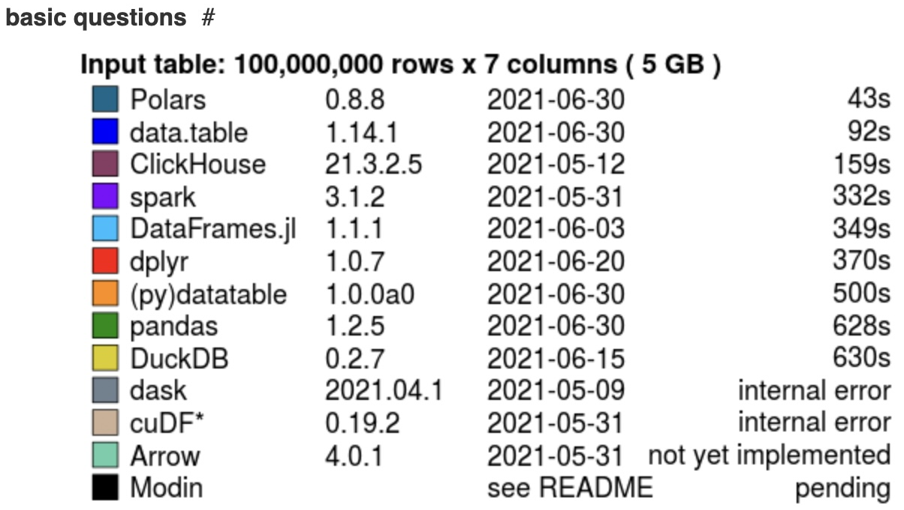
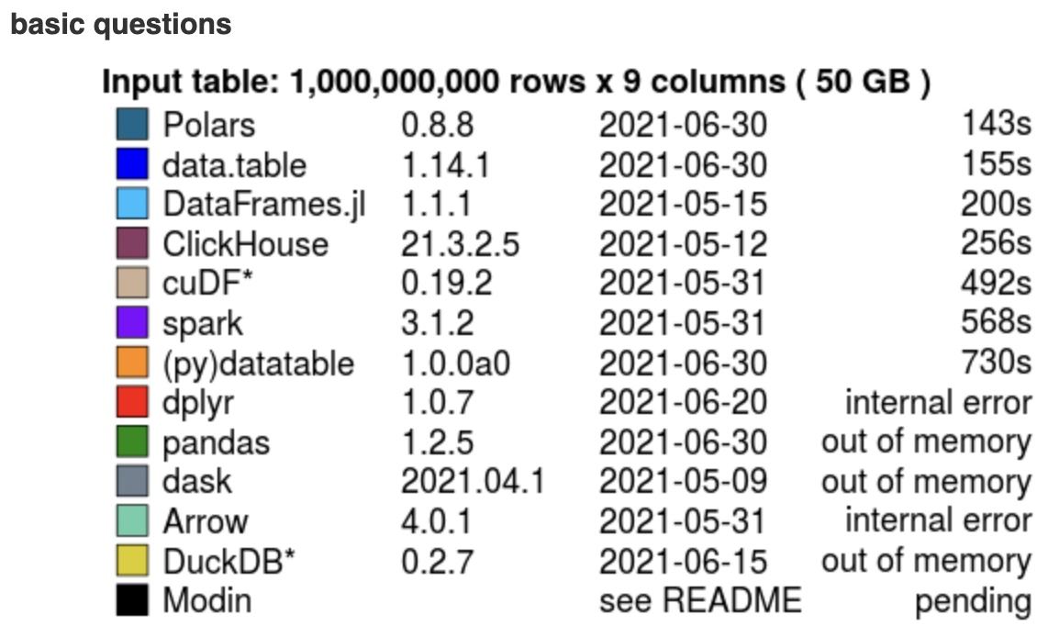
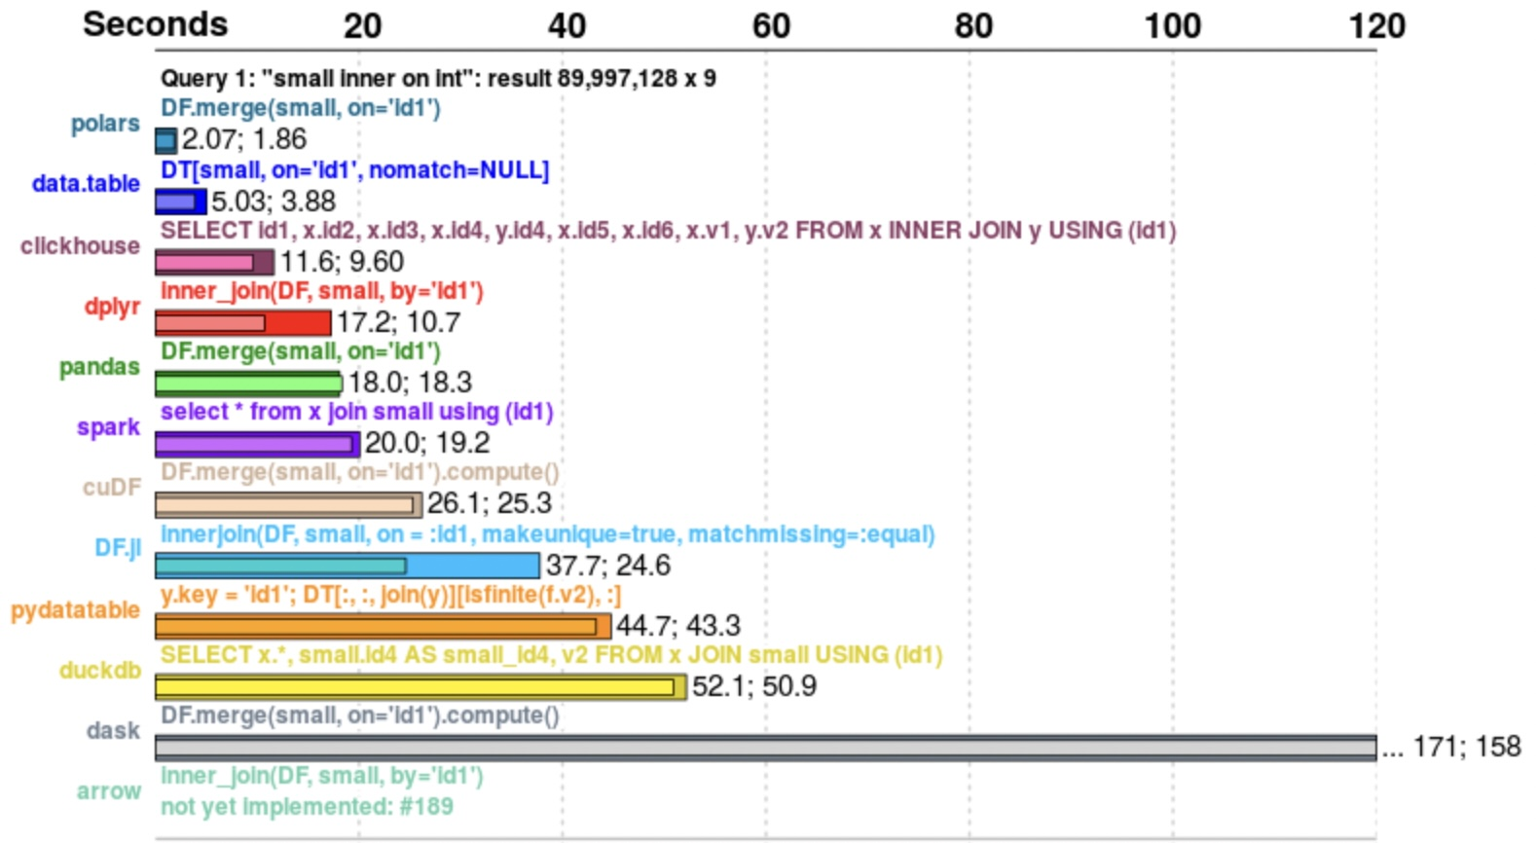
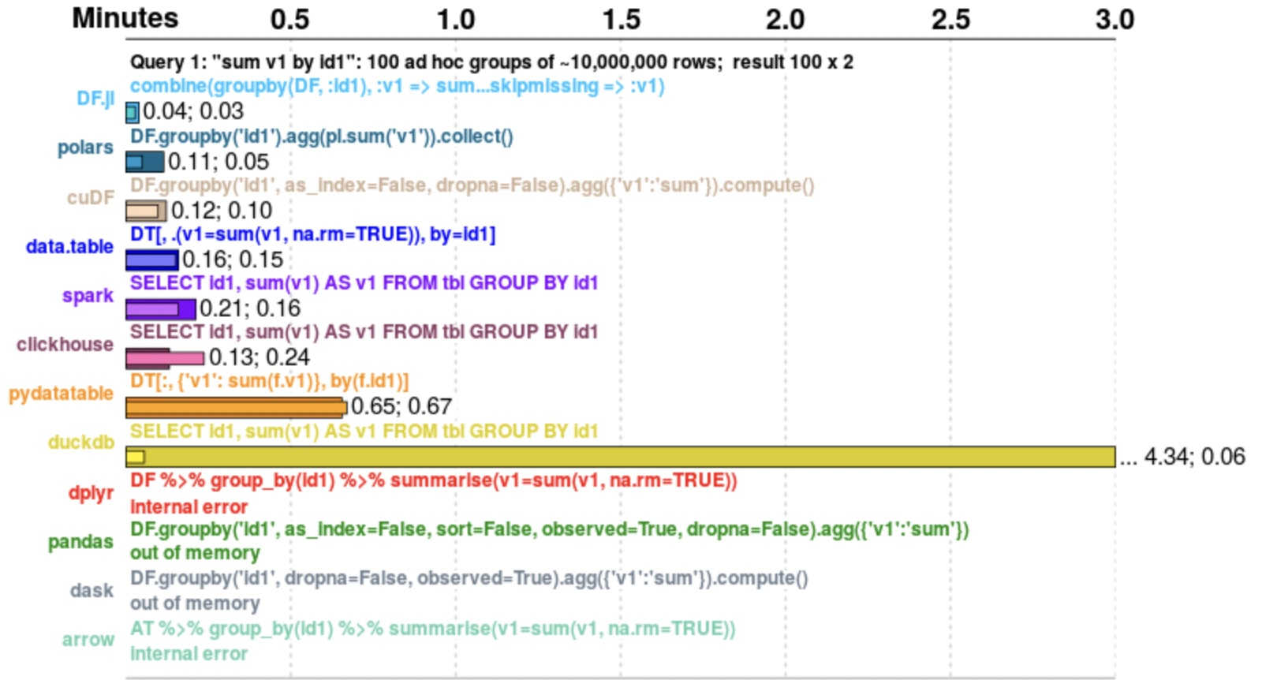
Benchmarks
https://h2oai.github.io/db-benchmark/

Slide 4
Polars Features
Copy-on-write (COW) semantics
"Free" clones
Cheap appends
Appending without clones
Column oriented data storage
No block manager (i.e. predictable performance)
Missing values indicated with bitmask
NaNs are different from missing
Bitmask optimizations
Efficient algorithms
Very fast IO
Its csv and parquet readers are among the fastest in existence
Out of Core
Many queries can be executed completely out of core (meaning that we can process datasets that are larger than RAM)
Arrow/IPC files can be memory mapped (this is the strategy vaex uses)
Query optimizations
Predicate pushdown
Filtering at scan level
Projection pushdown
Projection at scan level
Aggregate pushdown
Aggregations at scan level
Simplify expressions
Scan sharing
Common subplan elimination
Parallel execution of physical plan
Cardinality based groupby dispatch
Different groupby strategies based on data cardinality
SIMD vectorization
NumPy universal functions
https://pola-rs.github.io/polars-book/user-guide/introduction.html
Notes:
Polars is lazy and semi-lazy. It allows you to do most of your work eagerly, similar to Pandas, but it also provides a powerful expression syntax that will be optimized and executed on within the query engine.
In lazy Polars we are able to do query optimization on the entire query, further improving performance and memory pressure.
Polars keeps track of your query in a logical plan. This plan is optimized and reordered before running it. When a result is requested, Polars distributes the available work to different executors that use the algorithms available in the eager API to produce a result. Because the whole query context is known to the optimizer and executors of the logical plan, processes dependent on separate data sources can be parallelized on the fly.

Slide 5
Tool Comparisons
Pandas
A very versatile tool for small data. Read 10 things I hate about pandas written by the author himself. Polars has solved all those 10 things. Polars is a versatile tool for small and large data with a more predictable API, less ambiguous and stricter API.
Pandas the API
Designed for in memory data. aka poor fit for performant analysis on large data (read anything that does not fit into RAM).
Spark
Spark is designed for distributed workloads and uses the JVM. The setup for spark is complicated and the startup-time is slow. Polars has much better performance characteristics on a single machine. The API's are somewhat similar.
CuDF
GPU's are fast, but not readily available and expensive in production. The amount of memory available on GPU often is a fraction of available RAM. Next to that Polars is close in performance to CuDF and on some operations even faster. CuDF also doesn't optimize your query, so it is likely that on ETL jobs polars will be faster because it can elide unneeded work and materialization's.
https://pola-rs.github.io/polars-book/user-guide/introduction.html

Slide 6
Tool Comparisons (cont’d)
Vaex
Vaex’s method of out-of-core analysis is memory mapping files. This works until it doesn’t. Parquet or CSV files first need to be read and converted to a file format that can be memory mapped.
OS determines when pages will be swapped. Operations that need a full data shuffle, such as sorts cannot benefit from memory mapping. At the moment of writing Vaex relies on Pyarrow for sorts, meaning that the data must fit into memory.
Polars' out of core processing is not based on memory mapping, but on streaming data in batches (and spilling to disk if needed), we control which data must be hold in memory, not the OS, meaning that we don't have unexpected IO stalls.
Dask
Parallelizes existing single-threaded libraries like NumPy and Pandas. As a consumer of those libraries, Dask has less control over low level performance and semantics.
On a single machine the parallelization effort can also be seriously stalled by Pandas strings. Pandas strings, by default, are stored as python objects in Numpy arrays meaning that any operation on them is GIL bound and therefore single threaded. This can be circumvented by multi-processing but has a non-trivial cost.
https://pola-rs.github.io/polars-book/user-guide/introduction.html

Slide 7
Favorite takeaways
Memory efficiency:
Since scan_csv is lazy, using scan_csv followed by .select()’ing a subset of columns is equivalent to usecols in pd.read_csv
.collect(streaming=True) or .sink_parquet() streams larger-than-memory results into file instead of loading all in memory.
Simple Syntax:
pl.select() method can act as column selection as well as the pd.assign() column creation. Pares down on the amount of expressions you use - pl.with_columns() is just convenient for when you don’t want to reselect all the columns you’re not modifying.
Glob integration - .read_csv(‘*.csv’)
Window Functions – groupby aggregations no longer need long complicated expressions, just ___.over()
.when().then().otherwise() methods!
Blazingly fast:
Multithreads each expression group after query optimization
.fetch() for debugging or quickly viewing lazy dataset 23,000x faster than loading the whole thing with Pandas
https://kevinheavey.github.io/modern-polars/

Slide 8
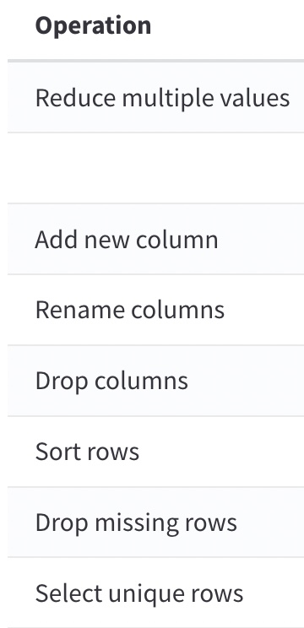
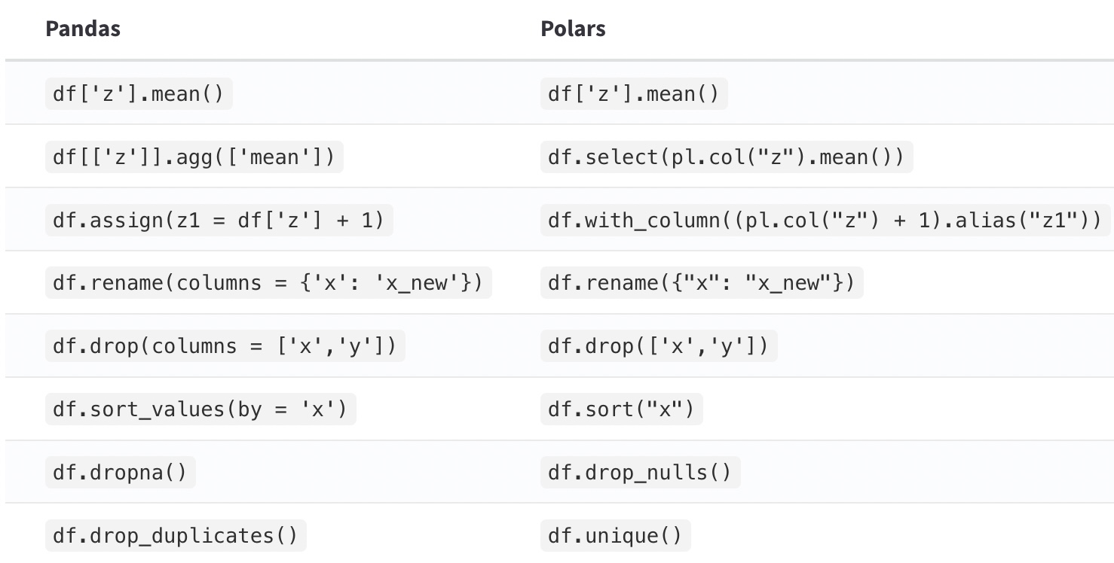
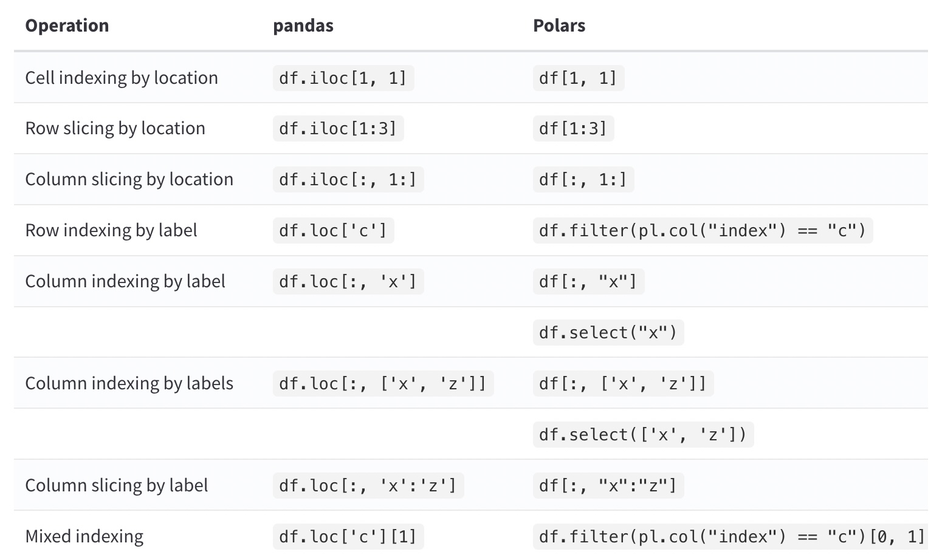
Pandas Comparisons
https://www.rhosignal.com/posts/polars-pandas-cheatsheet/
Notes:
it is recommended to use the Polars Expression API because:
-the Expression API can be used in lazy mode
-expressions can be optimized with the built-in query optimiser
-multiple expressions are run in parallel

Slide 9
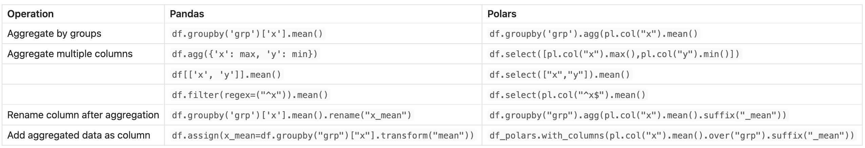
Pandas Comparisons (cont’d)
https://www.rhosignal.com/posts/polars-pandas-cheatsheet/
Notes:
it is recommended to use the Polars Expression API because:
-the Expression API can be used in lazy mode
-expressions can be optimised with the built-in query optimiser
-multiple expressions are run in parallel

Slide 10
References
Polars User Guide
Polars API Reference
Modern Polars – Polars and Pandas side-by-side
Polars on GitHub
Ritchie Vink
Polars Deep Dive
Pandas Cheatsheet

