Slide 1
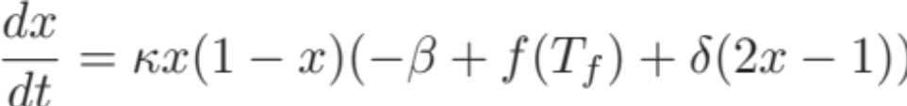
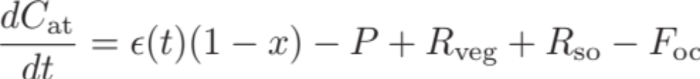
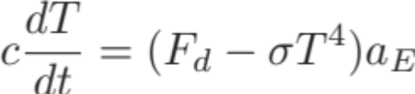
A simple socio-climate model
Dynamic social processes e.g social learning / norms
Social system
CO₂
emissions
Extreme events / Forecasts
Climate system
Carbon / climate feedbacks
Notes:
Parameter names:
x : proportion of mitigators
kappa : social learning rate
beta : mitigation cost
f(T) : perceived cost of climate change based on temperature projection T_f
delta : strength of social norms
C_at : total carbon in the atmosphere
epsilon(t) : anthropogenic emissions
P : photosynthesis carbon flux
R_veg : carbon flux via plant respiration
R_so : carbon flux via soil respiration
F_oc : carbon flux to oceans
c : specific heat capacity
T : average global temperature (change from pre-industrial values)
sigma : Stefan Boltzmann constant
a_E : Earth’s surface area

Slide 2
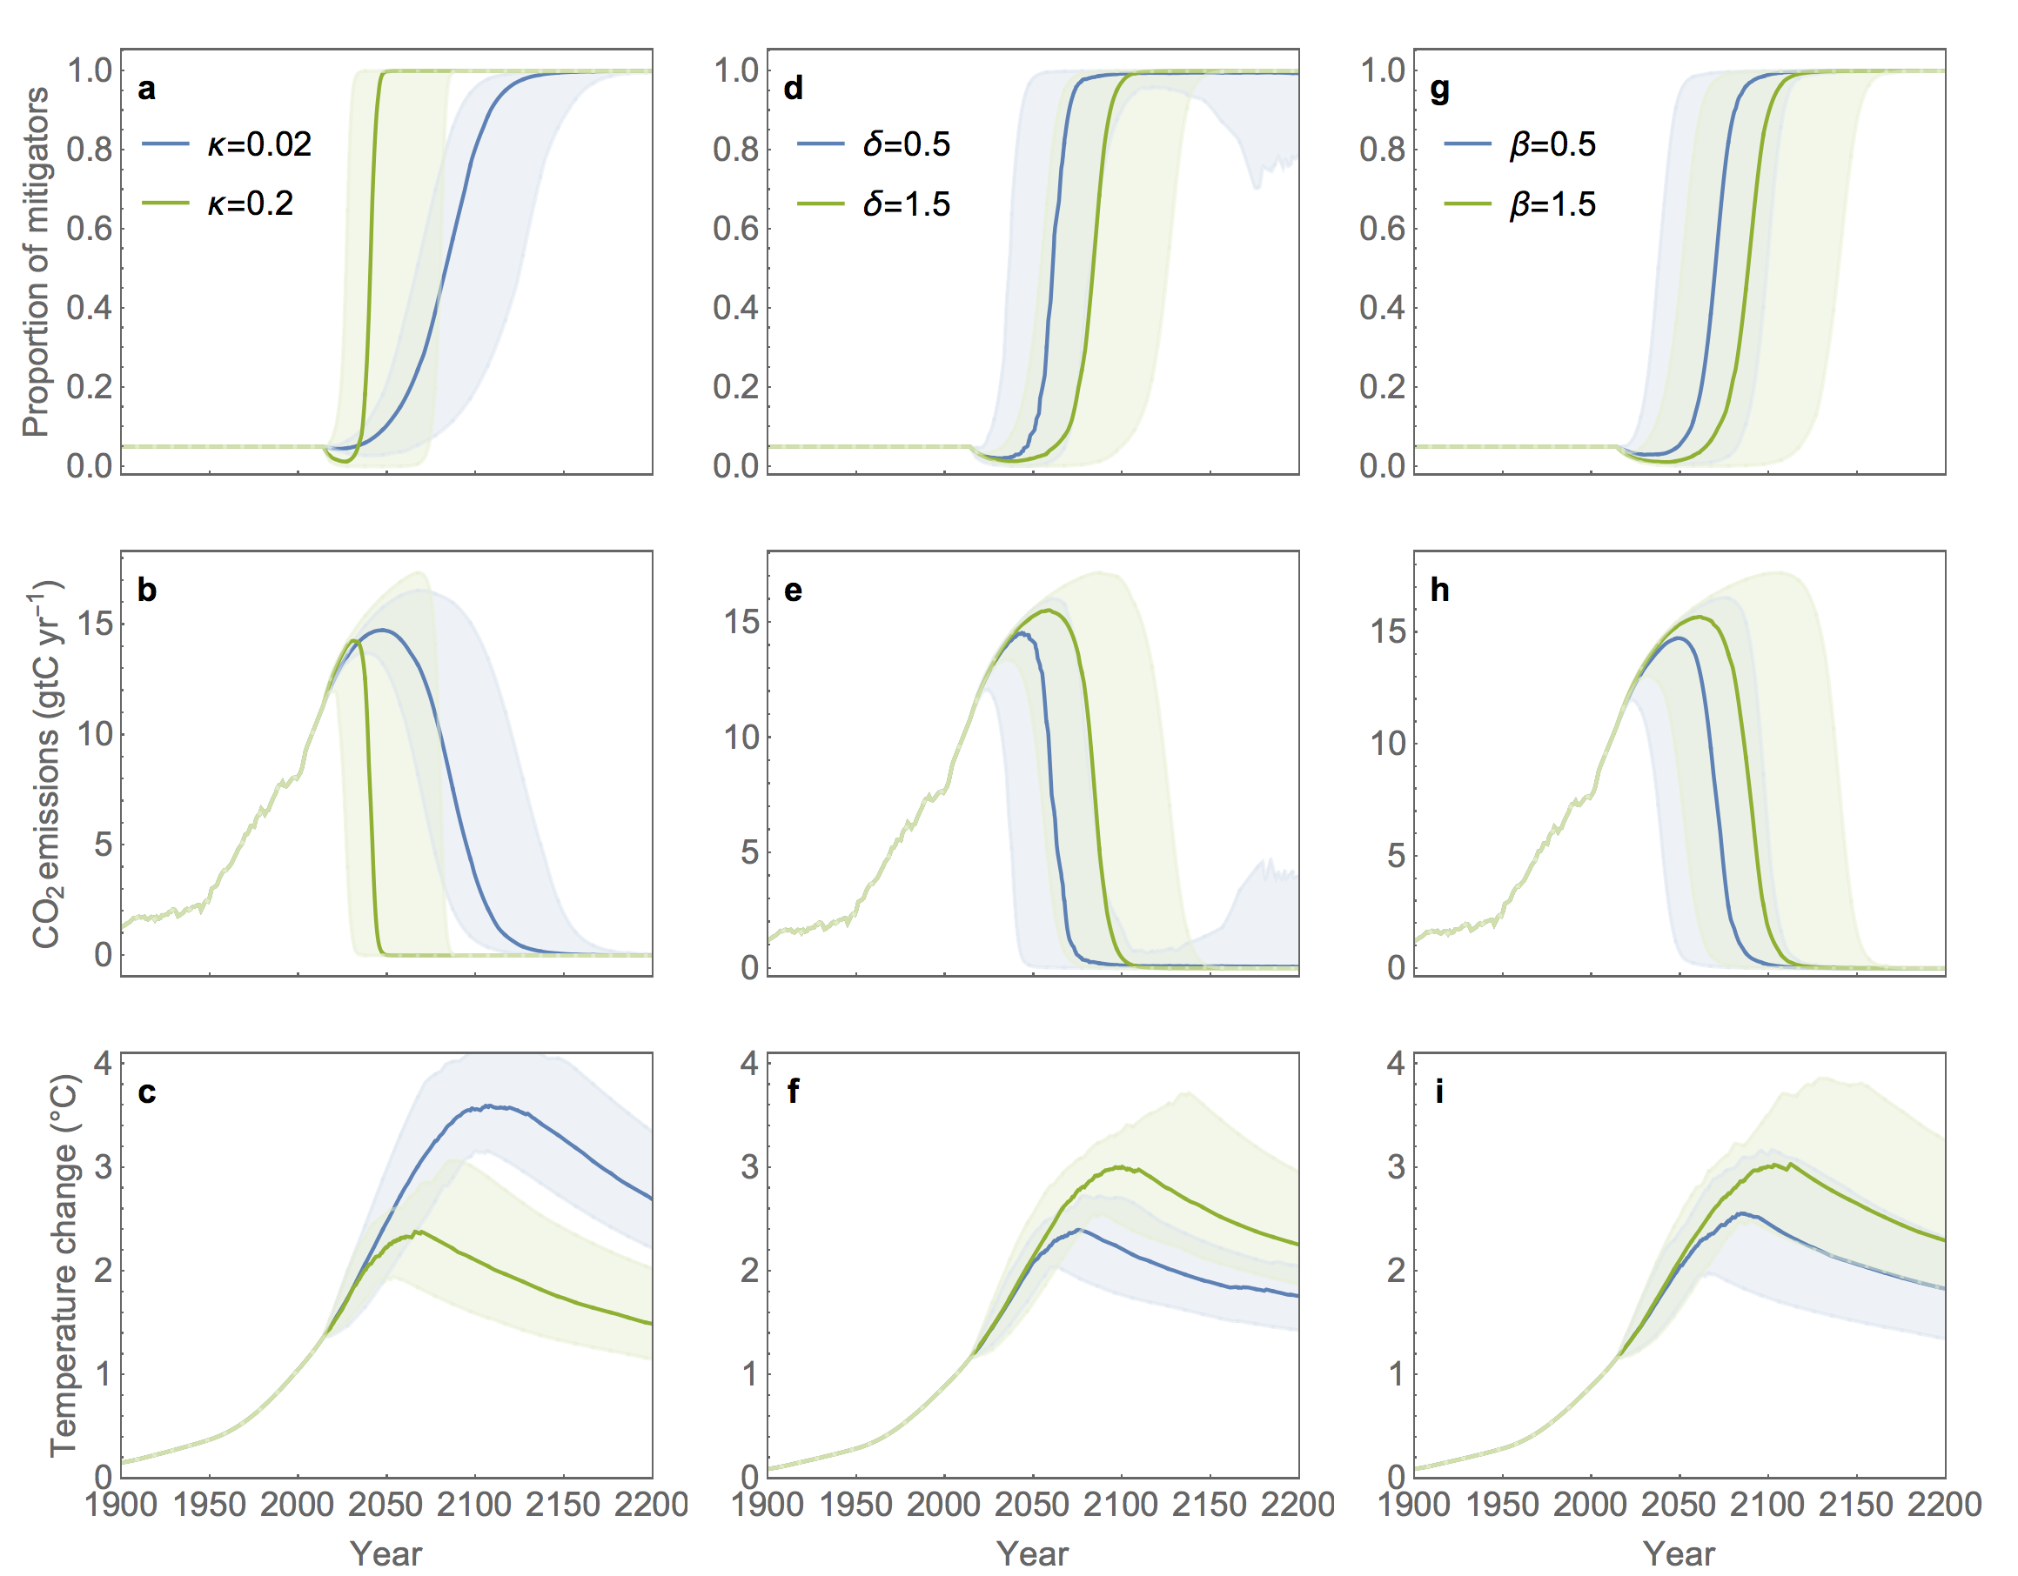
Notes:
Socio-climate trajectories under different social parameter regimes.
Kappa : social learning rate
Delta : strength of social norms
Beta: cost of mitigation

Slide 3
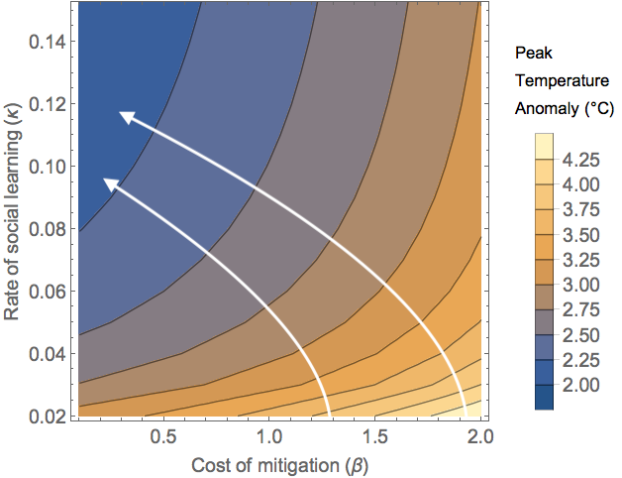
Charting pathways to mitigation
Notes:
Relative importance of changing each parameter at different locations in parameter space. Yields a path of optimal change.

