Slide 1
Thomas Marangoni 01634007
16 March 2021
Bachelor Thesis
TU Wien, Automation Systems Group
Device and Link Discovery in Industrial Ethernet Networks

Slide 2
Industry 4.0
Interoperability
Flexibility
Automation
Open- and vendor- independent protocols
(eg. Time-Sensitive Networking (TSN))
Modular systems with high reconfigurability and reusability
Detection of the network configuration and
reconfiguration with a single button press

Slide 3
LLDP
Link Layer Discovery Protocol
Open and vendor-independent protocol
Advertisement of identity and capabilities
Daemon is broadcasting information
Daemon is collecting information from neighbors
One-Way protocol => No Acknowledgments

Slide 4
SNMP
Simple Network Management Protocol
Open and vendor-independent protocol
Network monitoring and management
Three different Versions
Connectionless Protocol based on UDP
Possibility of Notifications via Traps
Uses MIB for data

Slide 5
NETCONF
Network Configuration Protocol
Open and vendor-independent protocol
Network monitoring and management
Uses Remote Procedure Calls (RPC)
Session Based Protocol
Possibility of Notifications
Uses YANG for data

Slide 6
Better Routes
with more Information for TSN
Network graphs with ports
Link speed
Link length
Link material

Slide 7

Network Scanning Flow
Network devices are using LLDP & SNMP
Nodes have SNMP traps installed
Parallel SNMP detection scan
Full SNMP scan per device
Network Graph gets rebuilt after every scan

Slide 8
Network Scanning Flow
Network devices are using LLDP & SNMP
Nodes have SNMP traps installed
Parallel SNMP detection scan
Full SNMP scan per device
Network Graph gets rebuilt after every scan

Slide 9
Network Scanning Flow
Network devices are using LLDP & SNMP
Nodes have SNMP traps installed
Parallel SNMP detection scan
Full SNMP scan per device
Network Graph gets rebuilt after every scan

Slide 10
Network Scanning Flow
Network devices are using LLDP & SNMP
Nodes have SNMP traps installed
Parallel SNMP detection scan
Full SNMP scan per device
Network Graph gets rebuilt after every scan

Slide 11
Network Scanning Flow
Network devices are using LLDP & SNMP
Nodes have SNMP traps installed
Parallel SNMP detection scan
Full SNMP scan per device
Network Graph gets rebuilt after every scan

Slide 12
Network Scanning Flow
Network devices are using LLDP & SNMP
Nodes have SNMP traps installed
Parallel SNMP detection scan
Full SNMP scan per device
Network Graph gets rebuilt after every scan

Slide 13
Network Scanning Flow
Network devices are using LLDP & SNMP
Nodes have SNMP traps installed
Parallel SNMP detection scan
Full SNMP scan per device
Network Graph gets rebuilt after every scan

Slide 14
Network Scanning Flow
Network devices are using LLDP & SNMP
Nodes have SNMP traps installed
Parallel SNMP detection scan
Full SNMP scan per device
Network Graph gets rebuilt after every scan

Slide 15
Network Scanning Flow
Network devices are using LLDP & SNMP
Nodes have SNMP traps installed
Parallel SNMP detection scan
Full SNMP scan per device
Network Graph gets rebuilt after every scan

Slide 16
Network Scanning Flow
Network devices are using LLDP & SNMP
Nodes have SNMP traps installed
Parallel SNMP detection scan
Full SNMP scan per device
Network Graph gets rebuilt after every scan

Slide 17
Network Scanning Flow
Network devices are using LLDP & SNMP
Nodes have SNMP traps installed
Parallel SNMP detection scan
Full SNMP scan per device
Network Graph gets rebuilt after every scan

Slide 18
Network Scanning Flow
Network devices are using LLDP & SNMP
Nodes have SNMP traps installed
Parallel SNMP detection scan
Full SNMP scan per device
Network Graph gets rebuilt after every scan

Slide 19
Network Scanning Flow
Network devices are using LLDP & SNMP
Nodes have SNMP traps installed
Parallel SNMP detection scan
Full SNMP scan per device
Network Graph gets rebuilt after every scan

Slide 20
Network Scanning Flow
Network devices are using LLDP & SNMP
Nodes have SNMP traps installed
Parallel SNMP detection scan
Full SNMP scan per device
Network Graph gets rebuilt after every scan

Slide 21
Network Scanning Flow
Network devices are using LLDP & SNMP
Nodes have SNMP traps installed
Parallel SNMP detection scan
Full SNMP scan per device
Network Graph gets rebuilt after every scan

Slide 22
Requirements
For devices - Part I
SNMP daemon
Support SNMPv1 and SNMPv2c
LLDP daemon
LLDP MIB Entry
Each port needs to have a unique MAC address

Slide 23
Requirements
For devices - Part II
LLDPd must send the port MAC address as ChassisID
Remote port data must be connected to a local port in the MIB data
Every network node (except end nodes) must send an SNMPv1 trap to the application on interface change

Slide 24
Firmware
Material of link
Different MIB data between firmware versions on the same model.
There is no standardized way to access the material of a link.
OID Alias
Every manufacture can have a own OID table, which represents the same data defined in standardized OID tables.
Non existing MAC-Address
Some devices are returning MAC-Addresses for ports on LLDP, which don’t exist in any interface entry.
Length of link
There is no default way to get the length of a link between two device.
LLDP connected to Bridge
Some manufactures are linking the collected LLDP data to the whole bridge and not single ports.

Slide 25
Results
Contribution and Conclusion
Partly working prototype
SNMP has its limits, NETCONF would be better
Work from manufacturer needed
Thesis on GitHub.com/ThomasMarangoni/discovery

Slide 27
Thank you!
Slide design from LibreOffice
Thesis on GitHub
ThomasMarangoni/discovery

Slide 28
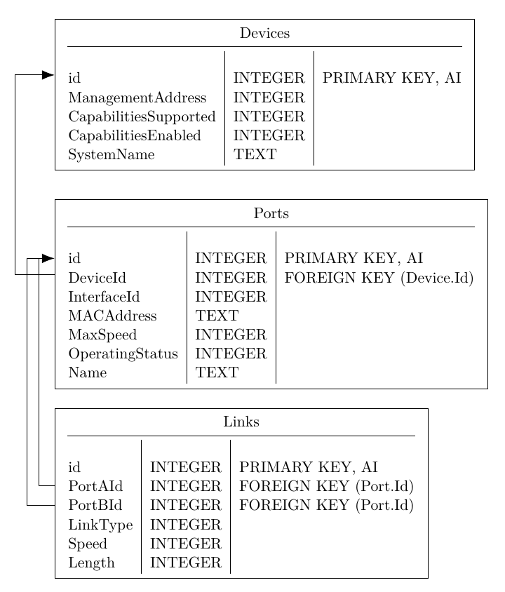

Slide 29
