Slide 1
An Evaluation of the Variances in the Winter Distribution of Loons in the Last 30 Years
Dr. James Paruk
Thomas Matthews

Slide 2
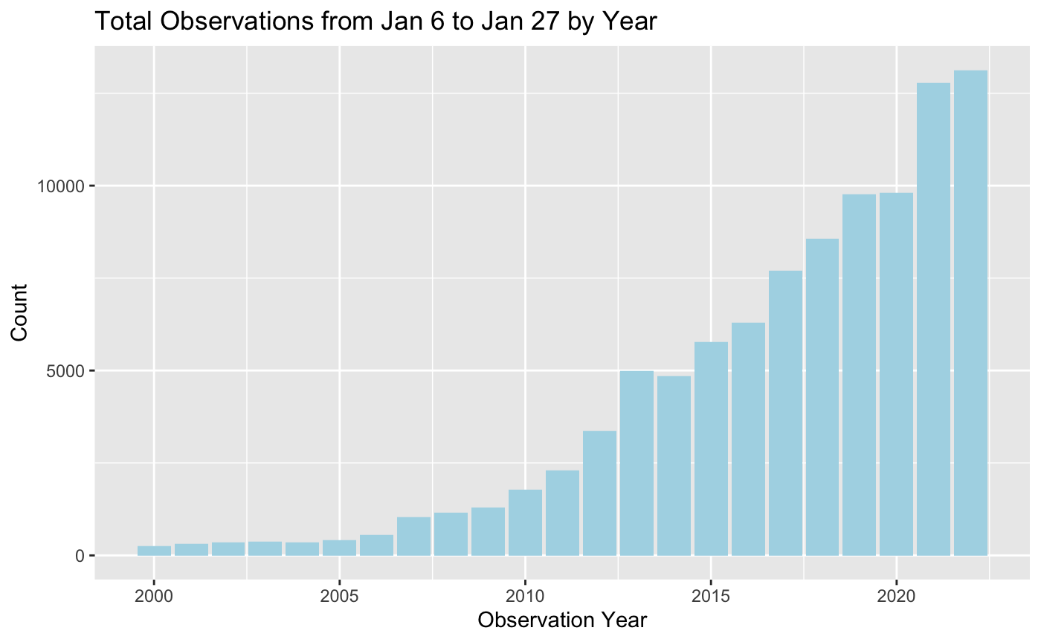
Citizen Science: eBird
~ 2 million total observations
~ 100,000 observations from Jan 6 to Jan 27, 21 days.
~ 60,000 observations in the last 5 years

Slide 3
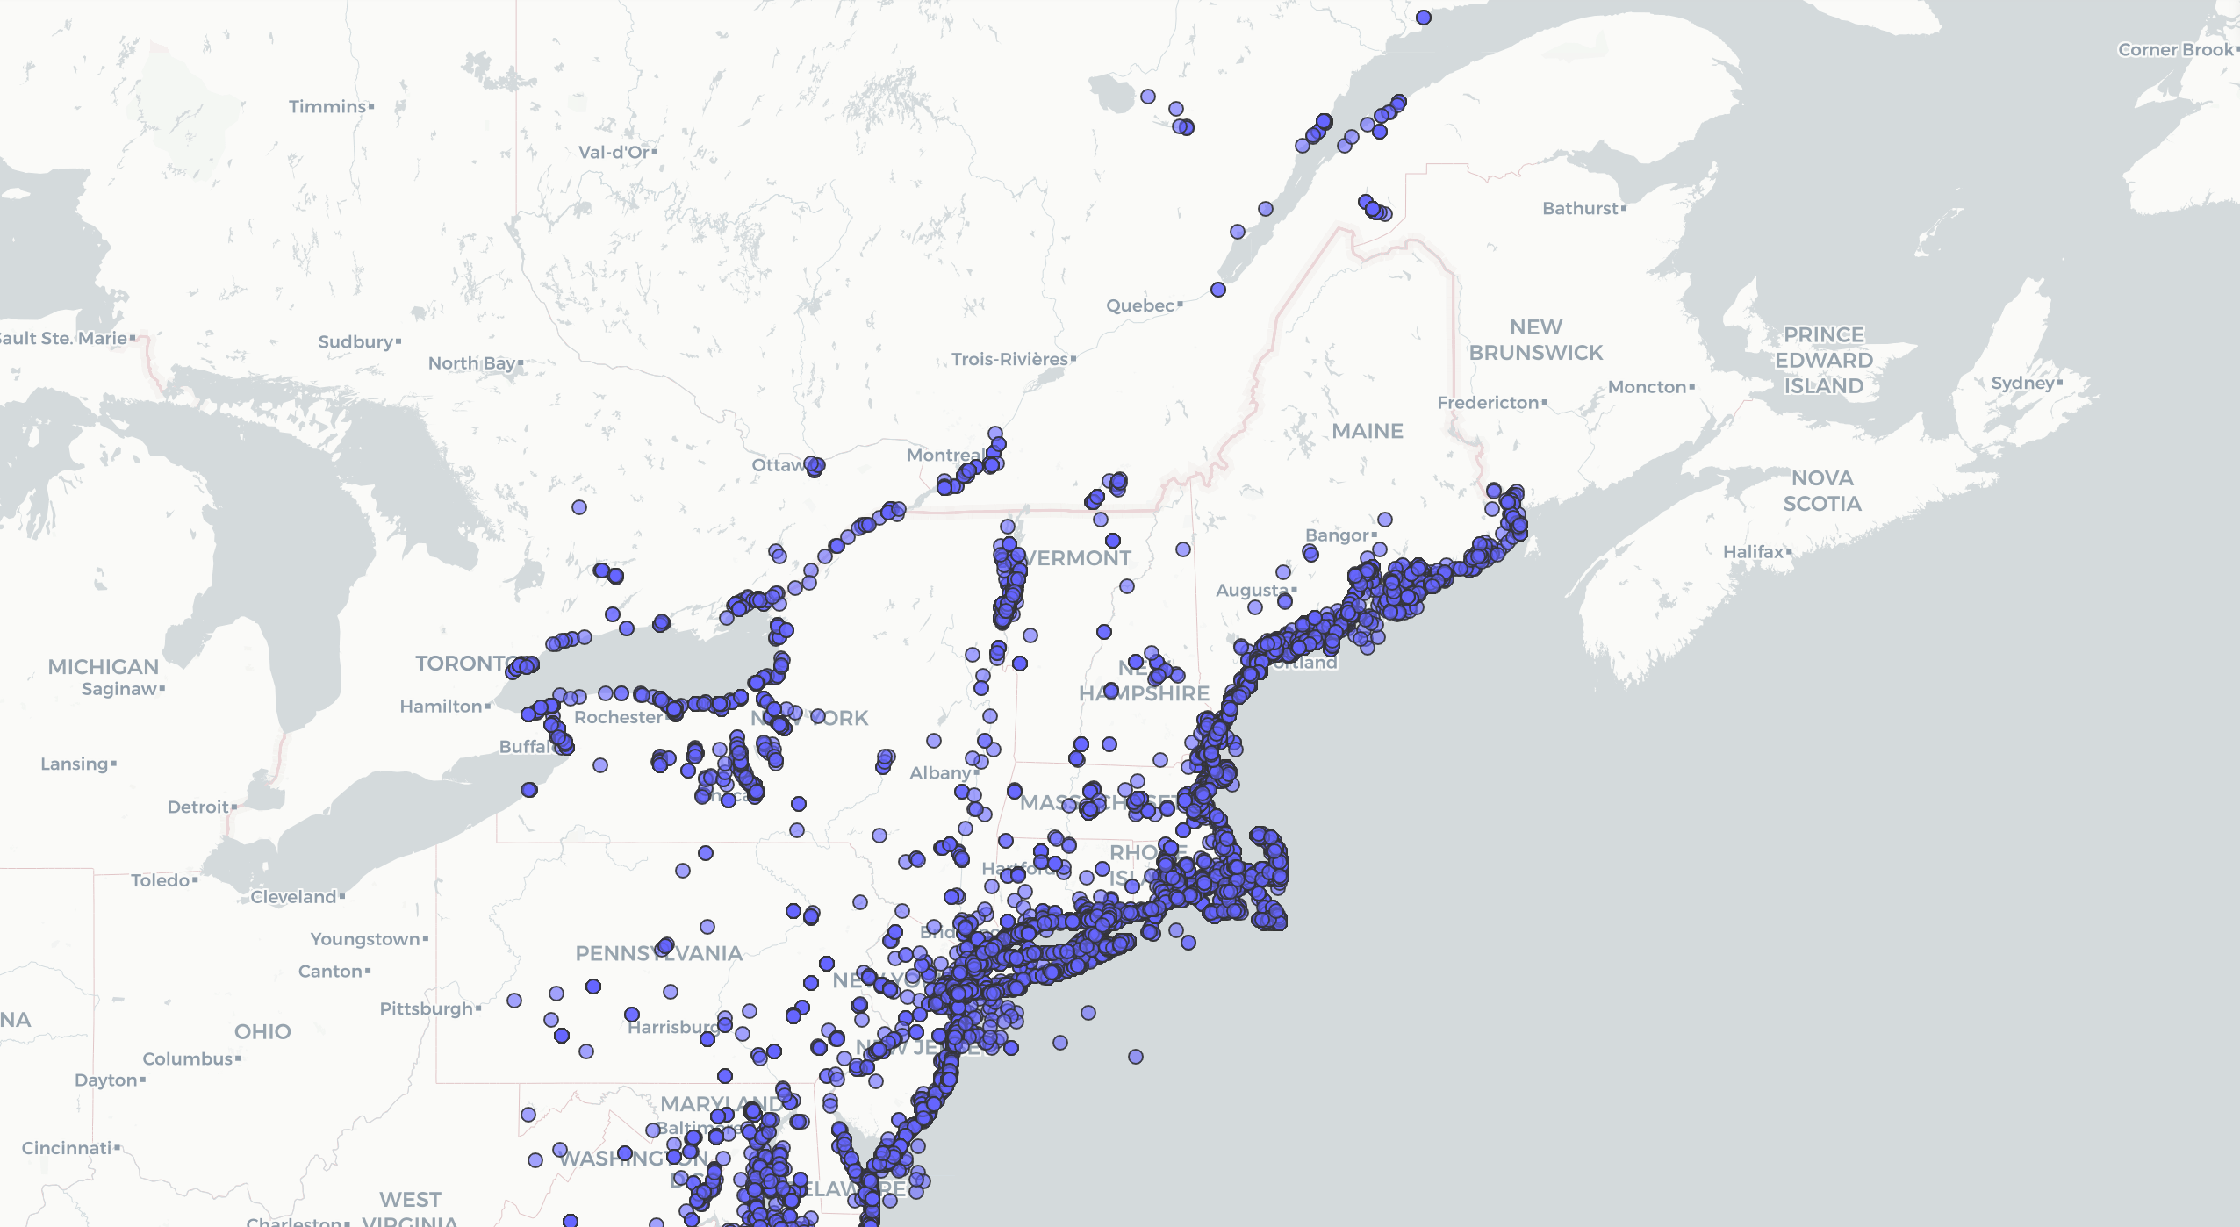
Looking at the Data
~50,000 data points

Slide 4
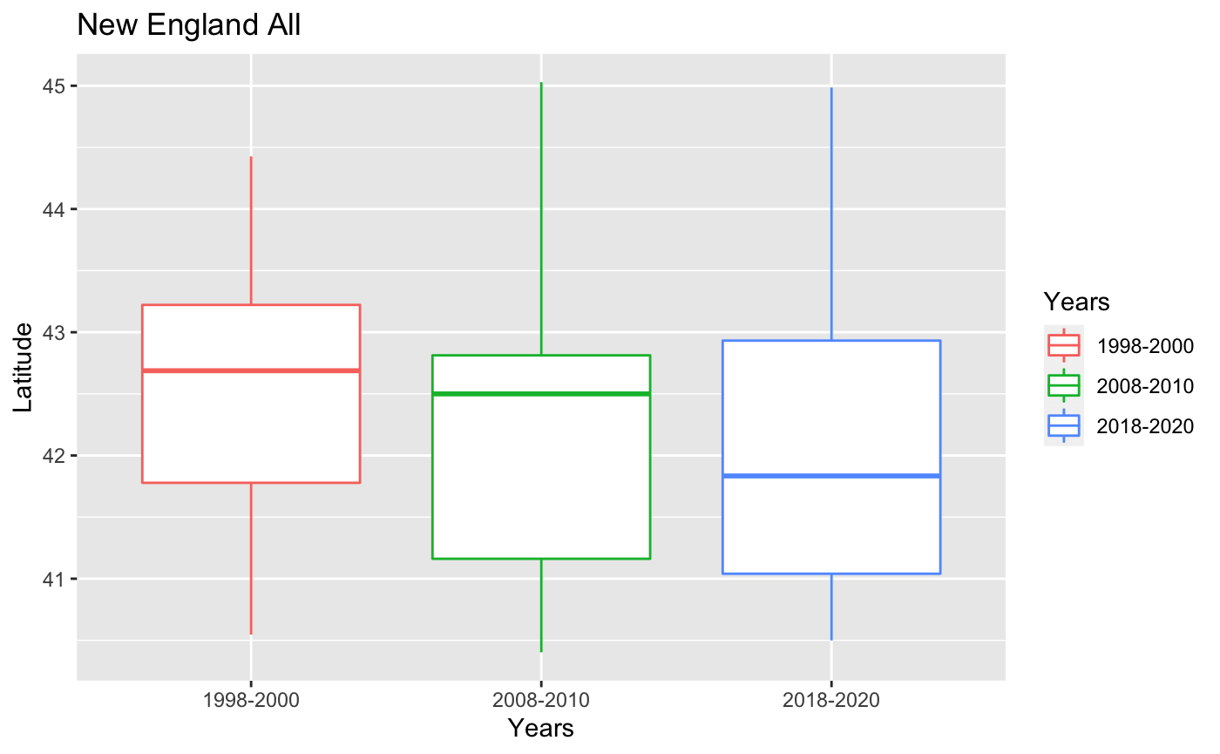
Measures of Central Tendency
- Median decreasing, around 42° latitude
- Very similar distributions
- Take another look at the data…

Slide 5
Looking at the Data
~50,000 data points

Slide 6
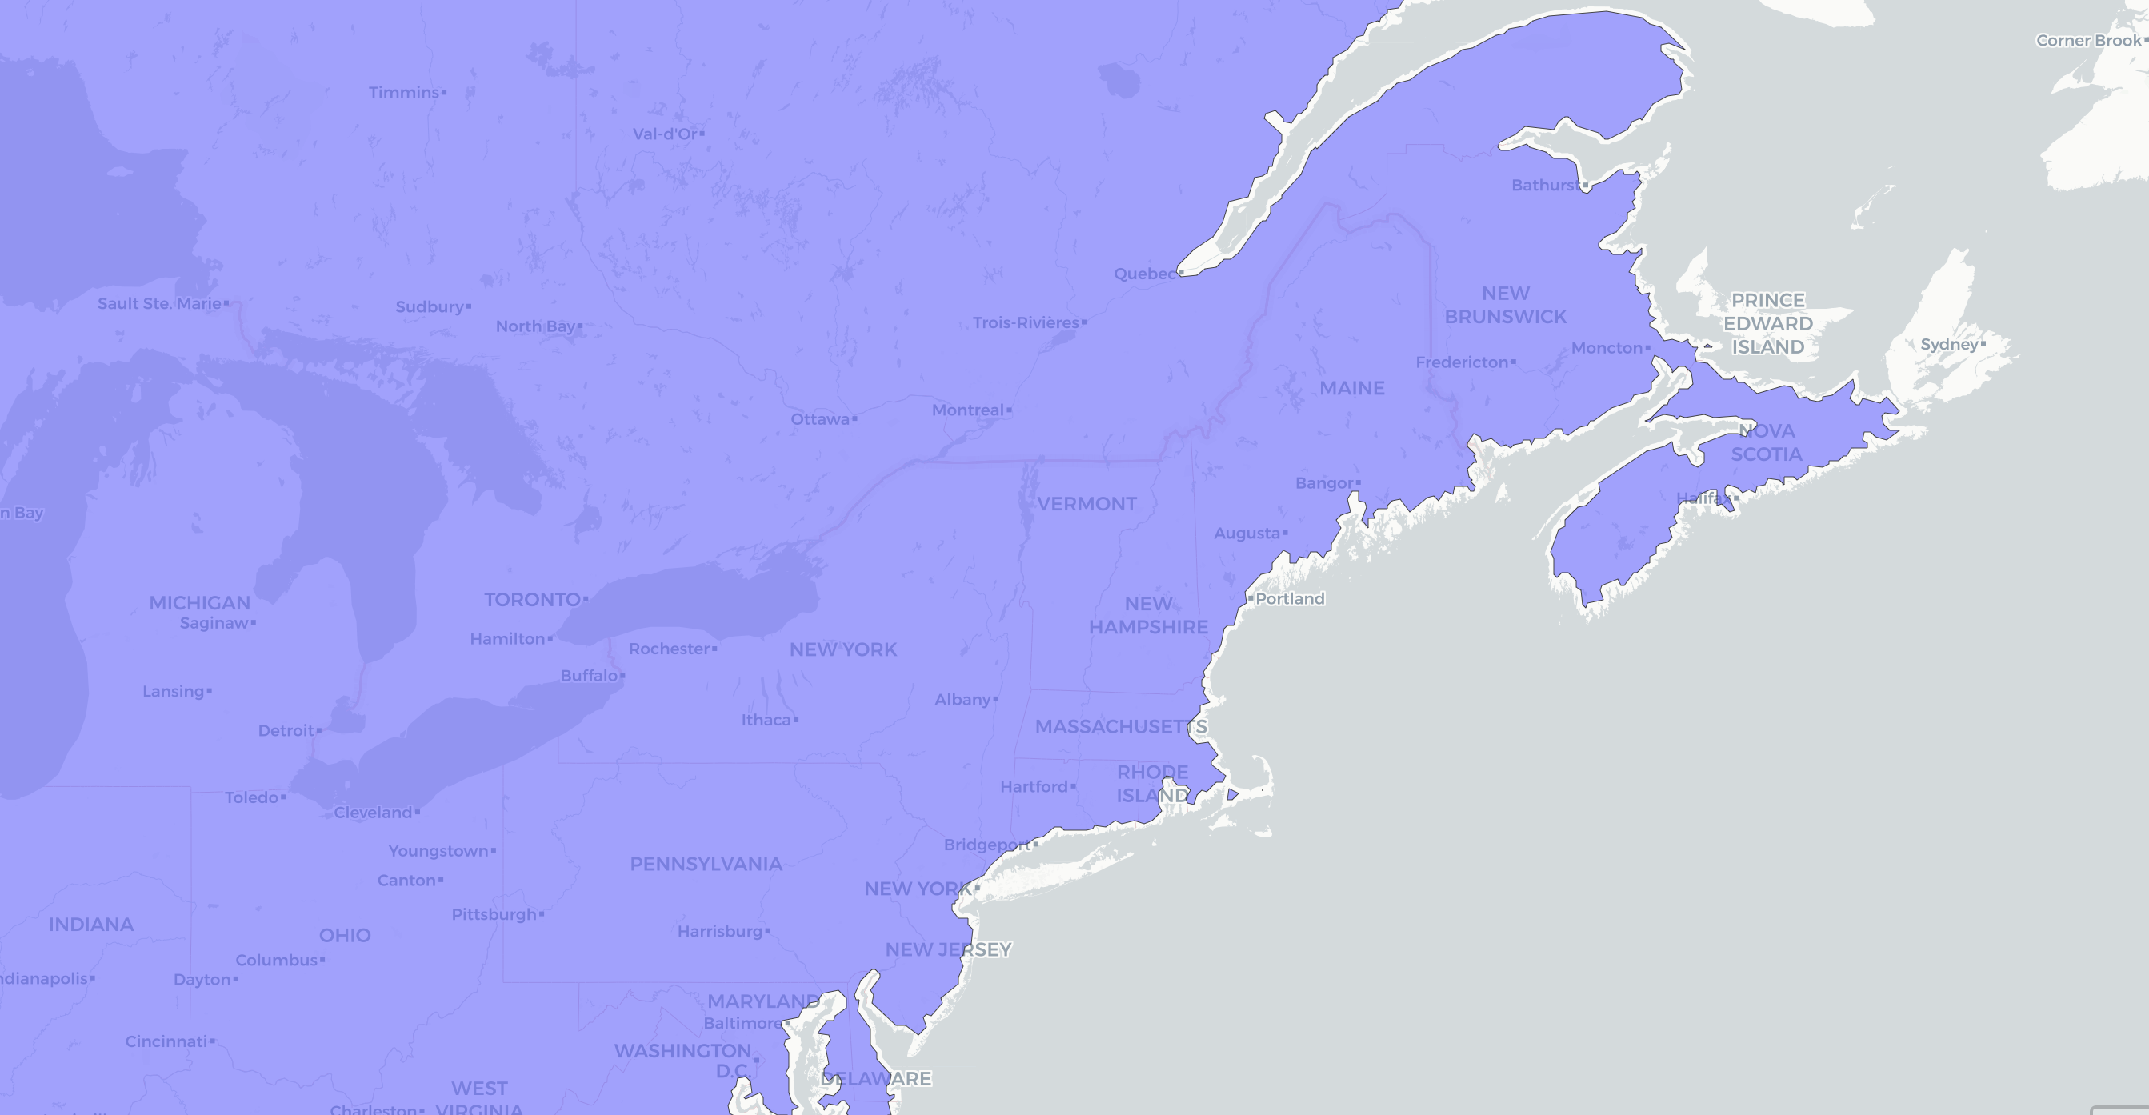
Looking at the Data
~50,000 data points

Slide 7
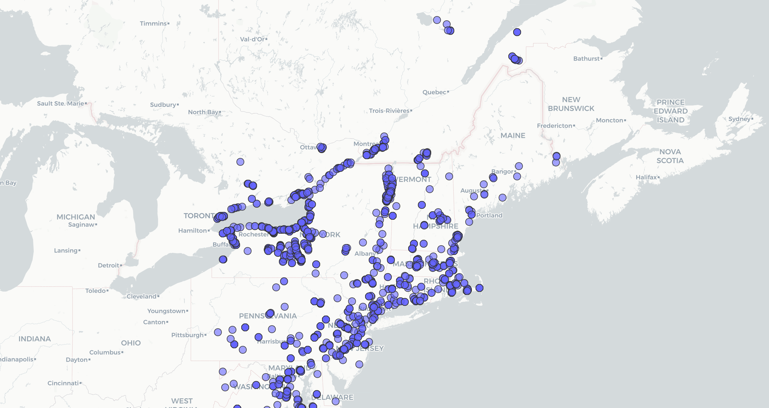
~4,000 data points

Slide 8
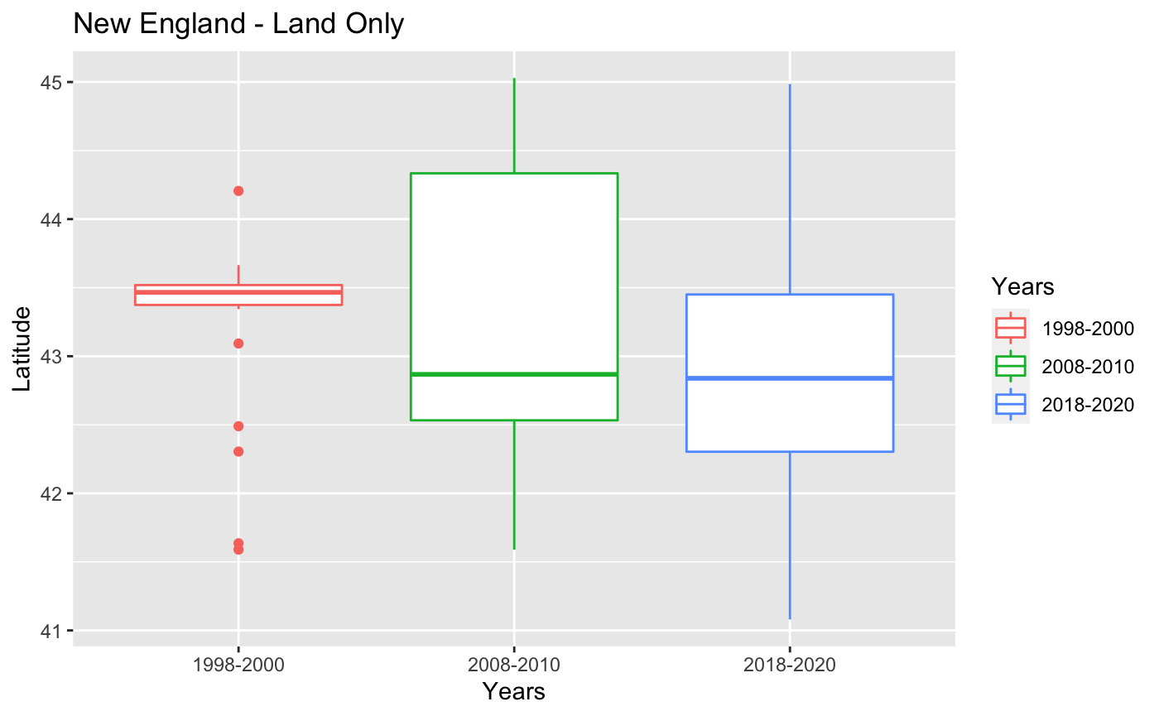
Measures of Central Tendency
- Median still decreasing, now higher at around 43°
- Change in distributions come from less data
- Center does not seem to be the answer

Slide 9
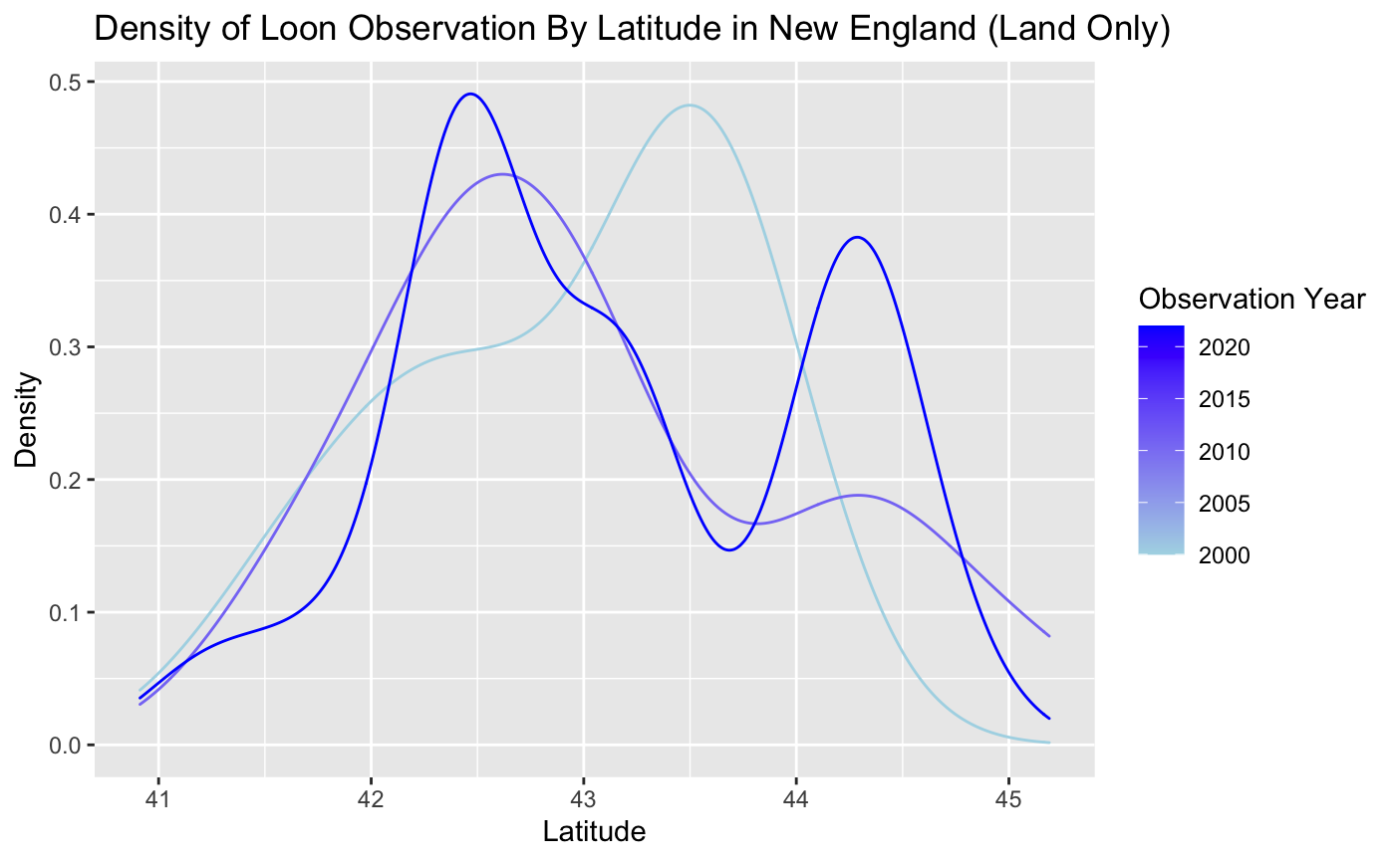
Analyzing High-end Dispersion in Data

Slide 10
Analyzing High-end Dispersion in Data
The median is the same as earlier, around 43°

Slide 11
Analyzing High-end Dispersion in Data
The median is the same as earlier, around 43°
At the higher end, there are higher densities in later years

Slide 12
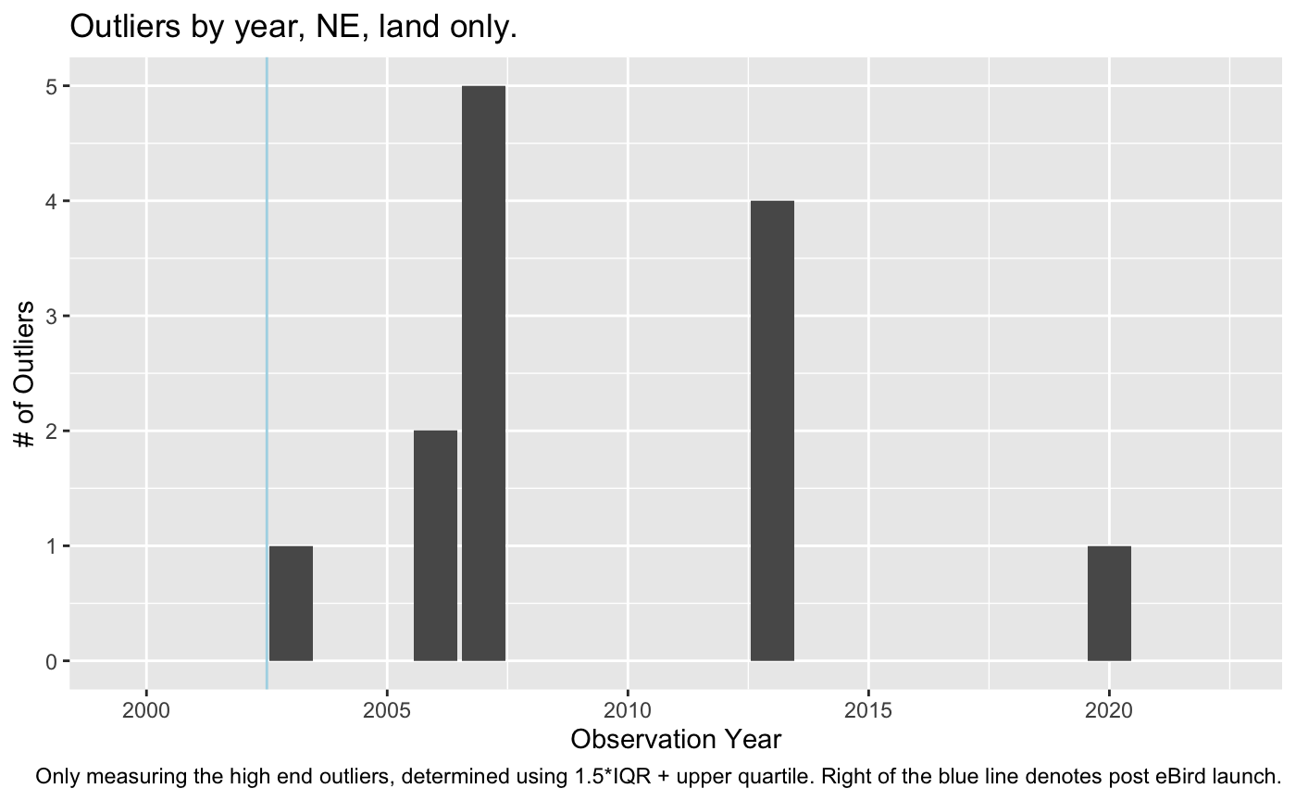
Outliers
Unknown distribution, so use IQR to determine outliers
Only plotting the outliers on the high end

Slide 13
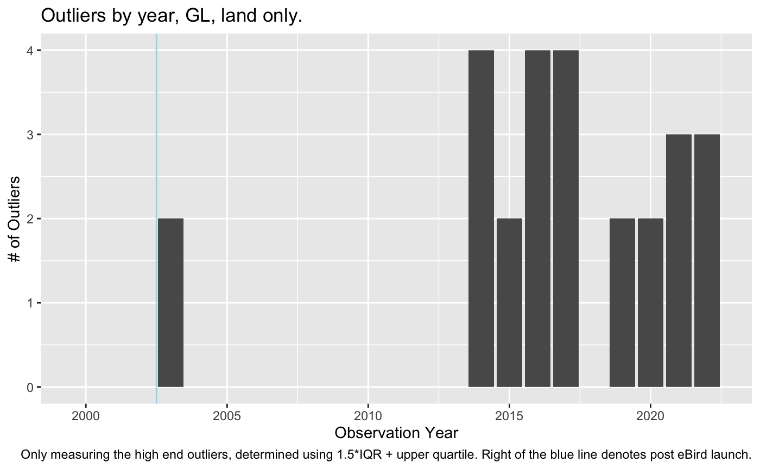
Outliers
Great Lakes Region show more outliers in later years
Median latitude for GL roughly 39°

Slide 14
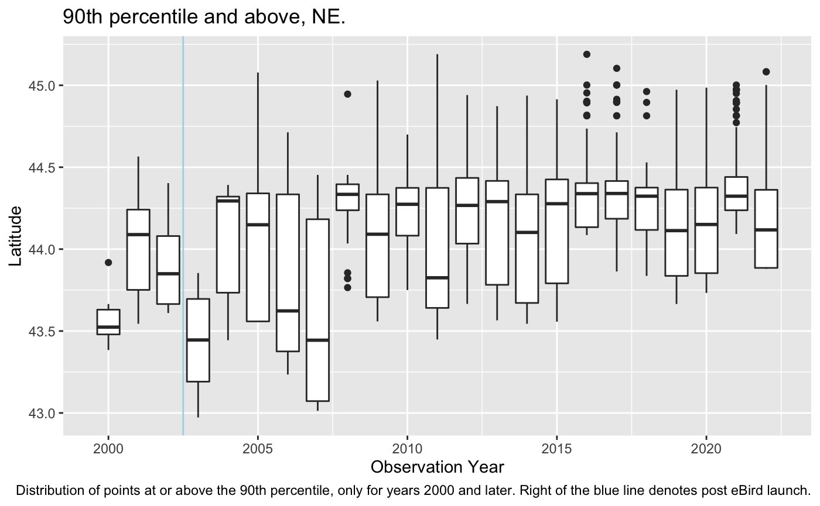
High-end Dispersion - Percentile
Take only values great than the 90th percentile
Median somewhere between 44° and 44.5°

Slide 15
High-end Dispersion - Percentile
Take only values great than the 90th percentile
Median somewhere between 44° and 44.5°

Slide 16
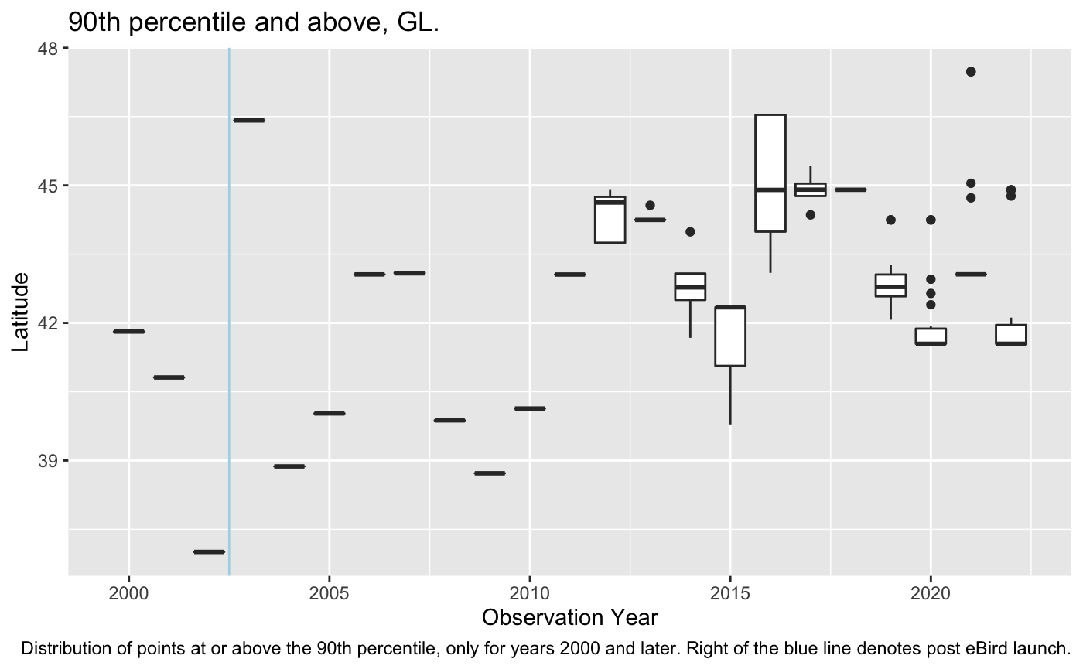
High-end Dispersion - Percentile
Flat lines represent insufficient data to properly create a boxplot
As before, some increased outliers

Slide 17
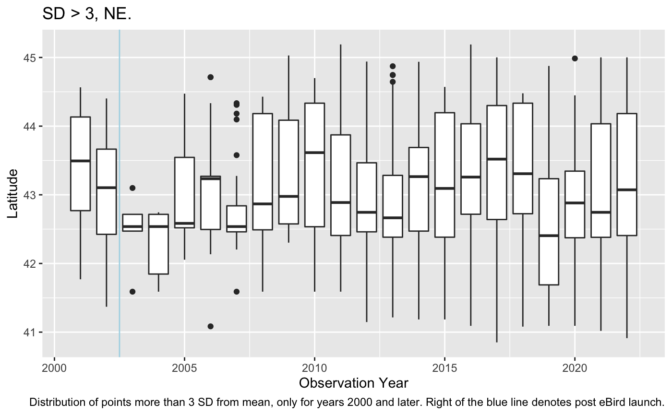
High-end Dispersion - SD

Slide 18
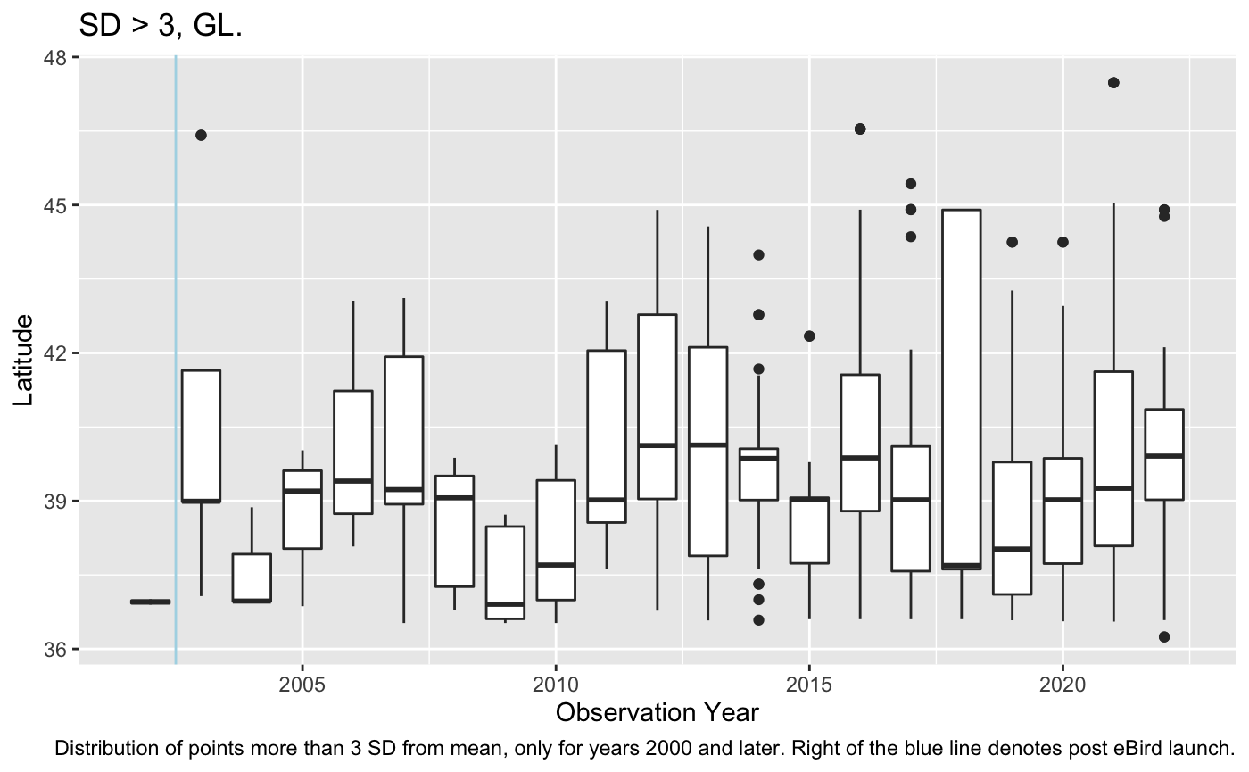
High-end Dispersion - SD

Slide 19
Conclusions/Summary
Median/mean/center has not shifted in the past 30 years.
However, dispersion on the high end of the distribution is increasing in New England and the Great Lakes Regions
More distributions show increasing amounts of northerly outliers
Great Lakes regions has more outliers in the past 20 years than New England
eBird, while messy, has potential to reveal insights into thermal changes in distribution over the next decade

Slide 20
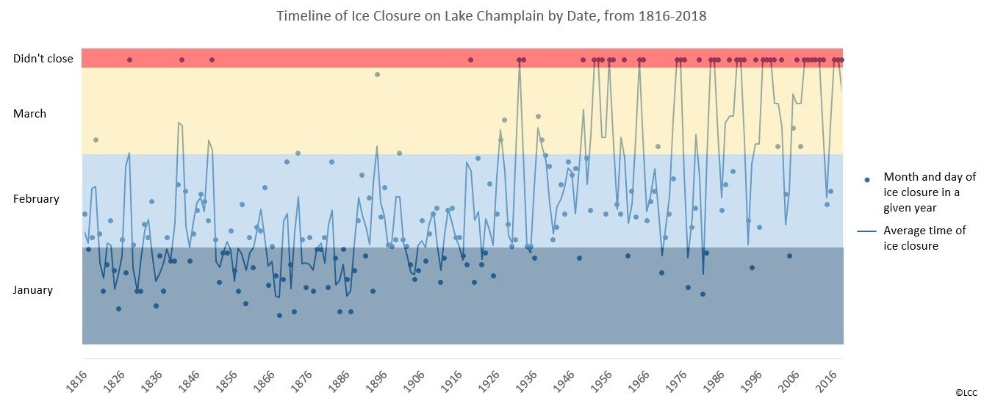
Future Research - Frozen Lakes

Slide 21
References
eBird Basic Dataset. Version: EBD_relAug-2022. Cornell Lab of Ornithology, Ithaca, New York. Aug 2022.
Global Self-consistent Hierarchical High-resolution Geography, Version 2.3.7 June 15, 2017, Distributed under the Lesser GNU Public License
“200 Years of Lake Champlain Ice Data – Climate Change in Action - LCC.” Lake Champlain Committee, 2018, https://www.lakechamplaincommittee.org/storage-folder/news-articles/200-years-of-lake-champlain-ice-data-climate-change-in-action.

