Slide 1
F – film
So – song
B – book
Se – Series
G – game
A – album
[ ] – number of words
“/”, “-”, etc. count as separate words
Usually one or more of the following apply:
1) Media contains word that has a scientific meaning
2) The answer is pronounced in a specific way
3) The answer is a concept from the Book/Film

Slide 2





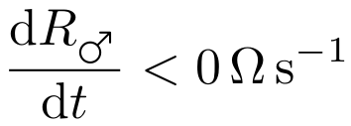

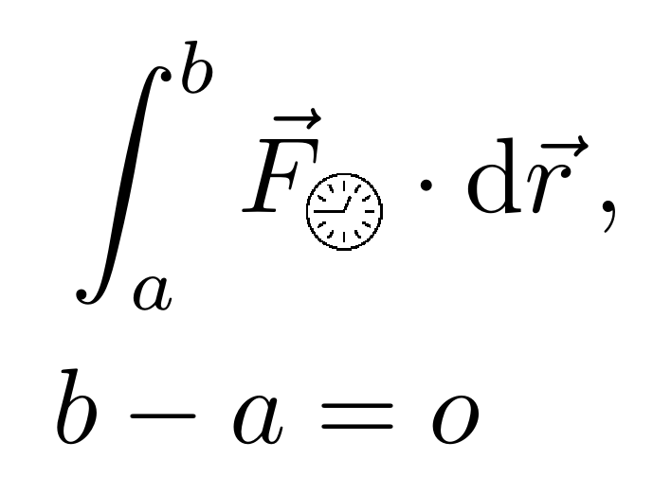




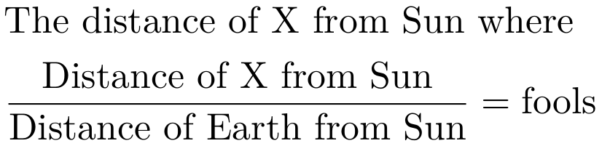

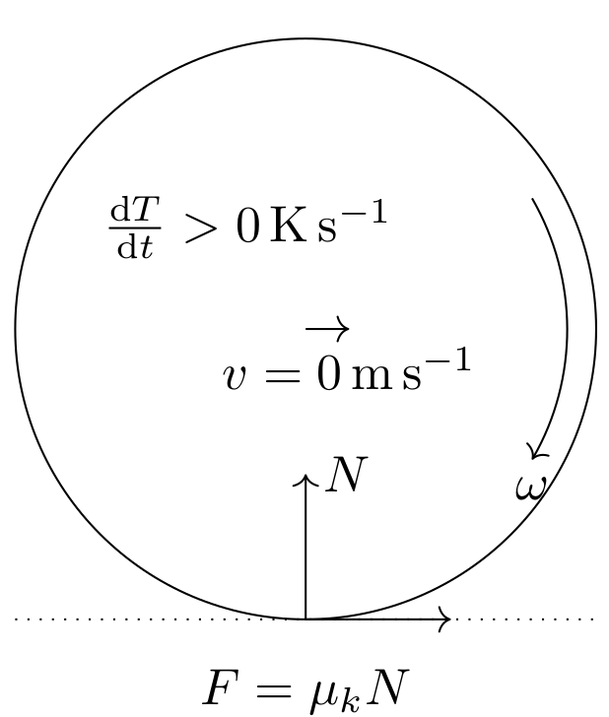


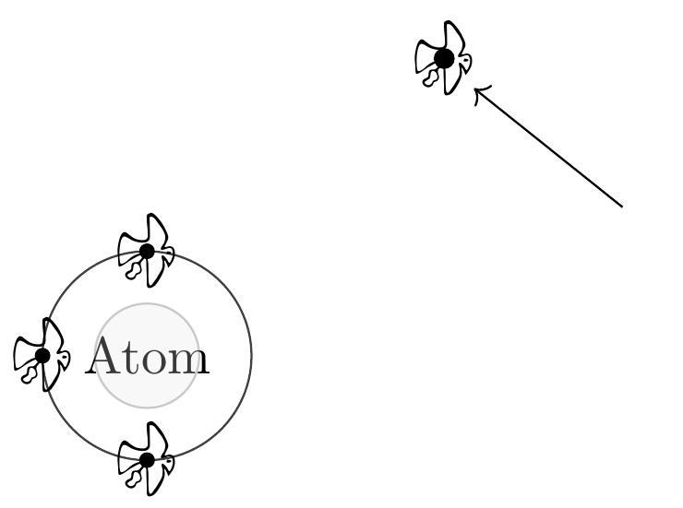
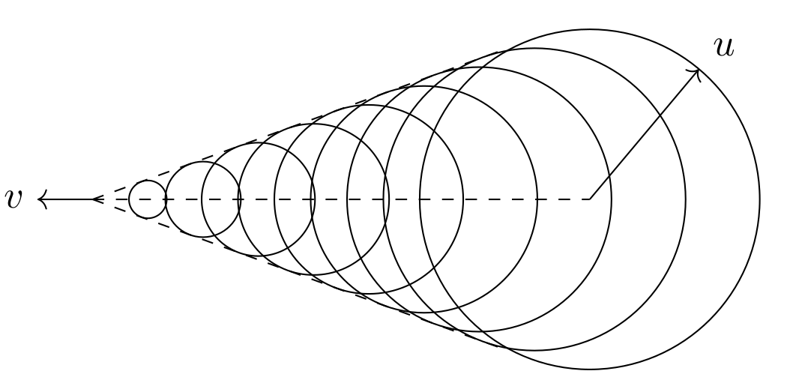
1) F [2]
2) So [3]
3) F[2]
4) So [5]
5) F [3]
6) G [4]
7a) F [4]
8) B/F [3]
9) G [2]
10)
F [1]
7b) F [2]
11) So [5]
12)So/A[1]
13) A [2]
14) A [2]
15)
So [2]
16) G [1]
17) So [2]
18) So [1]

Slide 3
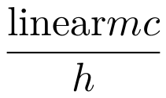
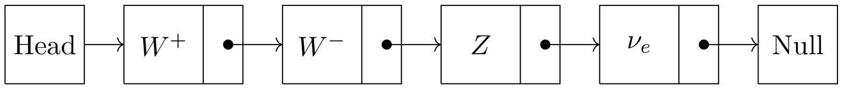
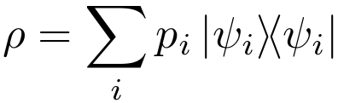
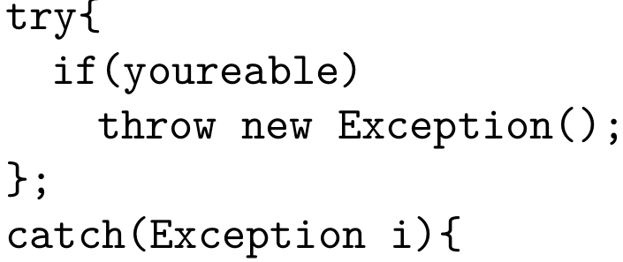
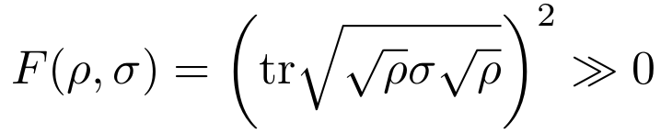

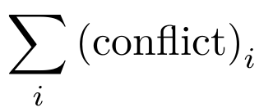
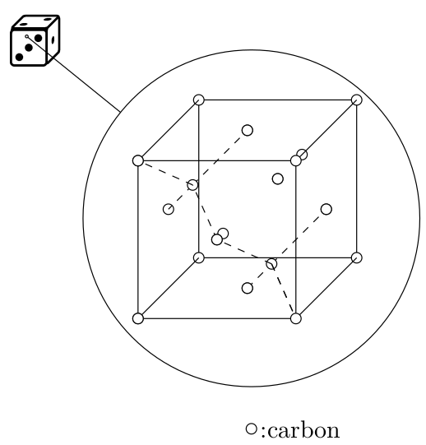
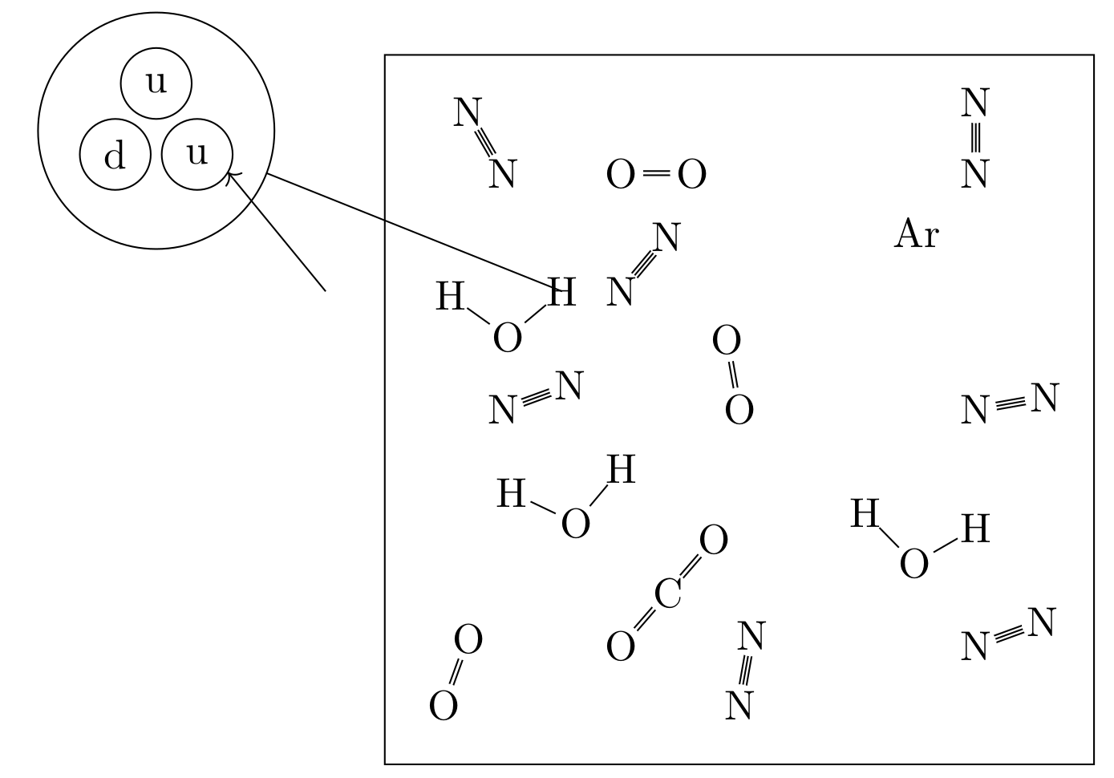
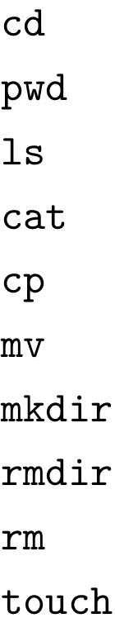
20) So/A/F[4]
22) Se [3]
21)
B/F[2]
23) So [5]
24) F [5]
25) G [2]
26) F [2]
27) F [3]
28) F [4]

