Slide 1
The Make Utility
Lecture 15

Slide 2
Independent compilation
Large programs are difficult to maintain
Problem solved by breaking the program into separate files
Different functions placed in different files
The main function appears in only one file, conventionally known as main.c
Advantages
  Reduction in complexity of organizing the program
  Reduction in time required for compilation
    Each file is compiled separately
    Only those files are recompiled that have been modified

Slide 3
Independet compilation
Compiler creates object files corresponding to each source file
The object files are linked together to create the final executable
Compilation time is reduced because linking is much faster than compilation

Slide 4
makefile
Source files are compiled separately under Linux using the -c option to the compiler
  gcc -c main.c
The entire sequence of commands to create an executable can be specified as
gcc -c main.c
gcc -c func.c
gcc -o prog main.o func.o

Slide 5
The make utility
Utility to aid in the design and maintenance of multiple-file programs
Relieves the programmer of the burden of remembering which files need recompilation
  Examines the date of modification of files to see if they have changed
  Recompiles the files if above is true
Requires the use of a special file (called description file) in the directory, called Makefile or makefile
  A script file that defines rules for what must be compiled and how to compile it.

Slide 6
make
Examines Makefile to determine the dependencies needed to build the executables
  Sorts out dependency relations among files
  Automatically recompiles only those files that have been changed after building the executable, and links them into the executable
Based on non-procedural programming techniques, such as backtracking used in logic programming languages

Slide 7
The Makefile
Used to make a target of the operation, using prerequisites or dependents; the dependents may have other files as prerequisites
  Target could be the name of a file generated by a program
  Target can also be the name of an action to carry out, such as clean
  A prerequisite is a file used as input to build a target
    A target may depend on several prerequisites
Recipe
  Action carried out by make
  Recipe may have one or more commands
  Every recipe line (rule) is started by a tab character
  Recipe creates a target if any of its prerequisites changes
    Some recipes may not have any prerequisite

Slide 8
The Makefile
Sensitive to dependencies such as
  source ⇒ object
  object ⇒ executable
Consists of two main types of lines described in the following general syntax
  The lines with a “:” are called dependency lines
target: dep1 dep2 dep3 ... # Dependency line
cmd # Command line
this is a tab NOT spaces
The command line must be indented by a single tab

Slide 9
make
Dependency lines
  Shows the dependencies between files
  Exactly one line long; use of backslash as the last character is allowed to extend the line
  The dependencies must be satisfied, possibly by building them as targets in other entries, to build the current target
  A single target may appear on multiple dependency lines; however, only one of them can be associated with commands
  Command lines
  Commands to be executed to compile the files
  Must be on a single line but the use of backslash as the last character of the line allows extended lines
  Must begin with a tab as the first character on line1

Slide 10
make
tabs in the Makefile can be checked by the command
cat -v -t -e Makefile
  -v and -e options cause all tabs to appear as ˆI
  -e option places a dollar sign at the end of each line to enable you to see any terminating white space
Multiple commands can be specified on successive lines to be executed in sequence
Multiple commands can be specified on same line if they are separated by a semicolon from each other
Comments can be specified by the # sign and extend to the end of line

Slide 11
make
Blank lines
  Allowed in some places
  Should not separate a dependency line from its commands
  Should not separate lists of commands
  Targets without prerequisites
  Must have a colon
  Need not be filenames and if so, are always executed
    make treats every non-existent target as out-of-date target
  Also known as phony targets

Slide 12
gcc flags
Many makefiles create variables for the compiler, flags, etc.
  CC = gcc
  CFLAGS = -g -Wall
Useful flags
  -g: debugging hook
  -Wall: all warning
  -Werror: treat warning as errors
  -O2, -O3: optimization
  -DDEBUG: macro for DEBUG (#define DEBUG)

Slide 13
make clean
To clean all generated files
  make clean
    Delete all files in the current directory that are normally created by building the program. Get rid of the executables, any temporary files, object files, etc.
To re-compile, you can
  Remove all generated files and make again.
    make clean; make
    Or you can
  touch main.h and then make again
    This changes the time stamp of main.h, so make thinks it necessary to make all the files.

Slide 14
make
CC = gcc
CFLAGS = -g
TARGET = math
OBJS = main.o square.o cube.o
$(TARGET): $(OBJS)
$(CC) -o $(TARGET) $(OBJS)
main.o: main.c
$(CC) $(CFLAGS) -c main.c
square.o: square.c
$(CC) $(CFLAGS) -c square.c
cube.o: cube.c
$(CC) $(CFLAGS) -c cube.c
clean:
/bin/rm -f *.o $(TARGET)

Slide 15
Variables
CC = gcc
CFLAGS = -g
TARGET = math
OBJS = main.o square.o cube.o
$(TARGET): $(OBJS)
$(CC) -o $(TARGET) $(OBJS)
main.o: main.c
$(CC) $(CFLAGS) -c main.c
square.o: square.c
$(CC) $(CFLAGS) -c square.c
cube.o: cube.c
$(CC) $(CFLAGS) -c cube.c
clean:
/bin/rm -f *.o $(TARGET)
NAME = value (declare)
$(NAME) (use)
Notes:
variables make it easier to change one option throughout the file also makes the makefile more reusable for another project

Slide 16
make
Dependency checking
  First target to be built is math
  make checks to see if math exists in the current directory
  If it exists, make checks main.o, square.o, and cube.o to see whether any of them are newer than math
  The process in the above step is repeated for each of the *.o files as targets, checking their dependencies, using later entries in Makefile
  Only after all the prerequisites have been verified and brought up-to-date, make will exit making sure that the file math is current
  Order of checking dependencies is important, and chain of commands must be issued in the correct order
  It should also be apparent by now why the target name (to the left of the colon) is the same as the filename resulting from the execution of a command

Slide 17
make
Minimizing rebuilds
  If some object files are used in multiple programs, they need to be compiled only once
Invoking make
  Any target in the Makefile can be built by using the command
  make target
Several targets can be specified in a single invocation of make
make square.o cube.o
If target is not specified, make attempts to make the first available target in the Makefile

Slide 18
Macros
Description file entries of the form
NAME = text_string
Can be referred to subsequently by $(NAME) or ${NAME}
  Parentheses or braces can be dispensed with for macros with single letter names
  Preferable to use braces as it allows the use of parentheses exclusively for library modules
Permit variation from one build to the next, for example, changing the DEBUG_FLAG from -g to -O
Can be used anywhere in the Makefile, on both the dependency lines as well as the command lines
Conceptually, the make utility expands macros before any other processing

Slide 19
macros
Conventionally, macro names are typed in all upper case letters
A pound sign end the definition and starts a comment
Macro definition can be continued on the next line by using backslash as the last character on the current line
A macro definition with no string after the equal sign is assigned the null string
Order of definition of macros is not important
  Cannot redefine a macro once it has been defined in the same file
  Macro must be defined before any dependency line in which it appears

Slide 20
Special Macros
$@ name of target
$? name of depended changed
$< name of the first dependent
$^ names of all dependents
There are other special variables

Slide 21
Suffix rules
Different make programs have incompatible suffix lists and implicit rules, and this sometimes creates confusion or misbehavior.
  So it is a good idea to set the suffix list explicitly using only the suffixes you need in the particular Makefile, like this:
.SUFFIXES:
.SUFFIXES: .c .o
The first line clears out the suffix list
The second introduces all suffixes which may be subject to implicit rules in this Makefile.

Slide 22
Suffix rules
CC = gcc
CFLAGS = -g
TARGET = math
OBJS = main.o square.o cube.o
.SUFFIXES: .c .o
$(TARGET): $(OBJS)
$(CC) -o $@ $(OBJS)
.c.o:
$(CC) $(CFLAGS) -c $<
clean:
/bin/rm -f *.o $(TARGET)

Slide 23
Library archive
CC = gcc
CFLAGS = -g
TARGET = math
OBJS = main.o
LIBOBJS = square.o cube.o
LIBS = -lmymath
MYLIBS = libmymath.a
LIBPATH = .
.SUFFIXES: .c .o
$(TARGET): $(OBJS) $(MYLIBS)
$(CC) -o $@ -L. $(OBJS) $(LIBS)
$(MYLIBS): $(LIBOBJS)
ar -rs $@ $(LIBOBJS)
.c.o:
$(CC) $(CFLAGS) -c $<
clean:
/bin/rm -f *.o $(TARGET)
In this example $@ represents TARGET (math)

Slide 24
Creating shared objects
CC = gcc
CFLAGS = -g
TARGET = math
OBJS = main.o
LIBOBJS = square.o cube.o
LIB = mymath.so
.SUFFIXES: .c .o
$(TARGET): $(OBJS) $(LIB)
$(CC) -o $@ $(OBJS) $(LIB)
$(LIB): $(LIBOBJS)
$(CC) -G -o $(LIB) $(LIBOBJS)
square.o: square.c
$(CC) -fpic -c square.c
cube.o: cube.c
$(CC) -fpic -c cube.c
.c.o:
$(CC) $(CFLAGS) -c $<
clean:
/bin/rm -f *.o $(TARGET)

Slide 25
Example
Source code files
  main.c Main function
  avg.c function to compute average
  avg.h header file for avg.c
  sum.c function to compute sum.
  sum.h header file for sum.c
  min.c function to find the smallest number
  min.h heard file for min.c
  max.c function to find the greatest number
  max.h header file for max.c
Task
  Create Makefile to compile the project

Slide 26
Generating Pseudo-Random Numbers
Set random seed: srand(seed)
  seed is of type unsigned int.
  seed determines sequence of random numbers.
  Sequences for same seeds are always the same.
  Can set using time (or not). We set it to 123.
Get next random unsigned int: rand ()
  Returns a random number
  Uniform distribution over {0, 1, …, RAND_MAX}
Maximum number to get from rand(): RAND_MAX

Slide 27
Compiling from Shell
Compile all files as
  gcc main.c avg.c sum.c min.c max.c -o stats -Wall -ansi
Compile step by step
Create object files main.o, avg.o, sum.o, min.o, max.o (option –c)
  gcc -c -Wall -ansi main.c
  gcc -c -Wall -ansi avg.c
  gcc -c -Wall -ansi sum.c
  gcc -c -Wall -ansi min.c
  gcc -c -Wall -ansi max.c
  Link the object files together to create executable
  gcc main.o avg.o sum.o min.o max.o -o stats

Slide 28
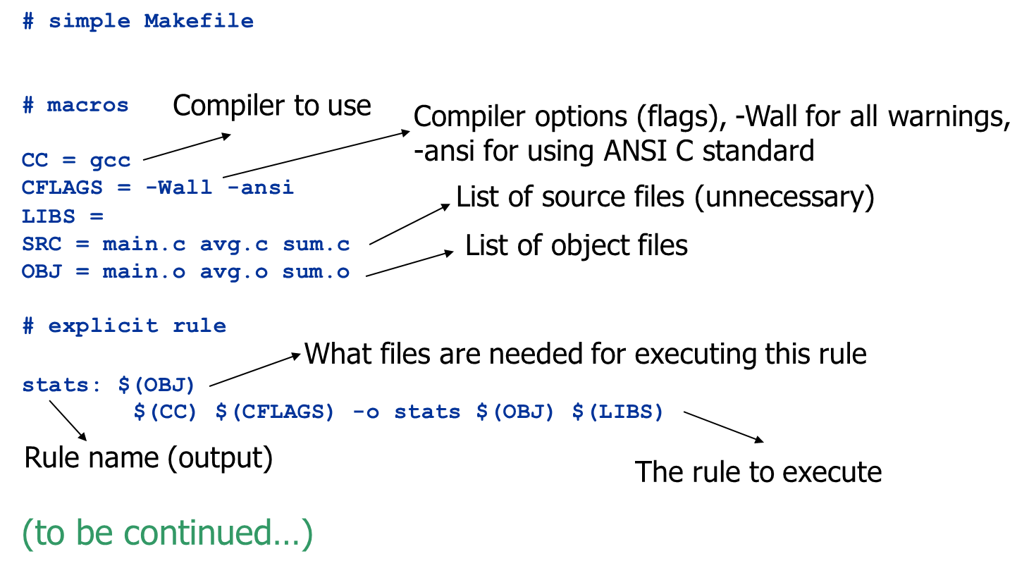
Code example 1/2

Slide 29
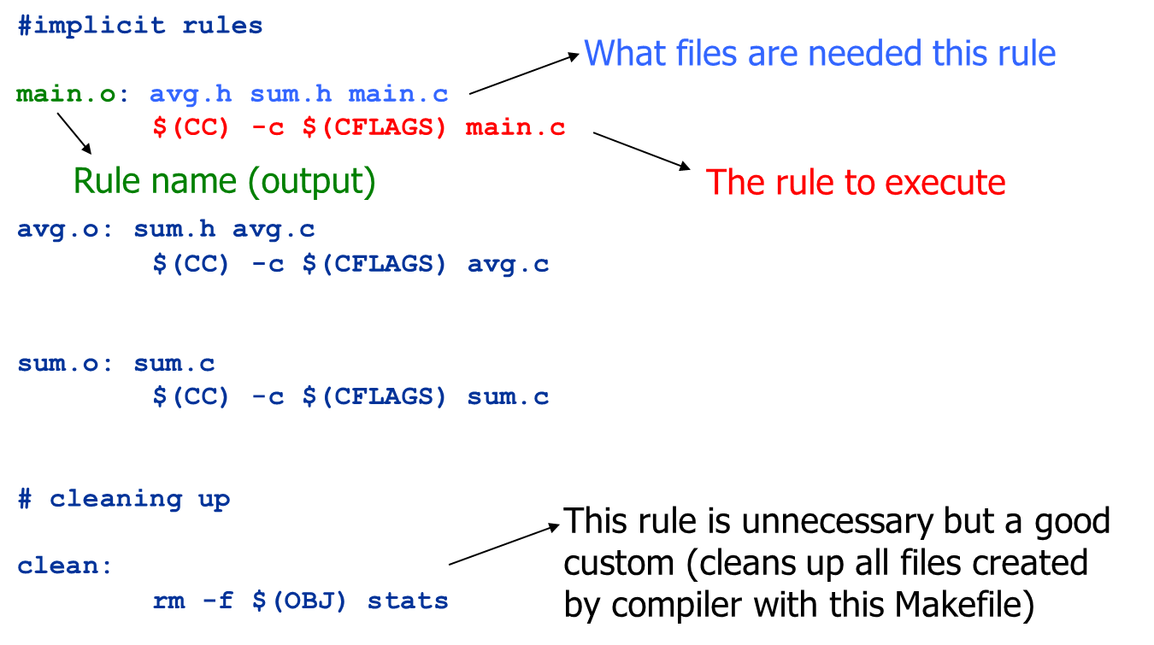
Code example 2/2

Slide 30
Important
avg.o: sum.h avg.c
$(CC) -c $(CFLAGS) avg.c
Important
  Before $(CC), there must be TAB, no spaces!

Slide 31
Handling variables in makefile
Note that makefiles uses a lot of variables
Example
  We set CC to be equal to the name of our compiler.
  We can use the variable using $(CC)
General idea
  We can use variable of any name starting with a character (lower case or upper case).
  Then we use the variable using $(name-of-variable)

Slide 32
How to Compile with our Makefile
Just run make
  make
If all goes well, executable “stats” should be there
Only files that have changed/modified are re-compiled (unnecessary compilation avoided)

Slide 33
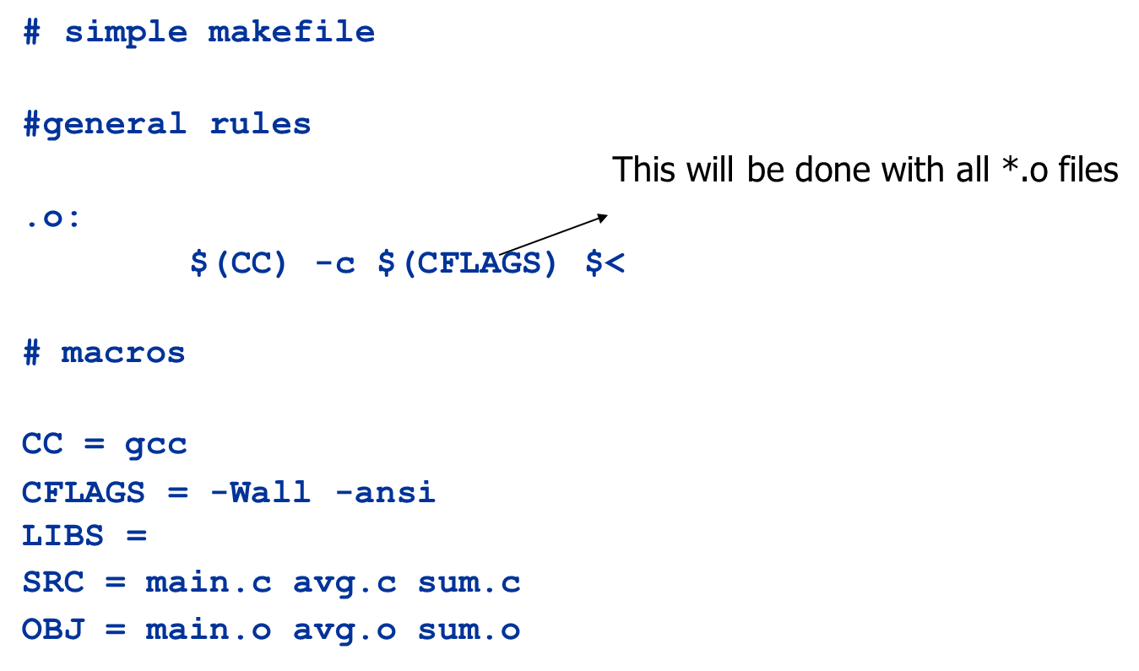
Simplifying some rules

Slide 34
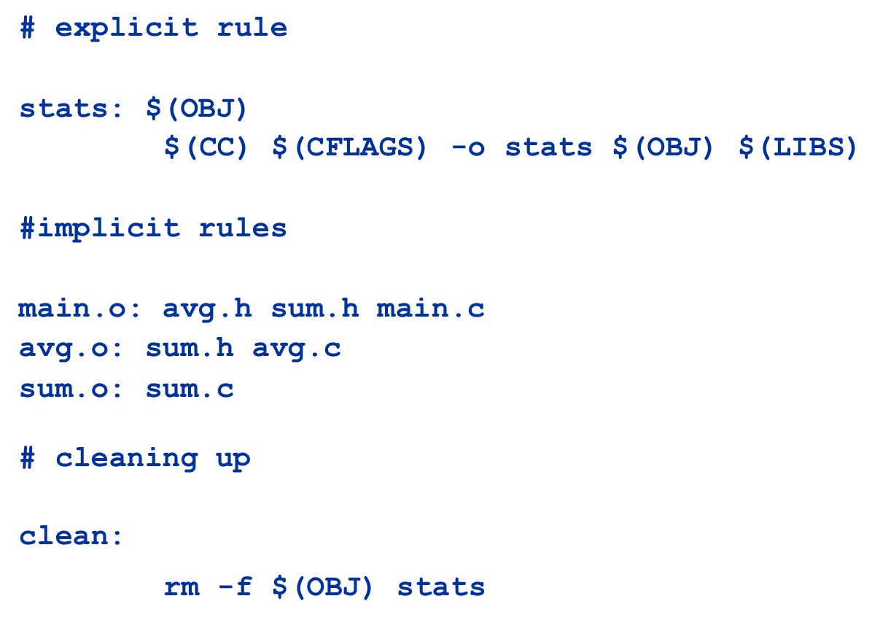
Simplifying some rules

Slide 35
Splitting Lines into Multiple Lines
You can split macros into several lines…
  Use “\” at the end of any line except for last
  Can put TAB characters between each new line (no spaces!)
Same with variable definitions (often used)
Example
OBJ = main.o \
avg.o \
sum.o

Slide 36
Important
Go online (Google) and look at other makefiles
From now on, each assignment will have to contain a working makefile!

