Slide 1
Characters, Strings & Bits
Lecture 16

Slide 2
Characters
Basic building block of source programs
  C supports the char data type for storing single character
  char uses one byte of memory
Constant characters
  One character surrounded by a single quotes
  char myGrade = 'A';
  char yourGrade = '?';
  Actually an int value represented as a character in single quotes
  Another form can also represented by \ddd where each d is an octal digit
  char a = '\063'; // the character 3

Slide 3
ASCII
The American Standard Code for Information Interchange (ASCII) character set, has 128 characters designed to encode the Roman alphabet used in English and other Western European languages.
C was designed to work with ASCII.
  The char data type is used to store ASCII characters in C

Slide 4
ASCII
ASCII can represent 128 characters and is encoded in one eight bit byte with a leading 0. Seven bits can encode numbers 0 to 127. Since integers in the range of 0 to 127 can be stored in 1 byte of space, the sizeof(char) is 1.
The characters 0 through 31 represent control characters (e.g., line feed, back space), 32-126 are printable characters, and 127 is delete.

Slide 5

ASCII Character Chart

Slide 6
Special Characters
Special characters and non-graphic characters
  Denoted by preceding other characters with a backslash \
\n newline
\t horizontal tab
\v vertical tab
\b backspace
\r carriage return
\f form feed
\\ backslash
\’ single quote
\ a alert

Slide 7
Characters
Null character
  Usually indicated by \0 or 0
    Another way of saying zero
    All bits corresponding to the character are 0
  Gives it the ascii value 0
    char a = '\0' is not the same as char a = '0'

Slide 8
Example
#include <stdio.h>
int main() {
int i;
for(i=0 ; i<256; i++)
{
printf("%3d=%c ", i, (char) i);
if ( (i+1) % 10 == 0 )
printf("\n");
}
return 0;
}

Slide 9
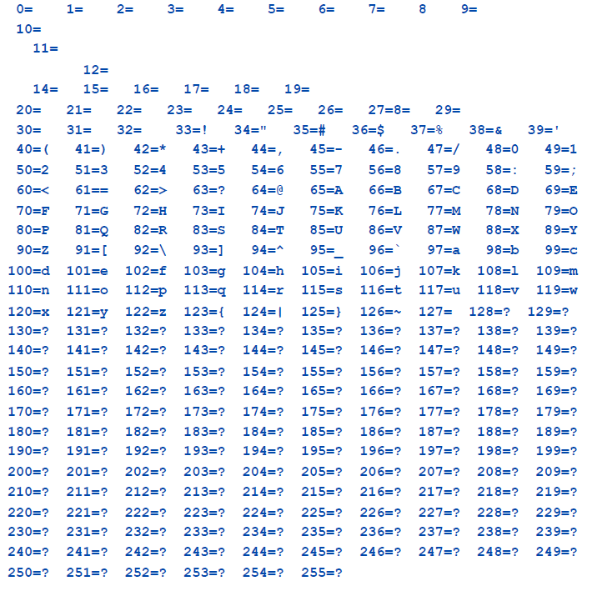
Output

Slide 10
Special Char Exam Code
What is the output from these statements?
printf("\t\tMove over\n\nWorld, here I come\n");
printf("I\’ve written \"Hello World\"\n\t many times\n\a");

Slide 11
Special Char Exam Code
What is the output from these statements?
printf("\t\tMove over\n\nWorld, here I come\n");
Move over
World, here I come
printf("I\’ve written \"Hello World\"\n\t many times\n\a");
I’ve written "Hello World"
  many times<beep>

Slide 12
String constants
Also known as literals
Sequence of characters surrounded by double quotes
  Examples: "Computer", "Coding", "1234", "peace“
Backslash can be used for special characters
  Examples: "professors\nare geeks\n", "rock \’n\’ roll"
  Double quotes within the string written as \"

Slide 13
Memory representation
Sequence of characters stored as array of chars
NULL character added after the last string character
"ABC" or "%d\n\n"
  "ABC" is stored in four bytes as "ABC\0"
  String constant "A" is different from character constant 'A'
String constant "ABC\nDEF" is a two-line string

Slide 14
Memory representation
Assume string "John"
Memory address | 101 | 102 | 103 | 104 | 105
Content as char | 'J' | 'o' | 'h' | 'n' | '\0'

Slide 15
String vs. Character
Important:
  A character constant is enclosed in single quotes while string constants are enclosed in double quotes
String containing one character A (plus NULL)
  "A"
Character A
  'A'

Slide 16
Accessing Strings
There is no specific string type in C
  Strings are arrays of char supported by library functions
String is accessed by pointer to the first character
  String is an array of characters
  Last character determined by NULL
  String has type char * or char []
      char color[] = "blue";
      char * color_ptr = color;
Changing strings
  Must have enough memory to store new string
  Important to take care of this if strings change
  Don’t forget about NULL when thinking of string size

Slide 17
Assigning a string to another variable
String is an array
  It thus cannot be copied with a single assignment
    color_ptr=color only copies pointer value, not the string itself
  Must be copied character by character
  strcpy function defines the operation
  Or we can do it manually

Slide 18
string
Assuming that color_ptr has enough memory allocated, the following function can also achieve the string copy
void copy_string(char* color_ptr, char* const color)
{
char * in = color;
char * out = color_ptr;
while ( *out++ = *in++ );
}

Slide 19
Initializing strings
Can be done using either array or pointer notation
char color[] = "blue";
  Compiler allocates the space and copies literal into that space
  This string can be modified
char * color = "blue";
  Compiler just creates a pointer to the string literal
  This string cannot be modified

Slide 20
Reading Strings from Standard Input
Approach 1: scanf
  Use scanf with %s type modifier to read strings
  char s[200];
  scanf("%s", s);
Approach 2: fgets with standard input stdio
Use fgets using standard input stream stdio
fgets arguments
  string (character pointer)
  maximum number of bytes to read (including NULL)
  file stream to read from (can be stdio)
fgets(s,200,stdin); (also reads '\n' in the end)
gets(s); (as fgets, but no limit on length)

Slide 21
Differences Between scanf and fgets
scanf
  Only reads nonempty strings
  New-line character is not put into the target string
  Cannot bound input size
fgets
  Can read even empty strings
  Includes new-line character in the end of the string
    Can be deleted using s[strlen(s)-1]='\0';
  Can bound input size

Slide 22
Printing Strings
Use printf
  printf("My string: %s",s);
Alternative (not so good but works, but modifies s)
  while (*s) printf("%c",*s++);
Example:
    #include <stdio.h>
    int main()
    {
    char *s = "John";
    while (*s) printf("%c",*(s++));
    return 0;
    }

Slide 23
Character handling library
There are many functions to handle characters. To use these functions in your code,
#include <ctype.h>
Note that the function parameter type is int, not char
Note that the return type for some functions is int since ANSI C does not support the bool data type Recall that zero is "false", non-zero is "true“
A few of the commonly used functions are listed on the next slide. For a full list of ctype.h functions, type man ctype.h at the Linux prompt

Slide 24
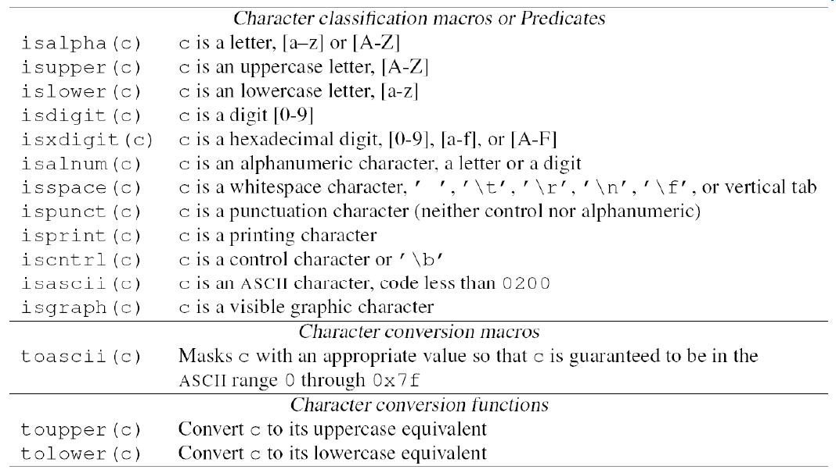
ctype.h

Slide 25
String conversion function
Available in general utilities library (stdlib)
Useful to convert a string of digits to integer or floating point values
In the following table, str represents a string (array) and ptr represents a pointer to a character
atof ( str ) | Convert string to double precision number
strtod ( str, ptr ) | Convert string to double precision number
atoi ( str ) | Convert string to integer
atol ( str ) | Convert string to integer
strtoi ( str, ptr, base ) | Convert string to integer

Slide 26
Character Input/Output
Use %c in printf()and fprintf()to output a single character
  char yourGrade = 'A';
  printf( "Your grade is %c\n", yourGrade );
Input char(s) using %c with scnaf()
  char grade, scores[3];
  %c inputs the next character, which may be whitespace
  scanf( "%c", &grade );
  %nc inputs the next n characters, which may include whitespace
  scanf( "%3c", scores ); // note -- no & needed

Slide 27
Array of char
An array of chars may be (partially) initialized. This declaration reserves 20 char (bytes) of memory, but only the first 4 are initialized
  char name2 [20] = { 'J', 'o', 'h', 'n' };
You can let the compiler count the chars for you. This declaration allocates and initializes exactly 4 chars (bytes) of memory
  char name3 [ ] = { 'J', 'o', 'h', 'n' };
An array of chars is NOT a string

Slide 28
Standard I/O library functions
Require the file <stdio.h> to be included
Functions
  getchar, gets, putchar, puts, sprintf, sscanf
Writing string using printf and puts
  Use %s format character
  Print first 5 characters: %.5s
  Print in block of 20 characters (right-align): %20s
  Left justification: %-20s

Slide 29
String Output
Use %s in printf()or fprintf()to print a string
All chars will be output until the '\0' character is seen
  char name[] = "John Doe";
  printf( "My name is %s\n", name );
As with all conversion specifications, a minimum field width and justification may be specified
  char book1[] = "Intelligence";
  char book2[] = "New World Order";
  printf("My favorite books are %12s and %12s\n", book1, book2 );
  printf("My favorite books are %-12s and %-12s\n", book1, book2);

Slide 30
Dangerous String Input
The most common and most dangerous method to get string input from the user is to use %s with scanf() or fscanf()
This method interprets the next set of consecutive non-whitespace characters as a string, stores it in the specified char array, and appends a terminating '\0' character.
  char name[22];
  printf( "Enter your name: " );
  scanf( "%s", name );

Slide 31
Safer String Input
A safer method of string input is to use %ns with scanf() or fscanf() where n is an integer
This will interpret the next set of consecutive non-whitespace characters up to a maximum of n characters as a string, store it in the specified char array, and append a terminating '\0' character.
  char name[ 22 ];
  printf( "Enter your name: ");
  scanf( "%21s", name ); // note 21, not 22

Slide 32
C String Library
C provides a library of string functions
To use the string functions, include <string.h>
Some of the more common functions are listed here on the next slides
To see all the string functions, type
man string.h at the Linux prompt

Slide 33
C String Library (2)
Commonly used string functions
These functions look for the '\0' character to determine the end and size of the string
  strlen( const char string[])
    Number of characters in s, not including the NULL character
  strcpy( char s1[], const char s2[])
    Copies s2 to s1 until the null character.
  strcmp( const char s1[], const char s2[])
    Returns < 0, 0, > 0 if s1 < s2, s1 == s2 or s1 > s2 lexigraphically
  strcat( char s1[], const char s2[])
    Appends a copy of strings s2 to the end of string s1

Slide 34
C String Library (3)
Some function in the C String library have an additional size parameter.
strncpy(char s1[], const char s2[], int n)
  Copies at most n characters of s2 on top of s1.
  The order of the parameters mimics the assignment operator
strncmp(const char s1[], const char s2[], int n)
  Compares up to n characters of s1 with s2
  Returns < 0, 0, > 0 if s1 < s2, s1 == s2 or s1 > s2 lexigraphically
strncat(char s1[], const char s2[], int n)
  Appends at most n characters of s2 to s1

Slide 35
String Code
char first[10] = "bobby";
char last[15] = "smith";
char name[30];
char you[ ] = "bobo";
strcpy( name, first );
strcat( name, last );
printf( "%d, %s\n", strlen(name), name );
strncpy( name, last, 2 );
printf( "%d, %s\n", strlen(name), name );
int result = strcmp( you, first );
result = strncmp( you, first, 3 );
strcat( first, last );

Slide 36
String search functions
strchr (s, c) | Returns a pointer to the first occurrence of character c in string s
strrchr (s, c) | Returns a pointer to the last occurrence of character c in string s
strpbrk (s1, s2) | Return a pointer in s1 to the first occurrence of any character from s2
strspn (s1, s2)
strcspn (s1, s2)
strstr (s1, s2)
strtok (s1, s2)

Slide 37
Memory functions
Declared in <memory.h> file
  Manipulate memory directly
  But can be used for strings as well
  However, they do not assume NULL-terminated string, they work on specified sequence of bytes
    memcpy ( s1, s2, n )
    memccpy ( s1, s2, c, n )
    memchr ( s, c, n )
    memcmp ( s1, s2, n )
    memset ( s, c, n )

Slide 38
Bit Operations
Bit or flag
  Smallest unit of information
  Can take on the value 1 (ture) or 0 (false)
  Used to manipulate the bits of integral operands, char, short, int, and long, both signed and unsigned
  Used to control the machine at the lowest level, specially in pixel-level graphics
Byte
  Collection of 8 bits
  Can be represented as two hexadecimal numbers by using 0xHH where H is a hexadecimal number

Slide 39
Bit
Bit operators
  Allow a programmer to manipulate individual bits in integer or character data types
Operator | Semantics
& | Bitwise and
| | Bitwise or
^ | Bitwise exclusive or
~ | Complement
<< | Shift left
>> | Shift right

Slide 40
Bitwise And: &
The and operator
  Compares corresponding bits in the two operands
  If both bits 1, result is 1; otherwise result is 0.
a & b
  01101000 &
  01001001 =
  01001000
  Consider the following program
int main(){
char c1 = 0x45,
c2 = 0x71;
printf ("Result of %x & %x = %x\n", c1, c2, c1 & c2);
}

Slide 41
Bitwise Or: |
The operators & and && are different
  Using bitwise operator to check if a number is even
    #define even(x) (((x) & 1) == 0)
The bitwise inclusive or operator
  If at least one bit 1, result is 1; otherwise result is 0.The bitwise exclusive or operator
  Compare two operands and set resultant bit to 1 if either of the corresponding bits is a 1 but not both
  a | b
  01101000 |
  01001001 =
  01101001

Slide 42
Bitwise Negation: ~
  The not operator
  Also called one’s complement, invert, or bit flip
  Unary operator
  If bit is 1, make it a 0; if bit is a 0, make it a
  Does not change the value of a variable if used by itself, for example ˜x does not change the value in x
Example
  ~01101000 =
  10010111

Slide 43
Bitwise Exclusive Or: ^
Go through all bits of a and b.
For each corresponding pair of bits apply (inclusive) or operator
  If exactly one bit 1, result is 1; otherwise result is 0.
Note that this is different from | operator
Example
  a ^ b
    01101000 ^
    01001001 =
    00100001

Slide 44
Bit
Setting and clearing bits
  Use & and | operator
    x |= mask; Set bits set in mask
    x &= ~mask; Clear bits set in mask
    x &= mask; Clear all bits not set in mask
    x ˆ= x; Clear all bits in x

Slide 45
Bit-shift operators
The left and right shift operators
  Allow us to move data by specified number of bits to the left or right
  Bits shifted out of the left side disappear
a<<1 = a*2
  Shift by 1 bit to left, fill 0 in the end
a>>1 = a/2
  Shift by 1 bit to right, delete last bit
a<<k = a*2^k
  Shift by k bits to left, fill k 0s in the end
a>>k = a/2^k
  Shift by k bits to right, delete the last k bits

Slide 46
Example Shifts
15 << 2
  15 = 1111
  15<<2 = 111100 = 60 (=15x2^2)
  11 >> 2
  11 = 1011
  11>>2 = 1011>>2 = 10 = 2 (=11/2^2)

Slide 47
Print Unsigned int in Bit Representation
#include <stdio.h>
void display_bits (unsigned int value)
{
unsigned int i;
/* The display_mask contains 1 shifted by the number of bits in unsigned int minus 1, which is basically 1 followed by many 0s (1000...) */
unsigned int display_mask = 1 << ( 8 * sizeof(unsigned int) - 1);
printf ( "%7u = ", value );
/* Go bit by bit, always printing the most significant bit and shifting to left by 1 bit to get the next bit to the left */
for ( i = 1; i <= ( 8 * sizeof ( unsigned int ) ); i++ )
{
putchar ( (value & display_mask) ? '1':'0' );
value <<= 1; /* shift by 1 bit to left */
if ( !( i % 8 ) )
putchar (' ‘);
}
putchar ('\n’);
}

Slide 48
Print Unsigned int in Bit Representation
int main()
{
unsigned int x; /* number to be printed */
printf ( "Enter an unsigned integer: " );
scanf ( "%u", &x );
display_bits ( x );
return 0;
}
Enter an unsigned integer: 15
15 = 00000000 00000000 00000000 00001111
Enter an unsigned integer: 30772
30772 = 00000000 00000000 01111000 00110100

Slide 49
Operator precedence
Precedence of shift operators is lower than addition/subtraction
This may cause issues if you replace multiply/divide by shift because precedence of multiply/divide is higher than addition/subtraction
Example
  Original: x = a + b * 2;, equivalent to x = a + 2b
  Using shift operator: x = a + b << 1;
        equivalent to x = 2(a + b)
  Should be: x = a + ( b << 1 );

Slide 50
Bit fields
Declaration of bit fields or packed structures
  Consider a structure with the following information:
      name ≤ 28 characters
      male 1 or 0
      married 1 or 0
      elderly 1 or 0
The last three items need just 1 bit each
  So why waste space with char/short int/int?

Slide 51
Bit fields
The structure can be declared as
struct person
{
char name[29]; /* 28 characters + end of string */
unsigned male : 1,
married : 1,
elderly : 1;
} people[1000];
What does it mean?
  The last three fields are represented by 1 bit each
  So all of them can be only 0 or 1
  We may choose more than 1 bit per field, of course

Slide 52
Accessing Bit Fields
Bit fields are accessed just like any other fields
  Just must be careful to obey the restriction on size
An assignment to bit fields can be made as
    people[i].married = 0;
Bit fields compressed into smaller space
  Need only as many bits as specified

Slide 53
Bit Fields
Advantage
  We use memory more efficiently
  Easy to work with (simpler than use bit-wise operations)
    But can do manually…
Disadvantage
  Accessing bit fields needs extra processing
  Portability might suffer
    Representations may change between computers
    Bit field length may have different upper limits

Slide 54
Bit
Another example of a bit field or packed structure
struct item
{
unsigned int list:1; /* item is in the list */
unsigned int seen:1; /* item has been seen */
unsigned int number:14; /* item number */
/* at most 16383 items */
};
Code to extract data from bit fields is relatively large and slow
Better for human consumption than bit operators which are complex and error prone

Slide 55
Exercises
Exercises
  Play around with strings
    Initialize them
    Read them from user
    Print them in different ways
    Copy them and change them
    Work with them with loops character by character
    Study in detail most important functions
Flip
  Uppercase to lowercase
  Lowercase to uppercase
    Computer cOMPUTER

