Slide 1
File handling and Streams
Lecture 17

Slide 2
File
Files
  Used for permanent storage of large quantity of data
  Usually kept on secondary storage devices
    Hard disk
    CDs
    SSD (Solid State Drive)
    …

Slide 3
Data Hierarchy
  Bit
  Binary digit
  true or false
  Smallest unit we can work with (quarks of computers)
Byte
  Character (including decimal digits)
  8 bits (but used to be 6 bits in 1960s)
  Smallest addressable unit (difficult to get by itself) (Atoms)
Word
  Collection of bytes (typically 2, 4 or 8)
  Smallest unit fetched to/from memory (Molecules)
  Usually the number of bits is measured as machine’s addressability (32-bit, 64-bit machine)

Slide 4
Data Hierarchy
Field
  Collection of bytes or even words
  Example
    Employee name of 30 characters
      8 words on a 32-bit machine
Record
  Collection of fields
    Name of an employee plus associated data
  struct in C

Slide 5
File
File
  Collection of records
  Each record in the file can be identified with a unique key
    Example of Keys
      ssoid, social security number, name
      I use student name as a key to keep the file of grades
      The payroll of a large company may use the social security number as the key

Slide 6
Types of files
Sequential file
  Records follow one another sequentially
  Can access records sequentially
  Imagine a tape
Random access file
  Can access any record at any time
    Location of record is a function of the key
  Mostly used in databases
  Imagine a CD
Indexed sequential file
  Location of record can be found in a separate index file

Slide 7
Streams in C
Stream
  Sequential stream of bytes
  Any source for input or destination for output
  Communication channels between programs
File pointer FILE *
  File pointer FILE * represent streams in C
  FILE * also called file descriptor
  FILE is defined in stdio.h
  Example
      #include <stdio.h>
      …
      FILE *my_file;
Files end in a EOF (end of file) marker
  Ctrl-D in Linux, Ctrl-Z in Windows

Slide 8
Standard Streams
There are 3 standard, predefined streams (stdio.h)
  stdin - Standard input
    Stream to read data from the keyboard
  stdout - Standard output
    Print data on the screen (buffered output)
  stderr - Standard error
    Prints data on screen as soon as it is available
We already used two streams (stdin and stdout)
  scanf - Reads formatted input from stdin
  printf - Prints sequence of chars (formatted output) to stdout

Slide 9
Redirecting Standard I/O Streams
Standard streams can be redirected
stdin
  Usually input taken from keyboard
  But we can redirect input to take input from file
  ./program < file
    Run program with std input from file instead of keyboard
stdout
  Usually output goes to screen
  But we can redirect output to go into a file
  ./program > file
    Run program with output going to file
We can do both
  ./program < file1 > file2

Slide 10
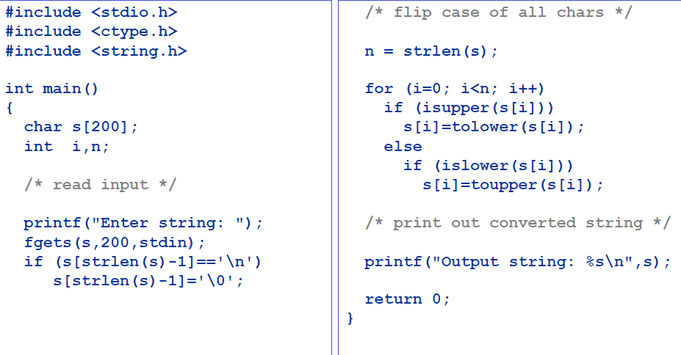
Example redirect.c

Slide 11
Output
$ gcc –Wall redirect.c –o redirect
$ ./redirect
Enter string: Testing Redirection
Output string: tESTING rEDIRECTION

Slide 12
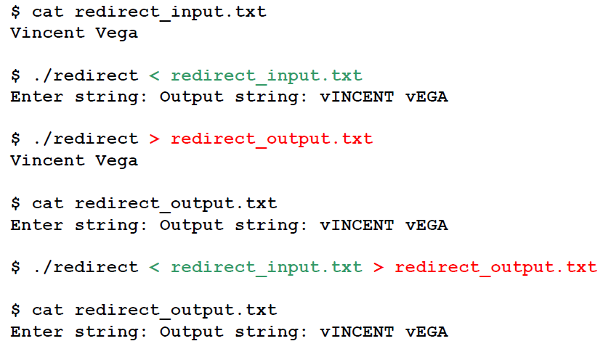
Experiments with Redirection
Create a file redirect_input.txt with text “Vincent Vega”

Slide 13
Opening & Closing Streams
To use a stream we must open it
  stdin, stdout, and stderr are automatically opened
  But the remaining streams must be opened by us
  At the end we must close streams we opened
  stdin, stdout, stderr are automatically closed
  But the remaining streams must be closed by us

Slide 14
Opening Streams
FILE * fd = fopen(name, mode)
  Opens a file with the give name in a given mode
  File variable name must be declared as type FILE *
  Every file must have its own FILE * variable
  The pointer should be assigned to a variable
  Returns pointer to FILE or NULL (failure)
if ((fd = fopen( “input.dat", "w" )) == NULL){
printf("Error opening the file input.dat\n");
return( 1 );
}
  If open fails, return a NULL
  Once it is open, can use fscanf, fgets, fputs, etc.

Slide 15
Files
Different file modes are
r | Read an existing file
w | Write a file, overwrite if file already exists
a | Append to existing file or create a new one
r+ | Read or write (update) an existing file
w+ | Same as w but also can read
a+ | Same as a but also can read

Slide 16
Cautions
Opening an existing file with mode “w” discards all contents of the file without warning and opens and empty file for writing
You must open a file and associate it with a FILE * before using it in the program
Never open a non-existent file for reading
Always check whether the file was opened properly

Slide 17
Closing Streams
Closing a file
  Disconnect the file from the program
  fclose(f)
    Returns 0 on success
    Returns EOF on error (such as trying to write to a file that was not opened for writing)
    f is the pointer to FILE of an open file
    All files should be properly closed when done using

Slide 18
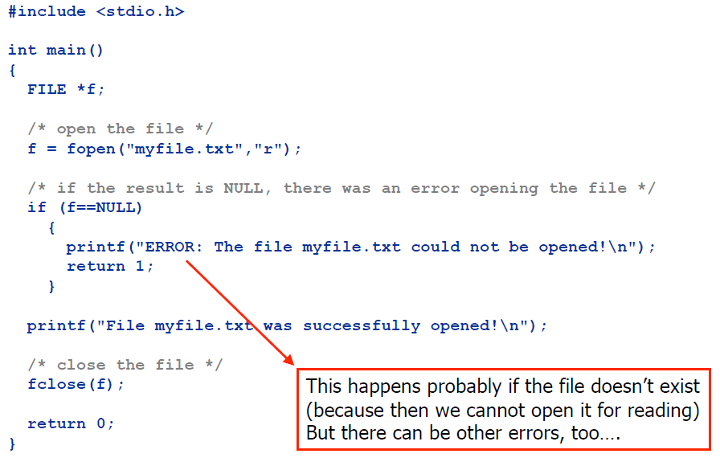
Example

Slide 19
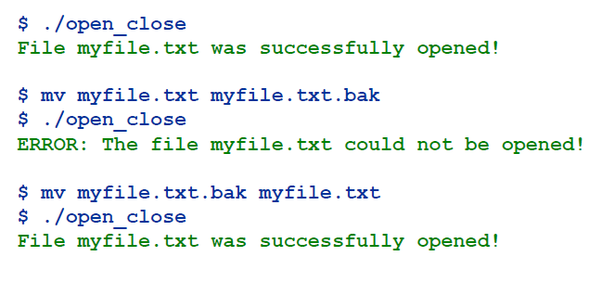
Example
gcc –Wall open_close.c –o open_close

Slide 20
Streams: Sequential Reading & Writing
Reading from streams
  Same as reading from keyboard
  But for keyboard we used stdin
  In general, we can use other files for input
Writing to streams
  Same as writing to screen
  But for screen we used stdout
  In general we can use other files for output

Slide 21
Other useful functions
Standard library provides many functions for reading and writing data from/to files
  fgets ( str, n, stream )
    Get a string str containing n characters from the stream
    Terminates reading at end-of-line or end-of-file
    If terminated at end-of-line, ‘\n’ is the last character
    Returns
      s if successful
      NULL if nothing read (probably end of file)
  fputs ( str, stream )
    Writes the string str on the stream
    Doesn’t add ‘\n’ in the end
    Returns non-zero if an error occurs, otherwise returns zero

Slide 22
fgetc & fputc
  fgetc ( fd )
    Reads one character from the file stream associated with fd
    Return
      Character read if successful
      EOF otherwise
  fputc ( ch, fd )
    Writes the character ch into the file stream associated with fd
Why is fgets better than gets/scanf even for stdin?
  Because we have limitation on length of input

Slide 23
feof
feof ( fd )
  Checks whether we’re at the end of file
  How to put end-of-file from keyboard input (stdin)?
    Ctrl-D
EOF
  Character constant denoting end of file
ferror( fd )
  Is non-zero if error has occurred while reading or writing into fd
  Maintains its value until cleared

Slide 24
fprintf & fscanf
fprintf
  Works just like printf
  But prints into any stream (printf always prints to stdout)
  Stream is specified as first argument.
fscanf
  Works just like scanf
  But reads from any stream (scanf always reads from stdin)
  Stream is specified as first argument

Slide 25
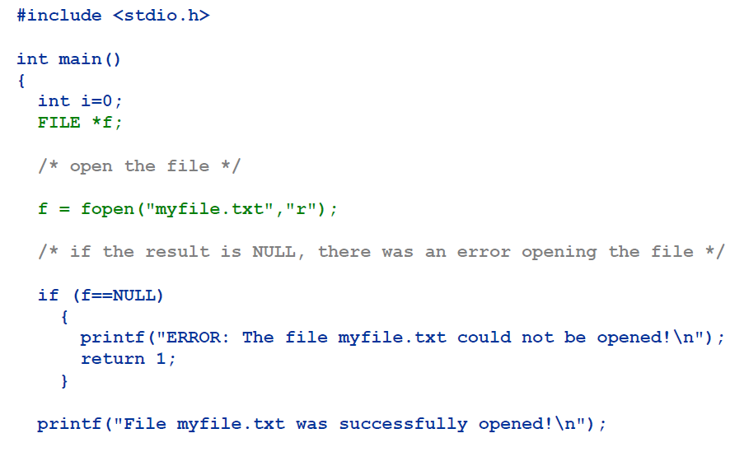
Example

Slide 26
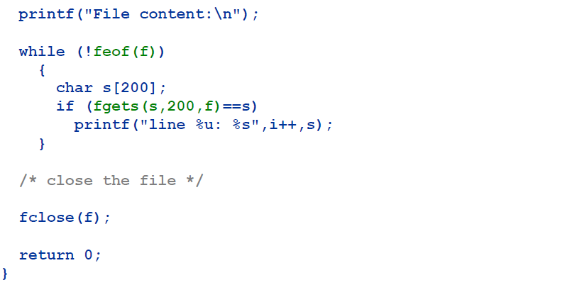
Example

Slide 27
Output
$ cat myfile.txt
  Katrina
  Catalonia
  James Bond
  Madonna
$ gcc –Wall feof.c -o feof
$ ./feof
  File myfile.txt was successfully opened!
  File content:
  line 0: Katrina
  line 1: Catalonia
  line 2: James Bond
  line 3: Madonna

Slide 28
Unformatted I/O
Block I/O
  Read and write memory blocks in single step
  Used primarily with binary streams
  But can be used with text streams as well
Random access files
  Can jump back and forth anytime we want
  Usually jump at beginning of record
  Can write anywhere in file
  Can modify a specific part of file without changing the rest

Slide 29
Binary Files
Binary files
  More efficient than text files (less space)
    Write in the format that is used internally in the machine (no conversion needed)
  Hard to view on the screen (cannot use standard editors)
  Not as portable as ASCII files
Modes
  “rb” open for reading
  “wb” open for writing (file need not exist)
  “ab” open for appending (file need not exist)
  “rb+” open for reading/writing, start at beginning
  “wb+” open for reading/writing (truncate if file exists)
  “ab+” open for reading/writing (append if file exists)

Slide 30
Binary file processing
Write/read to a binary file is done by fread and fwrite
fread
  size_t fread(void *ptr, size_t size, size_t nmemb, FILE *stream);
  Designed to read the array elements from a file (typically binary file)
  Reads nmemb records from stream
  Each record has size size (in bytes)
  fread(array address, size of each element (in bytes), number of elements to read, file pointer)
  n = fread(a, sizeof(a[0]), sizeof(a)/sizeof(a[0]), fp);

Slide 31
Binary file processing
fread
  n = fread(a, sizeof(a[0]), sizeof(a)/sizeof(a[0]), fp);
  n
    the actual number of elements read
    should be equal to the third argument unless:
      EOF was reached prematurely
      Error occurred

Slide 32
Binary file processing
fread
  n = fread(a, 1, 100, fp);
    Read 100 one-byte elements
    0 <= n <= 100
  n = fread(a, 100, 1, fp);
    Read one block of 100 bytes
    n = 0 or 1

Slide 33
Binary file processing
fwrite
  size_t fwrite(const void *ptr, size_t size, size_t nmemb, FILE *stream);
  Writes nmemb records into stream
  Location in file given by current state of stream
  Designed to write the array elements to a file (typically binary file)
  fwrite(array address, size of each element (in bytes), number of elements to write, file pointer)
  fwrite(a, sizeof(a[0]), sizeof(a)/sizeof(a[0]), fp);

Slide 34
Binary file processing
fwrite
  fwrite(a, sizeof(a[0]), sizeof(a)/sizeof(a[0]), fp);
  Writes the entire array a on a file
  Returns the actual number of elements written

Slide 35
Binary file processing
fwrite
  Data doesn't have to be in array form
  fread and fwrite can handle variables of all kinds
  fwrite(&s, sizeof(s), 1, fp);
  where s is a struct variable

Slide 36
Examples
fwrite
    int i = 19;
    FILE * fd;
    fd = fopen (“bin.dat”, “w”);
    ...
    fwrite(&i, sizeof ( int ), 1, fd);
fread
    int i;
    FILE * fd;
    fd = fopen (“bin.dat”, “r”);
    ...
    fread(&i, sizeof ( int ), 1, fd );

Slide 37
Binary file processing
fseek
  Moves file position to a particular location in the file
  int fseek(FILE *fp, long int offset, int whence);
  whence (where to start seeking)
    SEEK_SET (beginning of file)
    SEEK_CUR (current file position)
    SEEK_END (end of file)

Slide 38
Binary file processing
fseek
  fseek(fp, 0L, SEEK_SET);
    Moves to the beginning of file
  fseek(fp, 0L, SEEK_END);
    Moves to the end of file
  fseek(fp, -10L, SEEK_CUR);
    Moves back 10 bytes

Slide 39
Binary file processing
rewind
  Moves file position to the beginning of the file
  equivalent to:
    fseek(fp, 0L, SEEK_SET);

Slide 40
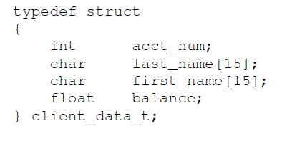
Example
Create a credit processing system capable of storing up to 100 fixed-length records. Each record should consist of an account number that will be used as the record key, a last name, a first name, and a balance. The resulting program should be able to update an account, insert a new account record, delete an account and list all the account records in a formatted text file for printing.
types.h

Slide 41
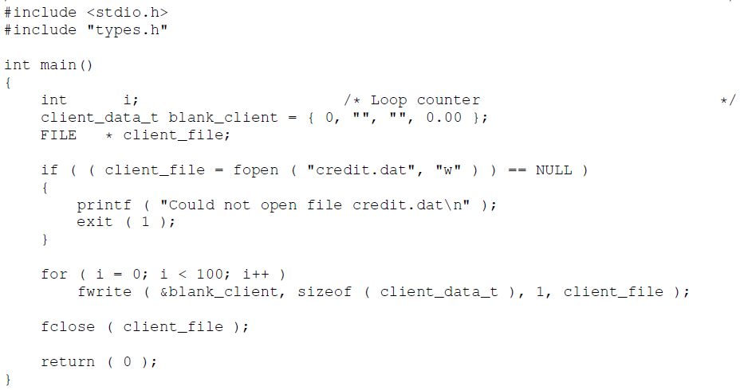
Creating a randomly accessed file (create.c)

Slide 42
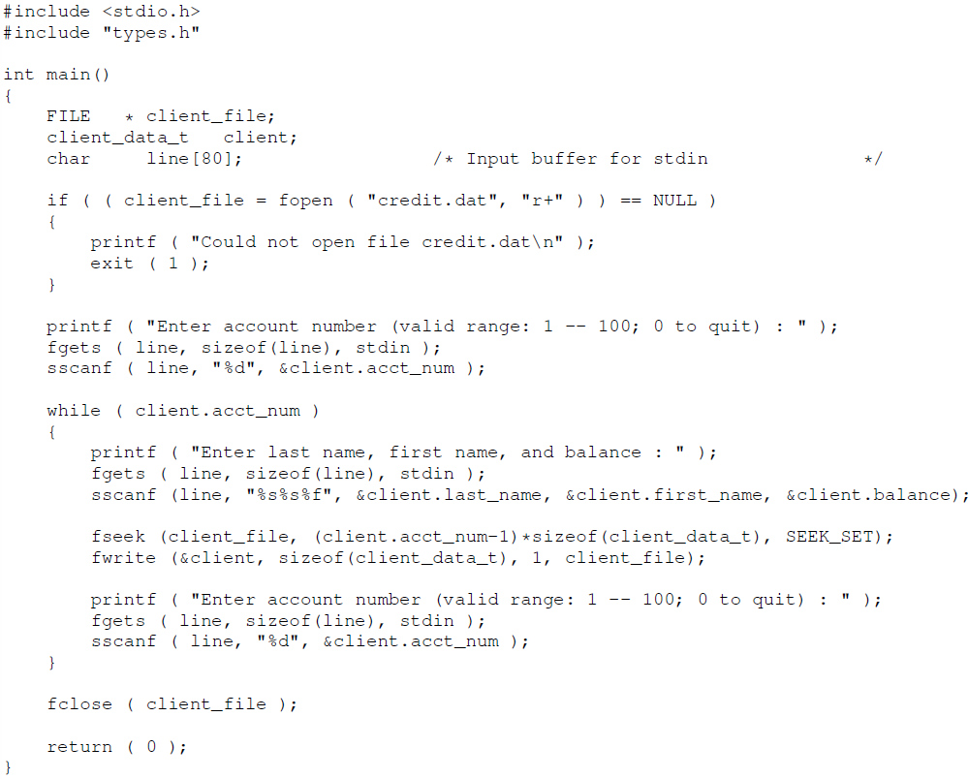
Updating a randomly accessed file (update.c)

Slide 43
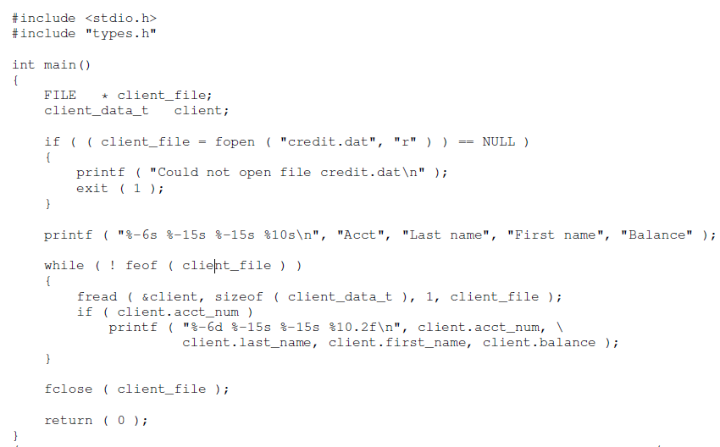
Reading data from a random access file (read.c)

Slide 44
Buffering problems
Stream operations are typically buffered
  Buffered I/O stores data in a buffer until the buffer is big enough to write to disk
  Read in text streams also buffered, typically into lines (input processed only after new line character).

Slide 45
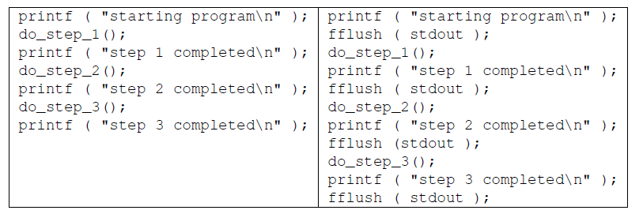
Example
Look at the following two codes
Left code: the printf puts the output data in a buffer; then outputted when buffer is full, or at the end of program
Right code: the fflush statement forces the buffers to be flushed

Slide 46
Buffer
Operating on buffers
  fflush
    Forces a write of all information from the buffer into the stream
  fpurge
    Erases any buffered I/O in the given stream
  Can also set buffer size and use explicit buffers
  Can also remove buffering on given streams

Slide 47
Set buffer
setvbuf and setbuf
  size is number of bytes in buffer
  mode can be assigned values from constants in stdio.h
    _IOFBF is full buffering
    _IOLBF is line buffering
    _IONBF is no buffering
  If setbuf buffer is set to NULL, buffering is turned off
    If not NULL, full buffering and buffer size equal to default BUFSIZ

Slide 48
Buffering
So why so much on buffering?
  It can cause problems, specially in debugging
    Program crashes before outputting buffers
  #ifdef DEBUG
  setbuf ( stdout, NULL);
  #endif
Turns off all buffering

Slide 49
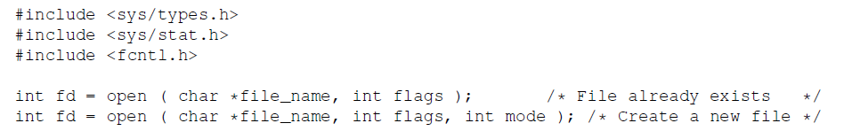
Unbuffed I/O
Can do unbuffered I/O
  Based on system calls, so similar to the standard library functions
  Low level I/O is never buffered
  open system call
    Open an unbuffered file
    open is used as follows
fd is an integer and not a pointer

Slide 50
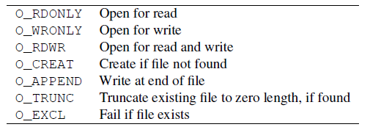
Unbuffed I/O
open system call
  file_name can be absolute path or relative to current directory
  Flags is an integer with each bit set to indicate type of access
    Defined in fcntl.h or sys/file.h depending on OS version
  mode is protection mode of file, used only when O_CREAT flag is set, otherwise ignored

Slide 51
Unbuffed I/O
Example
int in_fd, out_fd; /* File descriptors */
in_fd = open("infile", O_RDONLY, 0); /* Read only */
out_fd = open("outfile", O_WRONLY|O_CREAT, 0666);/*Write*/
Note that the permissions are specified as octal integer constant 0666, and not as a decimal integer 666; the prefix zero is very important

Slide 52
Unbuffered I/O
create system call
  Create a new file or truncate an existing one
  Defined by
    int creat(char *filename, int permissions);
  Returns file descriptor of created file, or -1 on error
  The call
    creat(filename, mode);
  Is equivalent to
    open(filename, O_WRONLY | O_CREAT | O_TRUNC, mode );

Slide 53
Unbuffered I/O
close system call
  Close the file
  Free the file descriptor for later use
  Defined by
    int close( int fd );
  read system call
  Read a block of data from file
  Defined by
    int read(int fd, char *buffer, int num );
  Returns the number of bytes read or 0 if EOF
    -1 if an error occurs

Slide 54
Unbuffered I/O
  write system call
  Write a block of data to a file
  Defined by
    int write(int fd, char *buffer, int num );
  Returns the number of characters written
    If this value less than num, an error occurs

Slide 55
File formats
Important to include file type information with each file
Windows does it with extensions, such as file.dat
Unix uses what is called a magic number
  Set in the first few bits of a file
  Just an identifying number for a file type
  For example, C compiler uses it to distinguish between source, object, assembly file formats
Can get this information with the file command
  Doesn’t just check magic number, runs several tests

Slide 56
Magic Numbers
Magic number is specified in file /etc/magic using four fields
  Offset: a number of bytes into file to test
  Type: Type of data to be tested - byte
  Value: Expected value of file type
  Message: Message to be printed if comparison succeeds
Developing magic numbers
  Start with first four letters of program name (e.g., list)
  Convert them to hex: 0x6c607374
  Add 0x80808080 to the number
  The resulting magic number is: 0xECE0F3F4
  High bit is set on each byte to make the byte non-ASCII and avoid confusion between ASCII and binary files

