Slide 1

Source Control Management
Lecture 20

Slide 2
Project management
Difficult to keep track of different versions of a file if several people are making updates
  Source code and documentation files change frequently
  Bugs need to be fixed (but keep a copy of the older working program)
  Programs may need to be enhanced
  Software is released at non-regular intervals
Problem is harder if there is more than one version of the program in circulation
Different people may attempt to fix different bugs by modifying different parts in the same file

Slide 3
Project management
Problems solved by utilities to manage and track changes in the files
  Source code management systems – SCCS, RCS, CVS, SVN, git
  Record a specific version or revision of the file so that it can be recovered in the event of a problem in that version
  Usable for managing source code and software documentation
  Control the set of people allowed to update a file
  Record the name of the person who made the change, and a comment about what was changed (log commentary)
  Provide control over new revision creation (major or minor revision), depending upon the version
  Possible to regenerate any version of the file that was saved
  Make sure that only one person can modify the file at any time

Slide 4
Goals of project control
Ability to group files by revision (snapshot)
Support for product abstraction
  Structuring a group of source files
  Support for concurrent development
  Ability to rebuild product revisions
  Support for multiple target platforms
  Control of released files

Slide 5
Git
Created by Linus Torvalds as an open source project to maintain the code base for Linux in 2005
Used to manage multiple revisions of files
Automates the storage, retrieval, logging, identification, and merging of revisions
Saves old revisions in a space efficient manner
Maintains a complete history of changes
Resolves access conflicts
Maintains a tree of revisions
Controls releases and configurations

Slide 6
Version Control
For working by yourself:
  Gives you a “time machine” for going back to earlier versions
  Gives you great support for different versions (standalone, web app, etc.) of the same basic project
For working with others:
  Greatly simplifies concurrent work, merging changes
For getting an internship or job:
  Any company with a clue uses some kind of version control
  Companies without a clue are bad places to work

Slide 7
Version Control
Save changes to groups of file thus you can revert back if needed
Local Version Control
  Personal PC, Mac or Linux machine
  Database
Centralized Version Control
  TFS - Microsoft Team Foundation Server
  Subversion
Distributed Version Control
  Git
  Mercurial

Slide 8
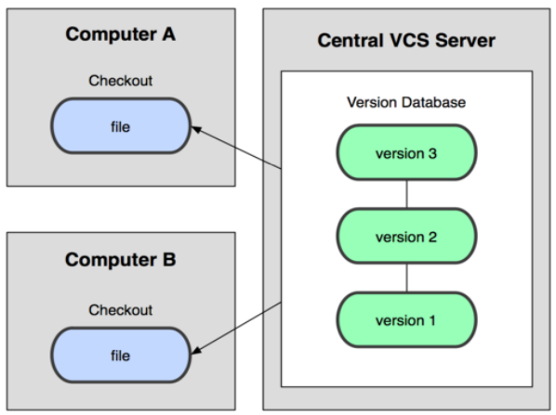
Centralized Model
A central server repository (repo) holds the "official copy" of the code
  the server maintains the sole version history of the repo
You make "checkouts" of it to your local copy
  you make local modifications
  your changes are not versioned
When you're done, you "check in" back to the server
  your checkin increments the repo's version

Slide 9
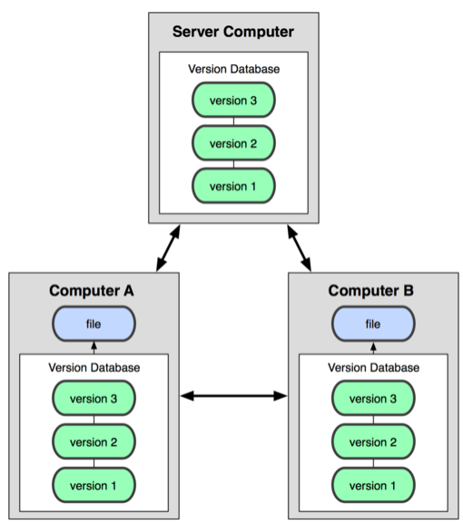
Distributed Model
In git, you don't "checkout" from a central repo
  you "clone" it and "pull" changes from it
Your local repo is a complete copy of everything on the remote server
  yours is "just as good" as theirs
Many operations are local:
  check in/out from local repo
  commit changes to local repo
  local repo keeps version history
When you're ready, you can "push" changes back to server

Slide 10
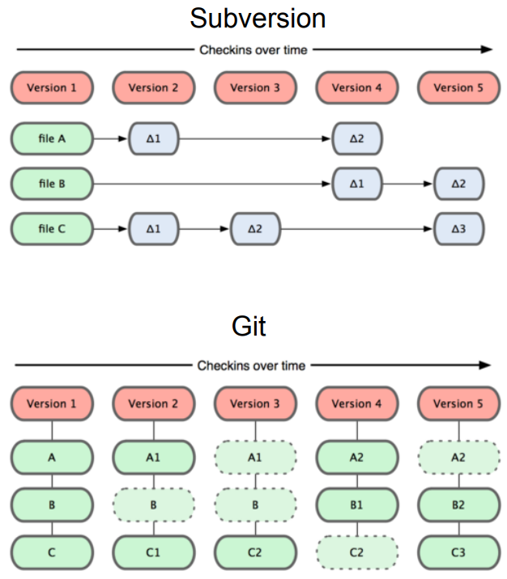
Git takes snapshots
Centralized VCS like Subversion track version data on each individual file
Git keeps "snapshots" of the entire state of the project
  Each checkin version of the overall code has a copy of each file in it
  Some files change on a given checkin,
  some do not
  More redundancy, but faster

Slide 11
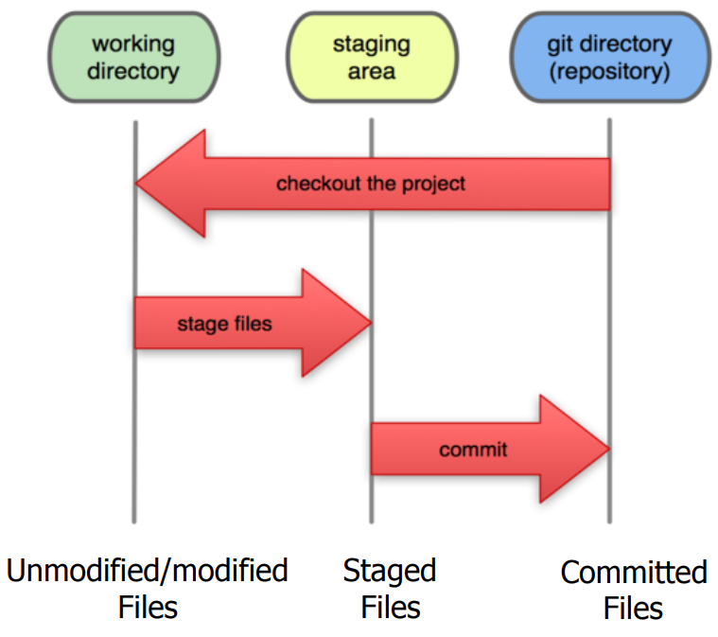
Files Transitions between 3 states
Modified Files
  Have been changed
  Working copy
Staged Files
  Mark to be saved
Committed Files
  Have been saved
A commit saves a
snapshot of all staged state

Slide 12
Git commit checksum
In Git, each user has their own copy of the repo, and commits changes to their local copy of the repo before pushing to the central server
Git generates a unique SHA-1 hash (40 character string of hex digits) for every commit
Refers to commits by this ID rather than a version number
  Often we only see the first 7 characters:
    1677b2d Edited first line of readme
    258efa7 Added line to readme
    0e52da7 Initial commit

Slide 13
Creating personal git server
Normally, you will be provided a git server to enable collaborative code development in an organization
  When you are working on individual projects, you will need to create your personal git server
Steps to create your personal git server
  Set up a password-less ssh login
    ssh-keygen -t rsa
      Use the default location to store the key
      Specify a pass-phrase when prompted; remember the pass-phrase
      Note down the location of the public key

Slide 14
Initial Git configuration
Set the name and email for Git to use when you commit:
  git config --global user.name "John Doe"
  git config --global user.email doej@umsl.edu
You can call git config --list to verify these are set
Set the editor that is used for writing commit messages:
  – git config --global core.editor nano
    it is vim by default

Slide 15
Creating personal git server
If you are using a remote machine as git server, you need to copy the keys to the server (assuming username ssoid on remote server)
cat ˜ /.ssh/id_rsa.pub | ssh ssoid@remote-server "mkdir -p ˜ /.ssh && \ cat >> ˜ /.ssh/authorized_keys"
ssh into the server as ssoid and create a project directory for git and create an empty repository
mkdir -p ˜ /projectname.git
cd ˜ /projectname.git
git init --bare
exit to get back to your local machine

Slide 16
Creating a Git repo
Create a git repository on local machine and initialize it
mkdir -p ˜ /git/project
cd ˜ /git/project
git init
    This will create a .git directory in your current directory
    Then you can commit files in that directory into the repo
Add files into the repository
    git add .
    dot means "this directory"
    Run the above command every time you create new files in the directory
    Takes a snapshot of the file, adds it to the staging area so it will be part of the next commit

Slide 17
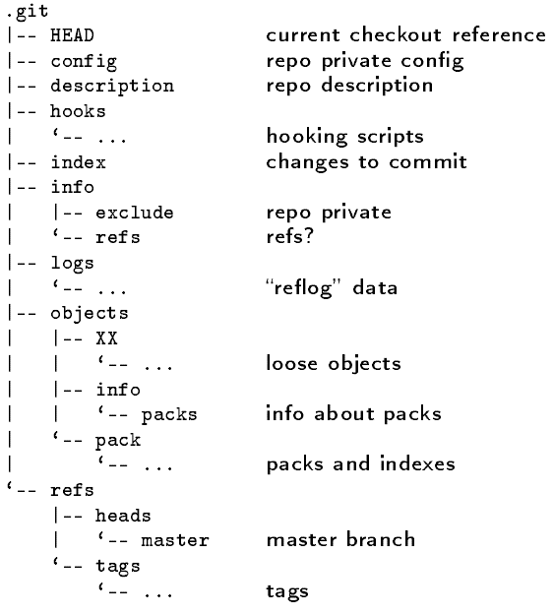
.git repository

Slide 18
git
Whenever you have a significant change in the file, you need to commit the change
  git commit -m "message" -a
  git commit -m "message" file.c
  git commit file.c (shows a text editor)
git remote add origin ssoid@remote-server:project.git
git push origin master
To move staged changes into the repo, we commit:
  git commit –m "Fixing bug #22"
To undo changes on a file before you have committed it
  git reset HEAD -- filename (unstage the file)
  git checkout -- filename (undo your changes)

Slide 19
Git Clone
You can clone your remote project on a new machine
git clone url localDirectoryName
  mkdir ~ /tmp
  cd ~ /tmp
  git clone ssoid@remote-server:project.git
This will create the given local directory, containing a working copy of the files from the repo, and a .git directory (used to hold the staging area and your actual local repo)
All repositories are equal
  But you can treat some particular repository (such as one on remote server) as the “master” directory

Slide 20
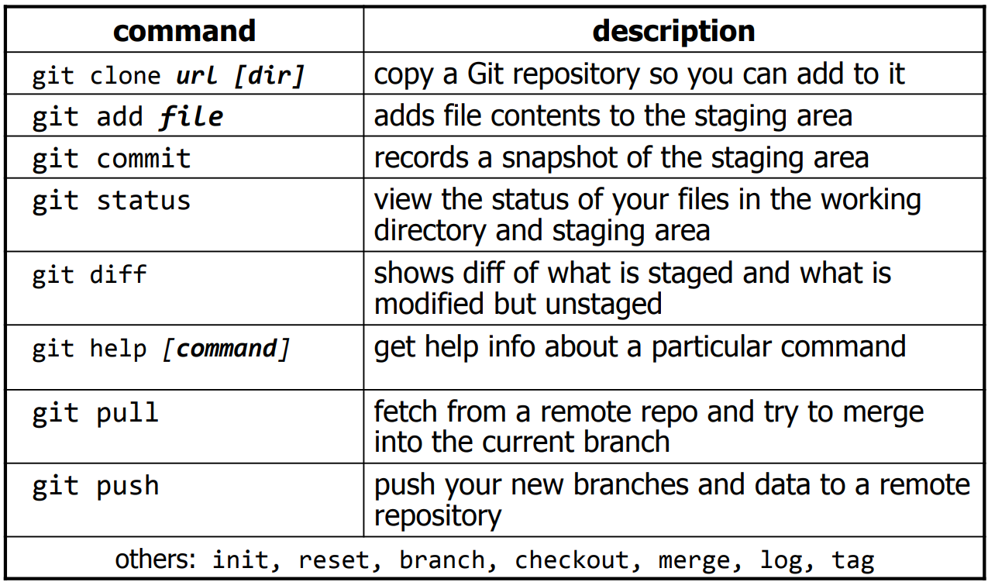
Git commands

Slide 21
Git workflow
When executing git init, a new subdirectory with the name .git gets created
  .git is repository
    The dot indicates a "hidden" directory
    You do not work directly with the contents of that directory; various git commands do that for you
    You do need a basic understanding of what is in the repository
Subdirectory contains three subdirectories
  Working directory – directory that contains your files
  Index – staging area for files that eventually get committed
  Head – points to the last commit that was made
  The flow is your working directory, then add to staging area, then commit moves files to head

Slide 22
The repository
At any time, you can take a "snapshot" of everything (or selected things) in your project directory, and put it in your repository
  This "snapshot" is called a commit object
  The commit object contains (1) a set of files, (2) references to the "parents" of the commit object, and (3) a unique "SHA-1" name
  Commit objects do not require huge amounts of memory
You can work as much as you like in your working directory, but the repository isn’t updated until you commit something

Slide 23
Git workflow
Git commands to move files through workflow
  cd project
    Change directory to where your files are located
  git init
    Use this command to initialize your working directory the first time for use with git; After first time, you don’t have to do this again
Add and Commit your changes to your local repo
  git add * or git add . or git add filename
    moves changes to index area
  git commit -m "commit message"
    moves changes to head area; note that files are not in remote repository yet

Slide 24
Git workflow
Push your local changes to the remote repo
Pull from remote repo to get most recent changes
  fix conflicts if necessary, add/commit them to your local repo
  To fetch the most recent updates from the remote repo into your local repo, and put them into your working directory
  git pull origin master
  To put your changes from your local repo in the remote repo
  git push origin master Use this command the first time
  git push use this command after the first time
  If you have a different remote server you want to push changes to use the following command
git remote add origin loginid@remoteserver.com:project.git

Slide 25
Branching
To create a branch called experimental
  $ git branch experimental
To list all branches (* shows which one you are currently on)
  $ git branch
To switch to the experimental branch
  $ git checkout experimental
Later on, changes between the two branches differ, to merge changes from experimental into the master
  $ git checkout master
  $ git merge experimental
git log --graph is useful for showing branches
  These branches are in your local repo!

Slide 26
Viewing/undoing changes
To view status of files in working directory and staging area
  git status or git status –s (short version)
To see what is modified but unstaged
  git diff
To see a list of staged changes
  git diff --cached

Slide 27
Git Logs
Git keeps logs of everything you do
  Git commands for various log output
To see a log of all changes in your local repo
  git log or git log --oneline (shorter version)
  git log -p -2 (Shows the difference in the last 2 commit)
  git log -5 (Shows only the 5 most recent updates)
  git log --author=John Shows only changes by John
  git log --pretty=oneline Shows compressed description of commits on one line
  git log --graph --oneline --decorate --all Outputs nice looking logs
  git log --name-status Shows which files have changed with each commit
  git log --help More options on output

Slide 28
Git Tagging
Used to name a particular commit
  Useful for naming a public release of software
  git tag 1.0.0.0 17948a9735
    17948b9725 is 1st 10 digits of a commit id, which can be obtained by looking at the logs

Slide 29
Git and Recovering Deleted files
Suppose you have deleted important work on your computer that you had already committed to git
  Let’s say this file is called file.txt
This is the command to get your file back from remote server
git archive --remote=ssoid@delmar.umsl.edu:project.git HEAD file.txt | tar -x > file.txt
This is the command to get your file back form local cached copy
  git checkout -- file.txt
These series of commands will reset local cache and retrieve a files from remote
  git fetch origin
  git reset --hard origin/master

Slide 30
Git useful commands and options
gitk Graphical User Interface for git, Linux systems
git config color.ui true colorize output from git

Slide 31
Git Resources
At the command line: (where verb = config, add, commit, etc.)
  $ git help <verb>
  $ git <verb> --help
  $ man git-<verb>
$ man gittutorial
Free Git Book
  https://git-scm.com/book/en/v2
  https://stackoverflow.com/questions/315911/git-for-beginners-the-definitive-practical-guide#323764

Slide 32
Important
From now on, I want to see the use of git on the remaining assignments!

