Slide 1
System Programming
Lecture 23

Slide 2
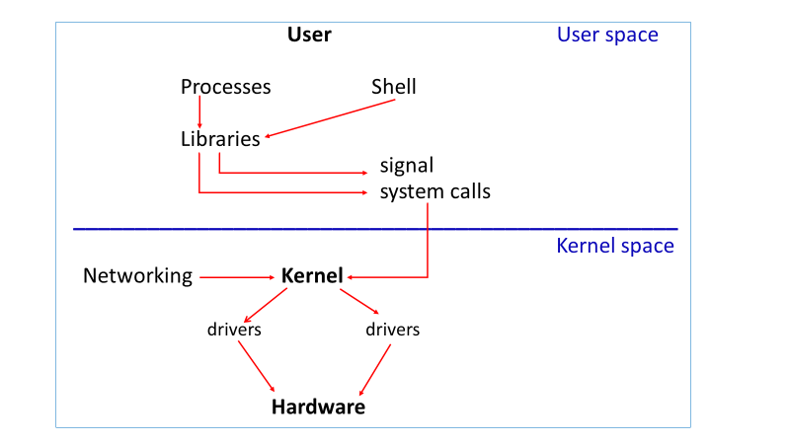
Linux

Slide 3
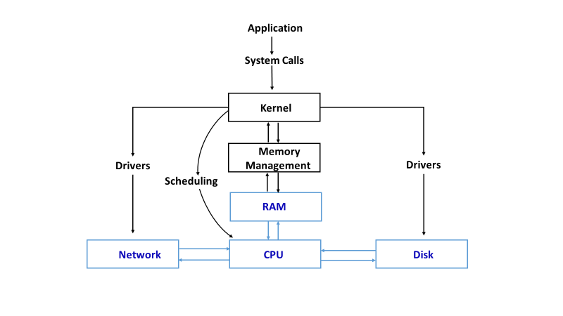
Kernel

Slide 4
System calls
It will allow us to use the OS in our programs
Provides direct access to the kernel (privileged part of OS)
Set of extended instructions provided by the OS
Used by our programs to communicate with OS and request services

Slide 5
System calls
Consider our use of library functions
  These are general purpose functions required in most programs
  However, many invoke a system call to achieve the task
  fopen()library call invokes open() system call
System calls are usually in second 2 of man pages
  man -s 2 open
  man 2 name
Whenever using system calls, good idea to check the man page
  Make sure to include proper headers

Slide 6
System calls
System-level library routines
  that directly access Linux kernel
    file management
    process management
    interprocess communication
    error handling

Slide 7
Error handling
errno
  Typically, each system call returns -1 if an error occurs
    But it doesn't explain why the error occurred
  Every system call process contains a global variable errno
    errno is initially set to zero
  If an error occurs, errno is set to a non-zero numeric code that is associated with the cause of the error
  errno is updated every time a new error occurs. Successful system call has no effect on errno

Slide 8
Error handling
errno
  /usr/include/sys/errno.h
    contains the list of predefined error codes
  #define EPERM 1 /* Operation not permitted */
  #define ENOENT 2 /* No such file or directory */
  #define ESRCH 3 /* No such process */
  #define EINTR 4 /* Interrupted system call */
  #define EIO 5 /* I/O error */

Slide 9
Error handling
perror
  void perror(char *str);
    perror converts the current value of errno into an English description
    perror displays the string str, followed by a colon, followed by an English description of the last system call error. If there is no error to report (or if errno==0), perror displays the string "Error 0".

Slide 10
Error handling
int open(char *filename, int mode [, int perms])
  One of Unix system calls for basic I/O operations
  mode flags are in /usr/include/fnctl.h
  perms - the protection mode for creating a new file
  returns an integer called file descriptor
  Flags - an integer code for the intended access
    O_RDONLY (read only)
    O_WRONLY (write only)
    O_RDWR (read/write)
    O_APPEND
    O_CREAT (creates one if not exists)
    O_EXCL (to produce an error if O_CREAT is on & file exists
    O_TRUNC (to truncate size to 0)

Slide 11
Error handling
File descriptor
  A small integer associated with each file
  fd = open(filename, ...);
    open file, return file descriptor
  Special file descriptors
Value | Meaning
0 | standard input (stdin)
1 | standard output (stdout)
2 | standard error (stderr)

Slide 12
Error handling
Other I/O system calls
  #include <unistd.h>
  charsRead = read(fd, buffer, BUFFER_SIZE);
    read from file
  charsWritten = write(fd, buffer, BUFFER_SIZE);
    write to file
  close(fd);
    closes the file descriptor (good practice)

Slide 13
Error handling
showErrno.c
  #include <stdio.h>
  #include <errno.h>
  #include <fcntl.h> /* file handling system calls */
  main() {
    int fd;
    /* Open a non-existent file to cause an error */
    fd = open("nonexist.txt", O_RDONLY);
    if (fd == -1) { /* an error occurred */
      printf("errno = %d\n", errno);
      perror("main");
    }

Slide 14
Error handling
showErrno.c
    fd = open("/", O_WRONLY); { /* different error */
    if (fd == -1) {
      printf("errno = %d\n", errno);
      perror("main");
    }
    /* execute a successful system call */
    fd = open("nonexist.txt", O_RDONLY | O_CREAT, 0644);
    printf("errno = %d\n", errno); /* successful */
    perror("main");
    errno = 0; /* manual reset */
    perror("main"); /* retry */
  }

Slide 15
Error handling
showErrno.c
  $ showErrno ...run the program
  errno = 2
  main: No such file or directory
  errno = 21
  main: Is a directory
  errno = 21 ...successful call has no effect on errno
  main: Is a directory
  main: Error 0 ...after reset

Slide 16
Process management
Process
  Instance of a running program
    One of the most profound ideas in computer science
    Not the same as “program” or “processor”
  Structure
    Code
    Data
    Stack
    PID number

Slide 17
Virtual address space
Memory layout of a process
Kernel
Stack
Data
Text
Shared
0xffffffff
0x00000000

Slide 18
Virtual address space
Stack
  A LIFO data structure used to manage function calls, returns, parameter passing, and returned values
Data
  The values of variables, arrays, and structures
Text
  The machine instructions that represent the procedures or functions in the program. This part of a process will generally stay unchanged over the lifetime of the process
Shared
  Code from libraries that is not duplicated when shared with other processes

Slide 19
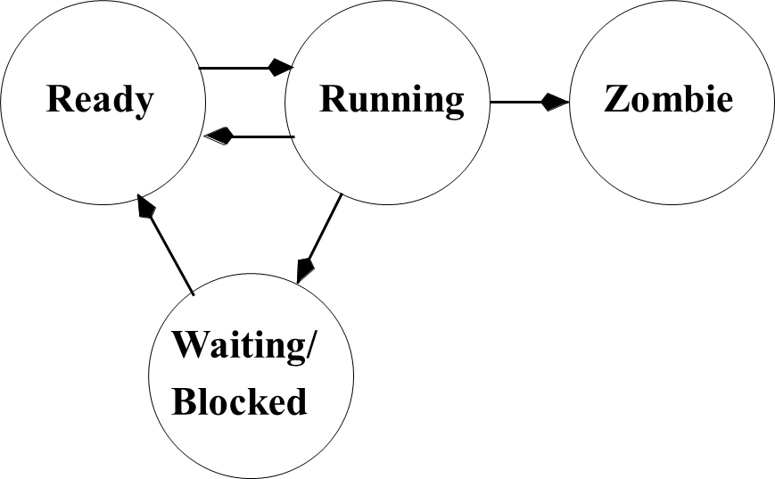
Process life cycle

Slide 20
Process life cycle
Running
  The process is executing
Waiting/Blocked
  A process in this state is waiting for an event to occur. Such an event could be an I/O completion by a peripheral device, the termination of another process, the availability of data or space in a buffer, the freeing of a system resource, and so on
  When a running process has to wait for such an event, it is blocked and waiting to be unblocked so it can continue to execute. A process blocking creates an opportunity for a context switch, shifting the CPU to another process. Later, when the event a blocked process is waiting for occurs, it awakens and becomes ready to run

Slide 21
Process life cycle
Ready
  A process in this state is then scheduled for CPU service
Zombie
  Process may terminate at a time when it is not being waited for
    Kernel does not allow such processes to die
    The unwaited for processes become zombies
      More on later slides

Slide 22
The Process Table
A system-wide process table is maintained in the Linux kernel to control all processes
There is one table entry for each existing process
Each process entry contains all key information needed to manage the process, such as PID (a unique integer process ID), UID (real and effective owner and group ID’s of user executing this process), process status, and generally information displayed by the ps command
Linux provides a directory under /proc/ for each existing process, making it easy to access information on individual processes from the Shell level

Slide 23
The ps Command
ps
  Displays process status
ps -af
  -a display all processes and f full-format listing
ps -e | grep string
  When you’re looking for a particular process, the pipe can be handy

Slide 24
Info. about each process
PID
  The process ID in integer form
PPID
  The parent process ID in integer form
S
  The single-letter state code from the ps man page
STIME or START
  The process start time
TIME
  CPU time (in seconds) used by the process
TT
  Control terminal of the process
COMMAND
  The user command which started this process

Slide 25
Process management
Child process
  A process can be duplicated, creating a child process
    The original process is called parent process
  The parent and child processes are virtually identical
    Code, data, stack are the same
    But PID, PPID are different

Slide 26
Process management
Child process
  In fact, the only way to create a new process in Linux is to duplicate an existing process
  A child process may then replace its code with that of another executable file (via exec)
  init
    The first process created when Linux starts (PID 1)
    The ancestor of all Linux processes, including login Shell
  Daemon
    A process without a control terminal such as the cron process

Slide 27
Process management
Example
  When a shell executes a utility in the foreground:
    The shell process duplicates into two shell processes
    The child shell process replaces its code with that of the utility
    The parent shell waits (sleeps) for the child process to terminate
    When the child terminates, the original parent process "awakens" and displays the next shell prompt

Slide 28
Process management
System calls
Name | Function
fork | duplicates a process
getpid | obtains a process' ID number
getppid | obtains a parent process' ID number
exit | terminates a process
wait | waits for a child process
exec | replaces the code, data, and stack of a process

Slide 29
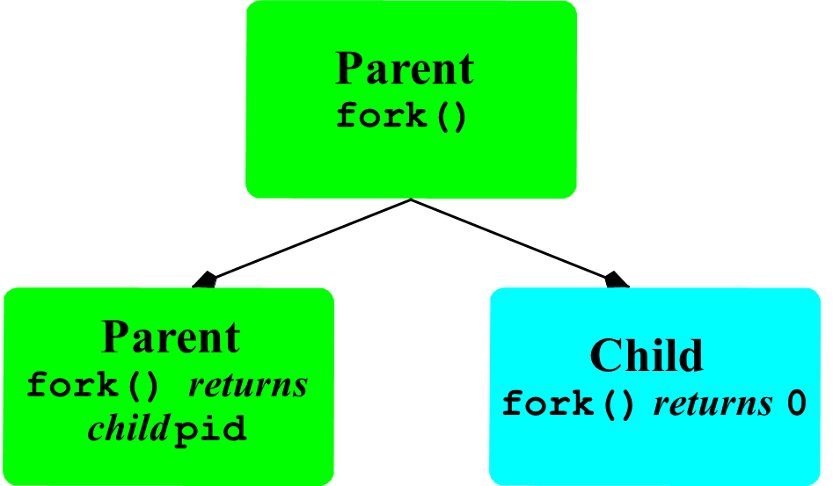
Process Creation
fork() is called by parent, but returns in both parent and the child
  In the parent, it returns the PID of the child process, whereas in the child, it return 0
  If fork fails, no child process is created, and it returns -1

Slide 30
Process management
fork()
  Duplicates the current process, creating a child process
  The child process gets the identical copy of code, data, stack from the parent process
  But the child process gets different PID, PPID numbers
  Both parent and child processes resume from the point where fork() is called

Slide 31
Process management
fork()
  If fork() succeeds, it returns:
    PID of the child (positive value) to the parent process
    0 to the child process
  If fork() fails, it returns:
    -1 to the parent process
    no child is created

Slide 32
Process management
getpid()
  Returns the PID number
getppid()
  Returns the PPID (Parent's PID) number

Slide 33
Process management
Example
Parent process PID 34 (shell)
Duplicate: fork()
Parent process PID 34 (shell)
Child process PID 35 (shell)
Differentiate: exec ()
Wait for child: wait()
Child process PID 35 (utility)
Terminate: exit ()
Parent process PID 34 (shell)
awakens
Child process PID 35 (utility)
terminates
Signal

Slide 34
Process management
myfork.c
  #include <stdio.h>
  #include <unistd.h>
  main() {
    int pid;
    printf("I'm the original process with PID %d and PPID %d.\n", getpid(), getppid());
    pid = fork(); /* duplicate. Child and parent continue from here */

Slide 35
Process management
myfork.c
    if (pid != 0) { /* nonzero pid, so I'm the parent */
      printf("I'm the parent process with PID %d and PPID %d.\n", getpid(), getppid());
      printf("My child's PID is %d\n", pid);
    }
    else { /* pid is zero, so I must be the child */
      printf("I'm the child process with PID %d and PPID %d.\n", getpid(), getppid());
    }
    printf("PID %d terminates.\n", getpid()); /* Both processes execute this */
  }

Slide 36
Process management
myfork.c
  $ myfork ...run the program
  I'm the original process with PID 13292 and PPID 13273.
  I'm the parent process with PID 13292 and PPID 13273.
  My child's PID is 13293.
  I'm the child process with PID 13293 and PPID 13292.
  PID 13293 terminates. ...child terminates
  PID 13292 terminates. ...parent terminates

Slide 37
Process management
Orphan process
  A child process whose parent dies first
  In this case, the child is automatically adopted by the "init" process, PID 1
  Note that in myfork.c, the parent may terminate earlier than its child (because the parent doesn't "wait()"), in which case the child becomes an orphan process
  Must kill child explicitly, or else will keep running indefinitely

Slide 38
Process management
orphan.c
  #include <stdio.h>
  #include <unistd.h>
  main() {
    int pid;
    printf("I'm the original process with PID %d and PPID %d.\n", getpid(), getppid());
    pid = fork(); /* duplicate. Child and parent continue from here */

Slide 39
Process management
orphan.c
    if (pid != 0) { /* nonzero pid, so I'm the parent */
      printf("I'm the parent process with PID %d and PPID %d.\n", getpid(), getppid());
      printf("My child's PID is %d\n", pid);
    }

Slide 40
Process management
orphan.c
    else { /* pid is zero, so I must be the child */
      sleep(5); /*** make parent terminate first ***/
      printf("I'm the child process with PID %d and PPID %d.\n", getpid(), getppid());
    }
    printf("PID %d terminates.\n", getpid()); /* Both processes execute this */
  }

Slide 41
Process management
orphan.c
  $ orphan ...run the program
  I'm the original process with PID 13364 and PPID 13346.
  I'm the parent process with PID 13364 and PPID 13346.
  My child's PID is 13365.
  PID 13364 terminates. ...parent terminates
  I'm the child process with PID 13365 and PPID 1. ...orphaned!!!
  PID 13365 terminates. ...child terminates

Slide 42
Process Termination
The program runs to completion and the function main returns
exit()
  A process may terminate at any time by executing exit() or the system call _exit
  When a child process terminates, it sends its parent a SIGCHLD signal and waits for its termination code status to be accepted
  The return code is stored in the shell variable $? (or $status in C shell)

Slide 43
Process management
exit()
  % cat myexit.c
  #include <stdio.h>
  #include <stdlib.h>
  main() {
    printf("I'm going to exit with return code 42\n");
    exit(42);
  }

Slide 44
Process management
exit()
  % myexit
  I'm going to exit with return code 42
  % echo $status
  42

Slide 45
Process management
Zombie process
  A child process cannot leave the system until its parent accepts its return code
  If the parent dies before the child, then "init" process will adopt the child and accept its return code

Slide 46
Process management
Zombie process
  However, if the parent is "alive" but never executes wait(), then the child process becomes a "zombie" after termination (because its return code will never be accepted)
  A zombie process does not have code, data, or stack, but it still occupies the process table, and therefore too many zombie processes may waste memory space!

Slide 47
Process management
zombie.c
  #include <stdio.h>
  #include <unistd.h>
  main() {
    int pid;
    pid = fork(); /* duplicate */
    if (pid != 0) {
      while (1) /* never terminates, never executes wait() */
        sleep(1000);
    }

Slide 48
Process management
zombie.c
    else { /* child */
    printf("Child terminates\n");
    exit(42); /* exit with a silly number */
    }
  }

Slide 49
Process management
zombie.c
  $ zombie & ...execute program in background
  [1] 13545
  $ ps
  PID TT STAT TIME COMMAND
  13535 p2 S 0:00 ksh ...shell
  13545 p2 S 0:00 zombie ...parent
  13546 p2 Z 0:00 <defunct> ...zombie child
  13547 p2 R 0:00 ps

Slide 50
Process management
zombie.c
  $ kill 13545 ...kill the parent
  [1] Terminated zombie
  $ ps ...zombie child is adopted by init, and gone
  PID TT STAT TIME COMMAND
  13535 p2 S 0:00 ksh ...shell
  13547 p2 R 0:00 ps

Slide 51
Synchronization with Child Processes
Parent reaps child by calling the wait function
#include <sys/types.h>
#include <sys/wait.h>
pid_t wait(int *t status);
  suspends current process until one of its children terminates

Slide 52
Synchronization
wait(int *status)
  A parent may execute wait() to wait for one of its children to terminate and then accept the child's termination code (which is placed in *status)
  wait() causes the parent process to suspend until one of its children terminates
  Successful wait() returns the PID of the child (Unsuccessful one returns -1)

Slide 53
Process management
mywait.c
  #include <stdio.h>
  #include <unistd.h>
  int main() {
    int pid, status, childPID;
    printf("I'm the parent process and my PID is %d\n", getpid());
    pid = fork(); /* duplicate */

Slide 54
Process management
mywait.c
    if (pid != 0) { /* parent */
      printf("I'm the parent process with PID %d and PPID %d\n", getpid(), getppid());
      childPID = wait(&status); /* wait for a child to terminate */
      printf("The parent has been signaled that the child %d just terminated\n", childPID);
    }

Slide 55
Process management
mywait.c
    else { /* child */
      printf("I'm the child process with PID %d and PPID %d\n", getpid(), getppid());
      printf("The child terminates\n");
      exit(42); /* exit with a silly number */
    }
    printf("Parent terminates\n"); /* child cannot execute this line */
  }

Slide 56
Waiting for a Specific Process
waitpid(pid, &status, options)
  suspends current process until specific process terminates
  various options (see man page)

Slide 57
Process management
exec()
  A process may replace its current code, data, and stack with those of another executable file by using one of the exec() family of system calls
    including execl, execv, execve, and several others, each a variation of the basic execv library function
  If the executable file is not found, exec() returns -1
  Successful exec() never returns (because the original code would be gone!!)

Slide 58
Process management
exec()
  int execl(const char *path, const char *arg0, const char *arg1, ..., const char *argn, NULL);
    path: full path name
    arg0: executable file name
    arg1, arg2, ..., argn: arguments
  int execlp(const char *path, const char *arg0, const char *arg1, ..., const char *argn, NULL);
    path: filename (its location is found by $PATH)

Slide 59
Process management
exec()
  int execv(const char *path, const char *arg[]);
    path: full path name
    arg[0]: executable file name
    arg[1], arg[2], ..., arg[n]: arguments
  int execvp(const char *path, const char *arg[]);
    path: filename (its location is found by $PATH)

Slide 60
Creating a new process
An exec call is often combined with fork to produce a new process which runs another program.
  Process A (the parent process) calls fork to produce a child process B
  Process B immediately makes an exec call to run a new program
An executable file is either a binary a.out or an executable text file containing commands for an interpreter. An executable text file begins with a line of the form
#!interpreter
For example, a Bash script may begin with the line
  #!/bin/bash
Notes:
man 5 elf
ELF: Executable and Linking Format

Slide 61
Executable Binary file format
Linux uses the standard ELF (Executable and Linking Format) which provides good support for the linking and dynamical loading of shared libraries
readelf -h a.out
displays the header section of the executable a.out

Slide 62
Process management
myexec.c
  #include <stdio.h>
  main() {
    printf("I'm process %d and I'm about to exec ls -l\n", getpid());
    execl("/bin/ls", "ls", "-l", NULL);
    printf("This line should not be executed\n");
  }

Slide 63
Process management
myexec.c
  $ myexec
  I'm process 13623 and I'm about to exec an ls -l
  total 125
  -rw-r--r-- 1 glass 277 Feb 15 00:47 myexec.c
  -rwxr-xr-x 1 glass 24576 Feb 15 00:48 myexec

Slide 64
vfork
Since fork copies the entire parent process, it is wasteful when used in conjunction with an exec call to create a new execution context
In a virtual memory system, the system call
int pid;
pid = vfork();
Should be used in conjunction with an exec call

Slide 65
The User Environment of a Process
Every time a process begins, another array of strings, representing the user environment, called the environment list, is also passed to the process
  int main(int argc,char* argv[],char* arge[])
arge receives additional values for the environment list which is always available for a process in the global array environ
  extern char **environ
It’s simpler to access environment values in a C program with the library routine getenv:
  #include <stdlib.h>
  char* getenv(const char* name)

Slide 66
Environment
/**** envtest.c ****/
#include <stdlib.h>
#include <stdio.h>
int main(int argc, char *argv[], char *arge[])
{
char *s;
s = getenv("PATH");
printf("PATH = %s\n", s);
return EXIT_SUCCESS;
}

Slide 67
Interrupts and Signals
Events outside a process can affect its execution. The moment when such an event would occur is not predictable. Thus, they are called asynchronous events
Examples of such events include I/O blocking, I/O ready, keyboard and mouse events, expiration of a time slice, as well as interrupts issued interactively by the user
Asynchronous events are treated in Linux using the signal mechanism. Linux sends a certain signal to a process to signify the occurrence of a particular event. After receiving a signal, a process will react to it in a well-defined manner

Slide 68
Interrupts and Signals
This action is referred to as the signal disposition. For example, the process may be terminated or suspended for later resumption
There is a system-defined default disposition associated with each signal. A process normally reacts to a signal by following the default action. However, a program also has the ability to redefine its disposition to any signal by specifying its own handling routine for the signal

Slide 69
Signals
A signal is an asynchronous notification of an event
  Asynchronous: could occur at any time
  Interrupts receiving process; jumps to signal handler in that process
  A (limited) menu of event types to pick from
What events could be asynchronous?
  Email message arrives on my machine
    Mailing agent (user) process should retrieve it
  Invalid memory access
    OS should inform scheduler to remove process from the processor
  Alarm clock goes off
    Process which sets the alarm should catch it

Slide 70
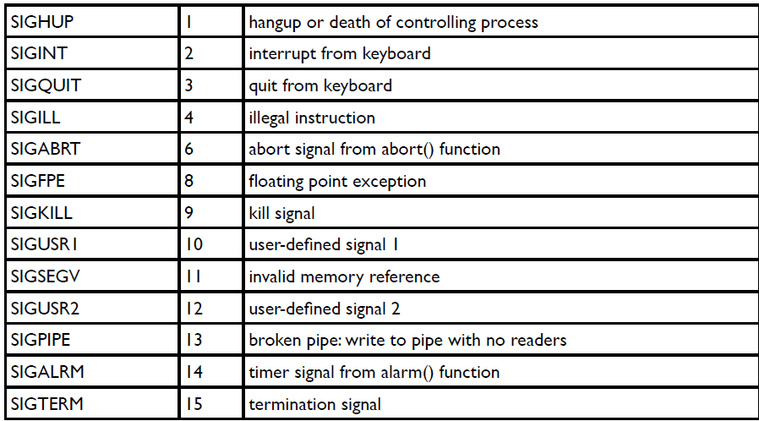
Some Linux Signals

Slide 71
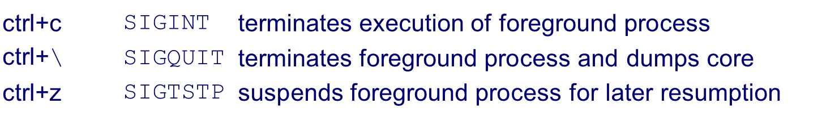
Keyboard Signals
Send signals to processes connected to your terminal window by typing certain control characters such as ctrl+\, ctrl+c, and ctrl+z
You can use Shell-level command Kill to send a specific signal to a given process
Kill [-sig_no] process

Slide 72
Signals
A program can signal itself
  Similar to raising an exception
int raise(int sig_no)
(sends sig_no to the process itself)
int kill(pid_t pid, int sig_no)
(sends sig_no to process pid)
Or can signal after a delay
unsigned alarm(unsigned seconds);
alarm(20)
  Send SIGALRM to calling process after 20 seconds
alarm(0)
  Cancels current alarm

Slide 73
Example
What does this do?
    int main() {
    alarm(10);
    while(1);
    }
Example of program signaling itself
“Infinite” loop for 10 seconds
Then interrupted by alarm
  Doesn’t matter that while loop is still looping
  No signal handler set by program; default action: terminate

Slide 74
Signal Delivery and Processing
Block further occurrences of the same signal during the delivery and handling of this occurrence
Temporarily suspend the execution of the process and call the handler function associated with this signal
If the handler function returns, then unblock the signal and resume normal execution of the process from the point of interrupt

Slide 75
Signal Trapping
The system call sigaction is used to trap or catch signals
  Changes the action taken by a process when it receives a specific signal
#include <signal.h>
int sigaction( int signum,
const struct sigaction *newact,
struct sigaction *oldact);
  signum is any valid signal except SIGKILL and SIGSTOP
  If newact is non-null, new action is installed from newact
  If oldact is non-null, previous action is saved in oldact

Slide 76
Pipes
Pipes
  Interprocess communication (IPC) mechanism
    allows two or more processes to send information to each other
  Typically used within shells
    to connect STDOUT of one utility to STDIN of another

Slide 77
Pipes
Example
  $ who | wc -l
who
wc
pipe
Bytes from who flow through the pipe to wc

Slide 78
Pipes
Example
  Both writer (who) process and reader (wc) process run concurrently (not sequentially)
  Pipe automatically buffers the output of the writer and suspends the writer if the pipe gets full
  If the pipe is empty, the reader is suspended until some more output becomes available

Slide 79
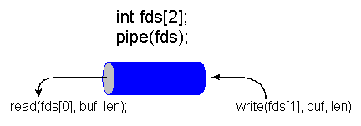
Pipes
Unnamed pipes
  Supported by all versions of Unix
  May be created by system call pipe()
  Has two ends: for reading and writing
  Typically used for communication between a parent process and its child
    where one process writing and the other process reading

Slide 80
Pipes
Typical sequence of events
  The parent process creates an unnamed pipe, using pipe()
    int fd[2]; /* file descriptors */
    pipe(fd);
    pipe() returns two file descriptors
      fd[0]
        points to the "read" end of the pipe
      fd[1]
        points to the "write" end of the pipe

Slide 81
Pipes
Typical sequence of events
  The parent process forks
  The writer closes its (unused) read pipe descriptor, and the reader closes its (unused) write pipe descriptor
  Processes communicate by using write() and read() calls
  Each process closes its active pipe descriptor when it's finished with it

Slide 82
Pipes
talk.c
  /* Parent gets a message from child */
  #include <stdio.h>
  #define READ 0
  #define WRITE 1
  char *phrase = "This is a message from child";
  main() {
    int fd[2], bytesRead;
    char message[100]; /* Parent's message buffer */
    pipe(fd); /* create an unnamed pipe */

Slide 83
Pipes
talk.c
    if (fork() == 0) { /* child, writer */
      close(fd[READ]); /* close unused end, indicating I'm not reading, I'm only writing */
      write(fd[WRITE], phrase, strlen(phrase)+1);
      /* include NULL character at the end */
      close(fd[WRITE]); /* close used end, indicating I'm done with writing */
    }

Slide 84
Pipes
talk.c
    else { /* parent, reader */
      close(fd[WRITE]); /* close unused end, indicating I'm only reading, not writing */
      bytesRead = read(fd[READ], message, 100);
      printf("Read %d bytes: %s\n", bytesRead, message);
      close(fd[READ]); /* close used end, indicating I'm done with reading */
    }
  }

Slide 85
Pipes
talk.c
  $ talk ...run the program
  Read 29 bytes: This is a message from child

Slide 86
Pipes
connect.c
  /* Shows how shell handles piping of two processes */
  #include <stdio.h>
  #define READ 0
  #define WRITE 1
  main(int argc, char* argv[]) {
    int fd[2];
    pipe(fd); /* Create an unnamed pipe */
    if (fork() != 0) { /* parent, writer */
    close(fd[READ]); / * close unused end */
    dup2(fd[WRITE], 1); /* copy write end to stdout */

Slide 87
Pipes
connect.c
    close(fd[WRITE]); /* close original used end */
    execlp(argv[1], argv[1], NULL); /* Execute writer program */
    perror("connect"); /* should never execute */
    }
    else { /* child, reader */
    close(fd[WRITE]); /* close unused end */
    dup2(fd[READ], 0); /* copy used end to stdin */
    close(fd[READ]); /* close original used end */
    execlp(argv[2], argv[2], NULL); /* execute reader program */
    perror("connect"); /* should never execute */
    }
  }

Slide 88
Pipes
connect.c
  $ connect who wc ...equivalent to who | wc
  34 204 2413

Slide 89
Summary
Processes
  At any given time, system has multiple active processes
  But only one can execute at a time on a single core
  Each process appears to have total control of
  processor + private memory space
Spawning processes
  Call fork
  One call, two returns
Process completion
  Call exit
  One call, no return

Slide 90
Summary
Reaping and waiting for processes
  Call wait or waitpid
Loading and running programs
  Call exec One call
  no return

