Slide 1
Knapsack problem
Grayson Hart – Developer
Thomas Mintun – Customer/User
February 20, 2018

Slide 2
The problem
The project description was intentionally left bare by professor Chakraborty. This was the first time we have encountered a project given to us in college and the description of the problem was non descript.
We came up with the storyline of someone trying to save their personal belongings in case of a wild fire. The items are not mine, and everything is fictional in our report. Coming up with the storyline took some effort because we do not write fiction often, and making all the pieces of the story and requirements together took some creativity.
We used the Requirements Analysis outline in the book as a guide.

Slide 3
The Story
From our Analysis Requirements: “The features of the product will be: real time software (the software does not take an extended amount of time from input of data to output of data), updatable list with developer help, ability to view list on web, variable weight of firefighter’s knapsack, and a maintenance contract for 6 months with possible updates at further cost. User classes will be: Thomas and firefighter.“
We made numerous assumptions to clarify what parties know what: “Implementation constraints will include: software must be functional in 3 days, Grayson Hart the developer must maintain a maintenance role for 6 months after the project. Assumptions that are being made: the Clear Lake fire department will adopt and use this because Thomas knows the fire chief, there will be no malicious actors for the first release, pre existing knowledge for both actors that the items saved by the firefighters will be available to Thomas the next day at the fire station, only Thomas and the firefighters have a link to the website and thus the only users will be Thomas and the firefighters for the first version, either the full item is grabbed or the item is not grabbed at all (no partial items for version one), the weights of the items are in pounds and integer values, the value scale of the items is integer values between one and ten inclusive, Grayson and Thomas have worked out what will be on his list of stuff to grab and Thomas knows this list cannot be changed without contacting Grayson and will take up to 48 hours to change.

Slide 4
Assumptions
The items highlighted in green make for a horrid user interface with no instructions to the end user. Luckily for the developer it was an assumption made that Thomas and the firefighter classes will have pre-existing knowledge and know how to use the web site. This is not ideal for scaling, but one of the contraints was to have the software operational in 3 days.
All of the assumptions we made will not work for product expansion. To expand our customers we would need to have a clear user interface with instructions and the information in the assumptions made clear to every user.

Slide 5

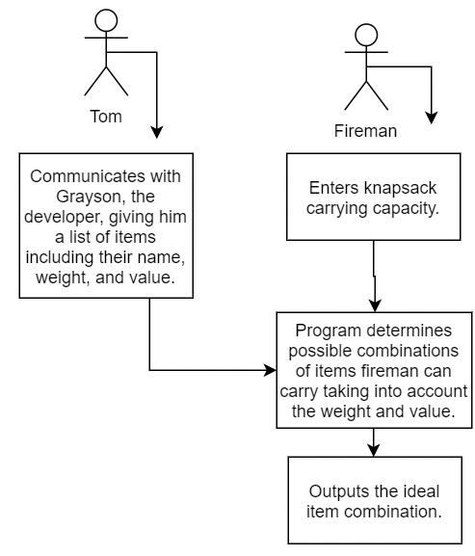

Program Design document

Slide 6
Success or failure?
Our software passed testing! It is successful according to the use cases of Thomas class, firefighter class, and our Requirements Analysis document.
Thomas use case: Success Scenario: The information is entered into software correctly. Grayson uploads software to server. Failure Scenario: The information is not entered in incorrectly. Grayson does not upload program to server.
Firefighter use case: Success Scenario: Software takes in the weight of the firefighter’s knapsack and returns the highest value items with the highest total value that fit in the knapsack on the list. Failure Scenario: Software does not give the most optimal items to grab that will fit in the knapsack.

Slide 7
Problems and solutions
We could not guarantee that the firefighters would actually save the items! We could only guarantee that the software will be successful according to the use cases.
Keeping the software as simple as possible helped. Complexities and “what if’s” arose with every assumption made, and we were constantly updating the list of assumptions.
Problem: The cat does not get saved unless knapsack 15 pounds or greater. The cat is the highest valued item on the list, but its value does not exceed the sum value of 2-3 smaller items when knapsack is under 15 pounds. The developer should have made it clear that the cat might not get saved unless the cat’s value is higher relative to the other items.

Slide 8
Program demonstration
Program Demonstation!

