Slide 1


Imagein
Jamie Wyatt; Yun Lu; Cole Alves; Tom Mintun
University of Missouri, St. Louis - CS4610 – Khaldoon Dhou

Slide 2
Demo
Everyone pull out your phones! Free to make an account… for now!
Error messages for login
Create new user
Show features of profile page
Show categories page for a category (technology category page to show phpMyAdmin tables)
$query = “Select * FROM ‘category’ JOIN ‘upload_pictures’ ON ‘category’.’Pic_Id’ = ‘upload_pictures’.’Pic_Id’ WHERE ‘category’.’Category’=‘$category’”;
Show features of search (can search for users and categories) (shows pic ids which match username, and the like count and date for each image. 2 SQL queries, 1 for categories 1 for username)
Upload image → any image type! Converts automatically to jpg → add categories (can upload gifs…. We don’t know how or why, but we like it!)

Slide 3
DEMO Continued
Demo picture page (page resulting from clicking on image. Lets you like and comment on picture)
Different for an image the user uploads vs image a different user uploaded. Owner user has rights to DELETE image, add categories to image, and Owner user can NOT like their own image. Can like and comment on other users images
Demo leaving a comment on picture, liking a picture of different user.
Demo Delete Image page: click on picture from profile page, go to to picture page, click delete (We do NOT keep your data… this is one of the many many multitudes of reasons we are better than Facebook!
Show features of User page (categories section, upload section) (search ‘Jamie’, click on one of his pics, click on his user name
To show user page… 1 query looping through picture table returning all pictures with username = Owner user (uploader), and displaying picture and information.

Slide 4
phpmyadmin
http://imagein1.com/root/Pictures/75.jpg
14 total tables
Most tables connected by Pic_ID. Username is also a primary key in more than one table.
Headache to get PhpMyAdmin set-up on server!

Slide 5
Login page
http://imagein1.com/root/Pictures/76.jpg
Connects to database
Checks if username and password combo exist
If exits then successful login, taking the user to Profile.php page
If username and password combination do not exist then unsuccessful login
Error dialogue for no username or password

Slide 6
Normalization and keys
Pic_id; Comment_id; and User_name are unique for pictures, comments, and users, and thus are primary keys. We used these three keys to retrieve the correct information from our database.
We are 3NF in every table

Slide 7
For future versions
Add JS so when our database gets updated it doesn’t take the user to a different URL. This will make it so when the user clicks buttons it will update without changing pages.
MORE SECURITY: more login security, verify email addresses, ability to upload different types of images and eventually different types of media including gifs and videos.
Error messages for search results not returning matches; longer character limit for comments with tagging features similar to FB/Instagram; ability to add picture without category; ability for user to create new categories;

Slide 8
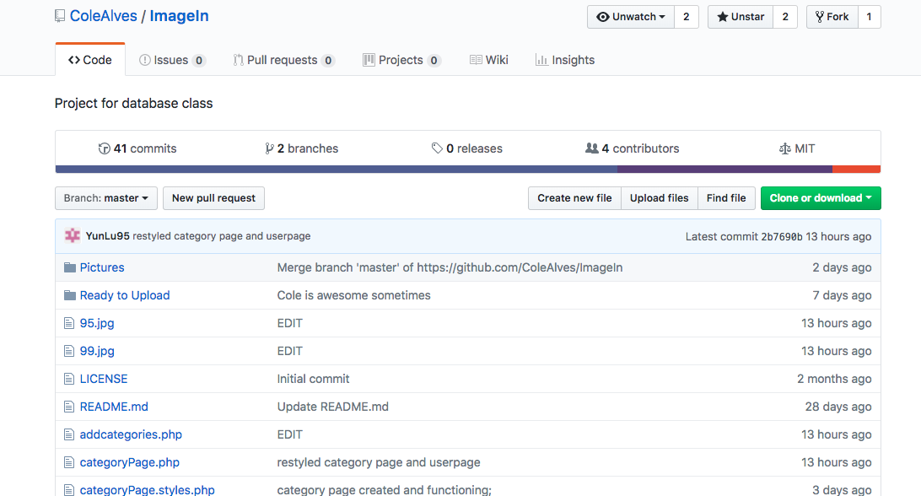
Working together AND SOURCES
We used Github for version control
Met at Math Lab once a week minimum and worked together
Google Docs
PHPMyAdmin for database control
FileZilla to transfer Github docs via FTP to server
GoDaddy server used to host

