Slide 1
AnyPackage
A PackageManagment (OneGet) replacement

Slide 2
Who am I?
Principal Technology Architect at Oracle
Been using PowerShell for 13 years

Slide 3
Package Management Landscape
Each platform have its own package manager
Some platforms have multiple package managers
New package managers being created
No consistent user interface

Slide 4
What is PackageManagement (OneGet)?
Module created by PowerShell team
Unified package management interface
Extensible
Used by PowerShellGet v2
Deprecated

Slide 5
Design goals
Address all known OneGet issues
Easily add new cmdlets
Intuitive user experience
Simple extension authoring experience
PowerShell and C# extensions
Notes:
Just like with PowerShellGet v3 addressing major user complaints. AnyPackage is doing that for OneGet. I went through every OneGet issue and ensured AnyPackage didn’t have that issue.
OneGet heavy-handed approach when it came to dependencies. Main example being NuGet provider circular dependency error.
OneGet Update-Package was never added and oldest issue.
Provider added parameters were added for multiple cmdlets and didn’t make sense like Install-Package having an AllVersions parameter.
Issue where OneGet silently fails when calling an unsupported cmdlet. Main example Programs provider piping to Uninstall-Package.
PowerShell issues to increase visibility for dynamic parameters #19454 and #19301

Slide 6
AnyPackage
Spiritual successor to OneGet
Not a fork of OneGet
Does not support OneGet providers
Notes:
If you’ve had issues with OneGet, give AnyPackage a shot. No shared code with OneGet and the only thing left the same is cmdlet names and some parameters.

Slide 7
Features
Technology
PowerShell
Cross-platform
Windows
Linux
MacOS
Written in C#
Extensible
C#
PowerShell
PowerShell 5.1+
Updateable help
Argument completers
Feedback and command predictor
DSC resources

Slide 8
Package Providers
Bridge AnyPackage to package manager
PowerShell modules
Import module to load package provider

Slide 9
Current Package Providers
Provider | Module
.NET Tool | AnyPackage.DotNet.Tool
Apt | AnyPackage.Apt
Chocolatey | AnyPackage.Chocolatey
Homebrew | AnyPackage.Homebrew
ModuleFast | AnyPackage.ModuleFast
Msu | AnyPackage.Msu
Pkgx | AnyPackage.Pkgx
PSResourceGet | AnyPackage.PSResourceGet
Programs | AnyPackage.Programs
Scoop | AnyPackage.Scoop
WinGet | AnyPackage.WinGet
Notes:
Shout out Ethan Bergstrom for Chocolatey, Homebrew, and WinGet providers also mention he is maintainer on OneGet providers

Slide 10
Potential Providers
OneGet providers: MSI, NuGet, Gist, etc.
Linux: DNF, Pacman, etc.
Applications/Languages: Docker, Python, NPM, etc.
Notes:
NuGet may wait until PowerShellGet adds that functionality.
Linux package managers could be added easily with nxTools module.

Slide 11
Demo

Slide 12
Creating Package Providers

Slide 13
Package Providers
Class based
Inherit a single class
Implement single interface per operation
Operations are cmdlets (Get-Package)
Mix and match operations
Dynamic parameters
Notes:
Issue where OneGet silently fails when calling an unsupported cmdlet. Main example Programs provider piping to Uninstall-Package.
PowerShell issues to increase visibility for dynamic parameters #19454 and #19301

Slide 14
Designing
Existing package manager
New package manager

Slide 15
Operations (Cmdlets)
Cmdlet | Interface
Find-Package | IFindPackage
Get-Package | IGetPackage
Install-Package | IInstallPackage
Publish-Package | IPublishPackage
Save-Package | ISavePackage
Uninstall-Package | IUninstallPackage
Update-Package | IUpdatePackage
Get-PackageSource | IGetSource
Register-PackageSource | ISetSource
Set-PackageSource | ISetSource
Unregister-PackageSource | ISetSource
Notes:
ISetSource is only interface with multiple methods/cmdlets to implement.

Slide 16
Potential Operations (Cmdlets)
Cmdlet | Description
New-Package | Create new package
Build-Package | Build/compile package
Restore-Package | Restore from dependencies file
Optimize-Package | Remove outdated
Unpublish-Package | Removes package from source
Lock-Package | Pin package to specific version
Unlock-Package | Unpin package from specific version
Hide-Package | Unlists package from source
Show-Package | Lists package from source
Enable-PackageSource | Enable package source
Disable-PackageSource | Disable package source
Notes:
These operations (cmdlets) can be added very easily, and existing providers can opt-in to these new features.
Call-out restore, optimize and pinning.

Slide 17
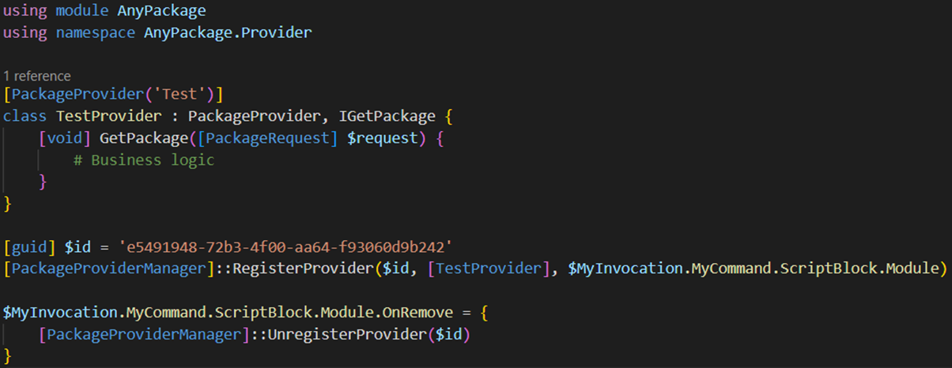
How to create a package provider
Notes:
8 lines of boilerplate code to create a provider.
Business logic does not have to be in the class if you like to use functions. Just put the function name with request as a parameter.

Slide 18
Demo

Slide 19
Creating Extensible Systems

Slide 20
Shipping extensions
PowerShell Modules
Standalone
Nested
Online registry
Find-PackageProvider
Discoverability
Find-PSResource –Tags ‘SecretManagement’
Get-PackageProvider –ListAvailable

Slide 21
Registering / Loading Extensions
Runtime
Registration
Import-Module
User initiated
Each PowerShell instance
Assembly inspection
Persistent
Automatic
Register-SecretVault

Slide 22
Programming Languages
Implementation
Language Features
Consistent
Language specific
Cmdlets/Functions
Classes
Interfaces

Slide 23
Framework vs Extension Logic
Framework
Extension
User interface
Parameter validation
Helpers
Limited to completing task
Returning data to framework

Slide 24
Multi-threading (Runspaces)
Stateless
Stateful
Static Runspace

Slide 25
Extensible Parameters
Dynamic Parameters
Hashtable Parameter
Parameters visibility
Easy validation
Install-Package –Provider Scoop –Architecture arm64
Hard to discover valid keys
Hard validation
–AdditionalParameters @{ Value1 = 1; Value2 = 2 }
Notes:
Discoverability
Validation
Intuitive

Slide 26
Challenges
High initial investment
Increased complexity
Difficulty in modifying extension interface

Slide 27
Advantages
Quickly add new capabilities through extensions
Removes boilerplate code
Framework improvements benefit all extensions

Slide 28
PowerShell is Extensible
Cmdlets / Functions
Parameters
Formatting
Extensible Type System (ETS)
PSProviders
PSSubSystem

Slide 29
Questions?

Slide 30
Additional Resources
Documentation
https://anypackage.dev
GitHub
https://github.com/AnyPackage/AnyPackage
Provider requests
https://github.com/AnyPackage/AnyPackage/discussions/categories/provider-requests
Jeffery Snover Interview
https://corecursive.com/building-powershell-with-jeffrey-snover

Slide 31
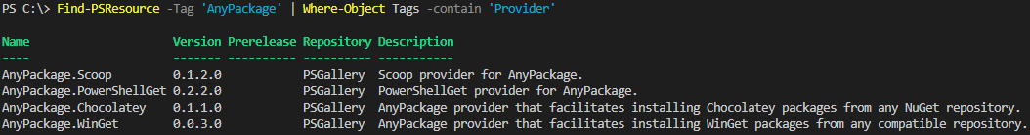
Finding Package Providers

Slide 32
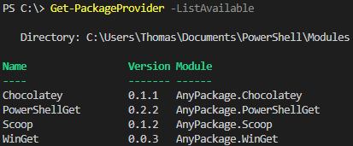
Getting Available Package Providers

Slide 33
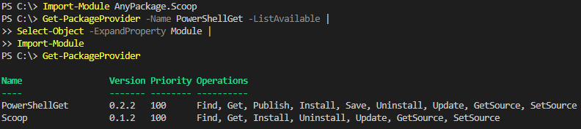
Importing Package Providers

Slide 34
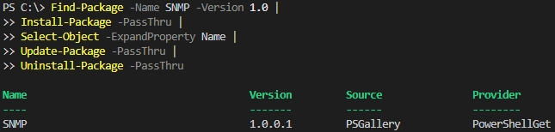
Package Lifecycle

Slide 35
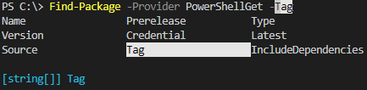
Dynamic Parameters
Provider parameter must be passed in order for dynamic parameters to appear
Currently have issues opened to increase discovery of dynamic parameters and their help

