Slide 1
AnyPackage
A PackageManagment (OneGet) replacement

Slide 2
What is PackageManagement (OneGet)?
Module created by PowerShell team
Unified package management interface
Used by PowerShellGet v2
Deprecated

Slide 3
AnyPackage
Not a fork of OneGet
Does not support OneGet providers
PowerShell 5.1+
Cross-platform
Written in C#
Updateable help
Argument completers
DSC resources
Notes:
If you’ve had issues with OneGet, give AnyPackage a shot. No shared code with OneGet and the only thing left the same is cmdlet names and some parameters.

Slide 4
Design goals
Learn from other extensible systems
OneGet
PSProviders
PSSubSystem
SHiPS
SecretsManagment
DSC
Lightweight framework
Easily add new cmdlets
Intuitive user experience
Simple extension authoring experience
PowerShell and C# extensions
Notes:
Just like with PowerShellGet v3 addressing major user complaints. AnyPackage is doing that for OneGet. I went through every OneGet issue and ensured AnyPackage didn’t have that issue.
OneGet heavy-handed approach when it came to dependencies. Main example being NuGet provider circular dependency error.
OneGet Update-Package was never added and oldest issue.
Provider added parameters were added for multiple cmdlets and didn’t make sense like Install-Package having an AllVersions parameter.

Slide 5
Package Providers
Shipped as modules
Class based
Inherit a single class
Implement single interface per operation
Operations are cmdlets (Get-Package)
Mix and match operations
Dynamic parameters
Notes:
Issue where OneGet silently fails when calling an unsupported cmdlet. Main example Programs provider piping to Uninstall-Package.
PowerShell issues to increase visibility for dynamic parameters #19454 and #19301

Slide 6
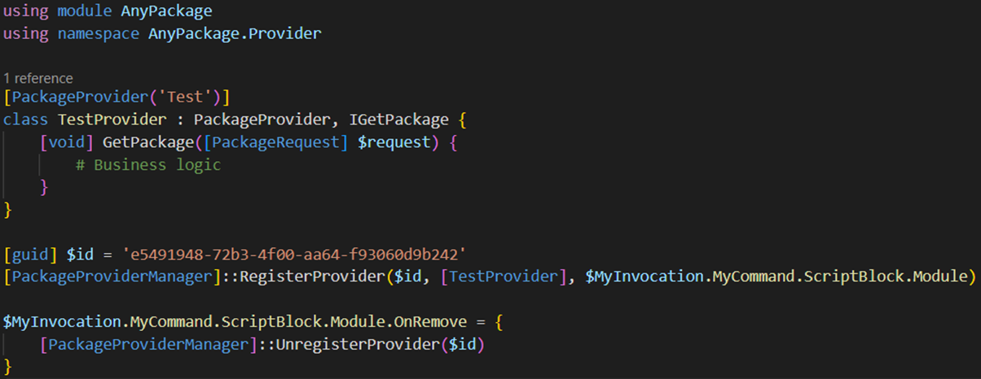
How to create a package provider
Notes:
8 lines of boilerplate code to create a provider.
Business logic does not have to be in the class if you like to use functions. Just put the function name with request as a parameter.

Slide 7
Operations (Cmdlets)
Cmdlet | Interface
Find-Package | IFindPackage
Get-Package | IGetPackage
Install-Package | IInstallPackage
Publish-Package | IPublishPackage
Save-Package | ISavePackage
Uninstall-Package | IUninstallPackage
Update-Package | IUpdatePackage
Get-PackageSource | IGetSource
Register-PackageSource | ISetSource
Set-PackageSource | ISetSource
Unregister-PackageSource | ISetSource
Notes:
ISetSource is only interface with multiple methods/cmdlets to implement.

Slide 8
Potential Operations (Cmdlets)
Cmdlet | Description
New-Package | Create new package
Build-Package | Build/compile package
Restore-Package | Restore from dependencies file
Optimize-Package | Remove outdated
Unpublish-Package | Removes package from source
Lock-Package | Pin package to specific version
Unlock-Package | Unpin package from specific version
Hide-Package | Unlists package from source
Show-Package | Lists package from source
Enable-PackageSource | Enable package source
Disable-PackageSource | Disable package source
Notes:
These operations (cmdlets) can be added very easily, and existing providers can opt-in to these new features.
Call-out restore, optimize and pinning.

Slide 9
Current Providers
Provider | Module
Chocolatey | AnyPackage.Chocolatey
Msu | AnyPackage.Msu
PowerShellGet | AnyPackage.PowerShellGet
Programs | AnyPackage.Programs
Scoop | AnyPackage.Scoop
WinGet | AnyPackage.WinGet
Notes:
Shout out Ethan Bergstrom for Chocolatey and WinGet providers also mention he is maintainer on ChocolateyGet, WinGet, and Homebrew OneGet providers

Slide 10
Potential Providers
OneGet providers: MSI, NuGet
Mac/Linux: Homebrew, Apt, DNF, Pacman, etc.
Applications/Languages: Docker, Python, NPM, etc.
Notes:
NuGet may wait until PowerShellGet adds that functionality.
Linux package managers could be added easily with nxTools module.

Slide 11
Demo

Slide 12
Questions?

Slide 13
Additional Resources
Documentation
https://anypackage.dev
GitHub
https://github.com/AnyPackage/AnyPackage
Provider requests
https://github.com/AnyPackage/AnyPackage/discussions/categories/provider-requests

Slide 14
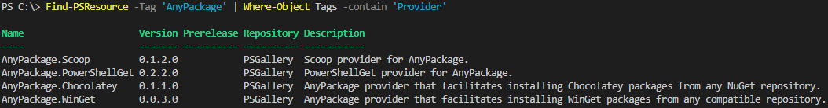
Finding Package Providers

Slide 15
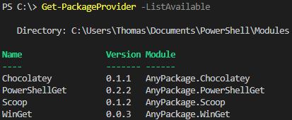
Getting Available Package Providers

Slide 16
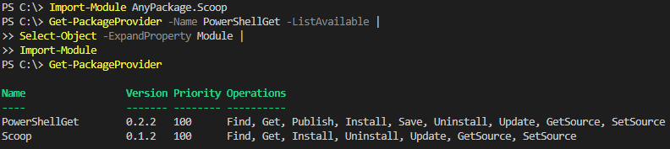
Importing Package Providers

Slide 17
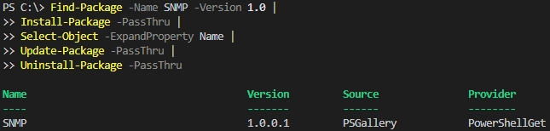
Package Lifecycle

Slide 18
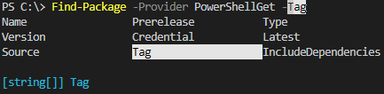
Dynamic Parameters
Provider parameter must be passed in order for dynamic parameters to appear
Currently have issues opened to increase discovery of dynamic parameters and their help

