Slide 1
Auto Scaling
Date: 27.06.2019

Slide 2
Agenda
Intro
Available Solutions
Alert Based Scaling
Auto Scaler Sokar
Roadmap

Slide 3
Intro
Goal
Automatically adjust the number of instances to fulfill a defined SLA in a cost efficient way.
Dynamically scale in/out based on current load.
Preconditions
Scalable Architecture + Implementation
Scalable resources (Platform)
Information about current System State
What to be scaled
Storage/ Transport (DB‘s, Message Queues)
Networking Infrastructure (Loadbalancer, Router, Gateways, ..)
Compute (EC2 Instances)
Mircoservices/ Components (Nomad Jobs)

Slide 4
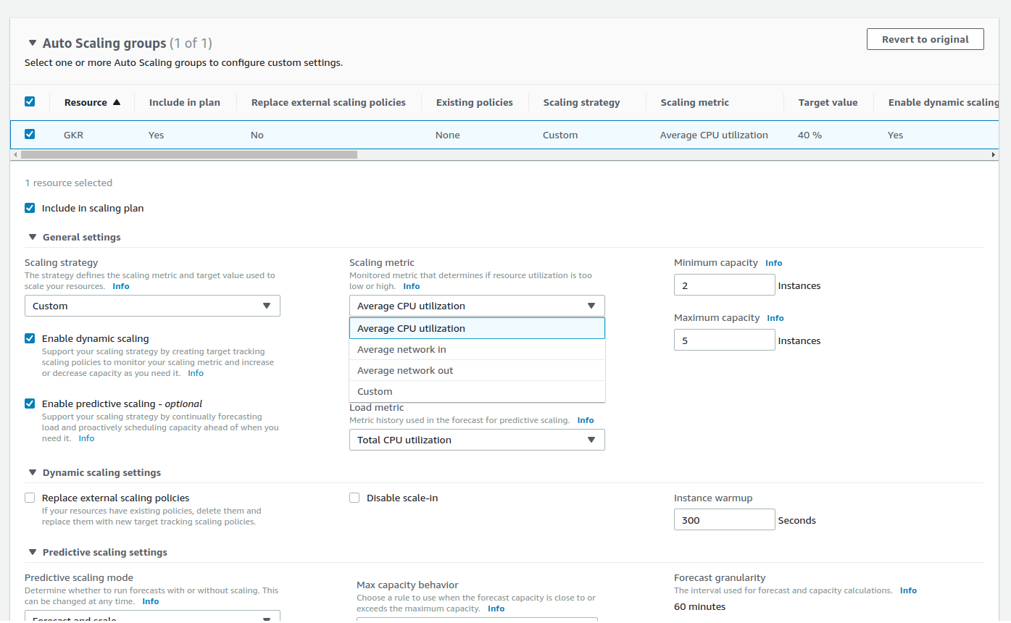
Available Solutions
AWS Dynamic Scaling (EC2 Instances/ Nomad Cluster)
https://docs.aws.amazon.com/autoscaling/ec2/userguide/as-scale-based-on-demand.html
AWS Autoscaling Policies
Predefined (availability, cost, performance) or custom Strategies
CPU, MEM and Custom metrics
Dynamic and Predictive Scaling

Slide 5
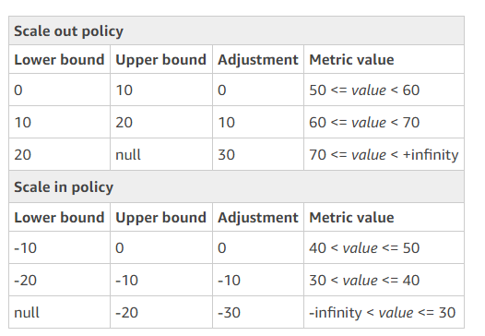
Available Solutions
AWS Autoscaling Policies
Custom metrics
Target Tracking Scaling Policiy
Scales to ensure that a defined target value for a metric is kept
Alarm is fired if the metric violates the defined target value
Calculates the needed instances based on difference between target and current metric value
Simple and Step Scaling Policy
Metric + Threshold
Alarm when thresholds are violated
Non-Linear, stepwise scaling adjustment

Slide 6
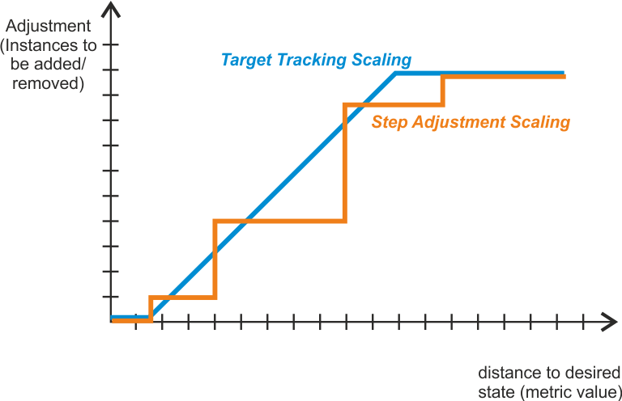
Available Solutions
AWS Autoscaling Policies
Custom metrics
Target Tracking Scaling Policiy
Scales to ensure that a defined target value for a metric is kept
Alarm is fired if the metric violates the defined target value
Calculates the needed instances based on difference between target and current metric value
Simple and Step Scaling Policy
Metric + Threshold
Alarm when thresholds are violated
Non-Linear, stepwise scaling adjustment

Slide 7
Available Solutions
Horizontal Pod Autoscaler (Kubernetes: job/pod)
https://kubernetes.io/docs/tasks/run-application/horizontal-pod-autoscale/
Target Tracking Scaling
Based on CPU or a custom metric
desiredReplicas = ceil[currentReplicas * ( currentMetricValue / desiredMetricValue )]
regards pod state (initial-readiness-delay, cpu-initialization-period)
conservative downscaling (downscale-stabilization-window = 5m)

Slide 8
Available Solutions
Replicator (Nomad: cluster and job)
https://github.com/elsevier-core-engineering/replicator
Cluster:
Calculates the needed nodes in „worker pool“ to handle the currently running jobs
Considers available (capacity) and used resources (CPU, MEM and disk)
Reserves space for jobs running by guessing they would scale by 1
Supports draining and selection of least used node (while scaling down)
Job:
Step Scaling
Based on CPU and MEM
Separate thresholds for CPU/MEM scale out/ in
Scale Up/ Down by 1 if threshold is violated
Max/ Min job count can be specified
Fixed cooldown between scale actions (replicator_cooldown = 60)

Slide 9
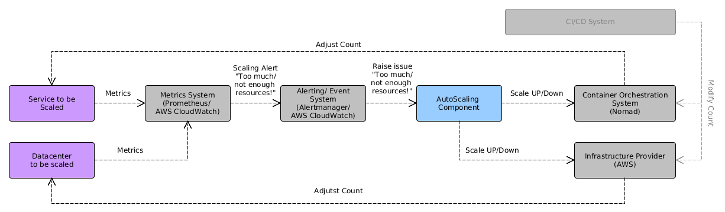
Alert based scaling
Use Metrics for scaling (information about system state)
Use Alerts to define the situation where scaling is needed
Sequence
Service to be scaled exposes its state through metrics
Metrics are evaluated against scaling alert rules
Multiple scaling alerts per service
Can be defined based on different metrics
Separate alerts for scaling up and scaling down
On rule match, a scale alert is created and routed to the auto scaling component
Auto scaling component aggregates the available alerts and decides what to do
If a scale up/ down was decided, the container orchestration system (nomad, K8, …) or the Compute Instance Scaler (i.e. AWS ASG) is triggered accordingly

Slide 10
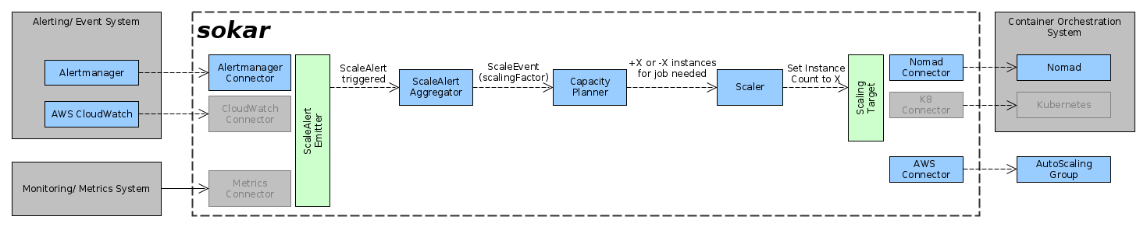
Sokar
Constant-, Linear- and Step Scaling
Weighted Scaling Alerts
One Auto Scaler per service

Slide 11
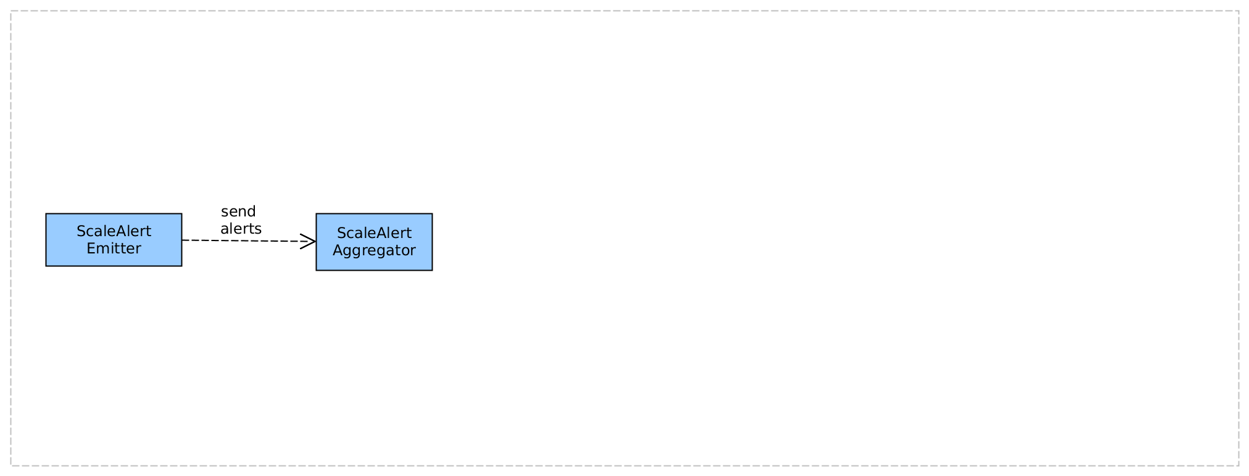
Sokar

Slide 12
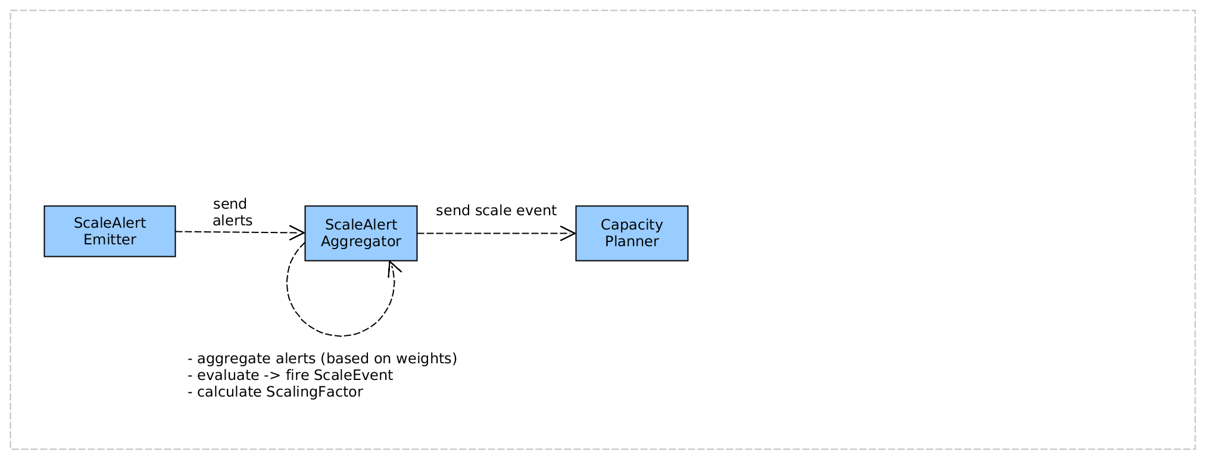
Sokar

Slide 13
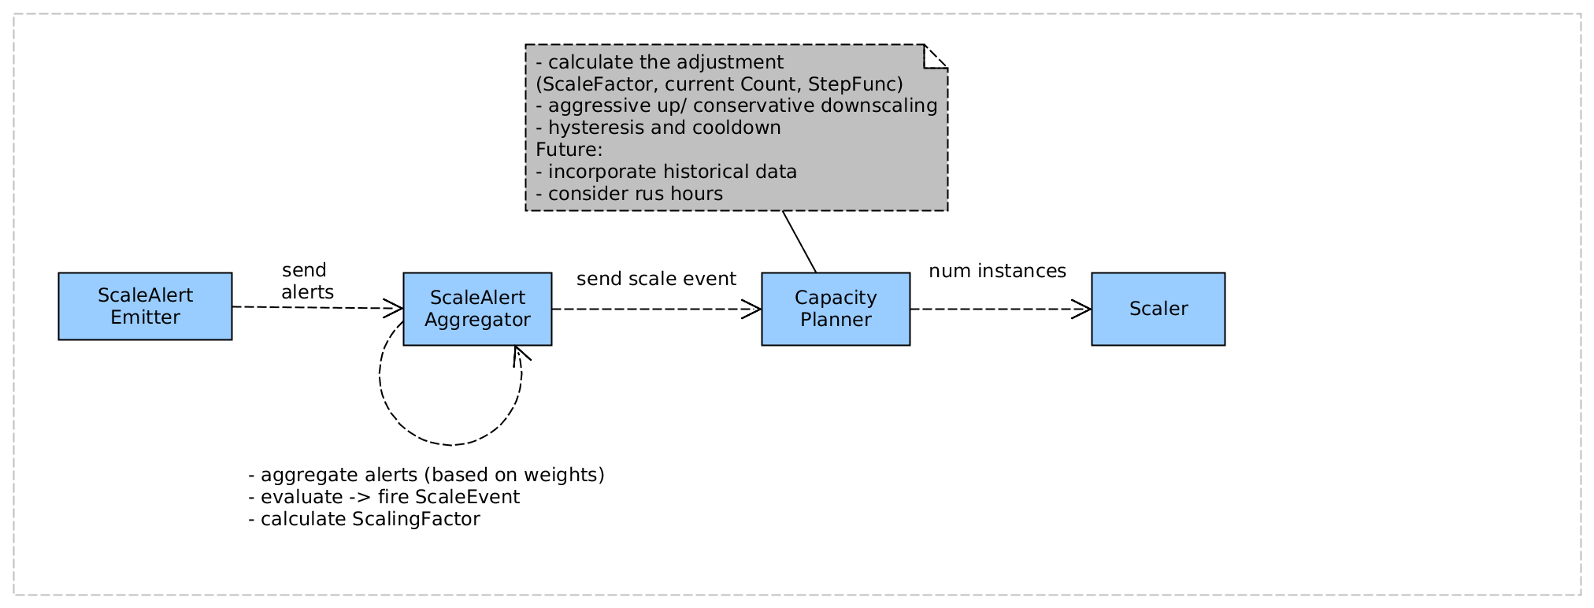
Sokar

Slide 14
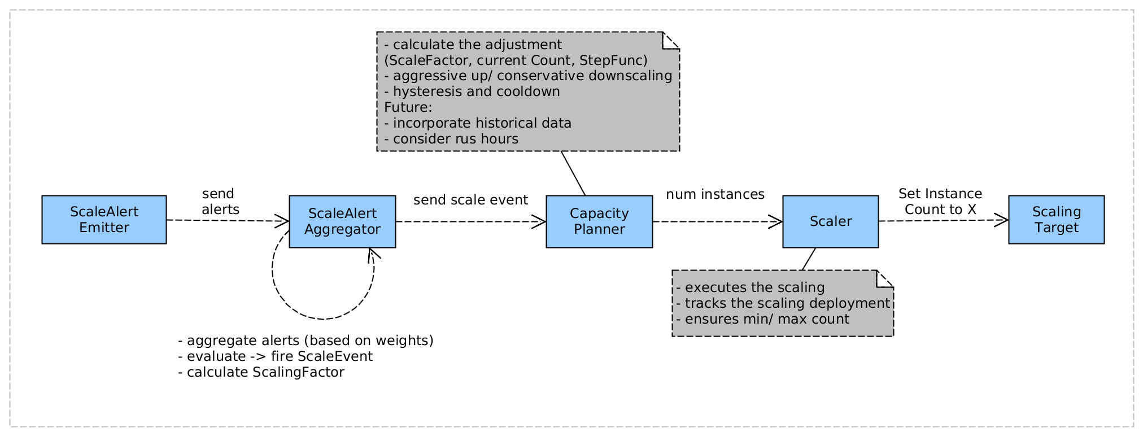
Sokar

Slide 15
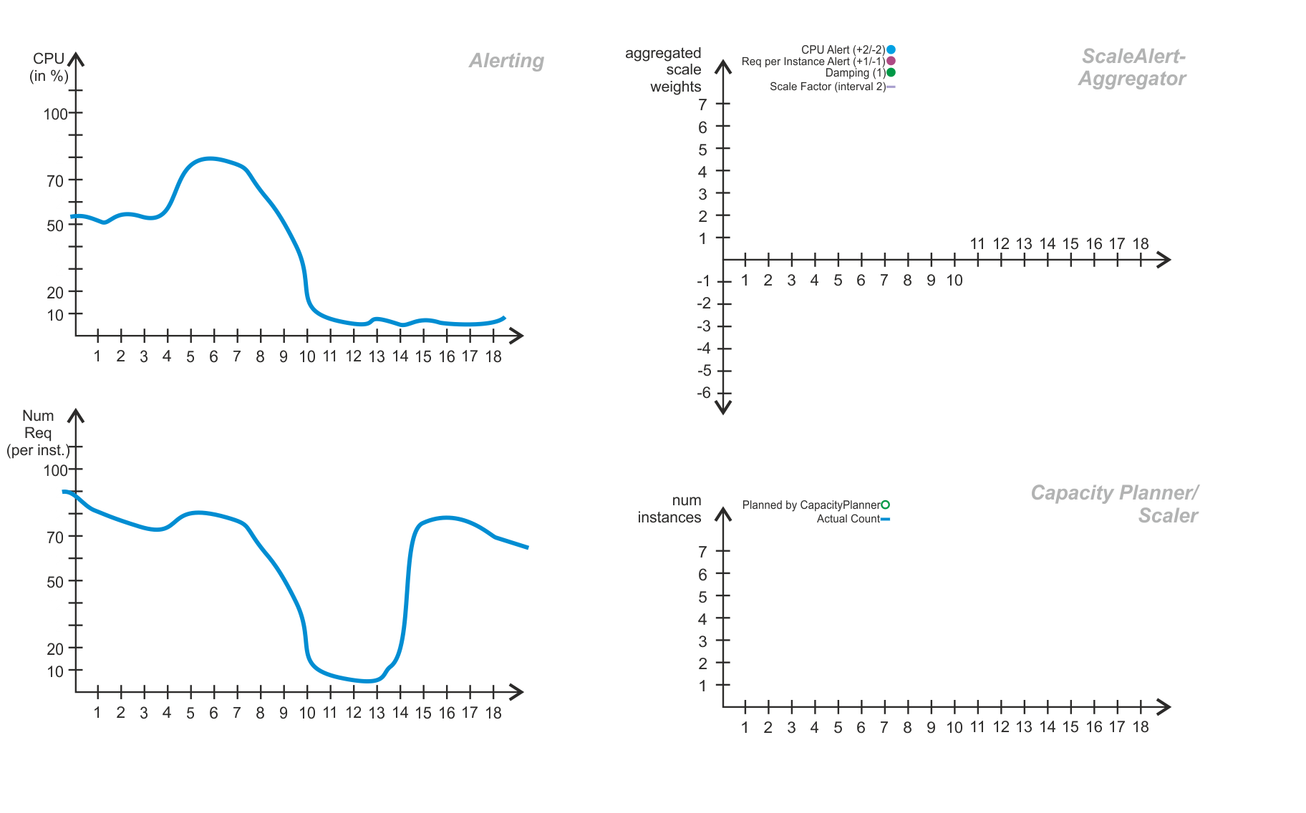
Sokar

Slide 16
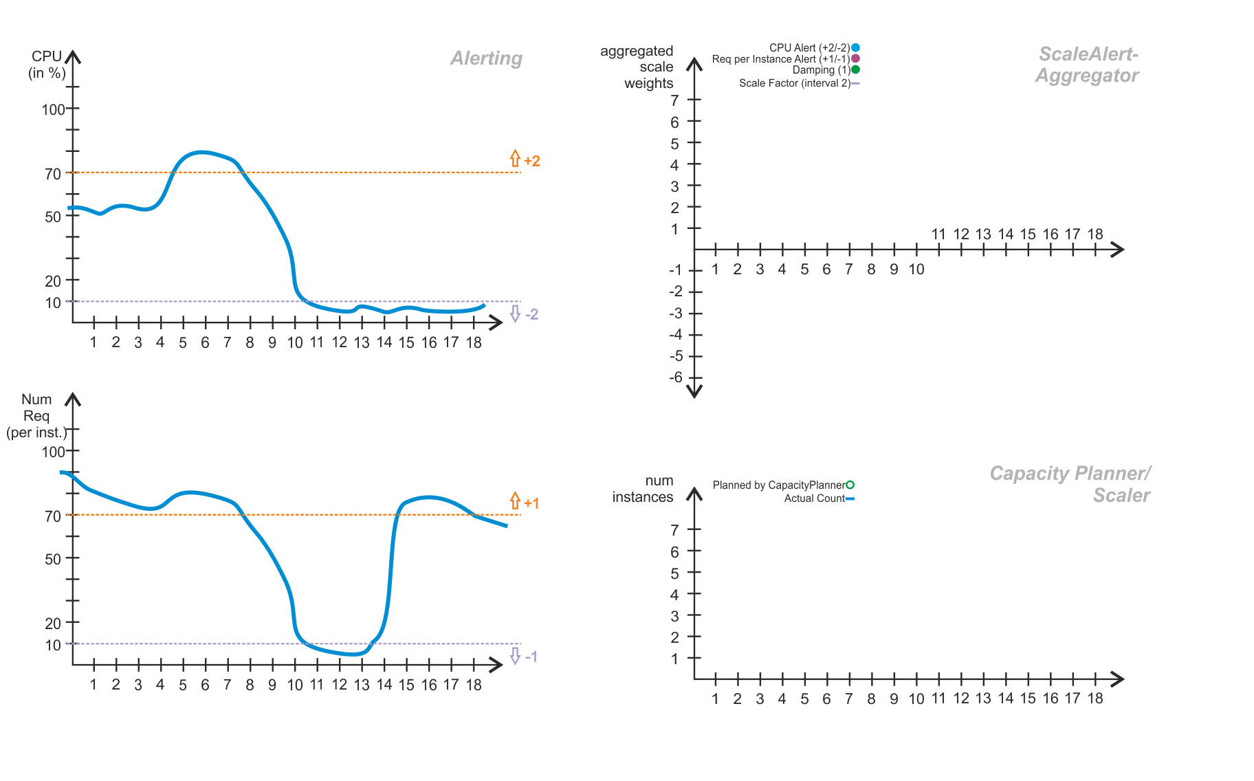
Sokar

Slide 17
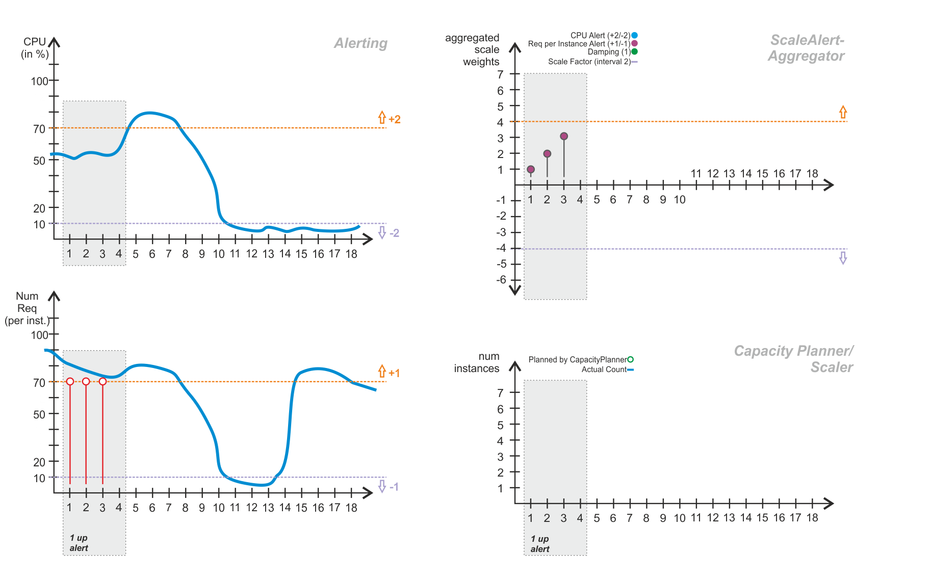
Sokar

Slide 18
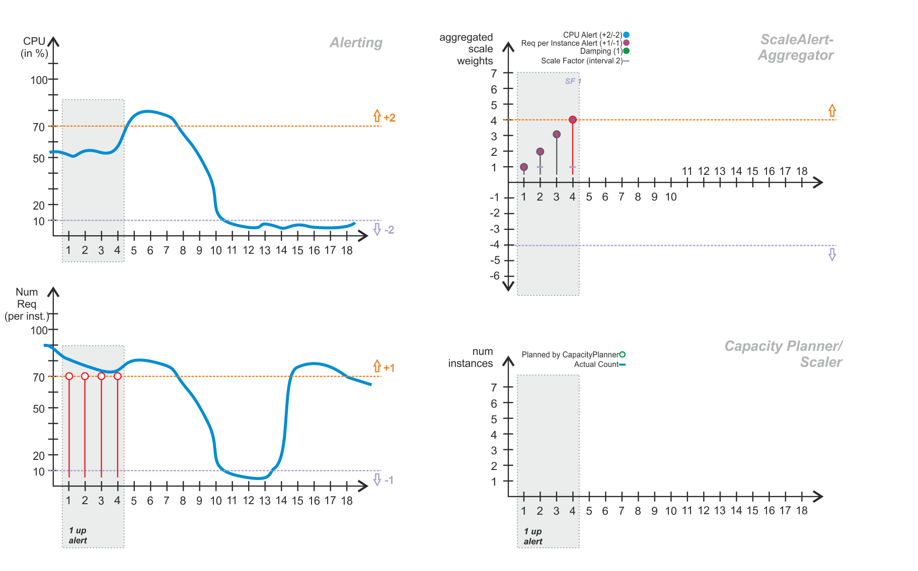
Sokar

Slide 19
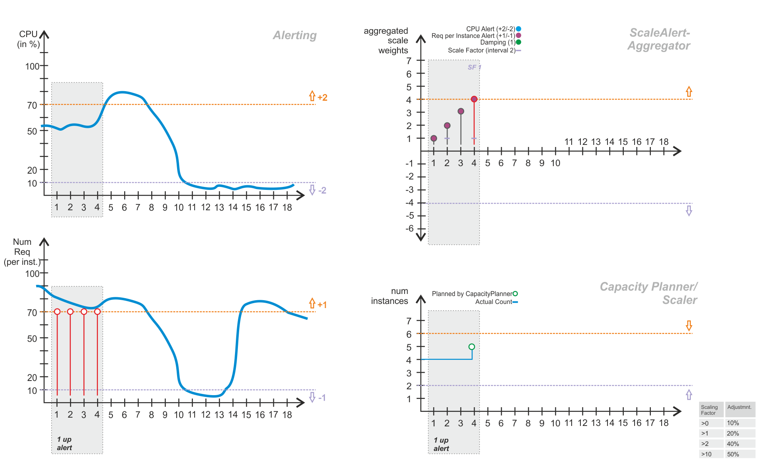
Sokar

Slide 20
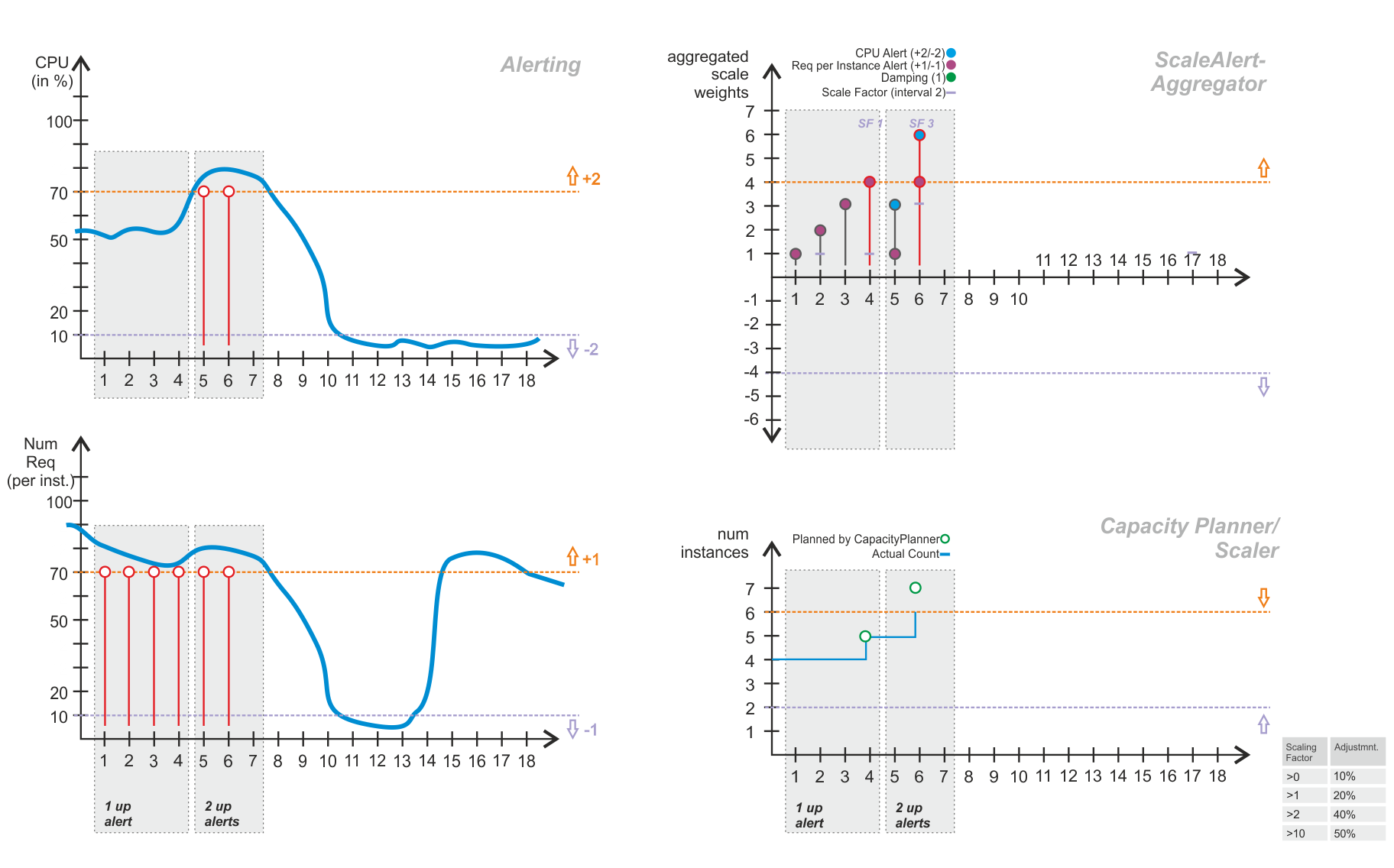
Sokar

Slide 21
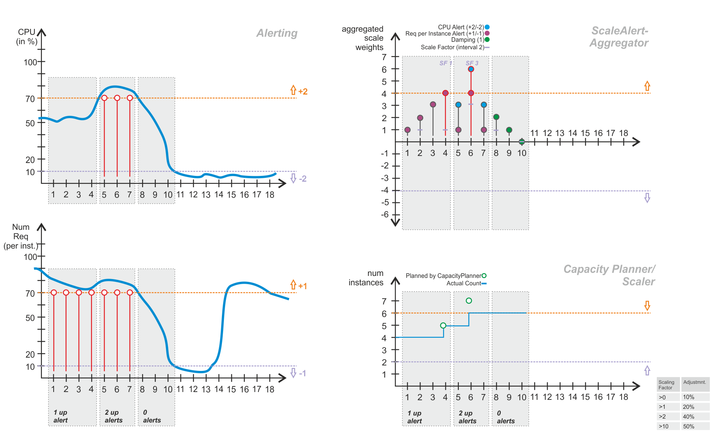
Sokar

Slide 22
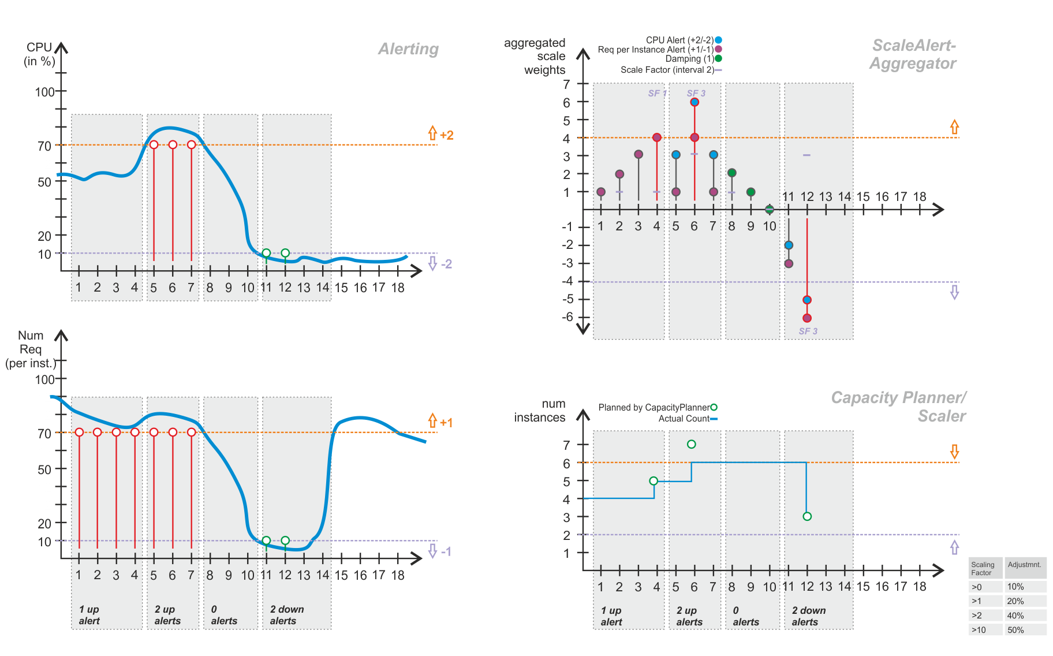
Sokar

Slide 23
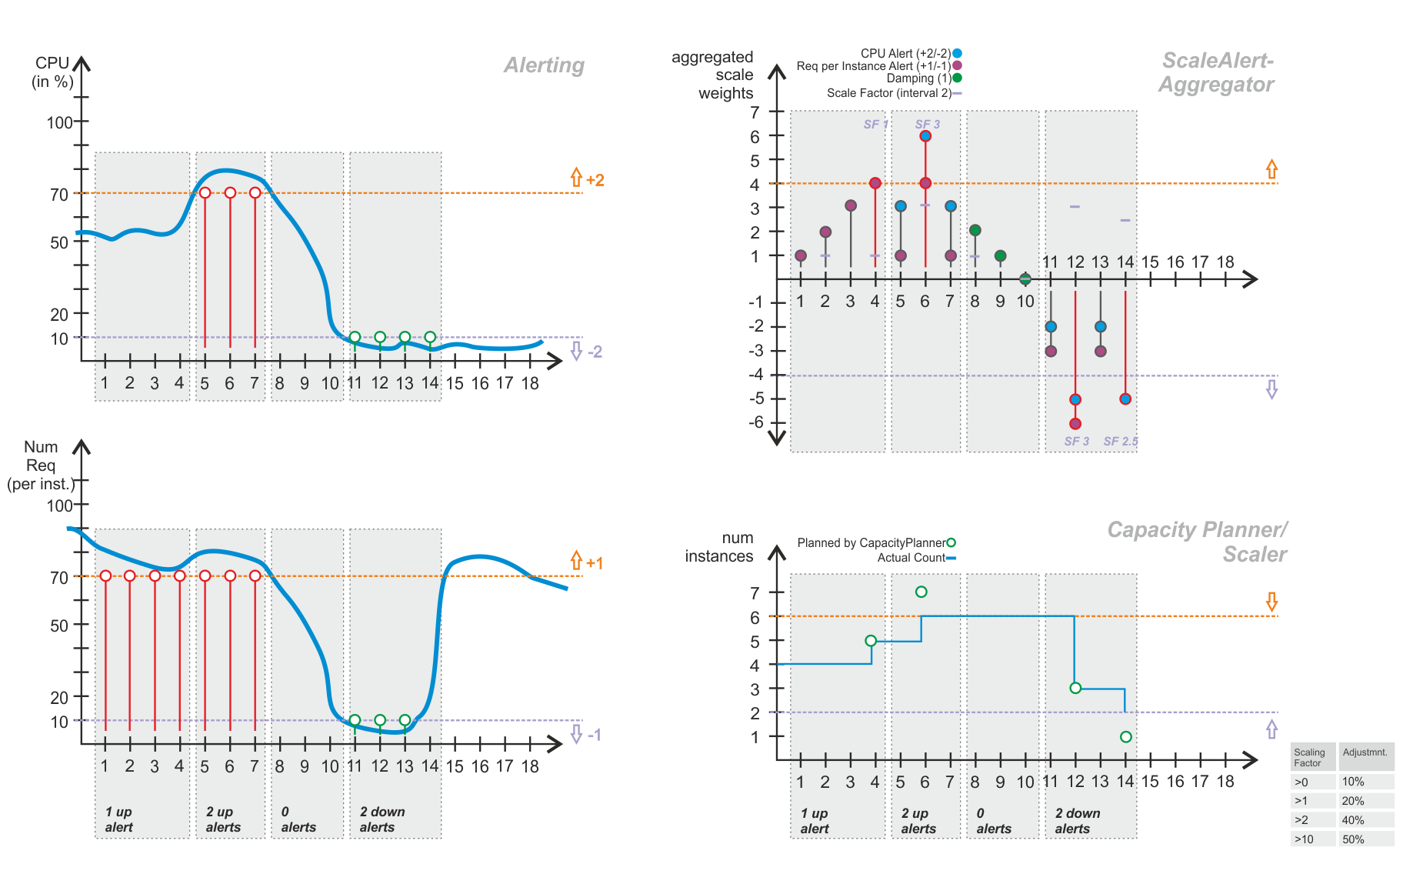
Sokar

Slide 24
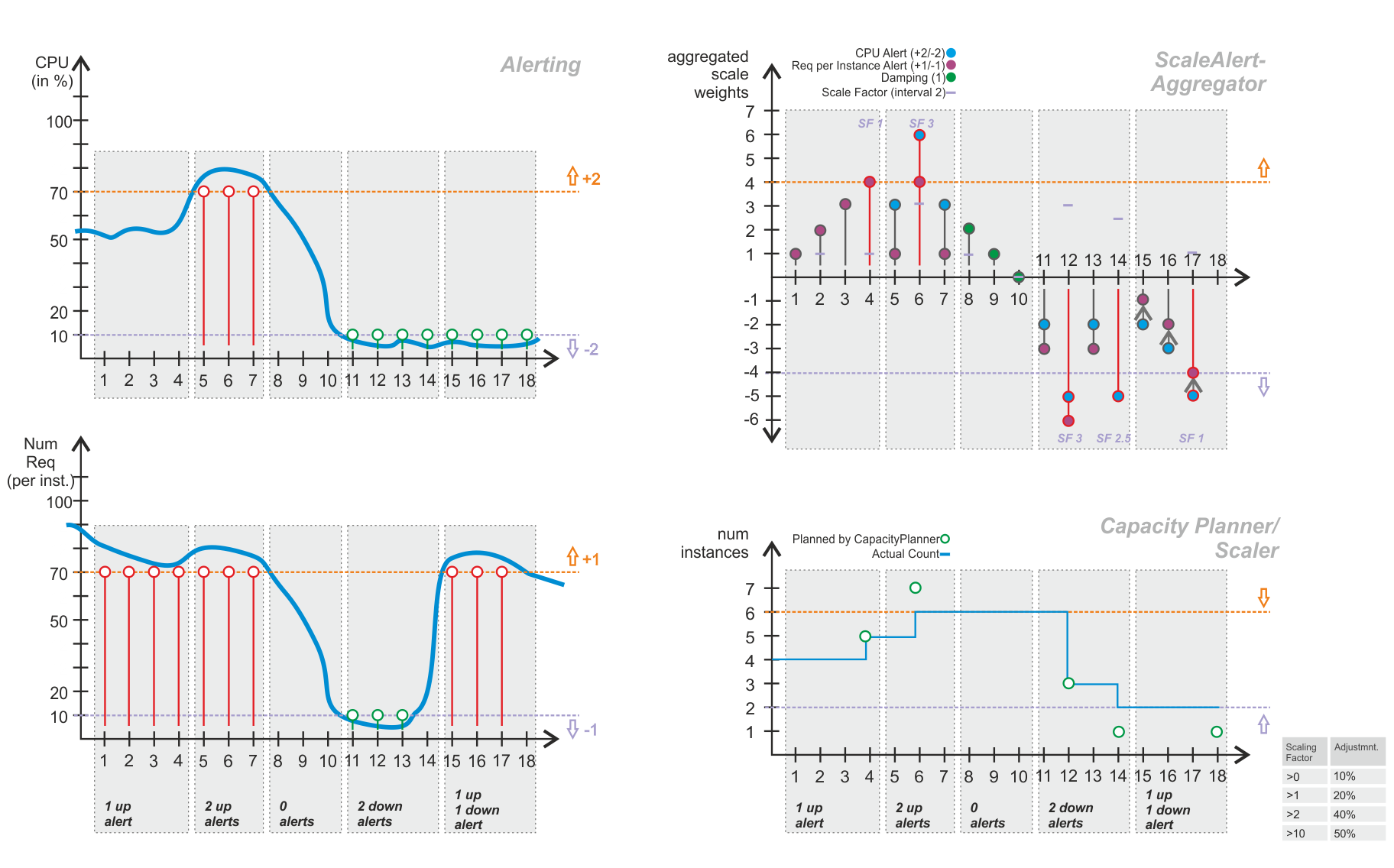
Sokar

