Slide 1
ENGI 301 FitTrack Proposal
9/25/2023
Thomas Pickell

Slide 2
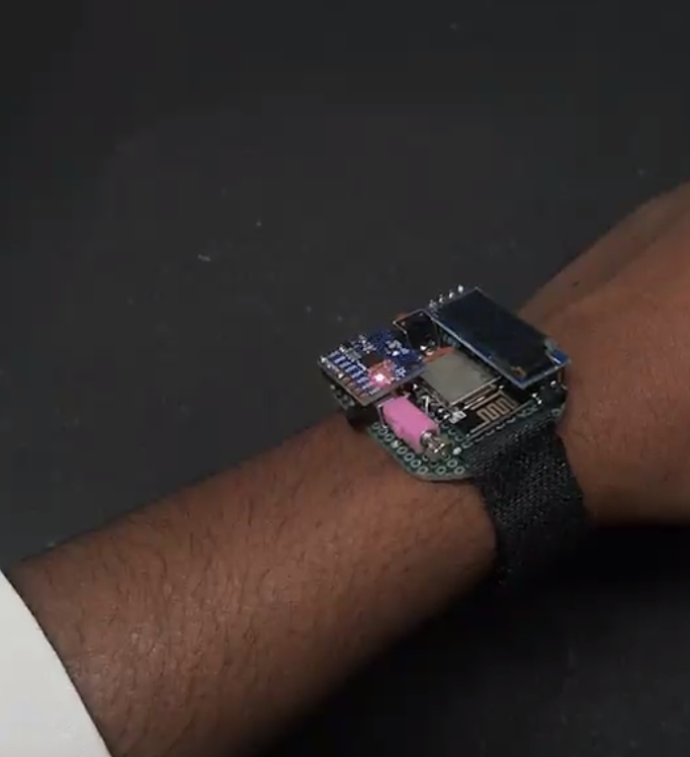
Background Information
I am proposing a fitness watch that can collect health data to be stored on a database on the beaglebone
I plan on using an ESP8266 Arduino to connect wirelessly to a server that I run on the BeagleBone Black
I’ll collect data on ambient movement, weather, and time, then send that data to a server when the user gives an input
I plan to add a stopwatch feature, which should be simple but does require more button inputs
A low power/offline mode, to conserve battery whenever people don’t want to be connected to the server (wireless connection draws a lot of power lol)
initial inspiration: https://www.hackster.io/Neutrino-1/smart-fitness-watch-with-esp8266-platform-io-5aaf15

Slide 3
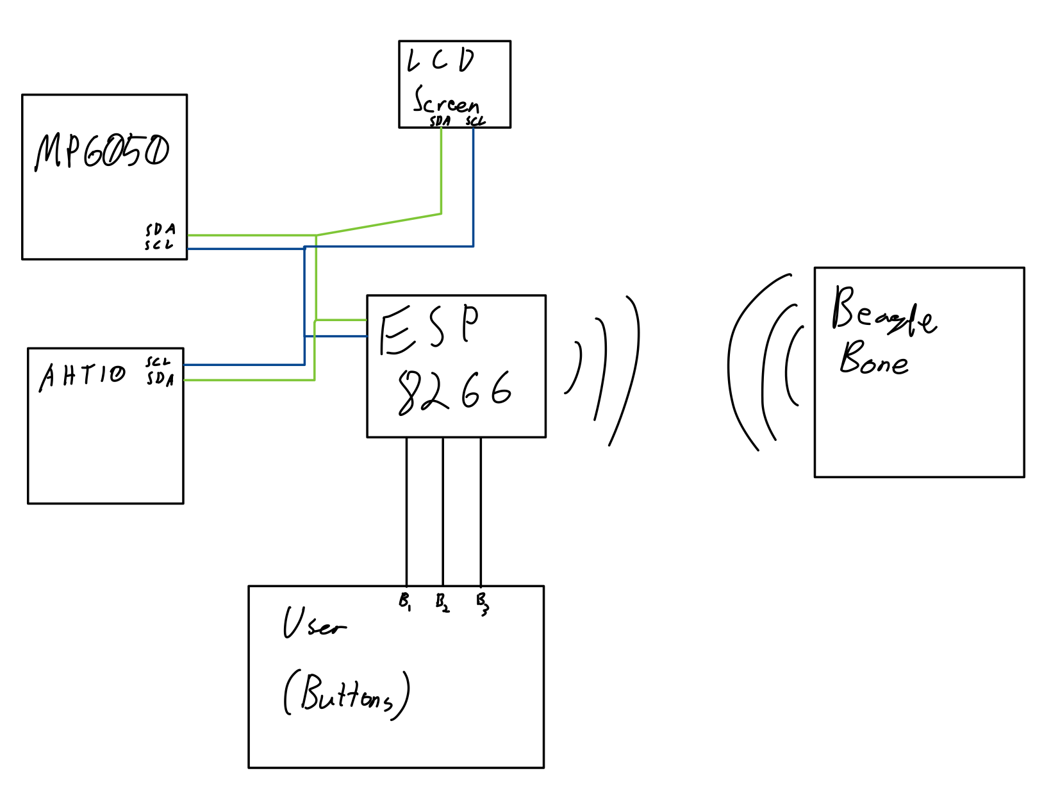
System Block Diagram

Slide 4
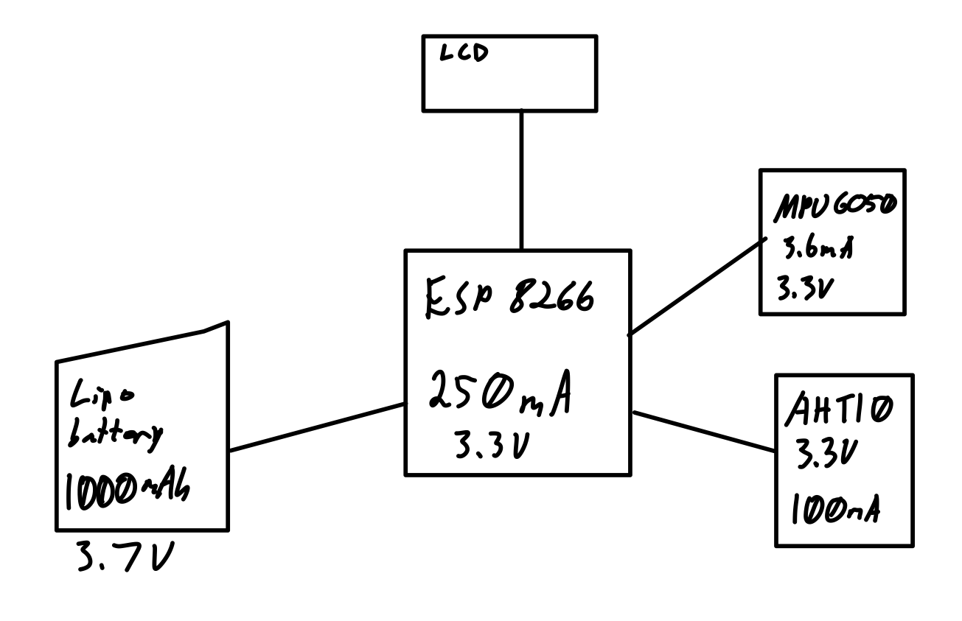
Power Block Diagram

Slide 5
Components / Budget
Component | Need to Buy | Cost
Attom Tech Dual USB Output Super Slim Power Bank Ultra Thin, 3000mAh Portable Charger Mini External Phone Battery Pack Small Dual Outlet, Emergency Phone Power Backup (Black) | Yes | 17.99
USB Wifi Adapter | Yes | 9.99
https://www.amazon.com/Hosyond-Display-3-3V-5V-Compatible-Arduino/dp/B09MZ8DW4R?th=1 |  | 3.25
MP6050 | Yes | 1.98
Temperature/Moisture Sensor | Yes | 1.70
Total

