Slide 1
Устройство Tuple
Николай Шаплов
n.shaplov@postgrespro.ru

Slide 2

Внимание, alpha версия!

Slide 3
Что такое tuple?
Wiktionary
Кортеж – упорядоченный набор конечный длины
Postgres
Экземпляр записи в рамках транзакции

Slide 4
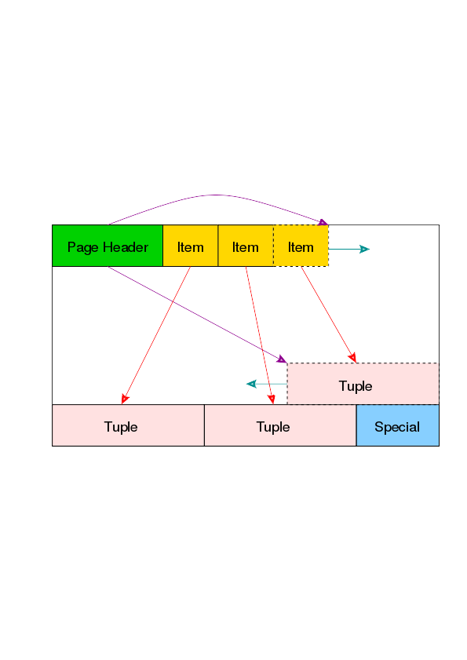
Tuple на странице

Slide 5
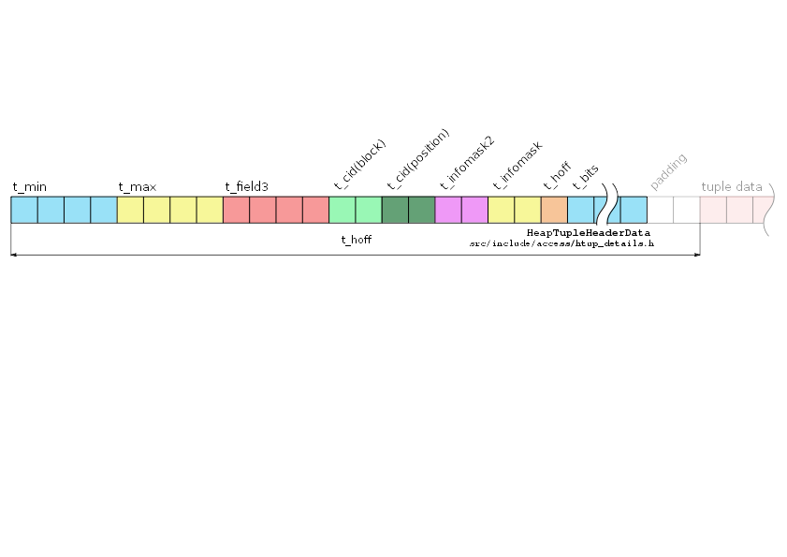
Tuple header
t_min
t_max
t_field3
t_bits – NULL attributes bitmap
t_hoff – offset of tuple data
tuple visibility
Tuple header does not have
information about attributes
layout
t_cid – tuple location in storage
t_infomask2
t_infomask
flags + nattrs

Slide 6
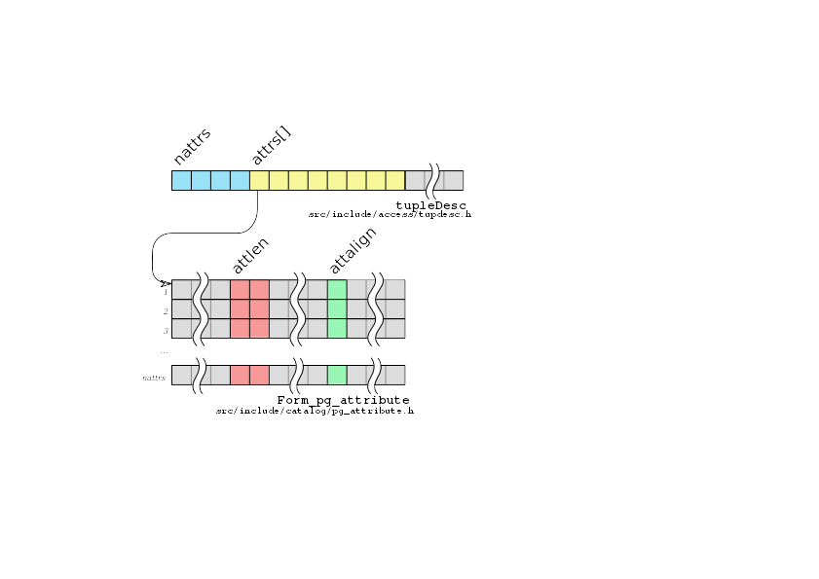
Tuple descriptor
Attributes layout are
are stored in tupleDesc,
available from
CreateTupleDescCopyConstr
function for each relation
attnen>0 – fixed-length attribute
attnen=-1 – variable-length attribute
attalign:
c – no alignment
s – 2-bytes alignment
i – 4 bytes alignment
d – 8 or 4 byte alignment

Slide 7

pageinspect

Slide 8
Fixed-length attribute types
test=# create table test (a int, b int, c int);
CREATE TABLE
test=# insert into test VALUES (1,2,3);
INSERT 0 1
test=# select lp, t_data from heap_page_items(get_raw_page('test', 0));
lp | t_data
----+----------------------------
1 | \x010000000200000003000000
test=# select * from heap_page_item_attrs(get_raw_page('test',0),'test'::regclass);
lp | t_attrs
----+---------------------------------------------
1 | {"\\x01000000","\\x02000000","\\x03000000"}
Numbers are stored
as numbers :-)

Slide 9

Variable-length attribute types
1-byte header
One byte header for
strings up to 126
byte length
test=# create table test (s varchar);
CREATE TABLE
test=# insert into test VALUES ('abcd'),('abc');
INSERT 0 1
test=# select lp, t_data from heap_page_items('test',0);
lp | t_data
----+--------------
1 | \x0b61626364
2 | \x09616263

Slide 10
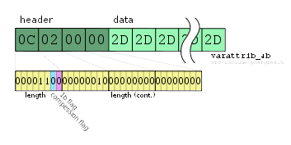
Variable-length attribute types
4-byte header
test=# create table test (a varchar);
CREATE TABLE
test=# insert into test VALUES (repeat('+',126)),(repeat('-',127));
INSERT 0 1
test=# select lp, t_attrs from heap_page_tuple_attrs('test',0);
lp | t_data
----+---------------------
1 | \xff2b2b2b2b2b...
2 | \x0c0200002d2d2d2...
Four byte header is
for strings longer
then 126 bytes, or
for compressed strings

Slide 11
NULLs
test=# create table test (a int, b int, c int);
CREATE TABLE
test=# insert into test VALUES (1,2,3),(1,null,3);
INSERT 0 2
test=# select lp, t_infomask, t_bits, t_data from heap_page_tuples('test',0);
lp | t_infomask | t_bits | t_data
----+------------+----------+---------------------------
1 | 2048 | | \x010000000200000003000000
2 | 2049 | 10100000 | \x0100000003000000
test=# select lp, t_infomask, t_bits, t_attrs from heap_page_tuple_attrs('test',0);
lp | t_infomask | t_bits | t_attrs
---+------------+---------+------------------------------------------
1 | 2048 | |{"\\x01000000","\\x02000000","\\x03000000"}
2 | 2049 |10100000 |{"\\x01000000",NULL,"\\x03000000"}

Slide 12
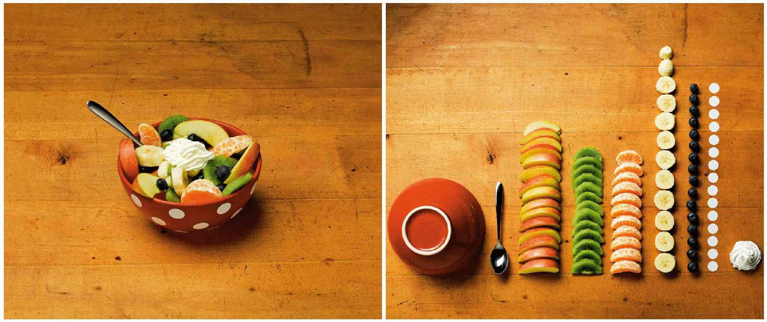
Alignment

Slide 13
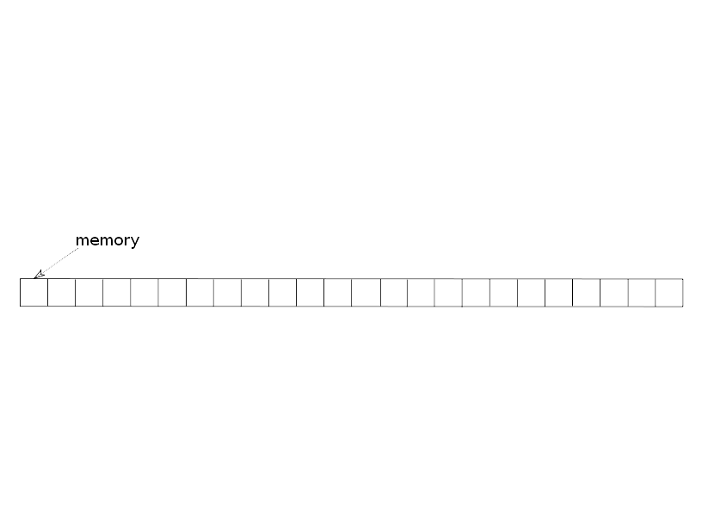
Alignment

Slide 14
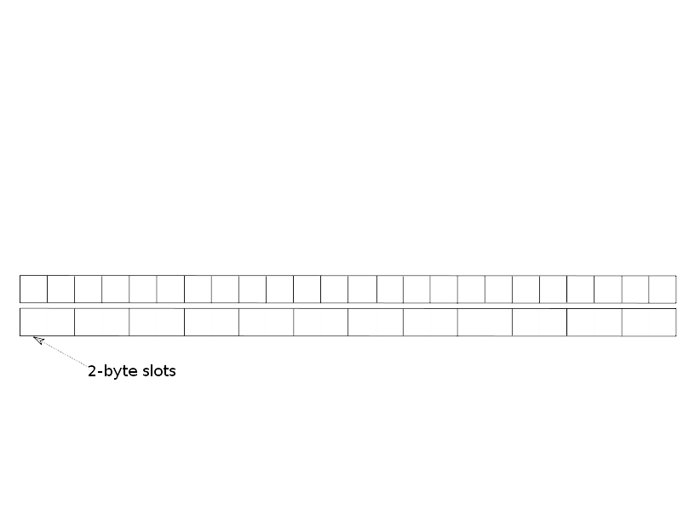
Alignment

Slide 15
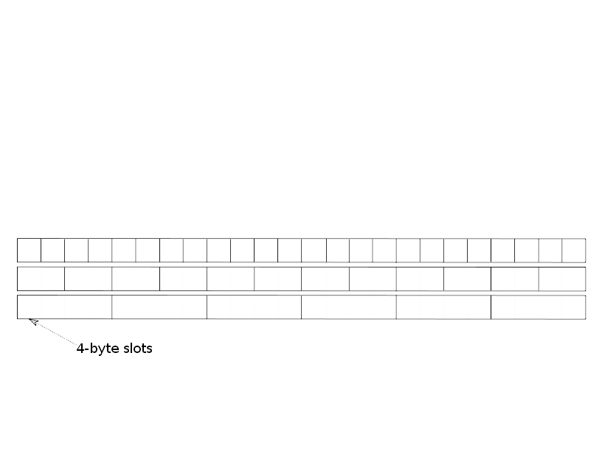
Alignment

Slide 16
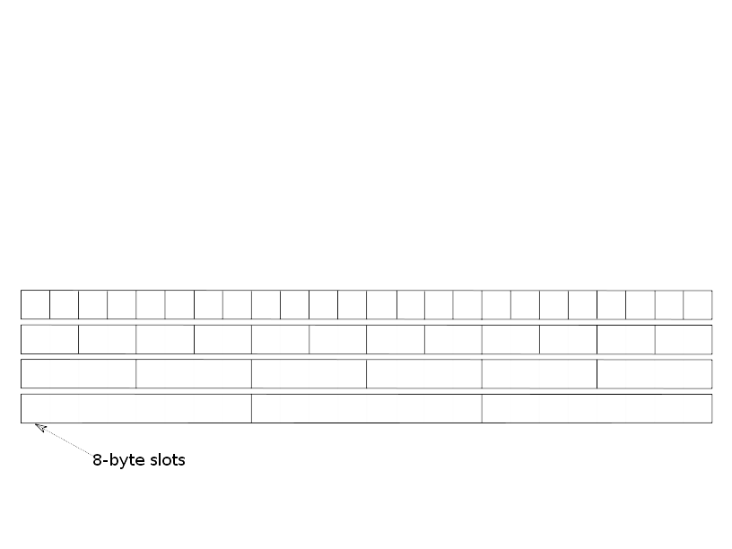
Alignment

Slide 17
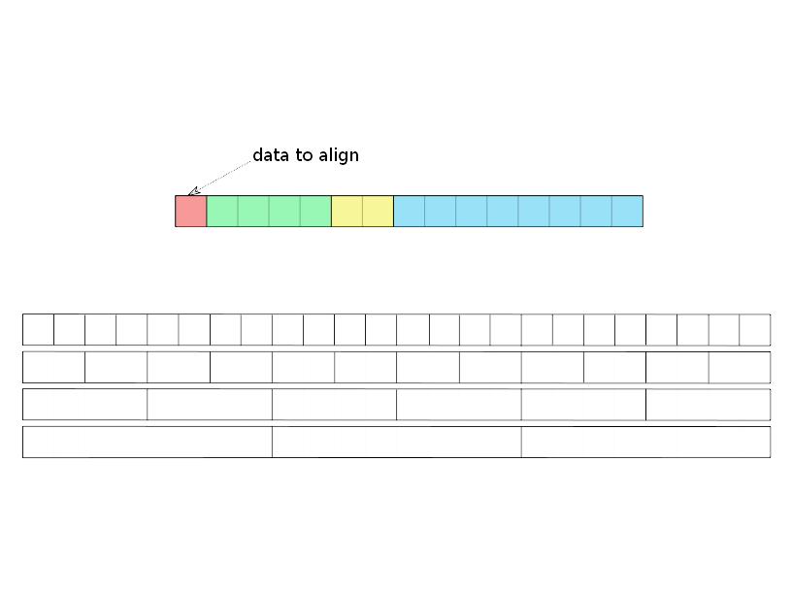
Alignment

Slide 18
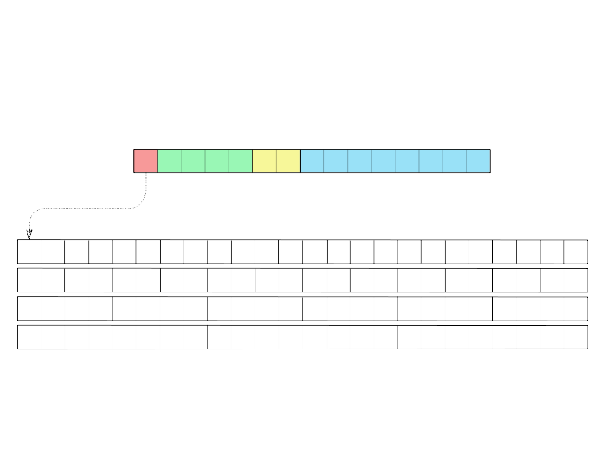
Alignment

Slide 19
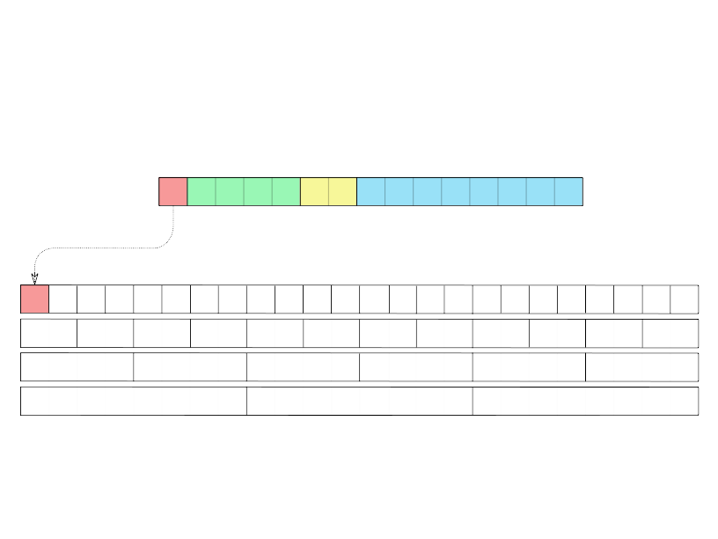
Alignment

Slide 20
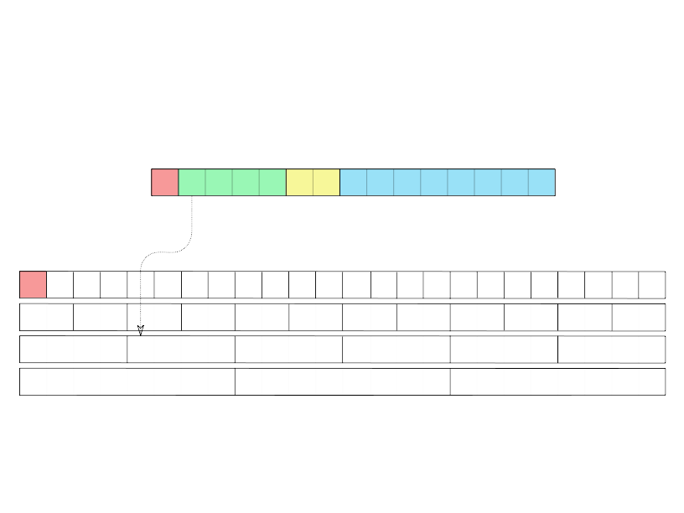
Alignment

Slide 21
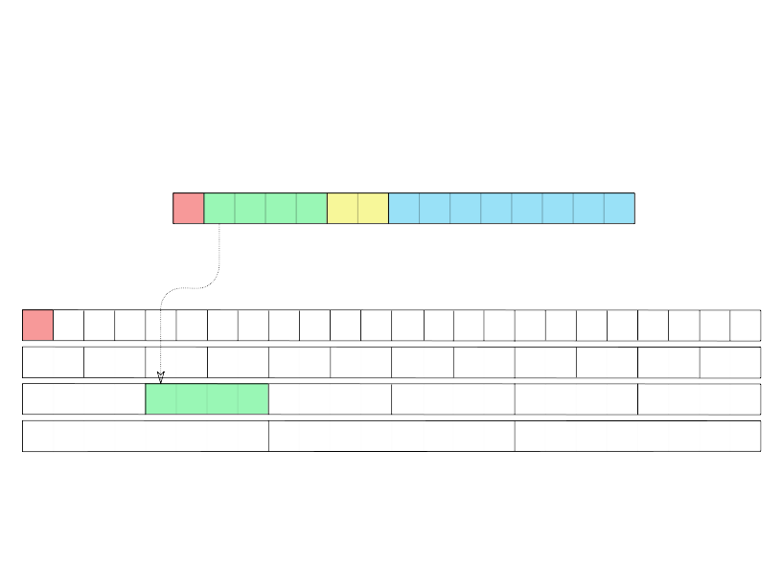
Alignment

Slide 22
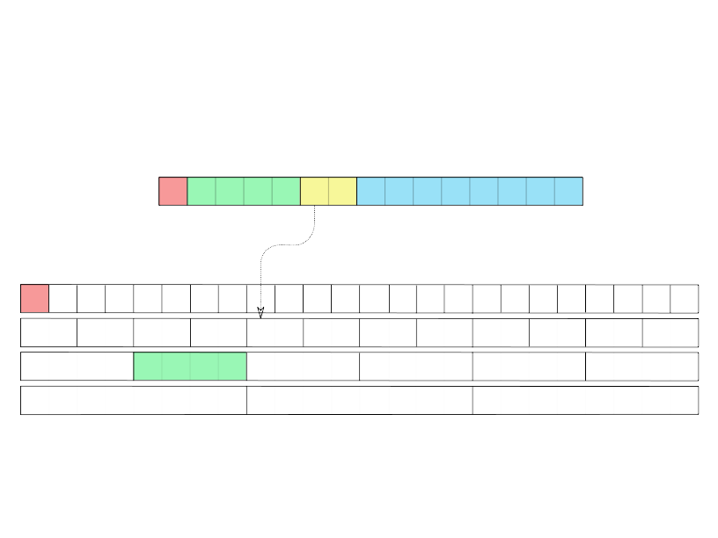
Alignment

Slide 23
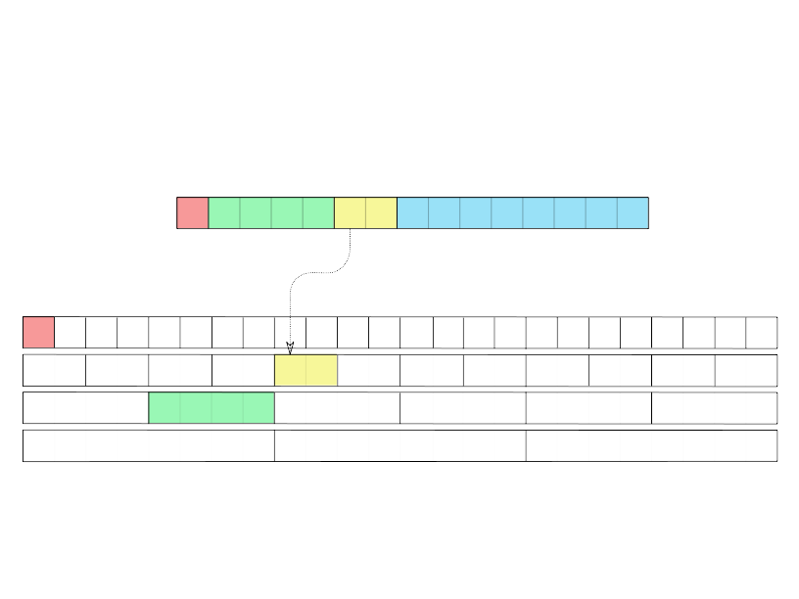
Alignment

Slide 24
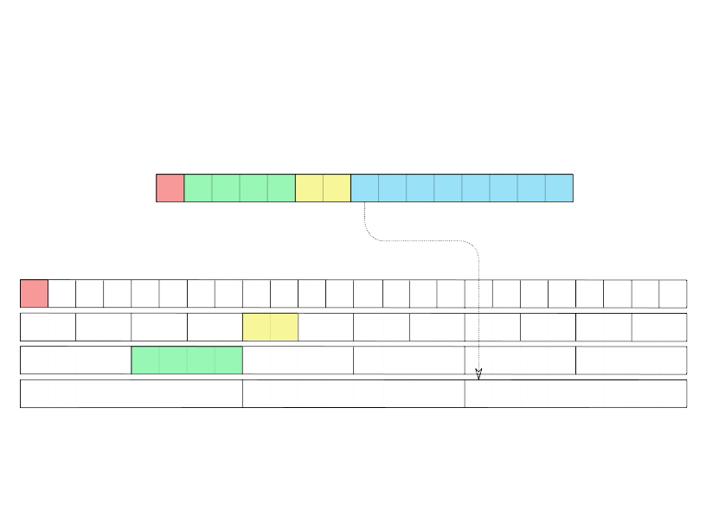
Alignment

Slide 25
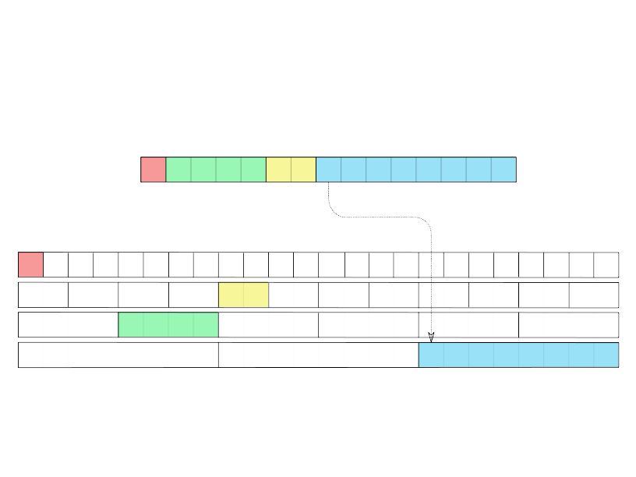
Alignment

Slide 26
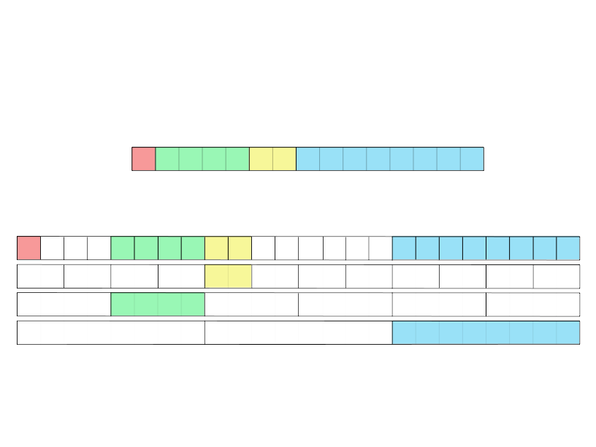
Alignment

Slide 27
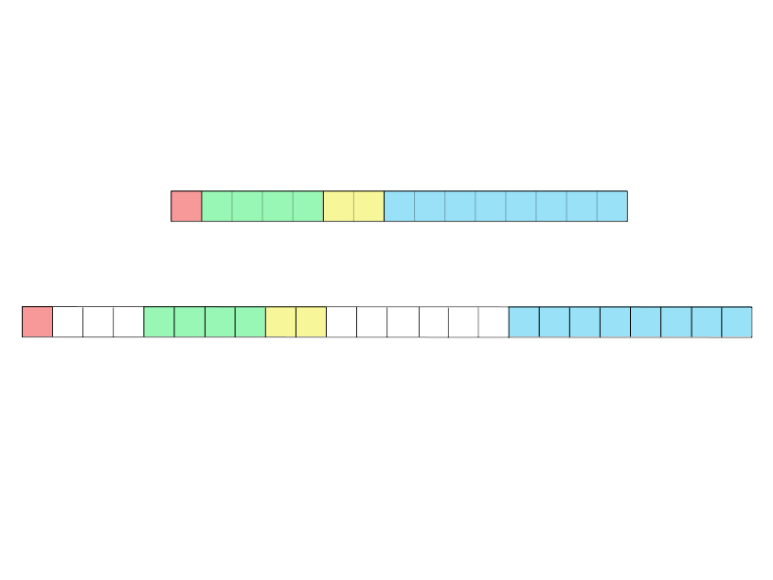
Alignment

Slide 28
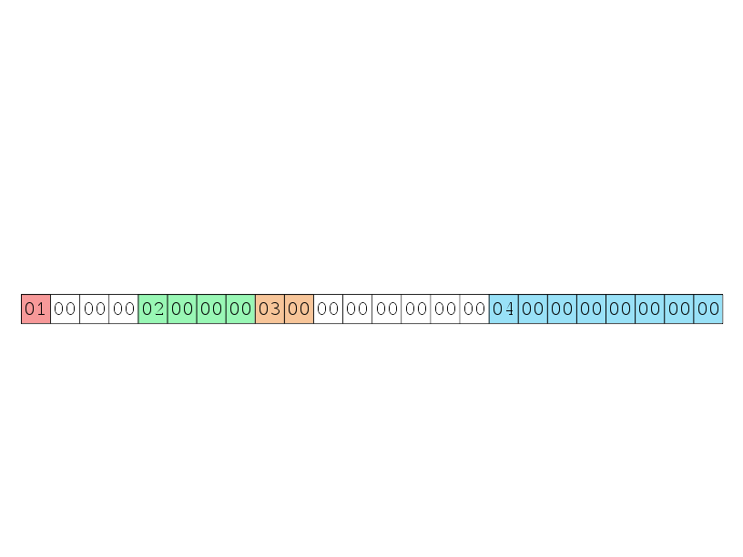
Alignment of fixed-length attributes
test=# create table test (a boolean, b int, c smallint, d bigint);
CREATE TABLE
test=# insert into test VALUES ('t',2,3,4);
INSERT 0 1
test=# select lp, t_data from heap_page_items(get_raw_page('test', 0));
lp | t_data
----+----------------------------------------------------
1 | \x010000000200000003000000000000000400000000000000

Slide 29
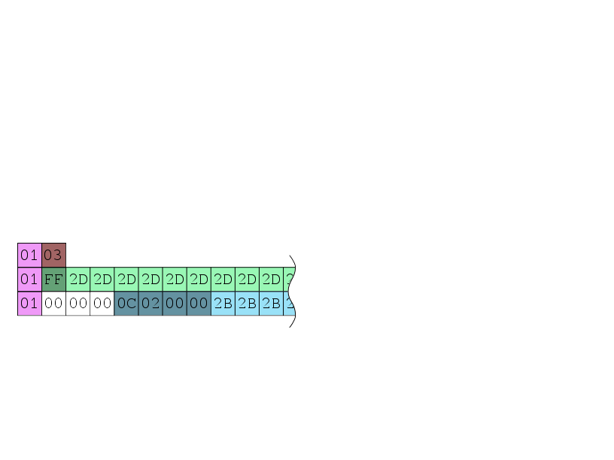
Alignment of variable-length attributes
test=# create table test (a boolean, b varchar);
CREATE TABLE
test=# insert into test VALUES ('t',''),
test-# ('t',repeat('-',126)),
test-# ('t',repeat('+',127));
INSERT 0 3
test=# select lp, t_data from heap_page_items(get_raw_page('test', 0));
lp | t_data
---+---------------------------
1 | \x0103
2 | \x01ff2d2d2d2d2d2d2d2d...
3 | \x010000000c0200002b2b2b2b2b...
For variable-length
attributes header is aligned:
4-byte header aligned as
four byte value, 1-byte
header is not aligned
at all

Slide 30
Alignment on
64- and 32-bit CPU
# create table test (b int, c bigint);
CREATE TABLE
# insert into test VALUES (1,2);
INSERT 0 1
Alignment works in different
ways on different CPUs
64bit
lp | t_data
---+-------------------------------------
1 | \x01000000000000000200000000000000
32bit
lp | t_data
---+-----------------------------
1 | \x010000000200000000000000

Slide 31
"Missing" attributes in tuple
Postgres does not update
tuples when you add column
with NULL default value, instead
it just returns NULL when user
reads this "missing" attribute
test=# create table test (a int, b int);
CREATE TABLE
test=# insert into test VALUES (1,10);
INSERT 0 2
test=# ALTER TABLE test ADD COLUMN c int;
ALTER TABLE
test=# insert into test VALUES (3,30,300);
INSERT 0 1
test=# select lp, t_infomask2, t_data from heap_page_tuples('test',0);
lp | t_infomask2 | t_data
----+-------------+----------------------------
1 | 2 | \x010000000a000000
2 | 3 | \x030000001e0000002c010000
test=# select * from heap_page_item_attrs(get_raw_page('test',0),'test'::regclass);
lp | t_infomask2 | t_attrs
---+----------+-------------------------------------------
1 | 2 | {"\\x01000000","\\x0a000000",NULL}
2 | 3 | {"\\x03000000","\\x1e000000","\\x2c010000"}

Slide 32

Big data storage
Compression
TOAST

Slide 33
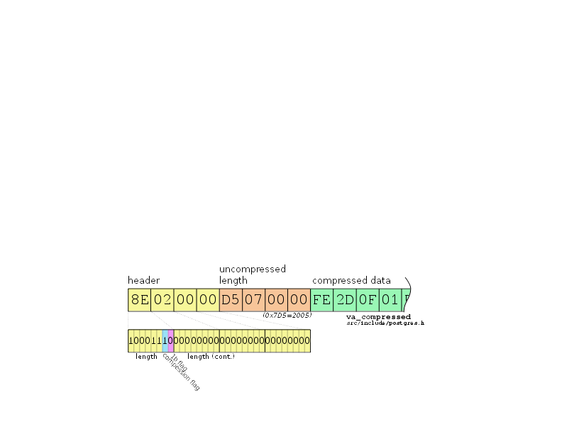
Compression
Postgres tries to
compress variable-length
attributes with LZ algorithm
if tuple size is ≳ 2K
test=# create table test (a varchar);
CREATE TABLE
test=# insert into test VALUES (repeat('-',2004)),
test-# (repeat('-',2005));
INSERT 0 2
test=# select lp, t_attrs from heap_page_tuple_attrs('test',0);
lp | t_attrs
---+-----------------------------------------------------------------------------
1 | \x601f00002d2d2d2d2d2d2d2d2d2d2d2d2d2d2d2d2d2d2d2d2d2d2d2d2d......
2 | \x8e000000d5070000fe2d0f01ff0f01ff0f01ff0f01ff0f01ff0f01ff0f01ff010f014b

Slide 34
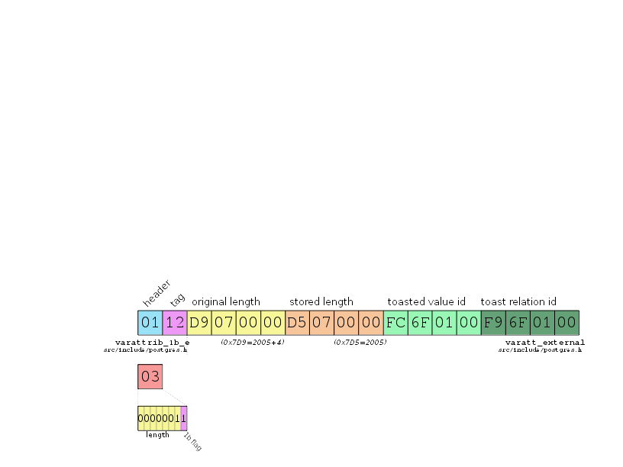
TOAST
Empty string has 0x03
one byte header.
0x01 is unreachable, so
it is used as TOASTed
string marker
test=# create table test (a varchar);
CREATE TABLE
test=# ALTER TABLE test ALTER a SET STORAGE EXTERNAL;
ALTER TABLE
test=# insert into test VALUES (repeat('-',2005),
test-# (''));
INSERT 0 2
test=# select lp, t_attrs from heap_page_tuple_attrs('test',0);
lp | t_attrs
----+-------------------------------------------
1 | \x0112d9070000d5070000fc6f0100f96f0100
2 | \x03

Slide 35
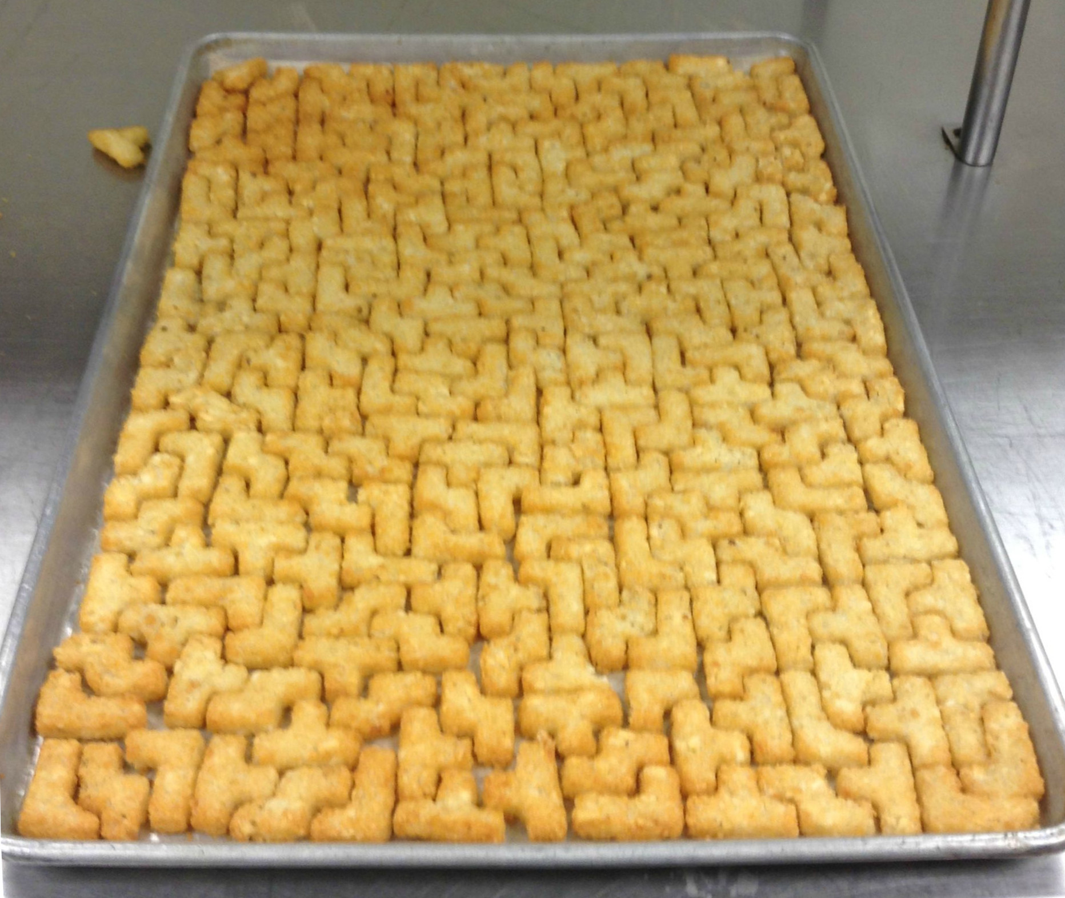
Optimization

Slide 36
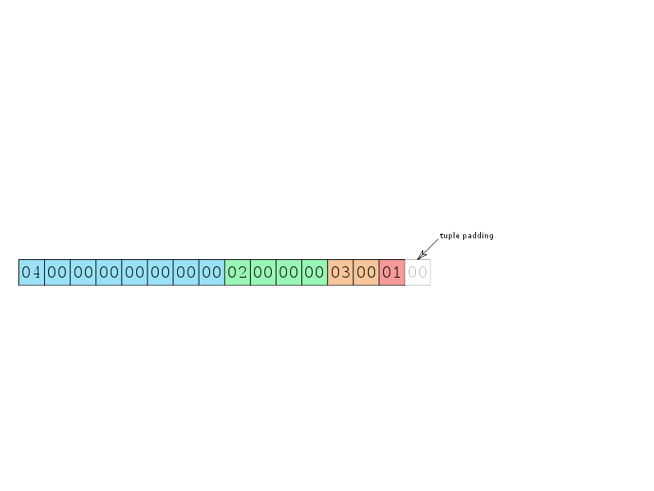
Size optimization
Remember about alignment: Remove padding holes
test=# create table test (a boolean, b int, c smallint, d bigint);
test=# create table test (d bigint, b int, c smallint, a boolean);

Slide 37
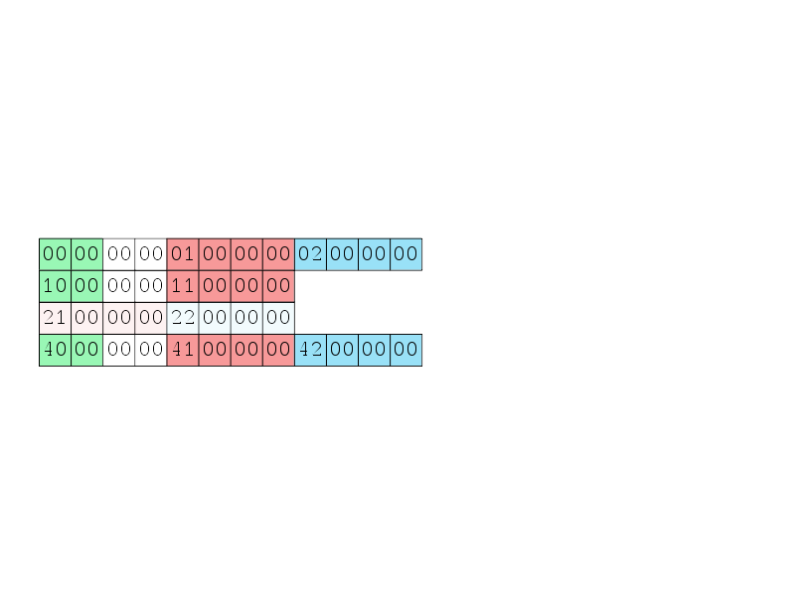
Access performance optimization
create table test (a smallint, b int, c int);
insert into test VALUES (0, 1, 2),
(16, 17, NULL),
(NULL,33, 34),
(64, 65, 66);
If there is no NULLs or
variable-length attributes,
position of an attribute
is predictable and
can be cached

Slide 38
Access performance optimization
Not NULL fixed-length attributes go first
Then put fixed-length attributes with less NULLs
Move all variable-length attributes to the right

Slide 39
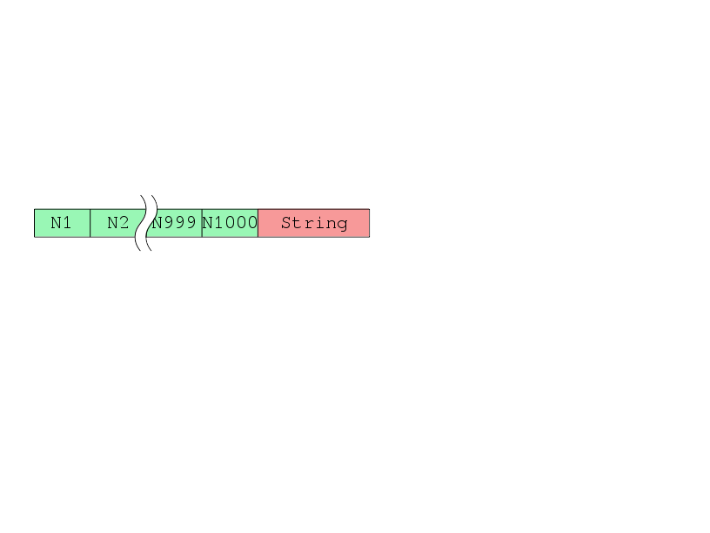
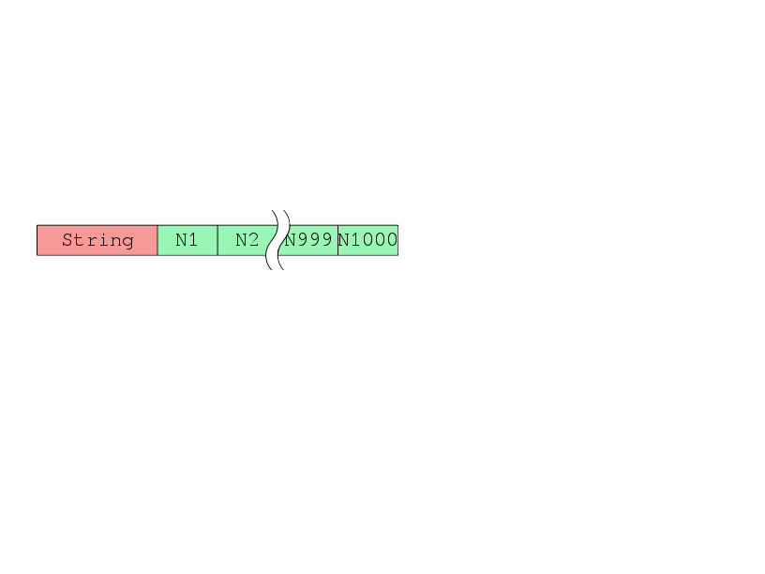
Access performance optimization
1 000 bigint attributes: N1..N1000
One string in the head or at the tail of a row
1 000 000 rows
Benchmark query: SELECT SUM(N1000)
Test Environment
CPU: 4 socket Xeon V7,
15 Core per socket
Shared Memory: 100Gb
pgbench
clients: 100
jobs: 100
time: 360
String is last
String is first
tps = 50.387503
tps = 64.373621
64.373621 / 50.387503 = 1.27

Slide 40


Slide 41
What to compress what to TOAST?
toast_insert_or_update
src/backend/access/heap/tuptoaster.c
TOAST_TUPLE_TARGET≈
BLCKSZ / 4
tuple size >
TOAST_TUPLE_TARGET
Are there uncompressed
varlen attributes?
Compress biggest
varlen attribute
Are there not TOASTed
varlen attributes?
TOAST biggest
varlen attribute
Tuple is ready

Slide 42
Access performance optimization
fastgetattr
Fetching attribute N
from tuple
src/include/access/htup_details.h
Tuple has NULLs?
Attribute N is NULL?
Attribute position
is cashed?
Return NULL
Return value from
cashed position
Fetch with
nocachegetattr

Slide 43
Access performance optimization
nocachegetattr
Fetching attribute N
from tuple
src/backend/access/common/heaptuple.c
Are there NULL before
attribute N?
Attribute position
is cashed?
Iterate over tuple data
till we reach attribute N
While iterating there
were NULL or varlen
attributes?
Return value from
cashed position
Remember position of
attribute N in cache
Return value we've found

Slide 44


Опять таки заголовок о чем-то на слайде
Подзаголовок 1
Пишем разные умные штуки которые помогают всем нашим заказчикам и позволяют нам жить хорошо и весело.
Картинка помогает проиллюстрировать глубиномыслие и широковзглядие автора
Подзаголовок 2
Всякий очень полезный текст о вреде зла и пользе добра

