Slide 1
Tuple internals: exposing, exploring and explaining
Nikolay Shaplov

Slide 2
Revision: 4.01 10-11-2015
Link to the newest version is in the last slide
Revision: 4.02 27-11-2015
Patch was committed. Changed patch URL from commitfest to commitlog
Revision: 4.03 25-01-2016
Fix incorrect examples
Revision: 4.04 08-02-2016
Found flowcarts from older versions of a talk; add it here in hidden slides may be for future usage

Slide 3
About the lecturer
Nikolay Shaplov
  Works in Postgres Professional (Russia)
  Open Source Software developer
  Based in Moscow
Contacts
  E-mail: n.shaplov@postgrespro.ru
  Jabber: n.shaplov@postgrespro.ru

Slide 4
Agenda
Introduction
Attributes in tuple
– Fixed-length attributes
– Variable-length attributes
  – NULL values
Alignment
Long variable-length attributes
– Compression
  – TOAST
Optimization tricks
  – Size
– Access performance

Slide 5
Postgres data structures for dummies
Bruce Momjian, PostgreSQL Internals Through Pictures:
File structure
Page structure
Tuple header structure
Nikolay Shaplov, Tuple Internals: exposing, exploring & explaining:
Tuple attributes layout

Slide 6
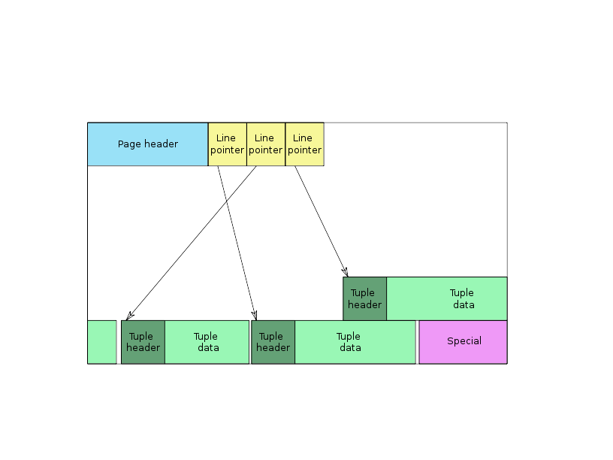
Page layout
Tuples are stored in pages.
Notice alignment padding
between tuples

Slide 7
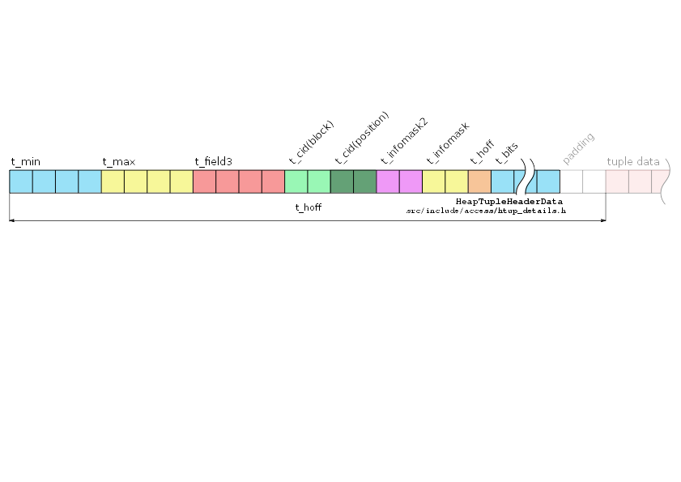
Tuple header
t_min
t_max
t_field3
t_bits – NULL attributes bitmap
t_hoff – offset of tuple data
tuple visibility
t_cid – tuple location in storage
There is no
information about attributes
layout in tuple header
t_infomask2
t_infomask
flags + nattrs

Slide 8
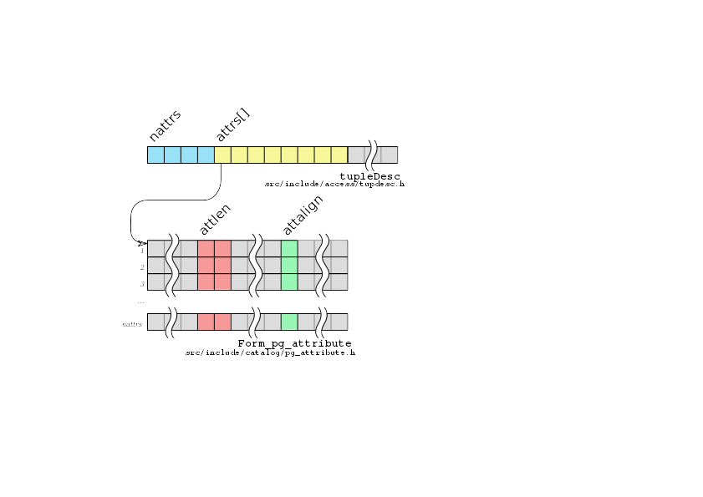
Tuple descriptor
Attributes layout
are stored in tupleDesc,
available from
CreateTupleDescCopy Constr
function for each relation
attlen>0 – fixed-length attribute
attlen=-1 – variable-length attribute
attalign:
c – no alignment
s – 2-bytes alignment
i – 4 bytes alignment
d – 8 or 4 byte alignment

Slide 9

Pageinspect extension
Patch d6061f8 allows to
look into tuple raw data.
Will be available in
postgres 9.6

Slide 10
Fixed-length attribute types
test=# create table test (a int, b int, c int);
CREATE TABLE
test=# insert into test VALUES (1,2,3);
INSERT 0 1
test=# select lp, t_data from heap_page_items(get_raw_page('test', 0));
lp | t_data
----+----------------------------
1 | \x010000000200000003000000
test=# select * from heap_page_item_attrs(get_raw_page('test',0),'test'::regclass);
lp | t_attrs
----+---------------------------------------------
1 | {"\\x01000000","\\x02000000","\\x03000000"}
Numbers are stored
as numbers :-)

Slide 11

Variable-length attribute types
1-byte header
One byte header for
strings up to 126
bytes length
test=# create table test (s varchar);
CREATE TABLE
test=# insert into test VALUES ('abcd'),('abc');
INSERT 0 1
test=# select lp, t_data from
heap_page_items(get_raw_page('test', 0));
lp | t_data
----+--------------
1 | \x0b61626364
2 | \x09616263

Slide 12
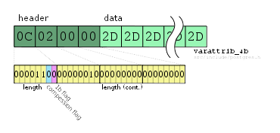
Variable-length attribute types
4-byte header
test=# create table test (a varchar);
CREATE TABLE
test=# insert into test VALUES (repeat('+',126)),(repeat('-',127));
INSERT 0 1
test=# select lp, t_data from
heap_page_items(get_raw_page('test', 0));
Four byte header is
for strings longer
than 126 bytes, or
for compressed strings
lp | t_data
----+---------------------
1 | \xff2b2b2b2b2b2b2b2b2b2b2b2b2b2b2b...
2 | \x0c0200002d2d2d2d2d2d2d2d2d2d2d2d2d2d2d...

Slide 13
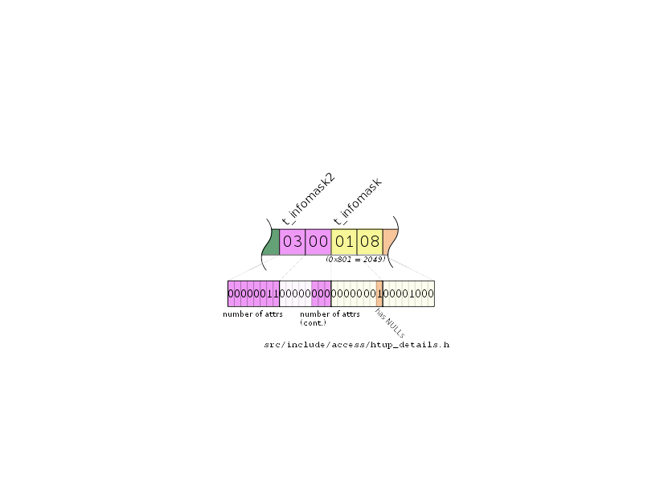
Infomask and Infomask2
test=# create table test (a int, b int, c int);
CREATE TABLE
test=# insert into test VALUES (1,2,3),(1,null,3);
INSERT 0 2
test=# select lp, t_infomask2, t_infomask, t_bits, t_data from heap_page_items(get_raw_page('test', 0));
lp | t_infomask2 | t_infomask | t_bits | t_data
----+-------------+------------+----------+---------------------------
1 | 3 | 2048 | | \x010000000200000003000000
2 | 3 | 2049 | 10100000 | \x0100000003000000
t_infomask stores various
flags, including has NULLs
flag; t_infomask2 stores
number of attributes and
some flags

Slide 14
NULLs
NULL values are not
stored in tuple data
test=# create table test (a int, b int, c int);
CREATE TABLE
test=# insert into test VALUES (1,2,3),(1,null,3);
INSERT 0 2
test=# select lp, t_infomask, t_bits, t_data from
heap_page_items(get_raw_page('test', 0));
lp | t_infomask | t_bits | t_data
----+------------+----------+---------------------------
1 | 2048 | | \x010000000200000003000000
2 | 2049 | 10100000 | \x0100000003000000
test=# select lp, t_infomask, t_bits, t_attrs from
heap_page_item_attrs(get_raw_page('test',0),'test'::regclass)
lp | t_infomask | t_bits | t_attrs
---+------------+---------+------------------------------------------
1 | 2048 | |{"\\x01000000","\\x02000000","\\x03000000"}
2 | 2049 |10100000 |{"\\x01000000",NULL,"\\x03000000"}

Slide 15

Alignment

Slide 16
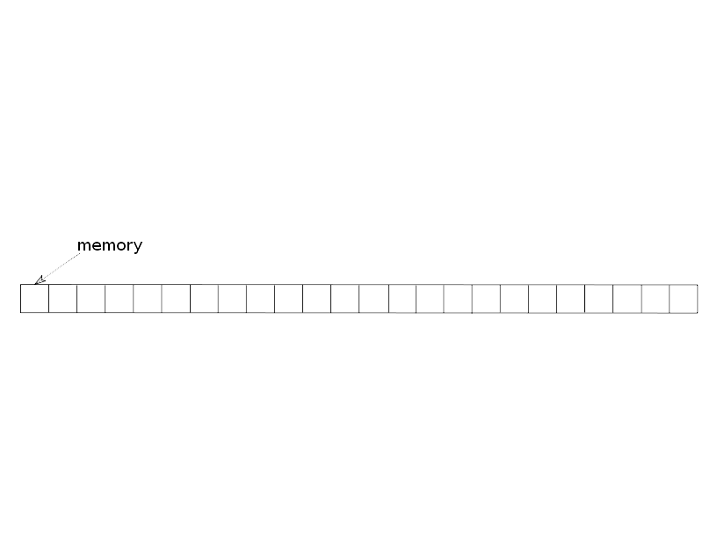
Alignment

Slide 17
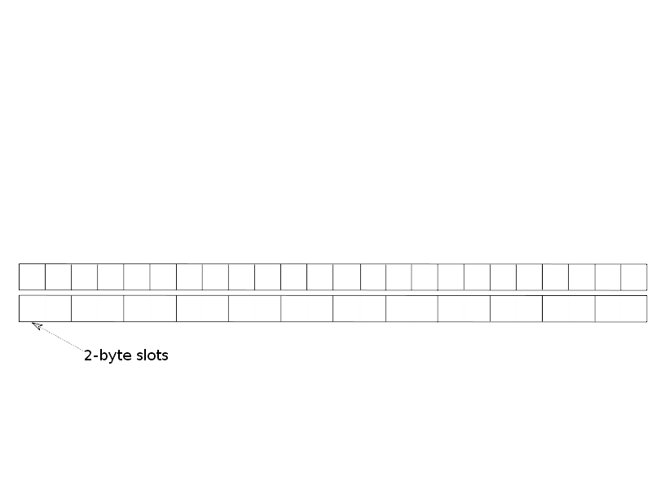
Alignment

Slide 18
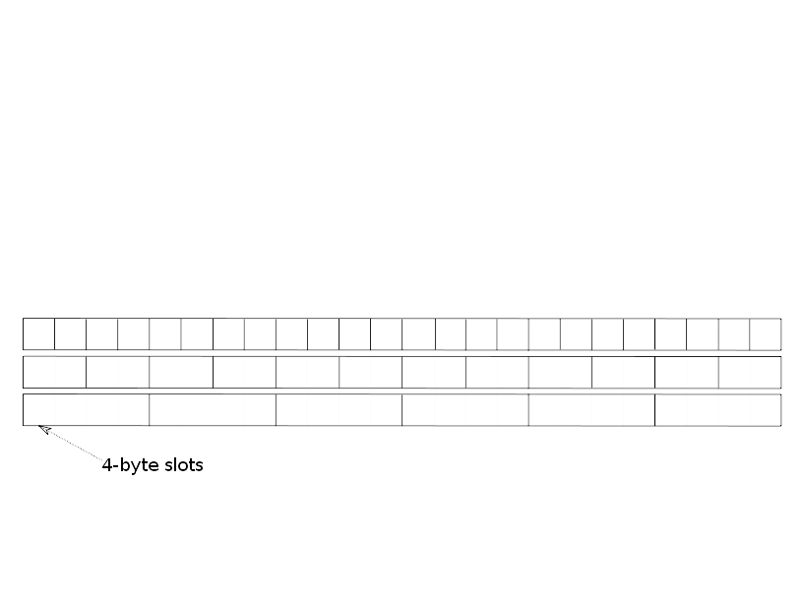
Alignment

Slide 19
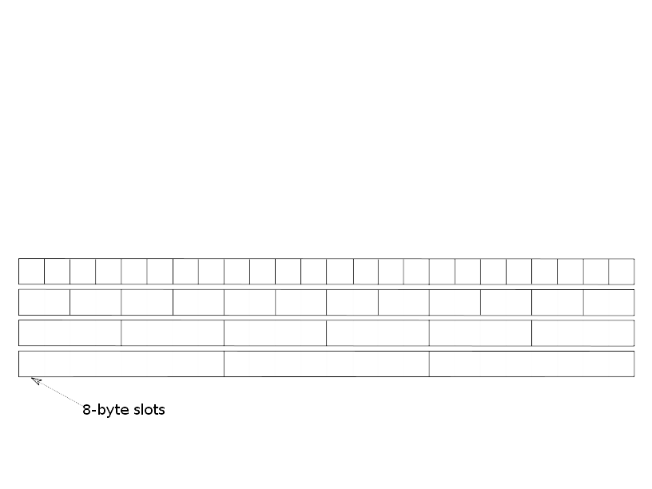
Alignment

Slide 20
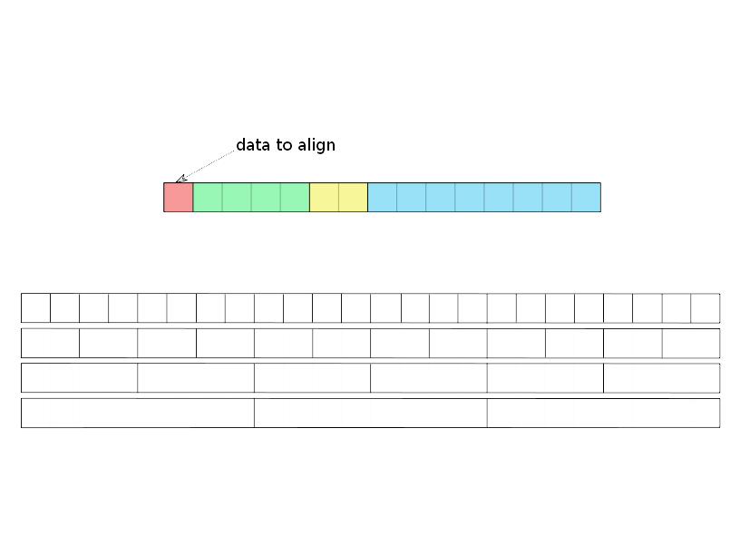
Alignment

Slide 21
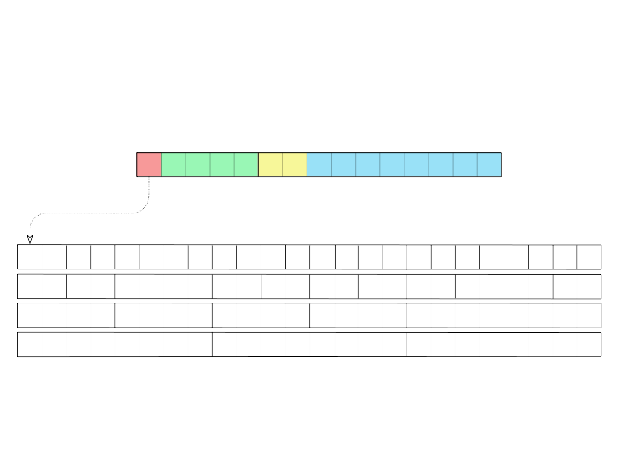
Alignment

Slide 22
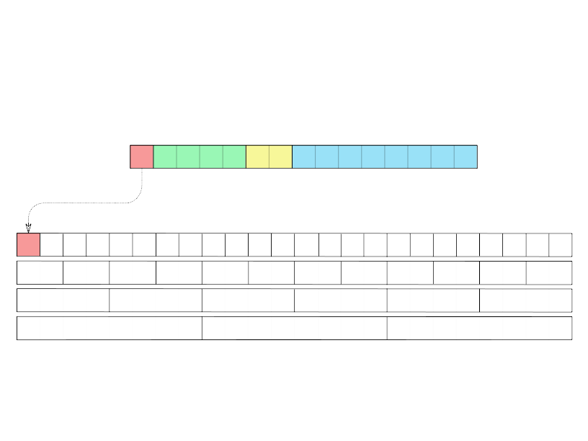
Alignment

Slide 23
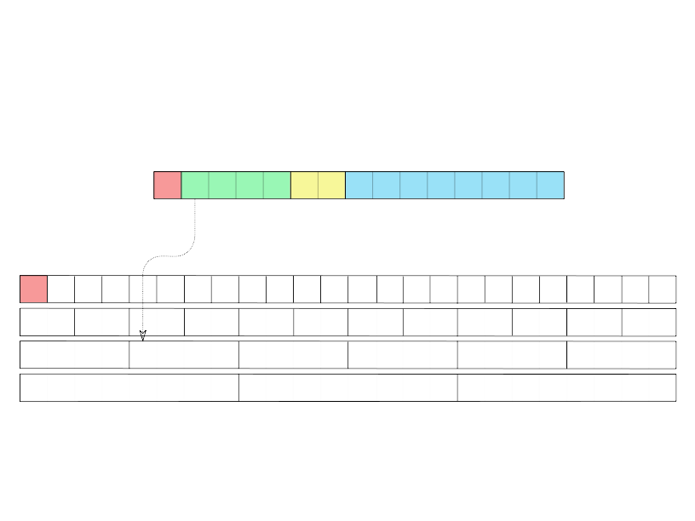
Alignment

Slide 24
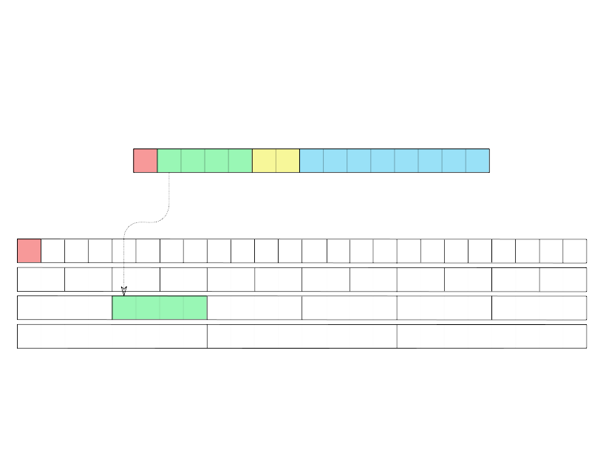
Alignment

Slide 25
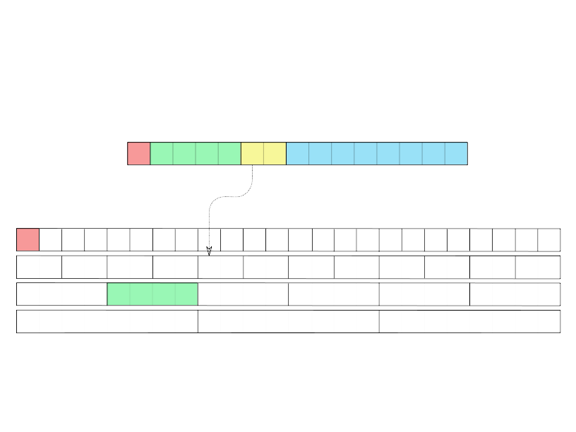
Alignment

Slide 26
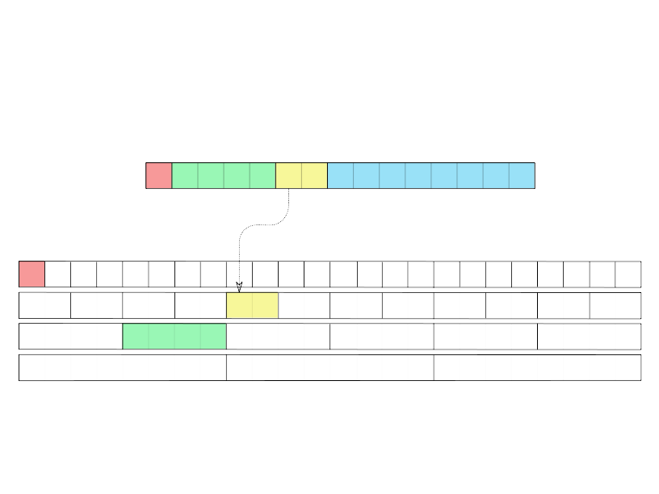
Alignment

Slide 27
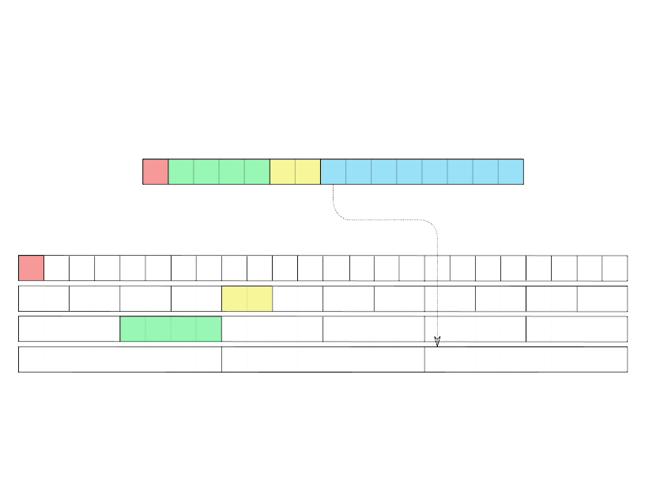
Alignment

Slide 28
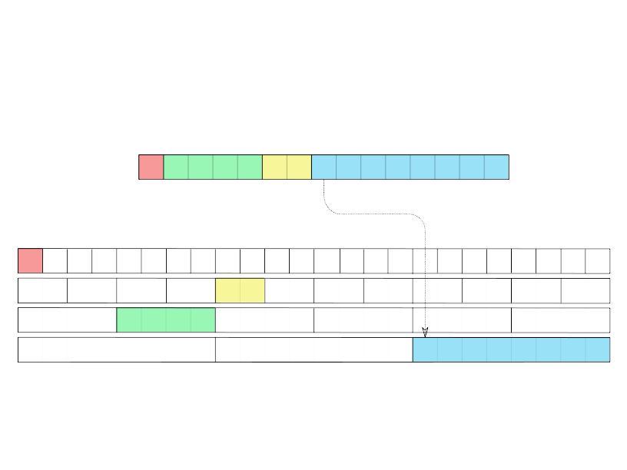
Alignment

Slide 29
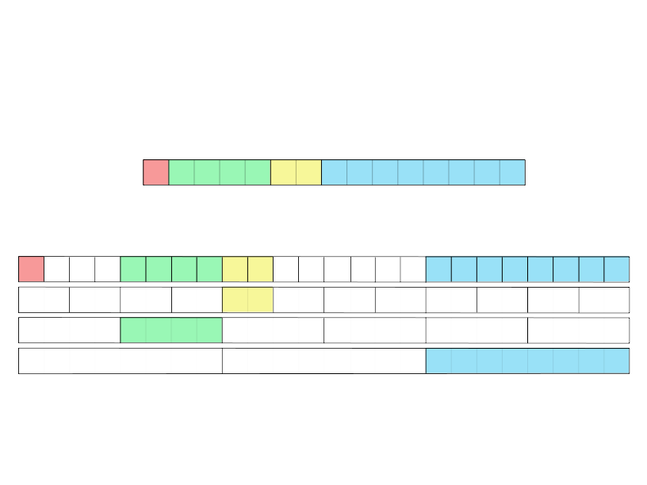
Alignment

Slide 30
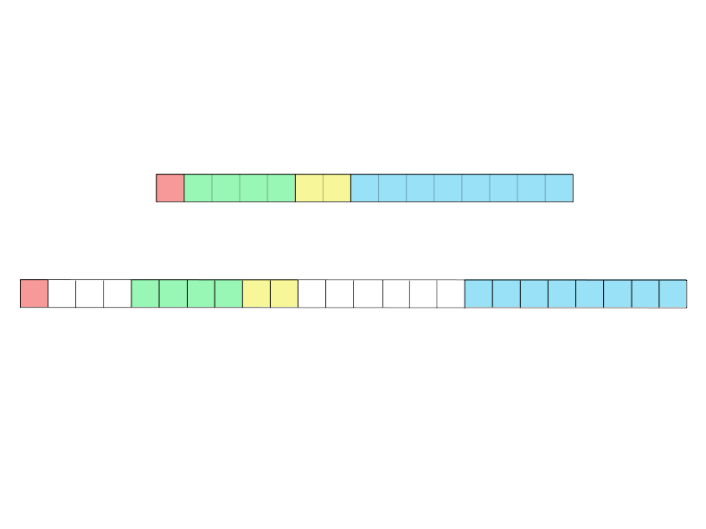
Alignment

Slide 31

Alignment of fixed-length attributes
test=# create table test (a boolean, b int, c smallint, d bigint);
CREATE TABLE
test=# insert into test VALUES ('t',2,3,4);
INSERT 0 1
test=# select lp, t_data from
heap_page_items(get_raw_page('test', 0));
Fixed-length
attributes are stored
properly aligned
lp | t_data
----+----------------------------------------------------
1 | \x010000000200000003000000000000000400000000000000

Slide 32
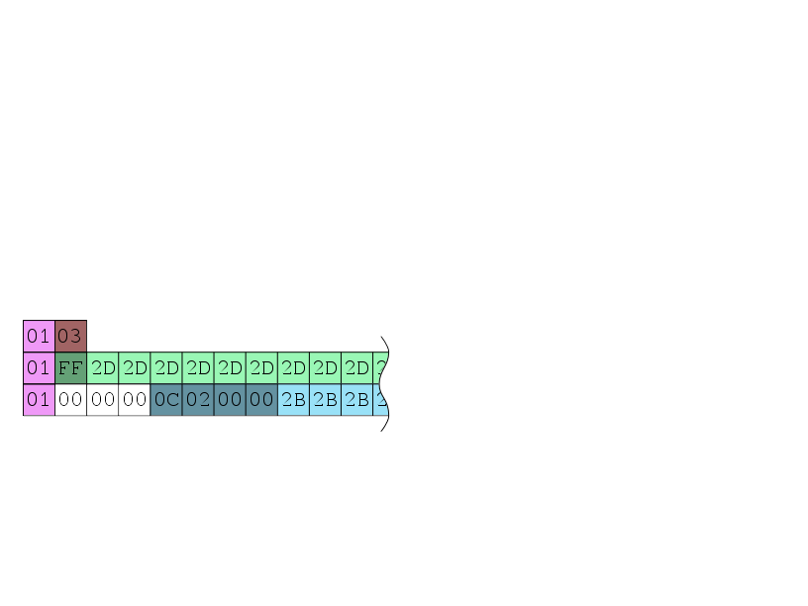
Alignment of variable-length attributes
test=# create table test (a boolean, b varchar);
CREATE TABLE
test=# insert into test VALUES ('t',''),
test-# ('t',repeat('-',126)),
test-# ('t',repeat('+',127));
INSERT 0 3
test=# select lp, t_data from heap_page_items(get_raw_page('test', 0));
For variable-length
attributes header is aligned:
4-byte header aligned as
four byte value, 1-byte
header is not aligned
at all
lp | t_data
---+---------------------------
1 | \x0103
2 | \x01ff2d2d2d2d2d2d2d2d...
3 | \x010000000c0200002b2b2b2b2b...

Slide 33
Alignment on
64- and 32-bit CPU
Alignment works in different
ways on different CPUs
# create table test (b int, c bigint);
CREATE TABLE
# insert into test VALUES (1,2);
INSERT 0 1
64bit
lp | t_data
---+-------------------------------------
1 | \x01000000000000000200000000000000
32bit
lp | t_data
---+-----------------------------
1 | \x010000000200000000000000

Slide 34
"Missing" attributes in tuple
Postgres does not update
tuples when you add column
with NULL default value, instead
it just returns NULL when user
asks for that "missing"
attribute
test=# create table test (a int, b int);
CREATE TABLE
test=# insert into test VALUES (1,10);
INSERT 0 2
test=# ALTER TABLE test ADD COLUMN c int;
ALTER TABLE
test=# insert into test VALUES (3,30,300);
INSERT 0 1
test=# select lp, t_infomask2, t_data from heap_page_items(get_raw_page('test', 0));
lp | t_infomask2 | t_data
----+-------------+----------------------------
1 | 2 | \x010000000a000000
2 | 3 | \x030000001e0000002c010000
test=# select lp, t_infomask2, t_attrs from
heap_page_item_attrs(get_raw_page('test',0),'test'::regclass);
lp | t_infomask2 | t_attrs
---+----------+-------------------------------------------
1 | 2 | {"\\x01000000","\\x0a000000",NULL}
2 | 3 | {"\\x03000000","\\x1e000000","\\x2c010000"}

Slide 35

Big data storage
Compression
TOAST

Slide 36
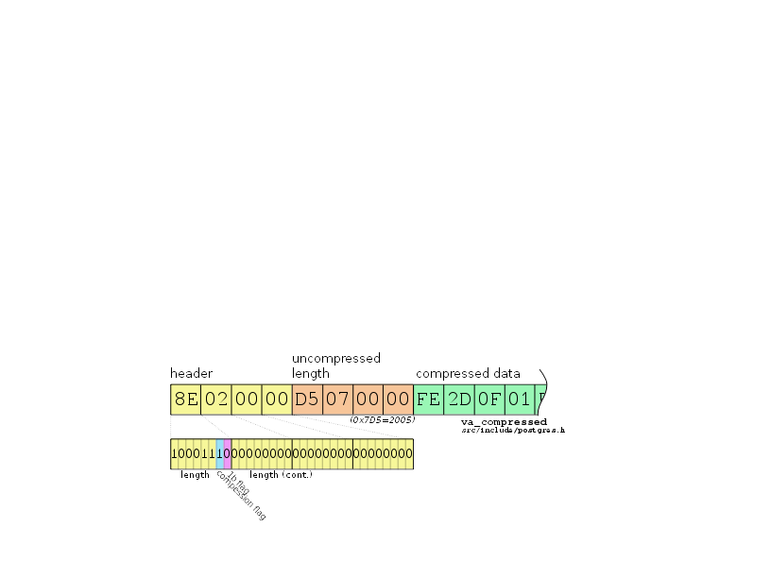
Compressed attributes
Postgres tries to
compress variable-length
attributes with LZ algorithm
if tuple size is ≳ 2K
test=# create table test (a varchar);
CREATE TABLE
test=# insert into test VALUES (repeat('-',2004)),
test-# (repeat('-',2005));
INSERT 0 2
test=# select lp, t_data from heap_page_items(get_raw_page('test', 0));
lp | t_data
---+-----------------------------------------------------------------------------
1 | \x601f00002d2d2d2d2d2d2d2d2d2d2d2d2d2d2d2d2d2d2d2d2d2d2d2d2d......
2 | \x8e000000d5070000fe2d0f01ff0f01ff0f01ff0f01ff0f01ff0f01ff0f01ff010f014b

Slide 37
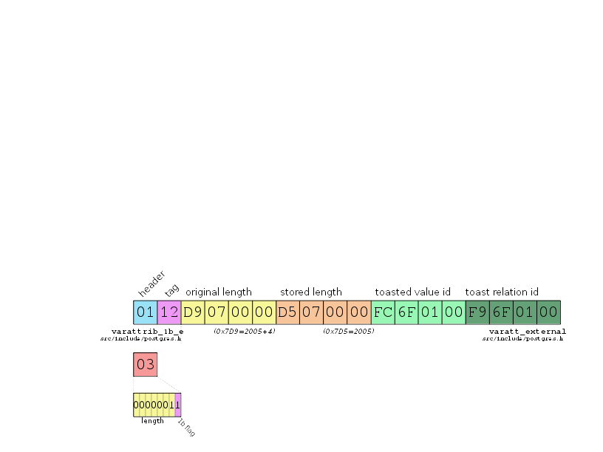
TOASTed attributes
test=# create table test (a varchar);
CREATE TABLE
test=# ALTER TABLE test ALTER a SET STORAGE EXTERNAL;
ALTER TABLE
test=# insert into test VALUES (repeat('-',2005),
test-# (''));
INSERT 0 2
test=# select lp, t_attrs from
heap_page_items(get_raw_page('test', 0));
lp | t_attrs
----+-------------------------------------------
1 | \x0112d9070000d5070000fc6f0100f96f0100
2 | \x03
Empty string has 0x03
one byte header.
0x01 is unreachable, so
it is used as TOASTed
string marker

Slide 38
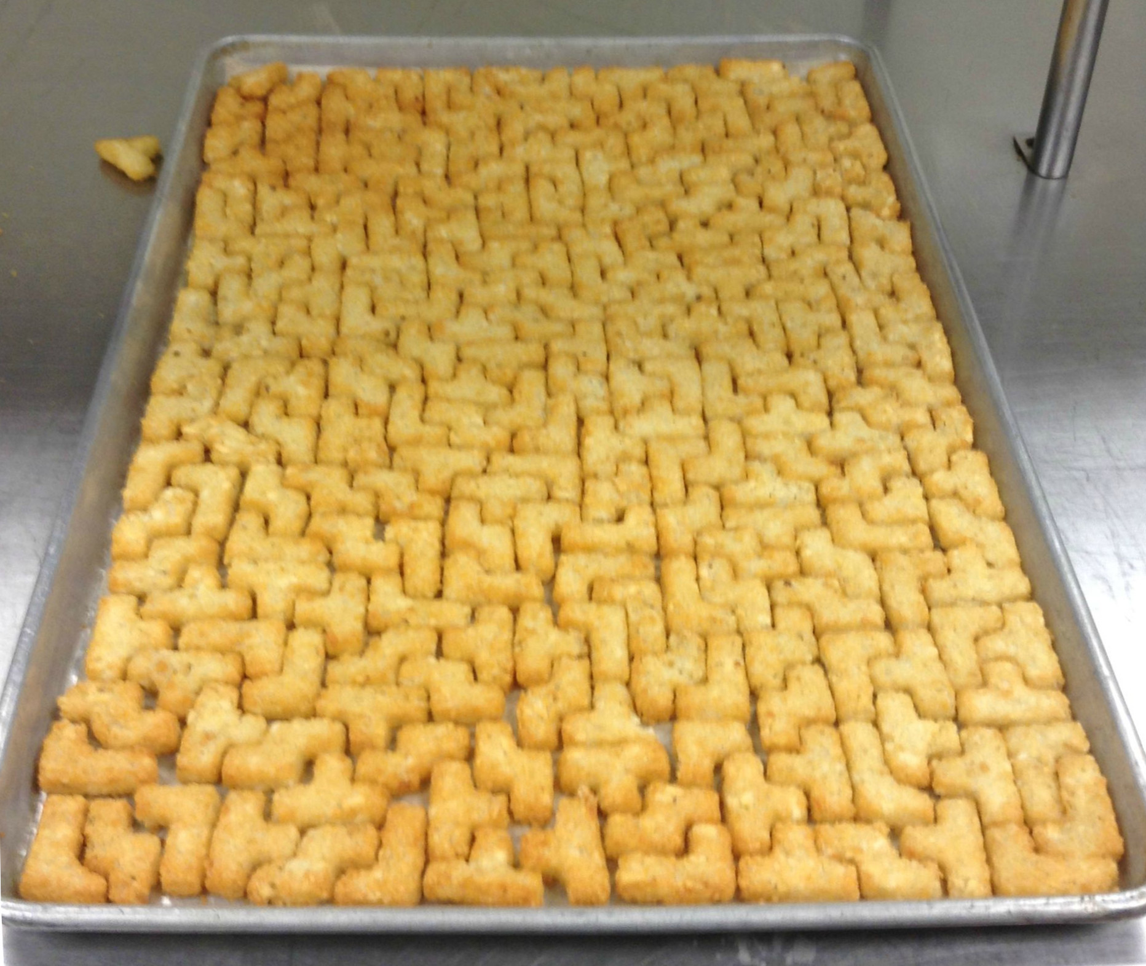
Optimization

Slide 39
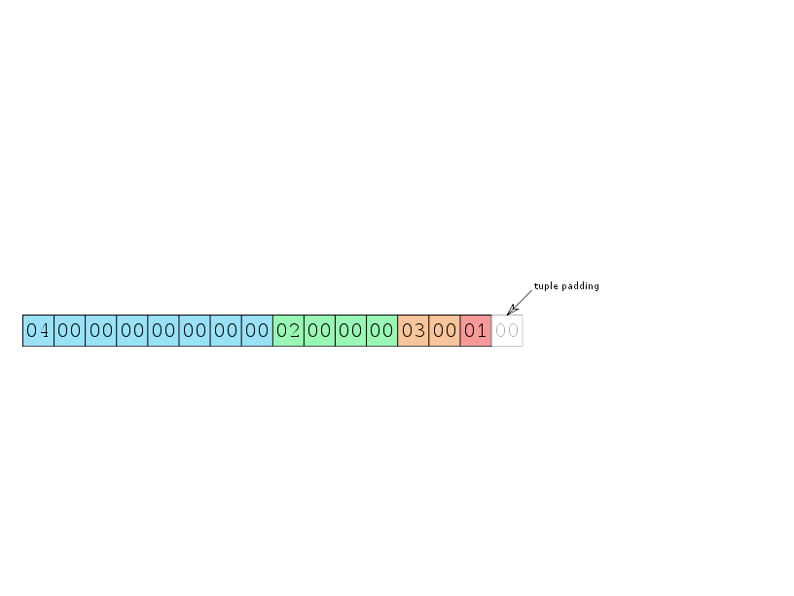
Size optimization
test=# create table test (a boolean, b int, c smallint, d bigint);
Reorder attributes in
to get rid of
unnecessary padding
test=# create table test (d bigint, b int, c smallint, a boolean);

Slide 40
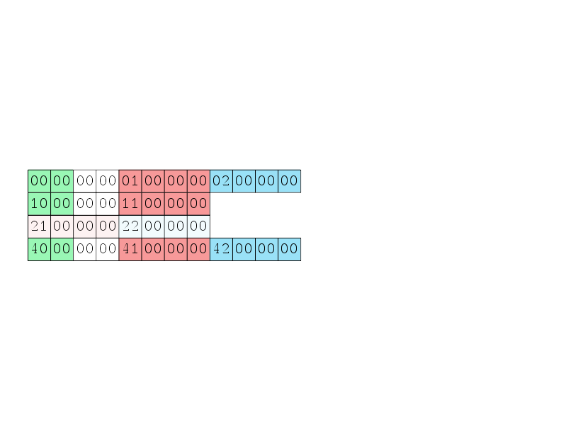
Access performance optimization
create table test (a smallint, b int, c int);
insert into test VALUES (0, 1, 2),
(16, 17, NULL),
(NULL,33, 34),
(64, 65, 66);
If there are no
NULLs and variable-length
attributes, position of an
attribute is predictable and
can be cached

Slide 41
optimization
Access performance
Not NULL fixed-length attributes go first
Then put fixed-length attributes with less NULLs
Move all variable-length attributes to the right

Slide 42
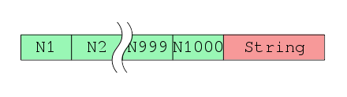
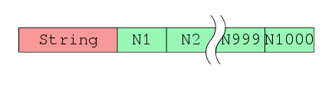
optimization
1 000 bigint attributes: N1..N1000
One string in the head or at the tail of a row
1 000 000 rows
Benchmark query: SELECT SUM(N1000)
Lets benchmark access
performance with varchar at
the beginning and in the
end of tuple
Test Environment
CPU: 4 socket Xeon V7,
15 Core per socket
Shared Memory: 100Gb
pgbench
clients: 100
jobs: 100
time: 360
String is last
String is first
tps = 64.373621
tps = 50.387503
64.373621 / 50.387503 = 1.27

Slide 43


Slide 44
What to compress
what to TOAST?
toast_insert_or_update
src/backend/access/heap/tuptoaster.c
TOAST_TUPLE_TARGET≈
BLCKSZ / 4
tuple size >
TOAST_TUPLE_TARGET
Are there uncompressed
varlen attributes?
Compress biggest
varlen attribute
Are there not TOASTed
varlen attributes?
TOAST biggest
varlen attribute
Tuple is ready

Slide 45
Access performance
optimization
fastgetattr
Fetching attribute N
from tuple
src/include/access/htup_details.h
Tuple has NULLs?
Attribute N is NULL?
Attribute position
is cashed?
Return NULL
Return value from
cashed position
Fetch with
nocachegetattr

Slide 46
Access performance
optimization
nocachegetattr
Fetching attribute N
from tuple
src/backend/access/common/heaptuple.c
Are there NULL before
attribute N?
Attribute position
is cashed?
Iterate over tuple data
till we reach attribute N
While iterating there
were NULL or varlen
attributes?
Return value from
cashed position
Remember position of
attribute N in cache
Return value we've found

Slide 47
Look for a newer versions at https://github.com/dhyannataraj/tuple-internals-presentation

