Slide 1



Me
Mass fragmentation:
What am I doing with
Peak Patterns of Small Metabolites?
Justin J.J. van der Hooft
Glasgow, UK
05 December 2014

Slide 2

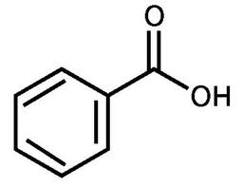

Mass spectrometry fragmentation
MS1
Ionization
Mass Separation
Mass Trapping
Mass Detection
+
+
+
+
m/z
+
+
+
+
MS2
+
+
+
m/z
Fragments to puzzle the metabolite structure

Slide 3


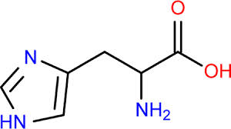
Analysis of fragmentation spectra: ‘barcode’ or ‘fingerprint’ of L-histidine
Standard_Mix1_Mixed2_Top5
T:
#
1735
RT:
10.35
AV:
1
NL:
4.03E5
FTMS + p ESI d Full ms2 156.08@hcd60.00 [50.00-175.00]
110.0713
100
C
5
H
8
N
3
95
90
Structural information
85
80
75
70
65
60
55
Mass fragments
Neutral losses
Relative Abundance
50
45
40
35
83.0604
30
C
4
H
7
N
2
25
93.0448
20
C
5
H
5
N
2
103.8980
156.0768
15
56.0498
81.0448
95.0604
C
6
H
10
O
2
N
3
10
C
3
H
6
N
68.0496
C
4
H
5
N
2
C
5
H
7
N
2
5
60.1322
C
4
H
6
N
89.3101
99.8003
133.2336
0
50
60
70
80
90
100
110
120
130
140
150
160
170
m/z

Slide 4
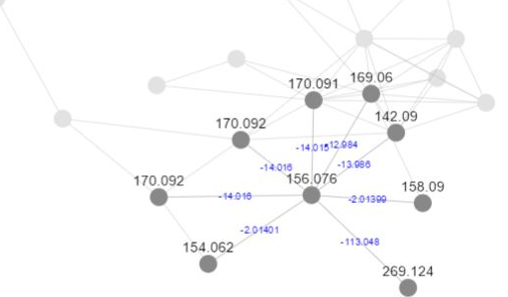
A story linked by fragments….
Challenge: comparing many many(!) spectra
Possible solution: use cosine function
Scores between 0 and 1 represent similarity
Create network based on cosine scores and other filters/thresholds
Note: no data interpretation is done yet!
MS2
MS2
MS2
MS2
MS2
m/z
m/z
m/z
m/z
m/z

Slide 5
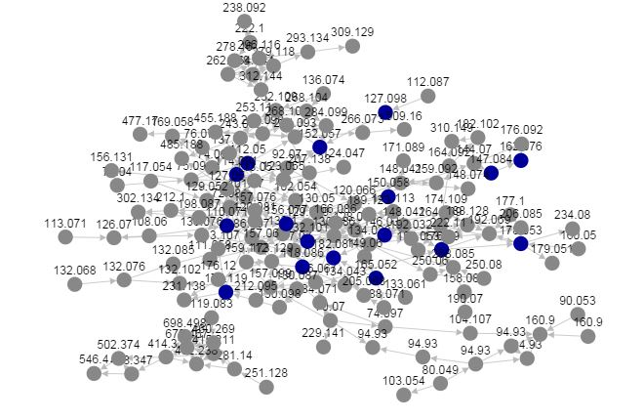
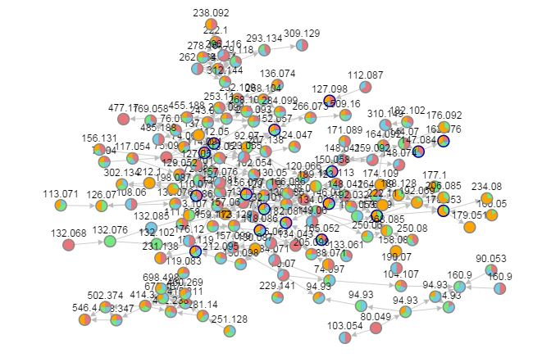

Molecular Network
0h
4h
9h
24h
Samples from Prof. David Smith
Developed by Dorrestein et al.

Slide 6
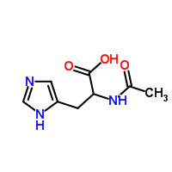
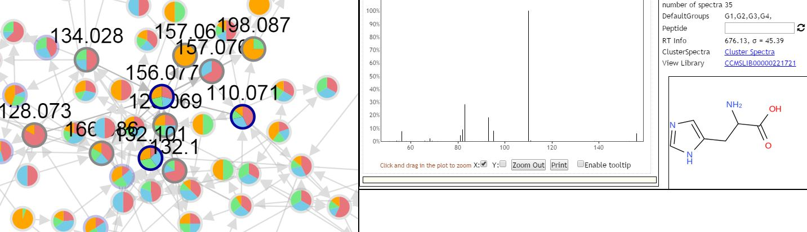
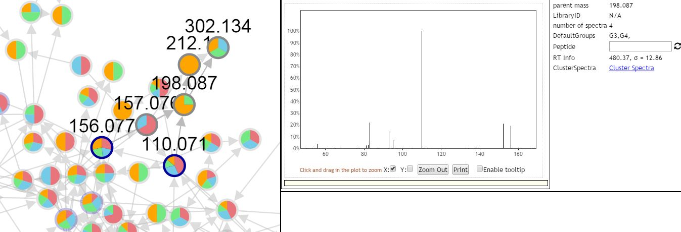

Slide 7
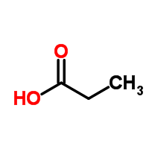
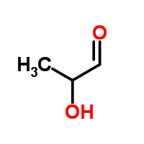
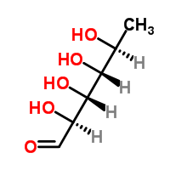
Campy_Fucose_24hrs_Top5_60NCEstepped_pos
F:
#
1995
RT:
8.95
AV:
1
NL:
1.79E5
FTMS + p ESI d Full ms2 302.13@hcd60.00 [50.00-325.00]
95.0604
Campy_Fucose_24hrs_Top5_60NCEstepped_pos
C
H
N
#
1672
RT:
7.55
AV:
1
NL:
7.24E5
F:
5
7
2
100
FTMS + p ESI d Full ms2 212.05@hcd60.00 [50.00-235.00]
110.0713
95
C
5
H
8
N
3
100
90
95
85
90
80
85
80
75
75
70
70
65
65
154.0975
60
C
H
O
N
60
55
7
12
3
Present at 24 hours….
Loss of C3H4O (C3H6O2)
Propionate or lactaldehyde or ….
Relative Abundance
55
50
83.0604
45
Relative Abundance
C
H
N
50
40
4
7
2
110.0713
45
35
C
H
N
5
8
3
C
156.0768
40
30
83.0604
6
H
10
O
2
N
3
35
25
C
4
H
7
N
2
166.0975
C
8
H
12
O
N
3
212.0951
30
20
93.0448
198.0874
C
7
H
18
O
4
N
S
15
C
H
N
C
H
O
N
68.0496
5
5
2
150.1027
8
12
3
3
25
10
56.0498
95.0604
C
H
N
194.0924
C
H
N
C
5
H
7
N
2
123.0110
8
12
3
C
H
4
6
20
5
3
6
N
C
3
H
7
O
3
S
138.0662
C
9
H
12
O
2
N
3
C
6
H
8
O
N
3
222.1236
0
101.6301
191.3631
198.4075
15
C
11
H
16
O
N
60
80
100
120
140
160
180
200
2
3
220
10
56.0498
124.0868
m/z
C
H
N
5
C
H
N
6
10
3
240.1339
311.0127
3
6
161.5426
C
11
H
18
O
3
N
C
H
O
P
0
3
280.5721
6
19
6
4
Campy_Fucose_24hrs_Top5_60NCEstepped_pos
#
2354
RT:
10.52
AV:
1
NL:
1.29E7
F:
FTMS + p ESI d Full ms2 156.08@hcd60.00 [50.00-175.00]
60
80
100
120
140
160
180
200
220
240
260
280
300
320
110.0713
C
5
H
N
100
8
3
m/z
95
90
85
80
Present at all time points….
Loss of C6H10O4 (C6H12O5)
Deoxyhexose! Fucose?
75
70
65
60
55
Relative Abundance
50
45
40
35
83.0604
30
C
4
H
7
N
25
2
93.0448
20
C
5
H
N
156.0768
15
81.0448
5
2
C
6
H
10
O
2
N
3
56.0498
C
H
N
95.0604
10
C
H
N
4
5
2
C
5
H
N
5
3
6
68.0496
7
2
138.0662
C
4
H
N
63.2183
6
85.2062
107.5948
C
6
H
8
O
N
152.7669
169.5725
0
50
60
70
80
90
100
110
120
130
140
3
150
160
170
m/z

Slide 8
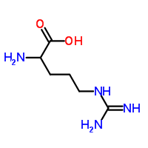
Neutral loss of 146.0577 at 0 hrs fucose added medium
RT:
3.00 - 20.00
NL: 7.15E7
100
7E7
Base Peak m/z=
90
175.1181-175.1199 F: FTMS +
80
p ESI Full ms [70.00-1050.00]
MS
70
Campy_Fucose_0hrs_Top5_60
60
NCEstepped_pos
Relative Abundance
RT:
3.00 - 12.00
4.70
NL:
50
100
1.10E6
40
95
Neutral Fragment
30
146.06 MS
90
Campy_Fucose_0
20
85
hrs_Top5_60NCEs
tepped_pos
10
80
0
75
NL: 1.89E7
100
70
2E7
Base Peak m/z=
90
65
321.1753-321.1785 F: FTMS +
80
7.04
p ESI Full ms [70.00-1050.00]
60
MS
70
55
Campy_Fucose_0hrs_Top5_60
60
Relative Abundance
NCEstepped_pos
50
50
8.70
8.95
45
40
40
30
35
20
30
10
25
8.47
0
20
4
6
8
10
12
14
16
18
20
15
Time (min)
7.15
9.25
4.90
8.22
Campy_Fucose_0hrs_Top5_60NCEstepped_pos
10
#
3772
RT:
17.04
AV:
1
NL:
1.08E7
Campy_Fucose_0hrs_Top5_60NCEstepped_pos
T:
#
2526
RT:
11.15
AV:
1
NL:
6.43E5
7.43
FTMS + p ESI d Full ms2 321.18@hcd60.00 [50.00-345.00]
4.02
5.03
T:
FTMS + p ESI d Full ms2 175.12@hcd60.00 [50.00-195.00]
10.25
70.0652
5
4.56
7.01
70.0652
C
4
H
8
N
C
4
H
N
10.74
11.15
100
3.60
3.72
5.15
5.40
5.92
6.68
7.70
8
9.49
10.08
11.36
95
0
100
90
3
4
5
6
7
95
8
9
10
11
12
Time (min)
85
90
80
114.0914
85
75
C
6
H
12
O
N
173.1397
80
70
C
7
H
17
O
N
4
75
65
70
60
65
55
60
Relative Abundance
55
50
Relative Abundance
45
50
40
45
35
217.1295
40
C
175.1189
C
H
O
N
6
H
15
O
2
N
84.0808
8
17
3
4
35
4
30
60.0559
C
5
H
10
N
30
60.0559
97.0760
C
H
N
25
C
H
6
N
3
C
5
H
9
N
2
25
6
3
116.0706
20
20
C
5
H
10
O
2
N
15
131.1291
241.1657
321.1767
15
130.0975
10
C
H
N
156.1132
200.1280
C
11
H
21
O
2
N
4
C
H
P
10
C
5
H
12
O
N
158.0924
5
15
4
C
7
H
14
O
N
3
277.1865
22
26
72.0808
3
C
6
H
12
O
2
N
5
C
10
H
18
O
3
N
C
13
H
30
N
2
P
S
5
68.0495
C
H
N
97.0761
112.0869
141.0664
3
191.8659
303.4981
4
10
C
5
H
10
N
0
C
4
H
N
C
H
N
3
C
H
O
N
P
C
P
S
60
80
100
120
140
160
180
200
220
240
260
280
300
320
340
0
50
52.6039
60
6
70
80
90
5
9
2
120.5136
2
12
2
3
180.8182
3
4
m/z
100
110
120
m/z
130
140
150
160
170
180
190

Slide 9

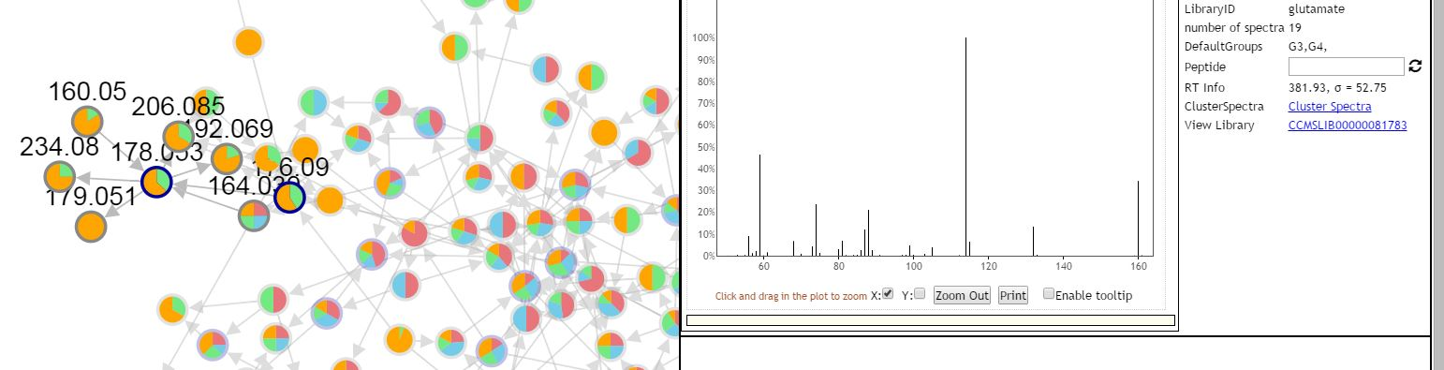
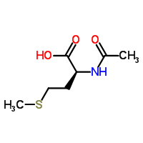

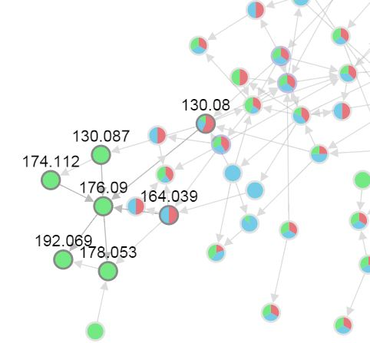

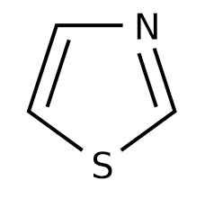
0h
4h
9h
24h
24hrs Medium
24hrs Glutamate
24hrs Fucose
?

Slide 10
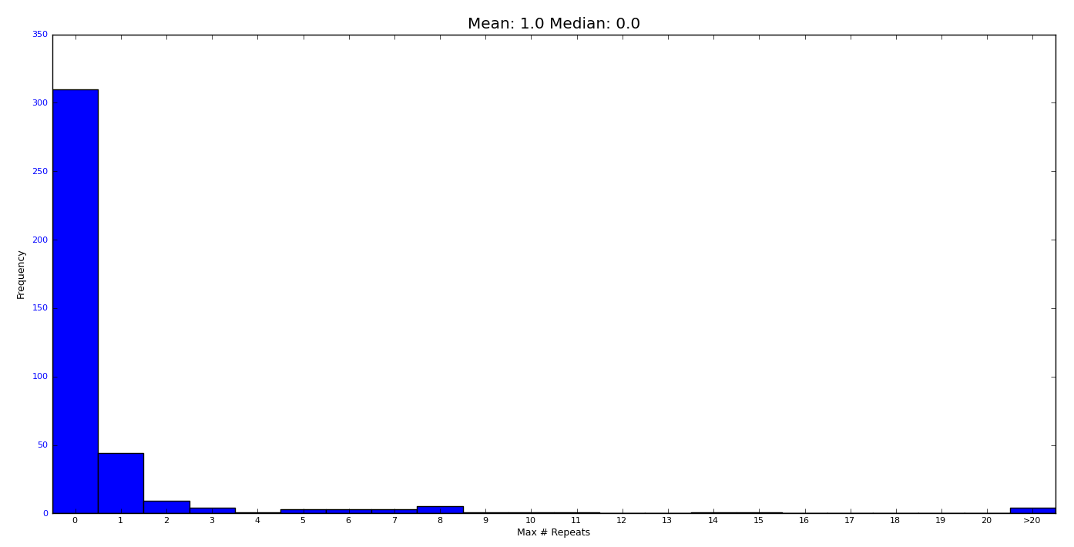
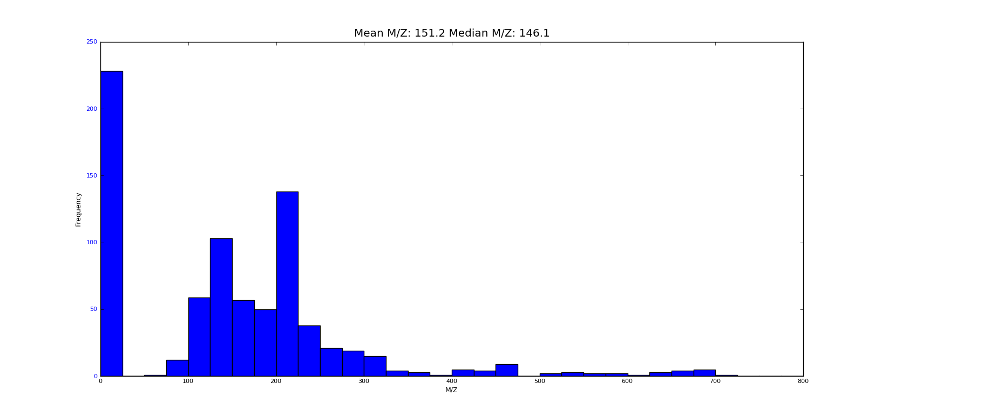
QC: RawExtract + Logviewer
Take information from scan header with RawExtract → plot with Logviewer
??

Slide 11
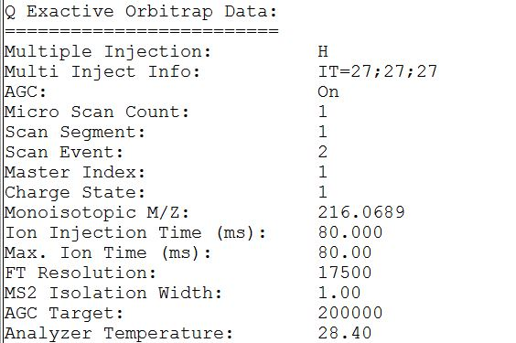
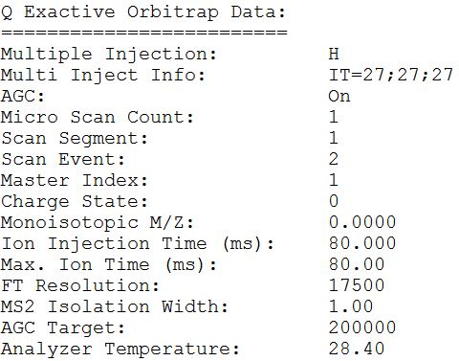

Slide 12

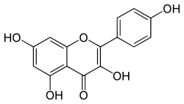


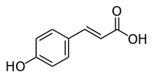


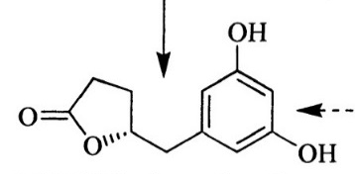
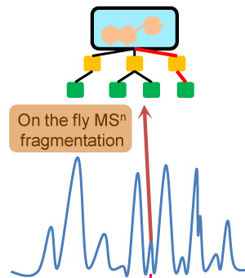
Thanks for your attention! Any questions?
100
85.0283
95
C₄H₅O₂
102.0913
90
60.0806
85
C₃H₁₀N
C₅H₁₂ON
80
75
70
103.0389
65
60
C₄H₇O₃
55
Relative Abundance
50
45
40
58.0650
35
C₃H₈N
30
57.0334
25
HCD@90NCE
162.1127
20
C₃H₅O
15
C₇H₁₆O₃N
10
5
0
50
60
70
80
90
100
110
120
130
140
150
160
170
m/z

Slide 13
A story linked by fragments….
Comparing many spectra
Cosine function → network
Annotation of key fragments
What are the modifications?
Biologically relevant? Biochemistry?
Taste of ‘real’ novel compounds

