Slide 1
The Votorum Index
The Wishlist Project By Thomas Pouw

Slide 2
What am i gonna talk about?
-Search
-Add/Edit
-Product Page
-User
-Admin
-Programming languages

Slide 3
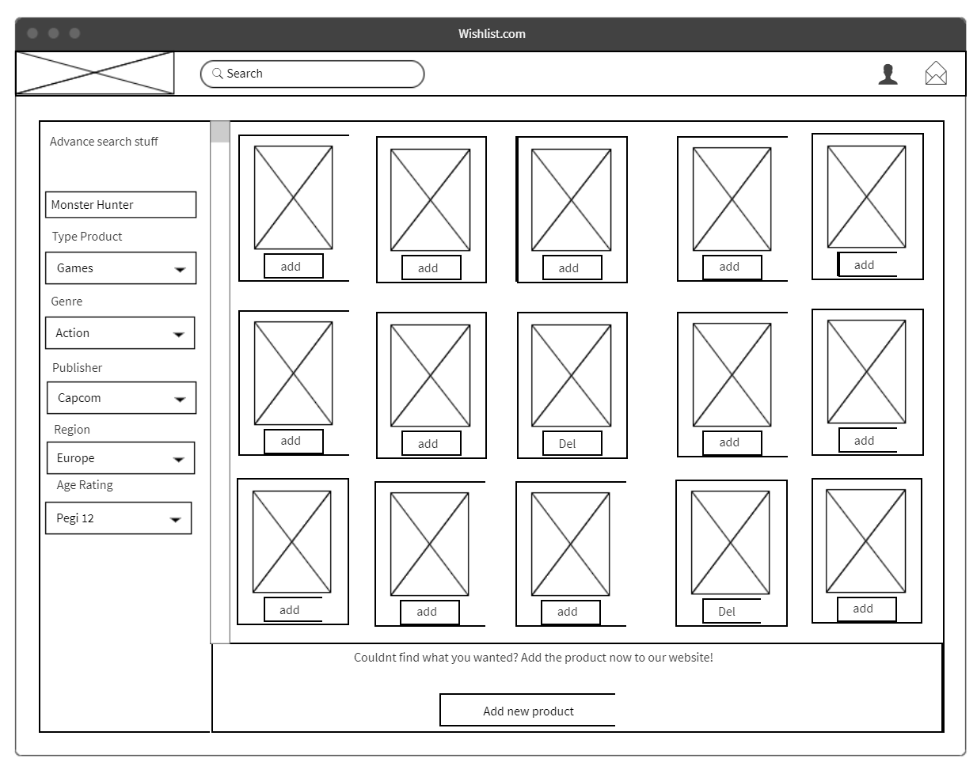
Search

Slide 4
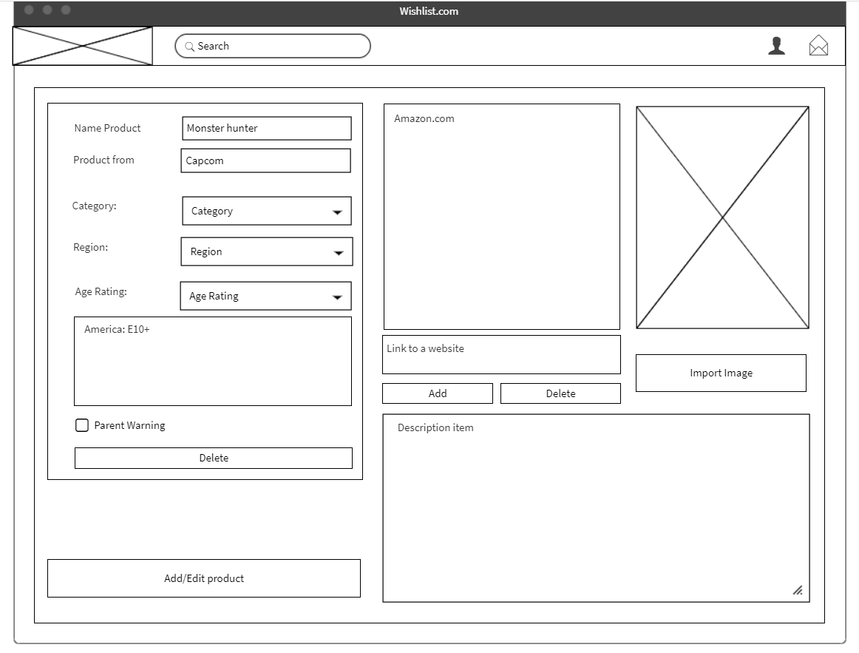
Add and Edit

Slide 5
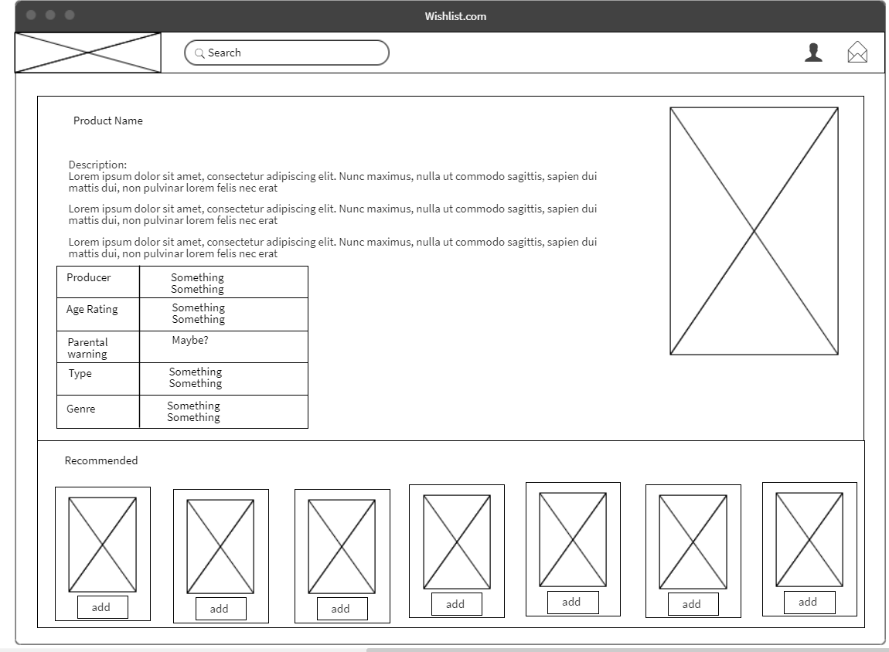
Product page

Slide 6
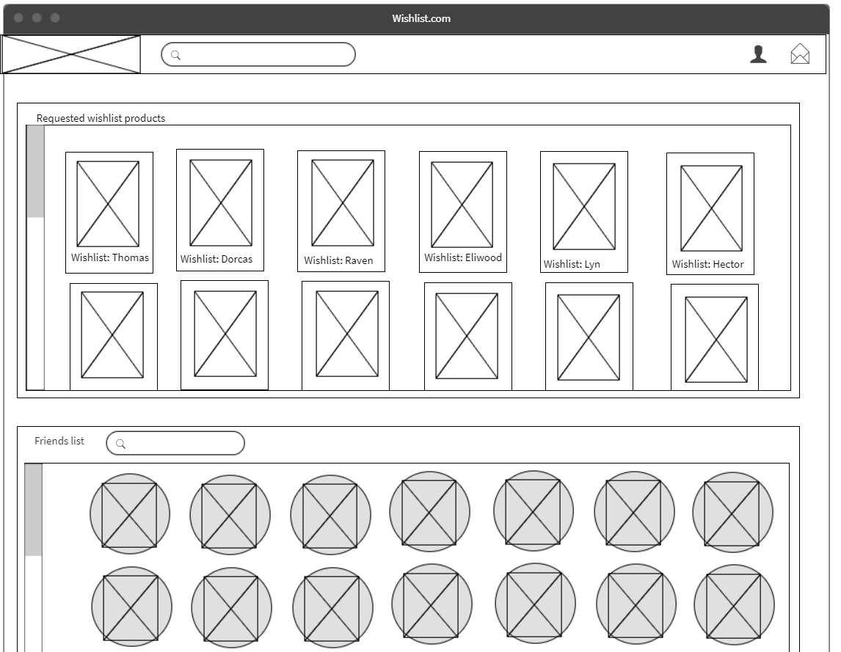
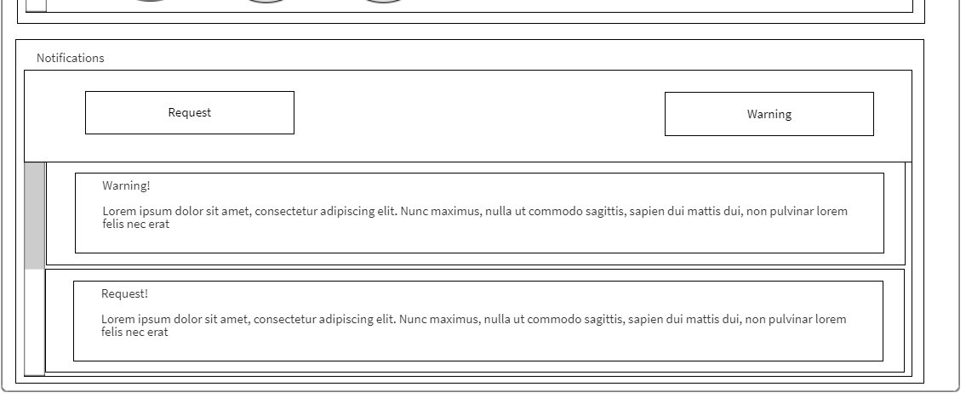
User

Slide 7
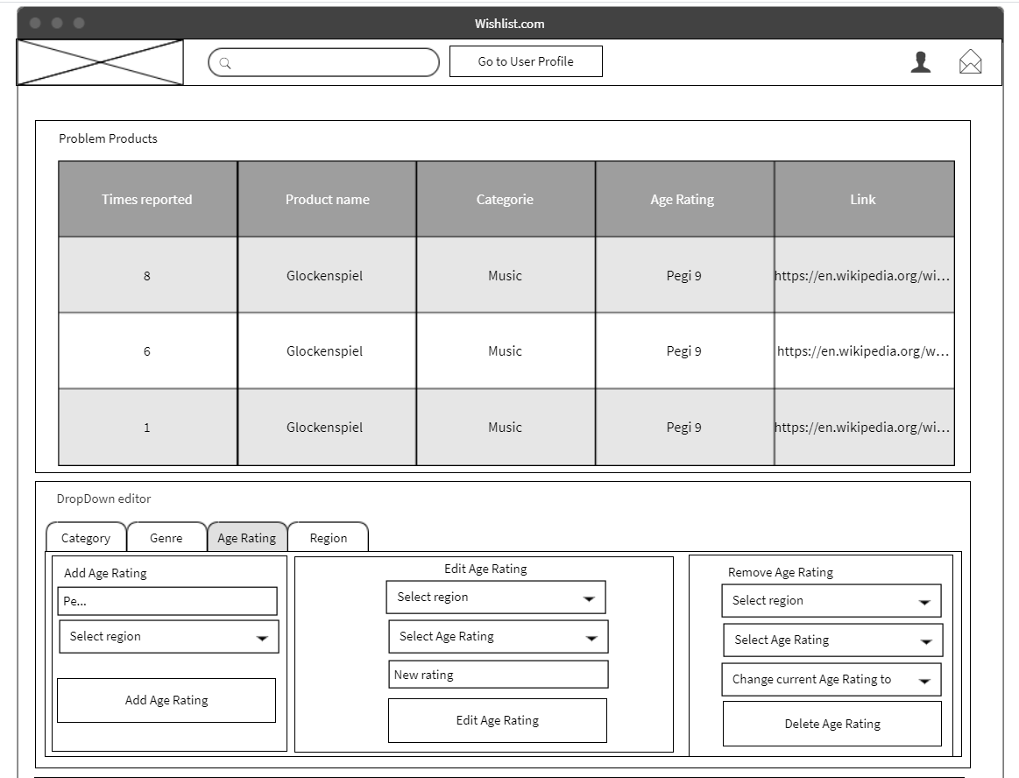
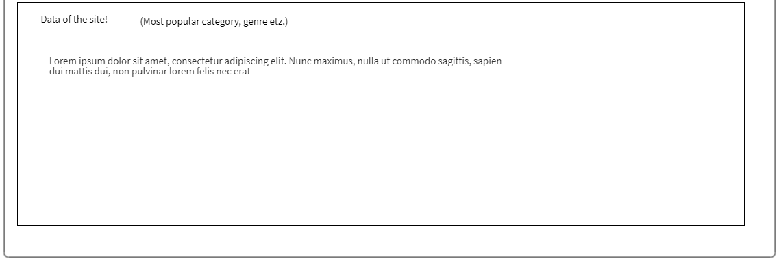
Admin

Slide 8
Programming Languages
React+Javascript
Java (Spring Boot)

