Slide 1


ShopAdmin Control your expenses with receipt scanner

Slide 2
Content
Live Demo
Approach
Details
Conclusion
1

Slide 3
Content
Live Demo
Approach
Details
Conclusion
2

Slide 4
Scrum Process
For the realization of ShopAdmin it was decided to use SCRUM
Product Vision
Daily Scrum
Sprint Review
Product Backlog
User Story 1
Sprint Planing
Sprint
Retrospective
User Story 2
Sprint Backlog
Tasks
Sprint execution
Potentially shippable product increment
User Story 3
User Story 1
User Story 4
User Story 4
3

Slide 5
Scrum Process
Pitch described by 8 Use Cases
Product Vision
Daily Scrum
Sprint Review
Product Backlog
User Story 1
Sprint Planing
Sprint
Retrospective
User Story 2
Sprint Backlog
Tasks
Sprint execution
Potentially shippable product increment
User Story 3
User Story 1
User Story 4
User Story 4
3

Slide 6
Scrum Process
Product Vision
Daily Scrum
Sprint Review
Product Backlog
User Story 1
Sprint Planing
Sprint
Retrospective
User Story 2
Sprint Backlog
Tasks
Sprint execution
Potentially shippable product increment
User Story 3
User Story 1
User Story 4
User Story 4
Out of 8 User Stories 101 Backlog Items have been created
3

Slide 7
Scrum Process
In 4 Sprints 44 Backlog Items have been completed
Product Vision
Daily Scrum
Sprint Review
Product Backlog
User Story 1
Sprint Planing
Sprint
Retrospective
User Story 2
Sprint Backlog
Tasks
Sprint execution
Potentially shippable product increment
User Story 3
User Story 1
User Story 4
User Story 4
3

Slide 8
Scrum Process
In 4 Sprints 39 Backlog Items have been completed
Product Vision
Daily Scrum
Sprint Review
Product Backlog
User Story 1
Sprint Planing
Sprint
Retrospective
User Story 2
Sprint Backlog
Tasks
Sprint execution
Potentially shippable product increment
User Story 3
User Story 1
User Story 4
User Story 4
3

Slide 9
Scrum Process
Product Vision
Daily Scrum
Sprint Review
Product Backlog
User Story 1
Sprint Planing
Sprint
Retrospective
User Story 2
Sprint Backlog
Tasks
Sprint execution
Potentially shippable product increment
User Story 3
User Story 1
User Story 4
User Story 4
Nevertheless a highly sophisticated product has been created
3

Slide 10
Responsibilities
4

Slide 11
Responsibilities
Core Competences
Requirements
Implementation
Individual Focuses
Testing
Documentation
4

Slide 12
Responsibilities
Corporate Design, Database
OCR and Classification
Tanja
Thomas
Core Competences
Requirements
Implementation
Individual Focuses
Testing
Documentation
Activity Development
Architecture Modeling
Katia
Project Management SCRUM Process
Iuliia
Sascha
4

Slide 13
Content
Live Demo
Approach
Details
Technical Design
Android Details
Character Recognition and Receipt Extraction
Conclusion
5

Slide 14
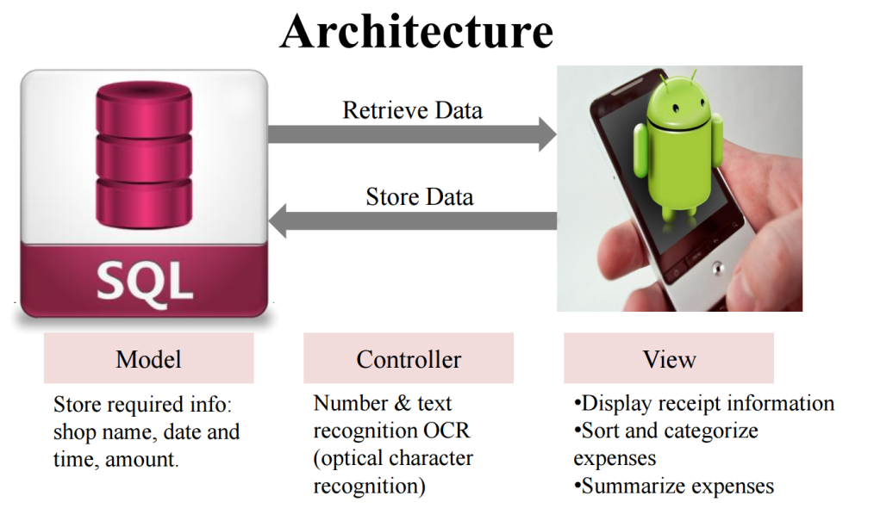
Architecture Overview
How it all began…
6

Slide 15
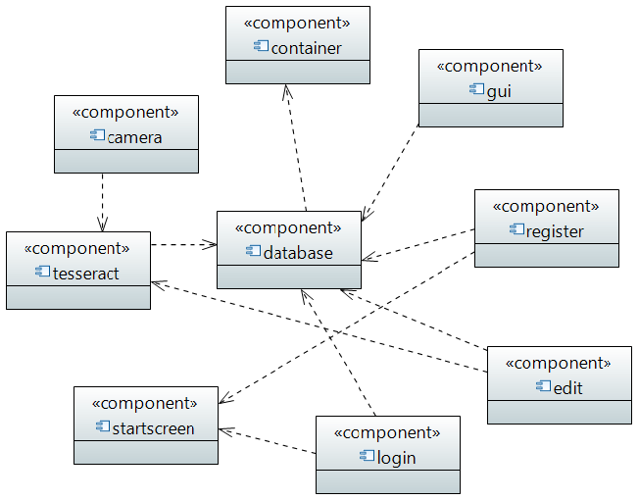
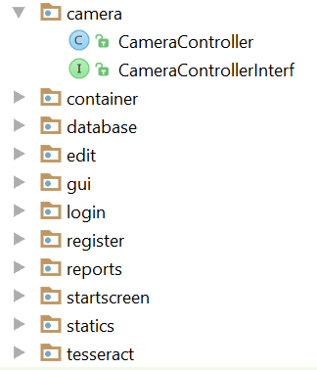
Architecture Overview
How it all began…
Project Structure:
division into 9 components
achieving modularity: interface/implementation
Component Diagram
6

Slide 16
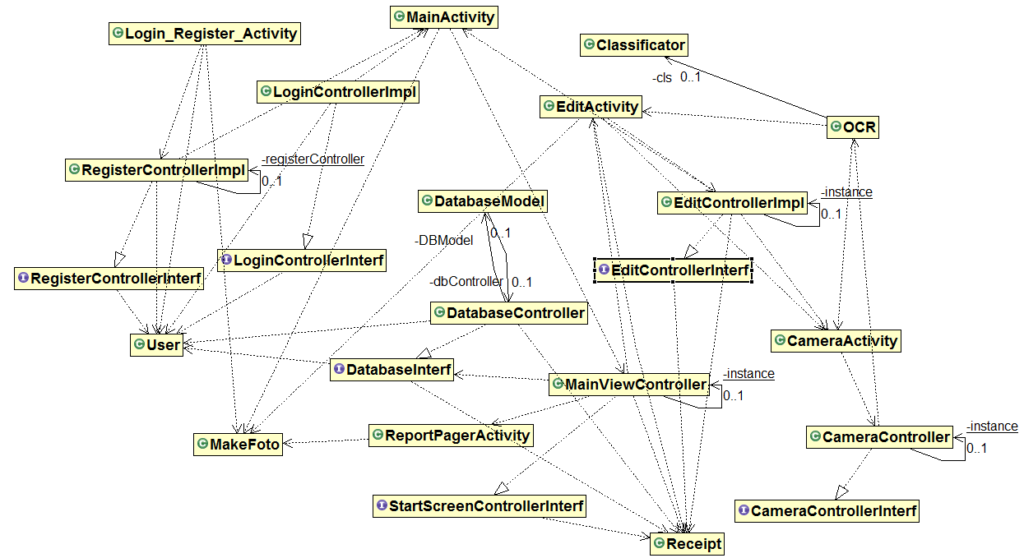
Project structure became more and more complicated…
Architecture: Structure
General Class Diagram
7

Slide 17
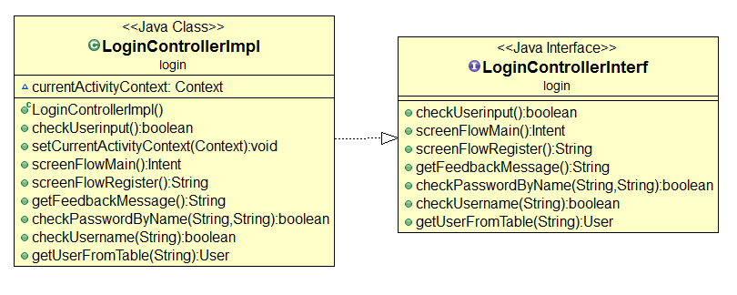
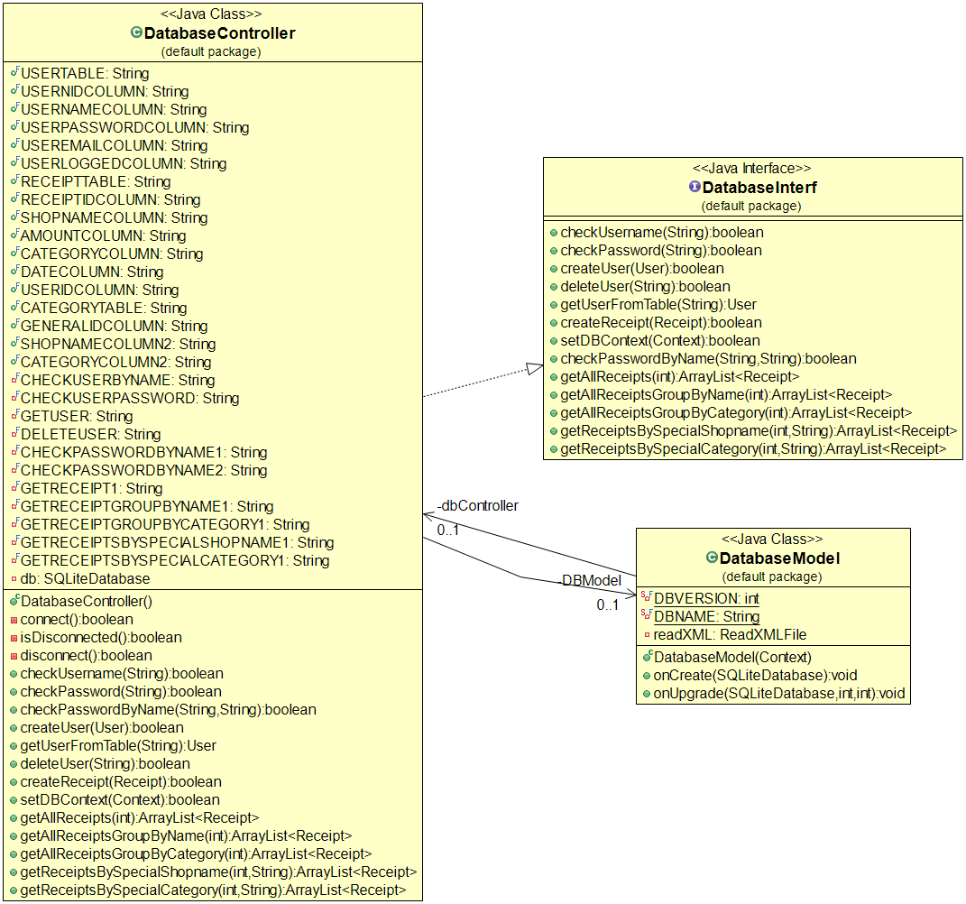
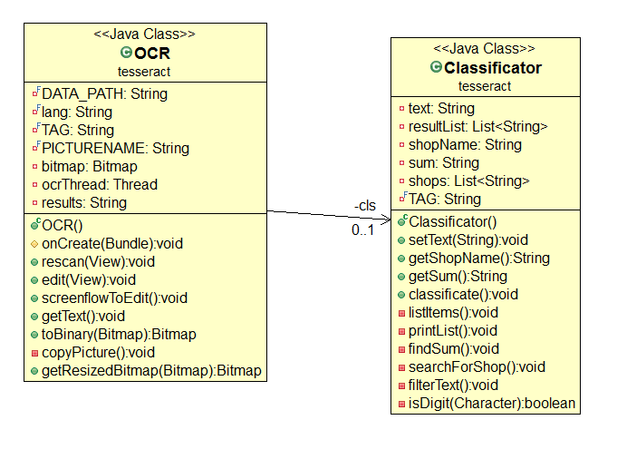
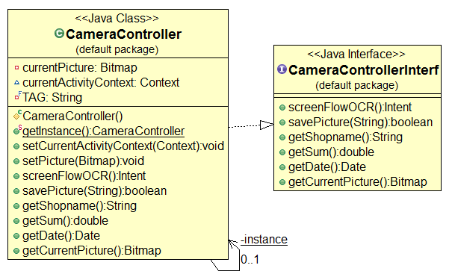
Project structure became more and more complicated…
Architecture: Structure
Expended Class Diagrams
8

Slide 18
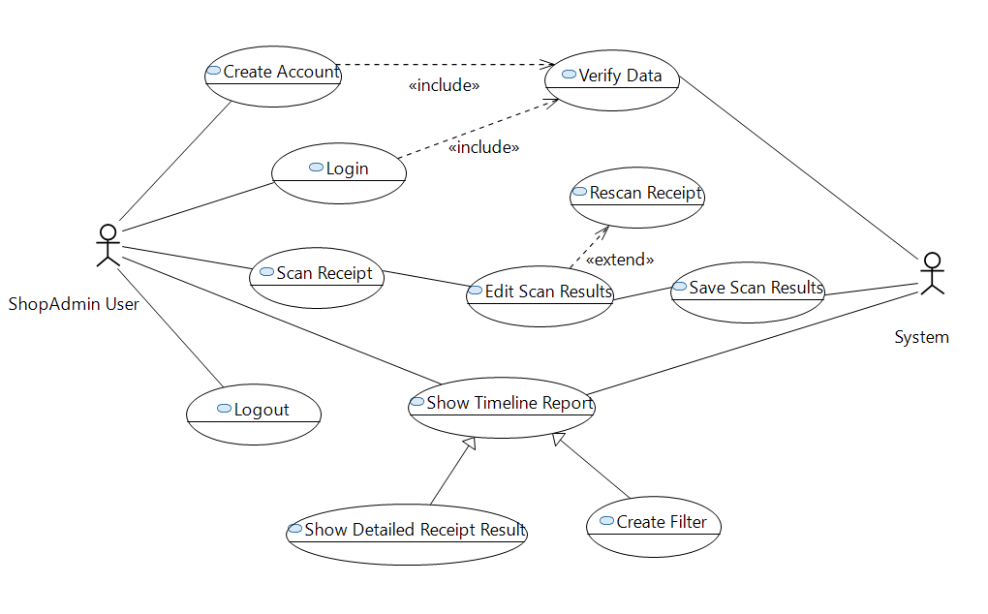
Usecase Diagram
Architecture: Behavior
9

Slide 19
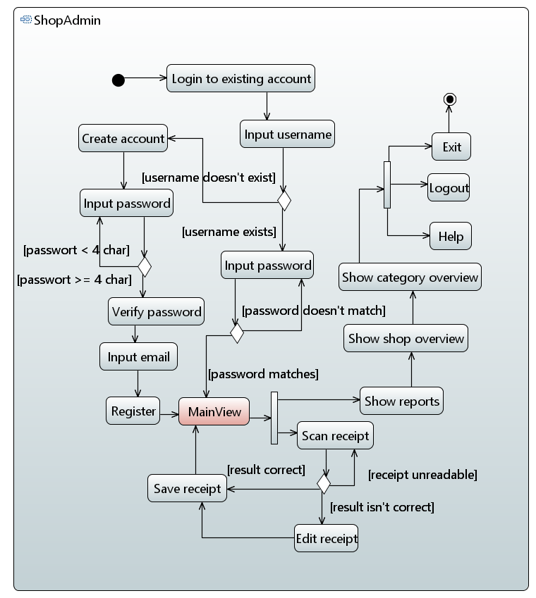
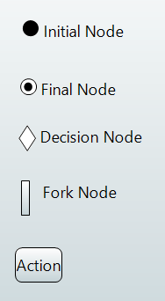
Activity Diagram
Architecture: Behavior
Notation Overview:
10

Slide 20
Content
Live Demo
Approach
Details
Technical Design
Android Details
Corporate Guideline
Activities
Character Recognition and Receipt Extraction
Conclusion
11

Slide 21

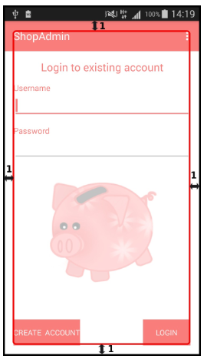
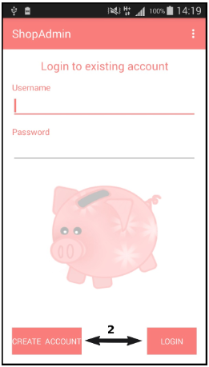
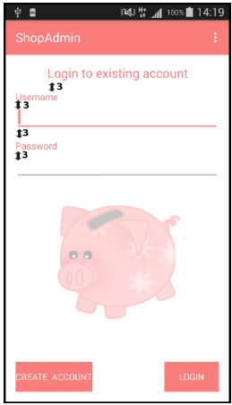
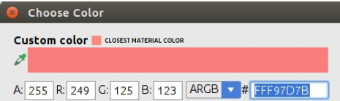
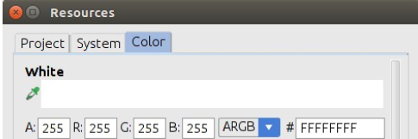
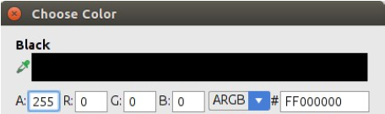
Corporate Design
Colors
Logo: piggybank (background in the app)
Pictures for Menu Help
12

Slide 22
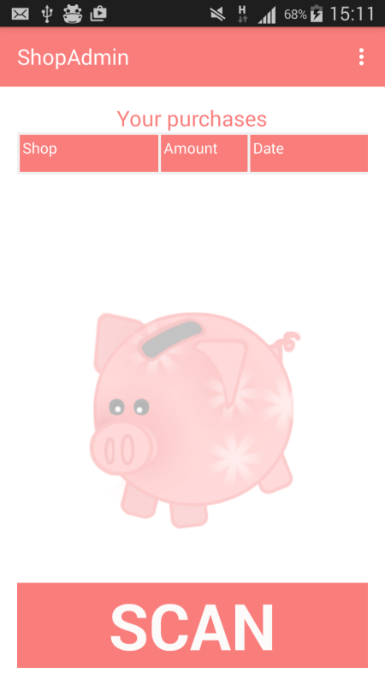
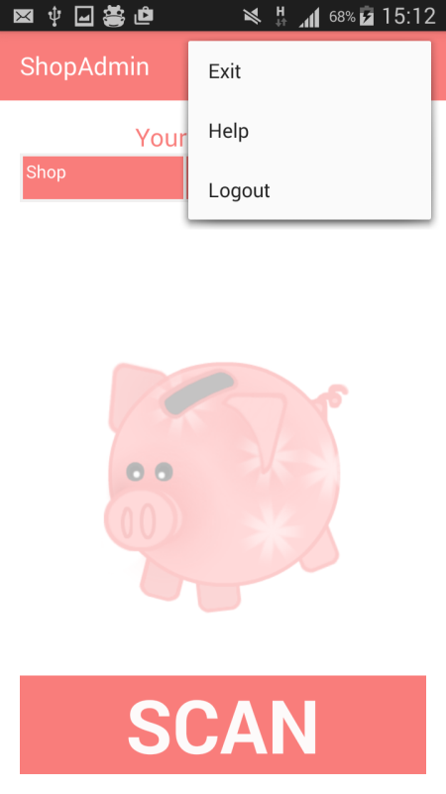
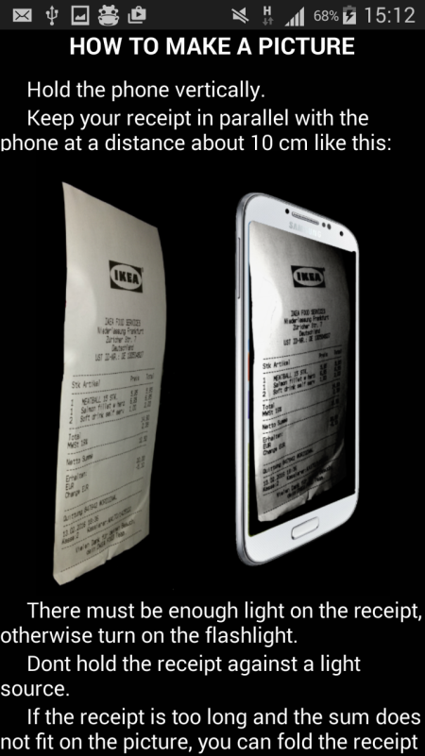
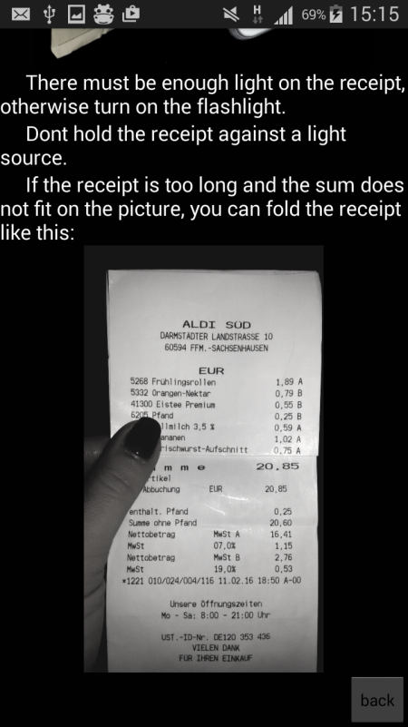
Action Bar with Overflow Menu
Functionality:
Exit
Help
13

Slide 23
Content
Live Demo
Approach
Details
Technical Design
Android Details
Corporate Guideline
Activities
Character Recognition and Receipt Extraction
Conclusion
14

Slide 24
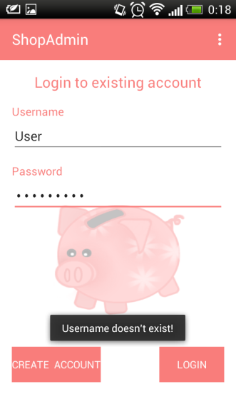
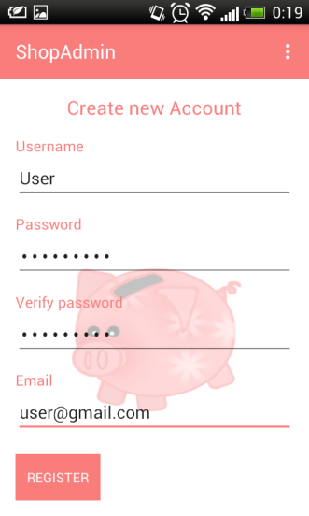
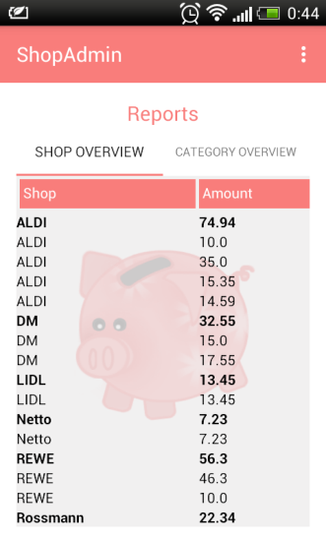
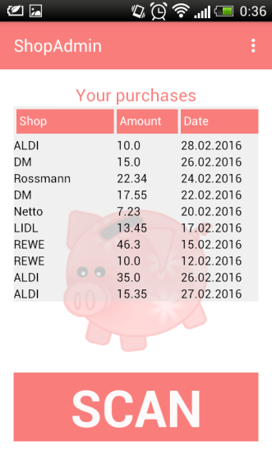
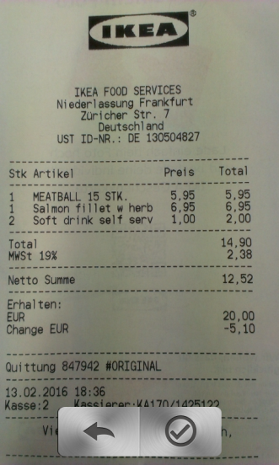
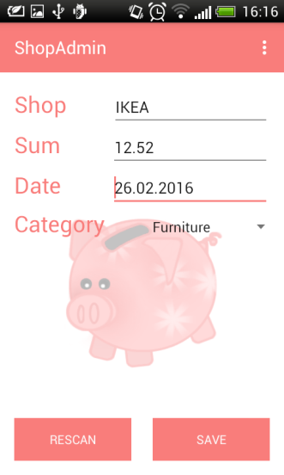
Scheme of Screens
15

Slide 25
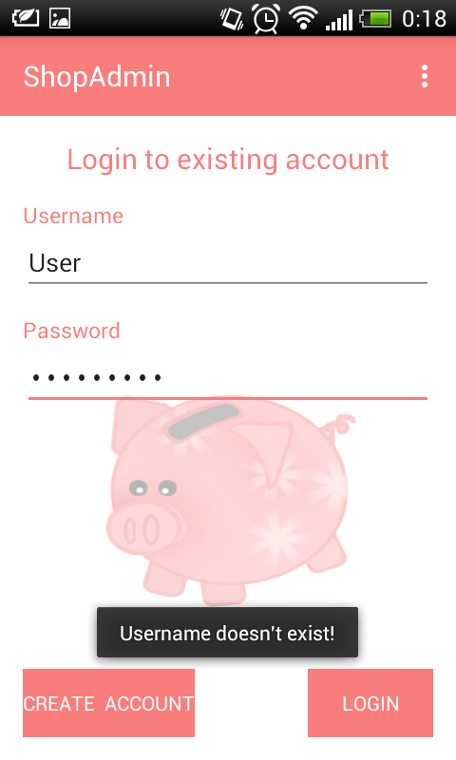

Activity Development
Creation of Register and Login View
Functionality in Register and Login view:
verifications
user name, password, email, complete input
visualize user feedback
save user data in database
hide and show fields in Register view
screen flow to Main view
16

Slide 26
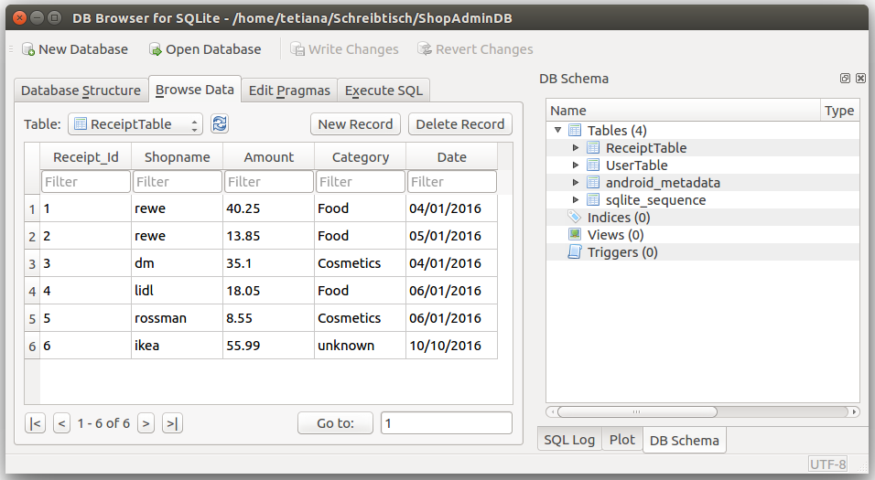
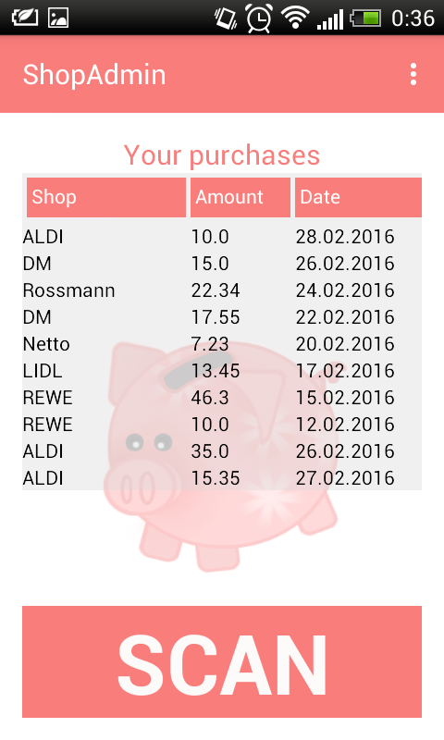

Activity Development
Functionality in Edit View
Manipulate extracted data
Save information to database
Functionality in Main view
get 20 latest receipts from database
Functionality in Report view
get all receipts grouped by name and category
expand and collapse feature
17

Slide 27
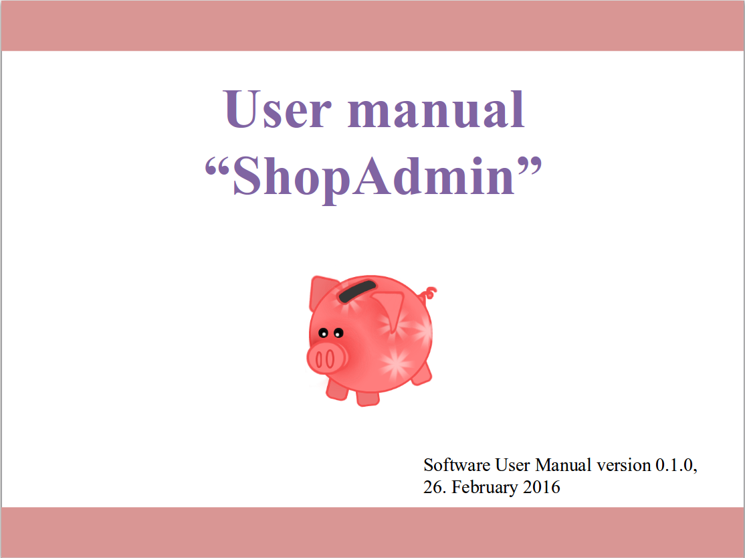
User Manual
User manual in 7 Steps:
Step 1 Registration
Step 2 Login
Step 3 Main view
Step 4 Scan receipt
Step 5 Check results
Step 6 Main view with summary
Step 7 Reports view
18

Slide 28
Content
Live Demo
Approach
Details
Technical Design
Android Details
Character Recognition and Receipt Extraction
Implementation
Test
Conclusion
19

Slide 29
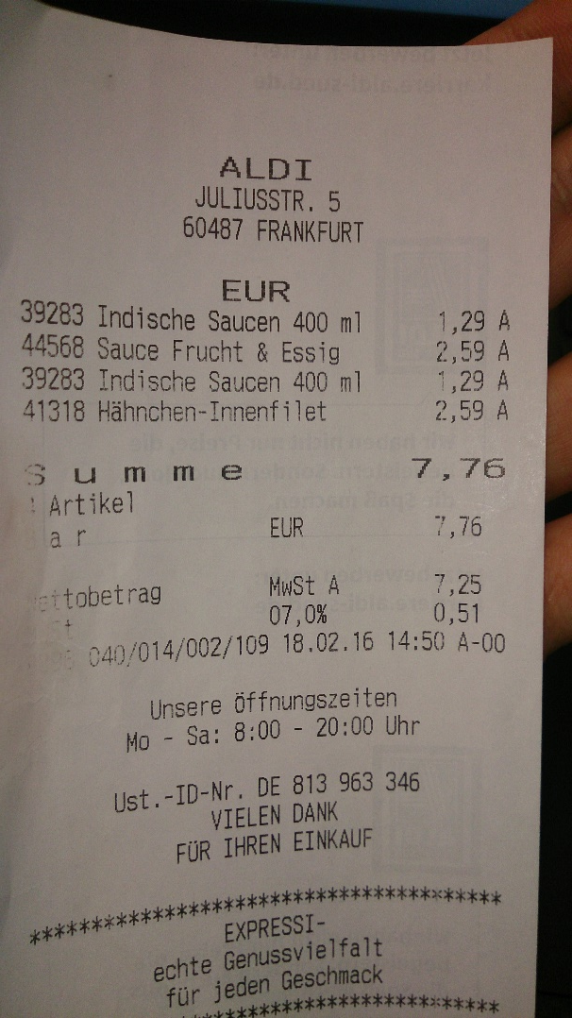
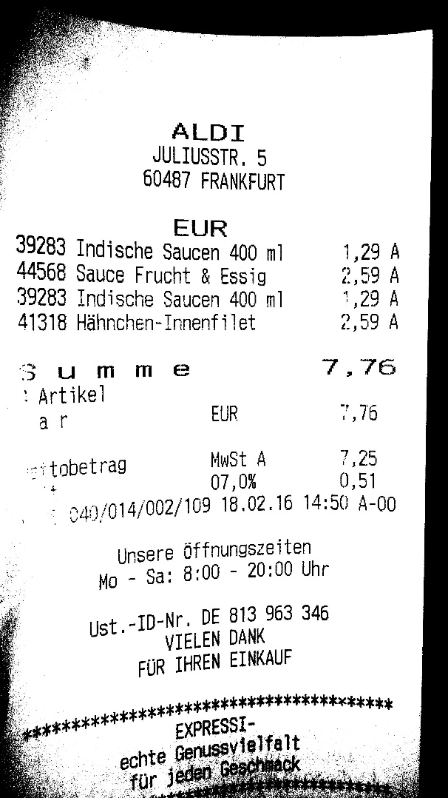
Optical Character Recognition
Use camera orientation to rotate picture
Resize image to 2000 x 1200 pixel
Colored image to black and white
Tesseract train language deu_frak
20

Slide 30
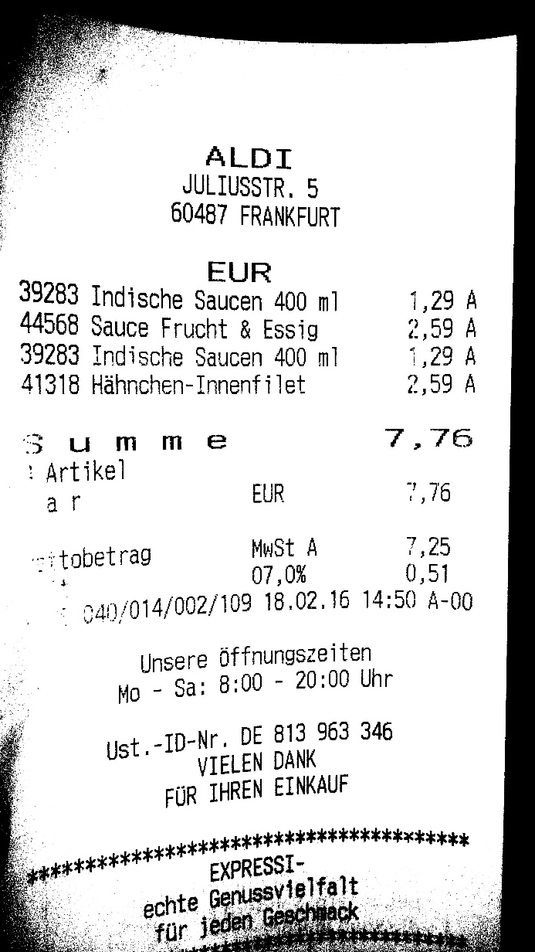
Classification
Pre analysis
Filter insignificant symbols
Combine single letters
Levenstein-algorithm
Post result adaption
SP »«.Z»’,-«»«S,«S- -"-1» « N. .;S.-V , « ALDX W JULLUSSTR. 5 60487 FRANKFURT EUR 39283 INDISCHE SAUCEN 400 IN1 1,29 A 44558 SAUCE FRUCHT S- ESSIG 2,59 A 39283 INDISCHE SAUSEN 400 M1 1,29 A 41318 HÄHNCHENS1NNENFILET 2,59 A , U M M E 7 , 76 » ' E1 . ;:J· HM EUR US L« T A 7,25 TJKTOBETRAG MOS- 0,51 C4O-014-002-109 18.02.16 14:50 HO UNSERE ÖFFNUNGSZEITEN NO — SA: EKOO - 20:OO UDFR « JWJU «»,-T"« S «. , »ES«
21

Slide 31
Limitations and Issues
Orientation misleading - does not represent picture orientation
Tesseract can not detect bold or large fonts
Shop name classification highly depends on name length
Receipt sum detection is very depending on OCR results
22

Slide 32
Content
Live Demo
Approach
Details
Technical Design
Android Details
Character Recognition and Receipt Extraction
Implementation
Test
Conclusion
23

Slide 33
Tests & statistics : How to make the photo
good lighting
flashlight | without flashlight
60 % | 70 %
bad lighting
flashlight | without flashlight
70 % | 0 %
folded receipt
no | yes
70 % | 30 %
24

Slide 34
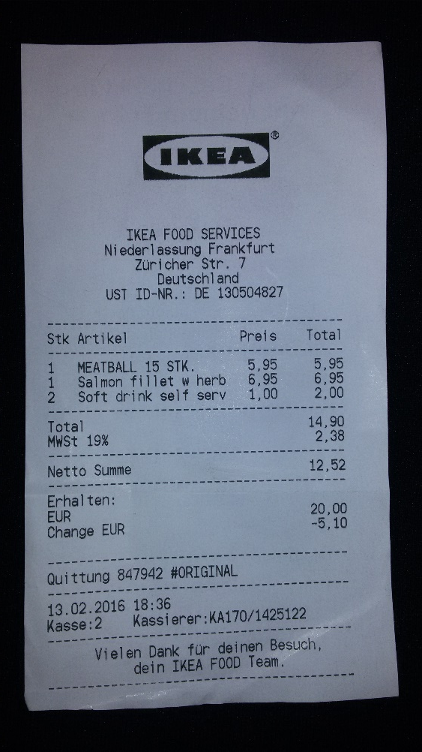
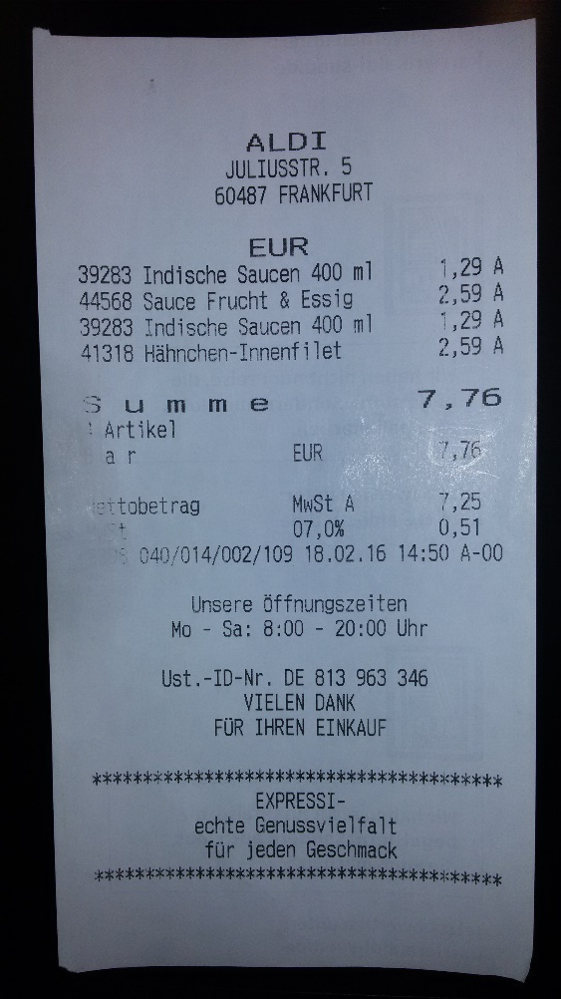
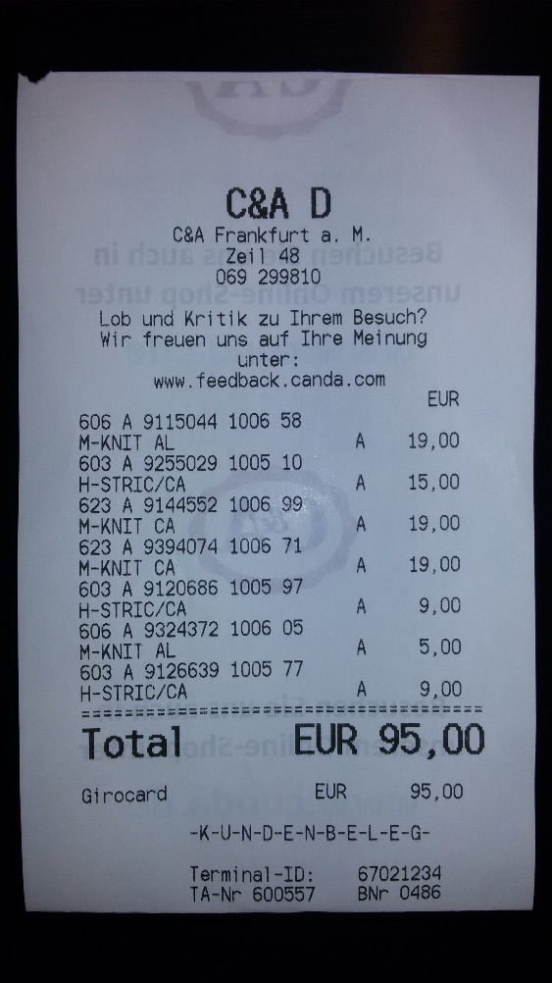
Tests & statistics : How to make the photo
text style
normal | bold
70 % | 10 %
25

Slide 35
Content
Live Demo
Approach
Details
Conclusion
26

Slide 36
Forecast to Market
Some Key-functionalities couldn’t be finished during the semester. Major Topics are:
Session handling
Group functionalities
Online Database
Advanced filter possibilities for Reports
Advanced picture processing
27

Slide 37
ShopAdmin Control expenses app with receipt scanner
Pitch Round-Up
Vision
Whom is it for?
students or young family
Functionality:
Manually enter your outgoing transactions
Scanner auto-extract receipt information such as shop names, data and time, amount
What problems does it solve?
Save time for counting expenses
Challenges:
Using Android for the first time
Implementing Tesseract Library OCR engine
28

