Slide 1


ShopAdmin Control your expenses with receipt scanner

Slide 2
Content
What happened till now
Live Demo
Forecast

Slide 3
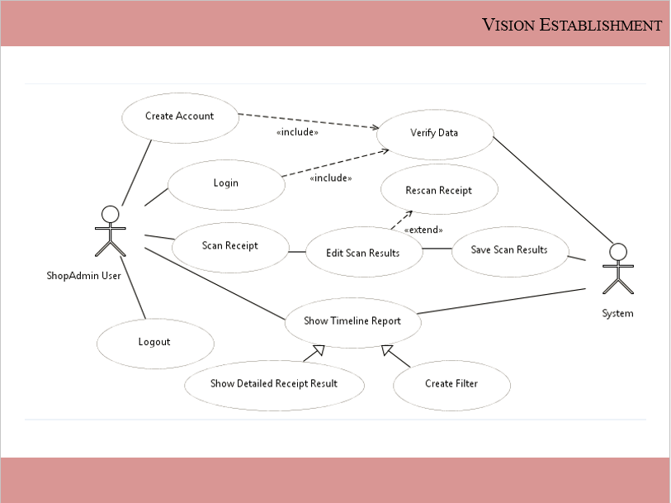
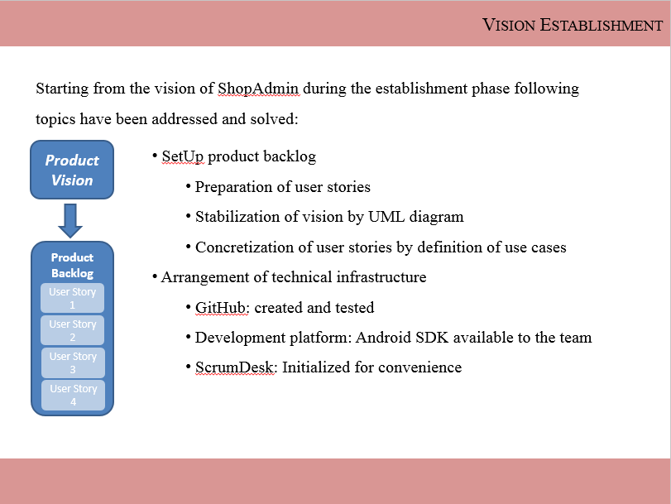
What happend till now
Product Vision
Daily Scrum
Sprint Review
Product Backlog
User Story 1
Sprint Planning
Sprint
Retrospective
User Story 2
Sprint Backlog
Tasks
Sprint execution
Potentially shippable product increment
User Story 3
User Story 1
User Story 4
User Story 4

Slide 4
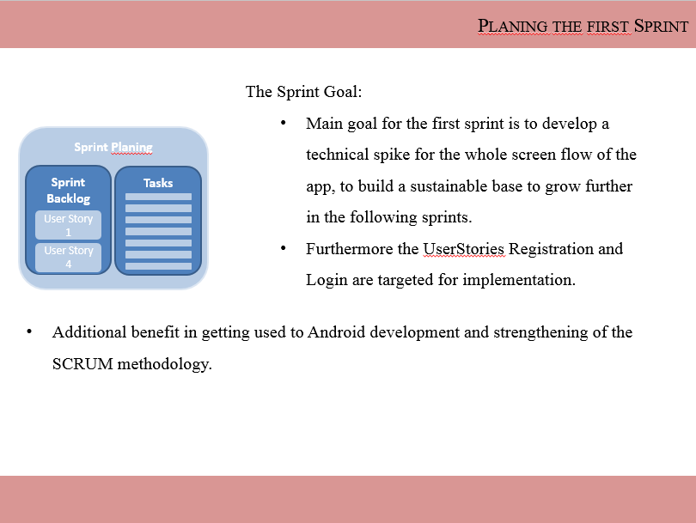
What happend till now
Product Vision
Daily Scrum
Sprint Review
Product Backlog
User Story 1
Sprint Planning
Sprint
Retrospective
User Story 2
Sprint Backlog
Tasks
Sprint execution
Potentially shippable product increment
User Story 3
User Story 1
User Story 4
User Story 4

Slide 5
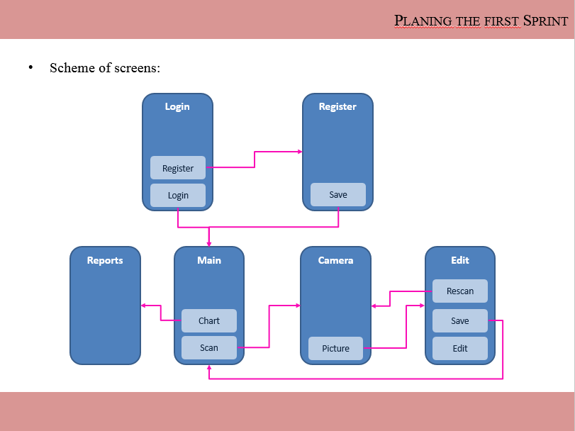
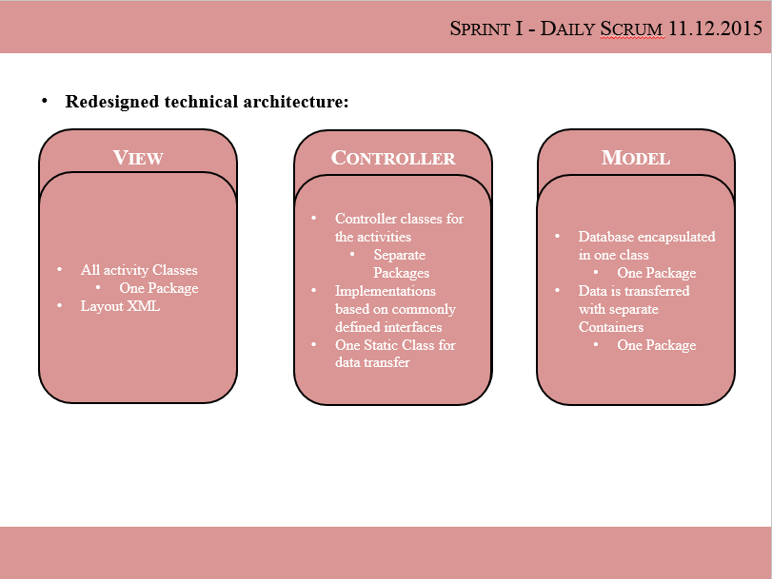
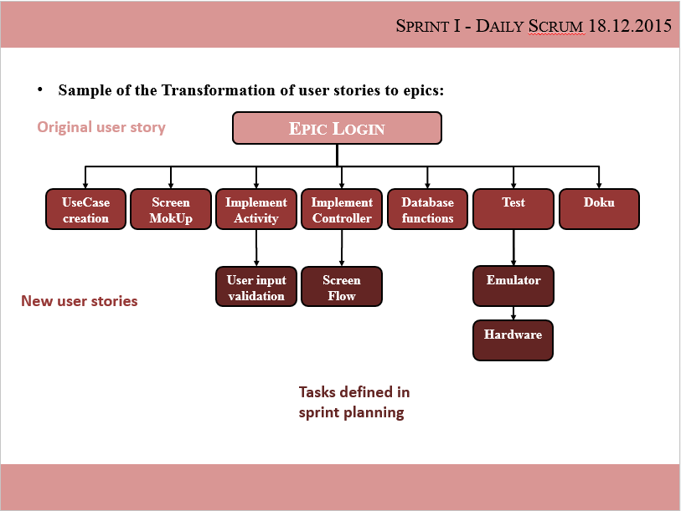
What happend till now
Product Vision
Daily Scrum
Sprint Review
Product Backlog
User Story 1
Sprint Planning
Sprint
Retrospective
User Story 2
Sprint Backlog
Tasks
Sprint execution
Potentially shippable product increment
User Story 3
User Story 1
User Story 4
User Story 4

Slide 6
Content
What happened till now
Live Demo
Forecast

Slide 7
Content
What happened till now
Live Demo
Forecast

Slide 8
Timeline
Timeline 2016:
Task/KW |  | 53 | 1 | 2 | 3 | 4 | 5 | 6 | 7 | 8
Holiday
Sprint I
 | Review
Sprint II
 | Planning
 | Daily Scrum
 | Retrospective
Sprint III
 | Planning
 | Daily Scrum
 | Retrospective
Sprint IV
 | Planning
 | Daily Scrum
 | Retrospective

Slide 9
Sprint II – Sprint Planning
The Sprint Goal:
Main goal for this sprint is the integration of the tesseract OCR component
Furthermore the implementations regarding the basement of the app (i.e. container classes and database model) need to be finalized
Also additional requirement clarifications and more detailed descriptions are intended
Sprint Planing
Sprint Backlog
Tasks
User Story 1
User Story 4

Slide 10
Thank you!

