Slide 1


ShopAdmin Control your expenses with receipt scanner

Slide 2
Content
Pitch Slides
ShopAdmin going agile
SCRUM and ShopAdmin
Genesis of ShopAdmin

Slide 3
ShopAdmin Control expenses app with receipt scanner
Kateryna Pryshchepa, Iuliia Guk
Vision
Whom is it for?
students or young family.
Functionality:
Manually enter your outgoing transactions
Scanners that auto-extract receipt information such as shop names, data and time, amount
What problems does it solve?
Save time for counting expenses.
What alternatives are available?
Cashbook Expense Tracker
Expense Manager
Expensify

Slide 4


Kateryna Pryshchepa, Iuliia Guk
Architecture
Retrieve Data
Store Data
Model
Controller
View
Store required info: shop name, date and time, amount.
Number & text recognition OCR
(optical character recognition)
Display receipt information
Sort and categorize expenses
Summarize expenses

Slide 5
Kateryna Pryshchepa, Iuliia Guk
Challenge
Using Android for the first time
Implementing Tesseract Library OCR engine and Leptonica Image Processing Library
Example:
Receipt | Amount
ALDI | 19.86
PENNY | 15.31
REWE | 25.35
Total: | 60.52

Slide 6
Content
Pitch Slides
ShopAdmin going agile
SCRUM and ShopAdmin
Genesis of ShopAdmin

Slide 7
In general the development of ShopAdmin will take place in an agile way
Mainly differentiation between being agile and a classical approach
time boxed approach
But furthermore agile has its merits and principles
Principles
Satisfy the customer
Welcome changes
Frequent deliveries
Cross-functional
Support and trust
Direct communication
Working software
Sustainable speed
Ambition for technical excellence
Self organization
Review and adapt
Merits
Commitment
Focus
Openness
Respect
Courage
Simplicity
Communication
Feedback
Agile
Time Boxed Cicle
Time Boxed Cicle
Analyse
Design
Analyse
Design
…
Test
Test
Develop
Delivery
Develop
Delivery

Slide 8
Content
Pitch Slides
ShopAdmin going agile
SCRUM and ShopAdmin
Genesis of ShopAdmin

Slide 9
Scrum Process
While being agile the development approach of ShopAdmin follows the SCRUM Process
Actual Phase
Product Vision
Daily Scrum
Sprint Review
Product Backlog
User Story 1
Sprint Review
Sprint
Retrospective
User Story 2
Sprint Backlog
Tasks
Sprint execution
Potentially shippable product increment
User Story 3
User Story 1
User Story 4
User Story 4

Slide 10
Scrum Team
Stakeholders
-> Users, Customers
All, lecture staff
Product Owner
-> Accountable
All
Scrum Master
-> Guardian of process
Thomas
Development team
-> self organized
All

Slide 11
Content
Pitch Slides
ShopAdmin going agile
SCRUM and ShopAdmin
Genesis of ShopAdmin

Slide 12
Genesis of ShopAdmin
Vision Establishment 15.11.2015 – 27.11.2015
Planning the first Sprint 27.11.2015

Slide 13
Vision Establishment
Starting from the vision of ShopAdmin during the establishment phase following topics have been addressed and solved:
Product Vision
SetUp product backlog
Preparation of user stories
Stabilization of vision by UML diagram
Concretization of user stories by definition of use cases
Arrangement of technical infrastructure
GitHub: created and tested
Development platform: Android SDK available to the team
ScrumDesk: Initialized for convenience
Product Backlog
User Story 1
User Story 2
User Story 3
User Story 4

Slide 14
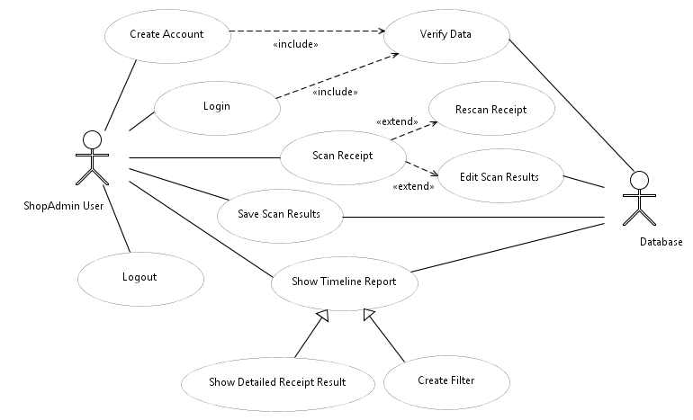
Vision Establishment

Slide 15
Vision Establishment
Open topics for this phase:
Arrange and commit on the definition of done
Discuss OpenItems from UseCases

Slide 16
Vision Establishment
Definition of done(proposal):
Source code commited on GitHub
Testcases written and green (includes developer unit test)
Relevant documentation/diagrams produced and/or updated
Task closed in ScrumDesk

Slide 17
Genesis of ShopAdmin
Vision Establishment 15.11.2015 – 27.11.2015
Planning the first Sprint 27.11.2015

Slide 18
Planing the first Spring
Topics:
Define Sprint Goal
Identify corresponding product backlog items
Create tasks
General
Development

Slide 19
BackUp

Slide 20
SCRUM as an agile project management method was chosen to maximize the value of ShopAdmin
On of the mainly differentiation between SCRUM and the classical project management approaches is its time boxed structure with short and complete iterations:
Time Boxed Cicle
Time Boxed Cicle
Analyse
Design
Analyse
Design
Test
Test
Develop
Delivery
Develop
Delivery

