Slide 1
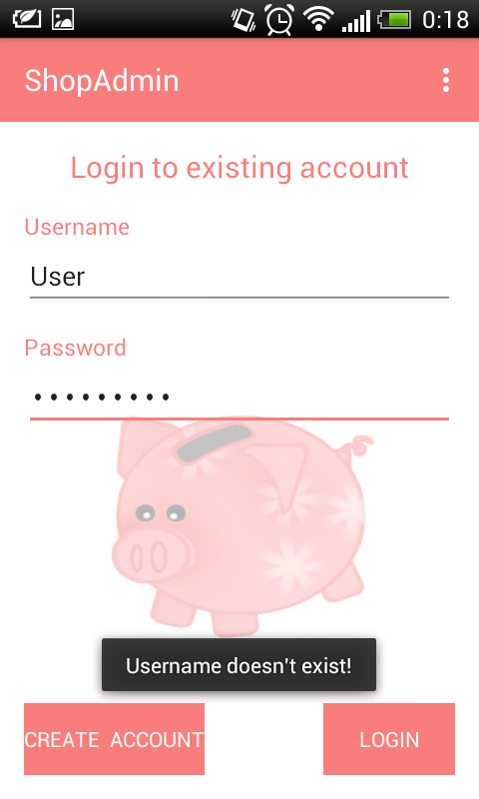
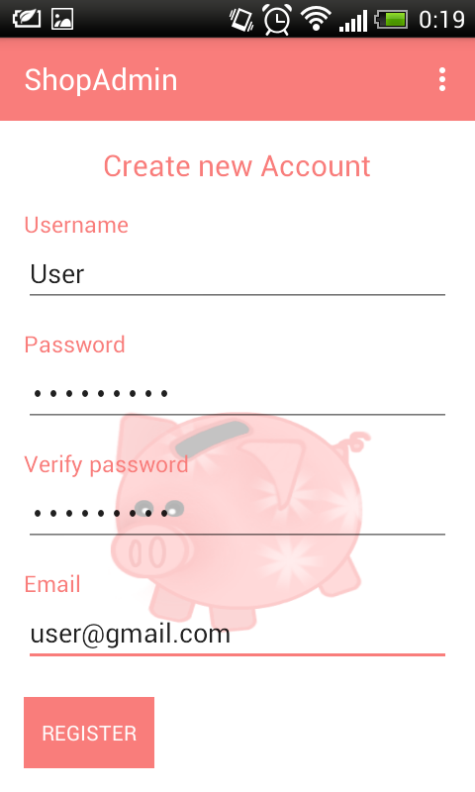
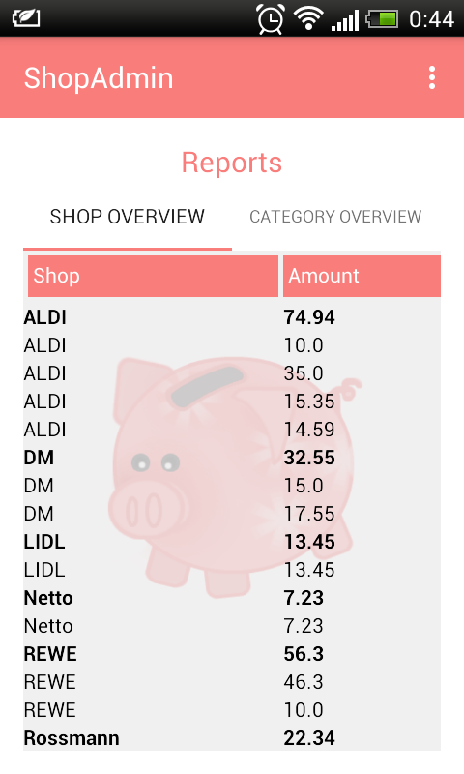
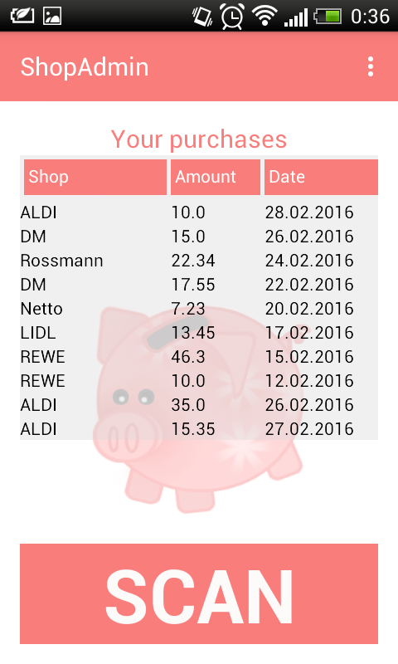
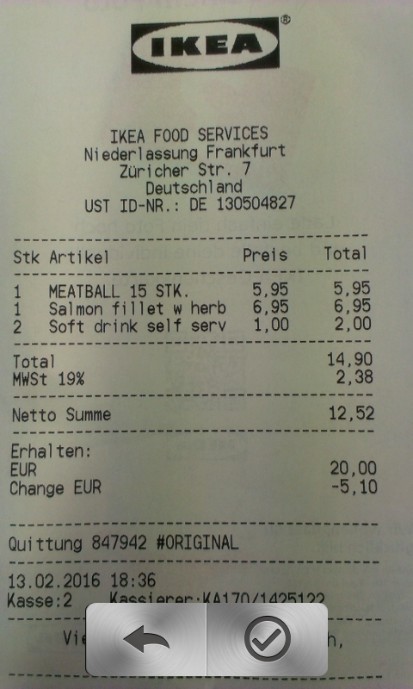
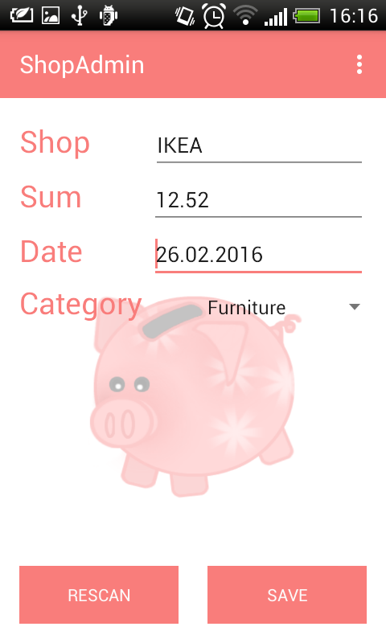

Slide 2
Development
Creation of Register and Login View
Functionality in Register and Login view:
verify user name
verify password(length, and equality)
verify email
verify all fields are filled
visualize user feedback
save user data in database
hide and show fields in Register view
screen flow to Main view

Slide 3
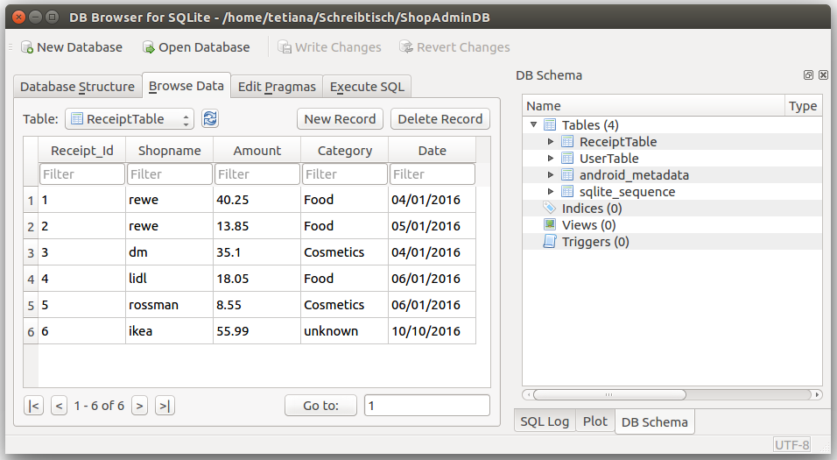
Development
Functionality in Main views
get last 20 receipts from database
Functionality in Reports views
get all receipts grouped by name
get all receipts grouped by category
expand receipts grouped by special shop name
expand all receipts grouped by special category

Slide 4
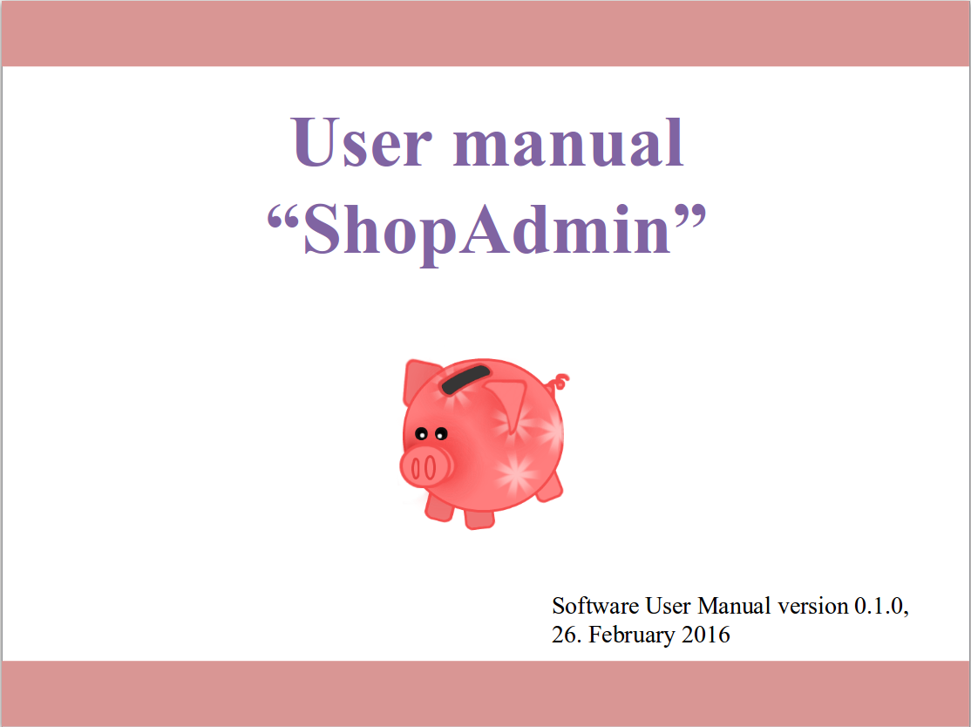
User manual
User manual in 7 Steps:
Step 1 Registration
Step 2 Login
Step 3 Scan Receipt
Step 4 Main page
Step 5 Scan Receipt
Step 6 Check results
Step 7 Main page with a filled receipts table
Step 8 Reports

