Slide 1


ShopAdmin Control your expenses with receipt scanner

Slide 2
Content
Pitch Slides
ShopAdmin going agile
SCRUM and ShopAdmin
Genesis of ShopAdmin

Slide 3
ShopAdmin Control expenses app with receipt scanner
Kateryna Pryshchepa, Iuliia Guk
Vision
Whom is it for?
students or young family.
Functionality:
Manually enter your outgoing transactions
Scanners that auto-extract receipt information such as shop names, data and time, amount
What problems does it solve?
Save time for counting expenses.
What alternatives are available?
Cashbook Expense Tracker
Expense Manager
Expensify

Slide 4


Kateryna Pryshchepa, Iuliia Guk
Architecture
Retrieve Data
Store Data
Model
Controller
View
Store required info: shop name, date and time, amount.
Number & text recognition OCR
(optical character recognition)
Display receipt information
Sort and categorize expenses
Summarize expenses

Slide 5
Kateryna Pryshchepa, Iuliia Guk
Challenge
Using Android for the first time
Implementing Tesseract Library OCR engine and Leptonica Image Processing Library
Example:
Receipt | Amount
ALDI | 19.86
PENNY | 15.31
REWE | 25.35
Total: | 60.52

Slide 6
Content
Pitch Slides
ShopAdmin going agile
SCRUM and ShopAdmin
Genesis of ShopAdmin

Slide 7
In general the development of ShopAdmin will take place in an agile way
Mainly differentiation between being agile and a classical approach
time boxed approach
But furthermore agile has its merits and principles
Principles
Satisfy the customer
Welcome changes
Frequent deliveries
Cross-functional
Support and trust
Direct communication
Working software
Sustainable speed
Ambition for technical excellence
Self organization
Review and adapt
Merits
Commitment
Focus
Openness
Respect
Courage
Simplicity
Communication
Feedback
Agile
Time Boxed Cicle
Time Boxed Cicle
Analyse
Design
Analyse
Design
…
Test
Test
Develop
Delivery
Develop
Delivery

Slide 8
Content
Pitch Slides
ShopAdmin going agile
SCRUM and ShopAdmin
Genesis of ShopAdmin

Slide 9
Scrum Process
While being agile the development approach of ShopAdmin follows the SCRUM Process
Actual Phase
Product Vision
Daily Scrum
Sprint Review
Product Backlog
User Story 1
Sprint Planing
Sprint
Retrospective
User Story 2
Sprint Backlog
Tasks
Sprint execution
Potentially shippable product increment
User Story 3
User Story 1
User Story 4
User Story 4

Slide 10
Scrum Team
Stakeholders
-> Users, Customers
All, lecture staff
Product Owner
-> Accountable
Julia, Kateryna
Scrum Master
-> Guardian of process
Thomas
Development team
-> self organized
All

Slide 11
Development Team
Characteristics:
Self organizing team following the one-team-approach
Interdisciplinary
Close coworkers of the product owner
Support regarding product backlog refinement
Responsible for sprint planning
Attributes:
3 – 9 persons
Ideally T-Shaped members

Slide 12
T-Shape Model
The T-Shape and you…
Broad Know-How
Idea:
Many T-Shapes cover all aspects and everybody has base knowledge in all areas
Design
GUI
QS
Testing
SQL
Backend development
Java Servlets
Expert Know-How

Slide 13
Content
Pitch Slides
ShopAdmin going agile
SCRUM and ShopAdmin
Genesis of ShopAdmin

Slide 14
Genesis of ShopAdmin
Vision Establishment 15.11.2015 – 27.11.2015
Timeline
Sprint I 27.11.2015 – 08.01.2016
Sprint II 09.01.2016 – 22.01.2016
Sprint III 22.01.2016 – 05.02.2016

Slide 15
Vision Establishment
Where are we now?
Actual Phase
Product Vision
Daily Scrum
Sprint Review
Product Backlog
User Story 1
Sprint Planning
Sprint
Retrospective
User Story 2
Sprint Backlog
Tasks
Sprint execution
Potentially shippable product increment
User Story 3
User Story 1
User Story 4
User Story 4

Slide 16
Vision Establishment
Starting from the vision of ShopAdmin during the establishment phase following topics have been addressed and solved:
Product Vision
SetUp product backlog
Preparation of user stories
Stabilization of vision by UML diagram
Concretization of user stories by definition of use cases
Arrangement of technical infrastructure
GitHub: created and tested
Development platform: Android SDK available to the team
ScrumDesk: Initialized for convenience
Product Backlog
User Story 1
User Story 2
User Story 3
User Story 4

Slide 17
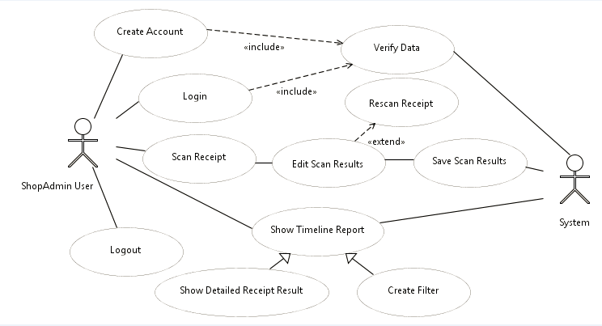
Vision Establishment

Slide 18
Vision Establishment
Definition of done:
All tasks have to be completed
All implementations have to be commented
All tests have to successfully run through
Documentation has to be updated
Everything has to be pushed to git
Scrum user story has to be set to completed

Slide 19
Genesis of ShopAdmin
Vision Establishment 15.11.2015 – 27.11.2015
Timeline
Sprint I 27.11.2015 – 08.01.2016
Sprint II 09.01.2016 – 22.01.2016
Sprint III 22.01.2016 – 05.02.2016

Slide 20
Timeline
Timeline 2015:
Task/KW |  | 46 | 47 | 48 | 49 | 50 | 51 | 52 | 53
Product Vision
Sprint I
 | Sprint Planning
 | Daily Scrum
Holiday

Slide 21
Timeline
Timeline 2016:
Task/KW |  | 53 | 1 | 2 | 3 | 4 | 5 | 6 | 7 | 8
Holiday
Sprint I
 | Review
Sprint II
 | Planning
 | Daily Scrum
 | Retrospective
Sprint III
 | Planning
 | Daily Scrum
 | Retrospective
Sprint IV
 | Planning
 | Daily Scrum
 | Retrospective

Slide 22
Genesis of ShopAdmin
Vision Establishment 15.11.2015 – 27.11.2015
Timeline
Sprint I 27.11.2015 – 08.01.2016
Planning the first Sprint 27.11.2015
Daily Scrum 04.12.2015
Daily Scrum 11.12.2015
Daily Scrum 18.12.2015
Sprint II 09.01.2016 – 22.01.2016
Sprint III 22.01.2016 – 05.02.2016

Slide 23
Planing the first Sprint
Where are we now?
Product Vision
Daily Scrum
Sprint Review
Product Backlog
Actual Phase
User Story 1
Sprint Planning
Sprint
Retrospective
User Story 2
Sprint Backlog
Tasks
Sprint execution
Potentially shippable product increment
User Story 3
User Story 1
User Story 4
User Story 4

Slide 24
Planing the first Sprint
Purpose of the sprint planning:
Define the product backlog items which will be developed (What?)
Plan the development (How?)
Preconditions:
Product backlog is sufficient cultivated
Business owner has a clear idea of the sprint goal
Clarity of the capacity of the development team (resources and tools)
Result:
Formalized Sprint Backlog
Commitment on sprint goal

Slide 25
Planing the first Sprint
The Sprint Goal:
Main goal for the first sprint is to develop a technical spike for the whole screen flow of the app, to build a sustainable base to grow further in the following sprints.
Furthermore the UserStories Registration and Login are targeted for implementation.
Sprint Planing
Sprint Backlog
Tasks
User Story 1
User Story 4
Additional benefit in getting used to Android development and strengthening of the SCRUM methodology.

Slide 26
Planing the first Sprint
Scheme of screens:
Login
Register
Register
Login
Save
Reports
Main
Camera
Edit
Rescan
Chart
Save
Scan
Picture
Edit

Slide 27
Genesis of ShopAdmin
Vision Establishment 15.11.2015 – 27.11.2015
Timeline
Sprint I 27.11.2015 – 08.01.2016
Planning the first Sprint 27.11.2015
Daily Scrum 04.12.2015
Daily Scrum 11.12.2015
Daily Scrum 18.12.2015
Sprint II 09.01.2016 – 22.01.2016
Sprint III 22.01.2016 – 05.02.2016

Slide 28
Sprint I - Daily Scrum 04.12.2015
Where are we now?
Product Vision
Actual Phase
Daily Scrum
Sprint Review
Product Backlog
User Story 1
Sprint Planning
Sprint
Retrospective
User Story 2
Sprint Backlog
Tasks
Sprint execution
Potentially shippable product increment
User Story 3
User Story 1
User Story 4
User Story 4

Slide 29
Sprint I - Daily Scrum 04.12.2015
Purpose:
Synchronization of the development team
Planning till the next daily scrum (Inspect & Adapt)
Preconditions:
Discipline regarding time box, communication, accuracy
Result:
Answers on the 3 questions by all participants:
What was achieved since the last daily scrum
What is planed till the next daily scrum
Are there impediments on the way to the sprint goal

Slide 30
Sprint I - Daily Scrum 04.12.2015
MokUp
Corporate Design based on three colors:
pink
white
light grey
Font:
black
white
Black
White

Slide 31
Sprint I - Daily Scrum 04.12.2015
MokUp
Defined GUI-Elements
Buttons
Tables
Header
Data
1x Dropdown Box
Category on EditView
1x Undefined very fancy element to choose different reports
Click Me
Column
Column
Data
Data

Slide 32



Sprint I - Daily Scrum 04.12.2015
Impediments:
Pigs! We need more pigs…
User Stories:
Dependencies regarding developments.
I.e. activity register needs to be finished before work on activity login can start.
Reduce scope of user stories, so that one developer can work individually on one user story.
User stories will be recombined via Epics in ScrumDesk
Furthermore the impediment adapted to the commonly used android app
Technical resolution is based on interfaces

Slide 33
Genesis of ShopAdmin
Vision Establishment 15.11.2015 – 27.11.2015
Timeline
Sprint I 27.11.2015 – 08.01.2016
Planning the first Sprint 27.11.2015
Daily Scrum 04.12.2015
Daily Scrum 11.12.2015
Daily Scrum 18.12.2015
Sprint II 09.01.2016 – 22.01.2016
Sprint III 22.01.2016 – 05.02.2016

Slide 34
Sprint I - Daily Scrum 11.12.2015
Where are we now?
Product Vision
Actual Phase
Daily Scrum
Sprint Review
Product Backlog
User Story 1
Sprint Planning
Sprint
Retrospective
User Story 2
Sprint Backlog
Tasks
Sprint execution
Potentially shippable product increment
User Story 3
User Story 1
User Story 4
User Story 4

Slide 35
Sprint I - Daily Scrum 11.12.2015
Conclusions:
Based on the identified impediments new tasks where defined to achieve the sprint goal
The new technical architecture was established and further clarified
Added new Static class for Session and controller handling
Further focus on implementation

Slide 36
Sprint I - Daily Scrum 11.12.2015
Redesigned technical architecture:
View
Controller
Model
All activity Classes
One Package
Layout XML
Controller classes for the activities
Separate Packages
Implementations based on commonly defined interfaces
One Static Class for data transfer
Database encapsulated in one class
One Package
Data is transferred with separate Containers
One Package

Slide 37
Genesis of ShopAdmin
Vision Establishment 15.11.2015 – 27.11.2015
Timeline
Sprint I 27.11.2015 – 08.01.2016
Planning the first Sprint 27.11.2015
Daily Scrum 04.12.2015
Daily Scrum 11.12.2015
Daily Scrum 18.12.2015
Sprint II 09.01.2016 – 22.01.2016
Sprint III 22.01.2016 – 05.02.2016

Slide 38
Sprint I - Daily Scrum 18.12.2015
Where are we now?
Product Vision
Actual Phase
Daily Scrum
Sprint Review
Product Backlog
User Story 1
Sprint Planning
Sprint
Retrospective
User Story 2
Sprint Backlog
Tasks
Sprint execution
Potentially shippable product increment
User Story 3
User Story 1
User Story 4
User Story 4

Slide 39
Sprint I - Daily Scrum 18.12.2015
Conclusions:
Focus on image processing requirements
Decision to not end the current sprint for the holiday season
Additional time will be used on further implementation based on personal preferences
Also ongoing rework to reduce scope of user stories

Slide 40
Sprint I - Daily Scrum 18.12.2015
Sample of the Transformation of user stories to epics:
Epic Login
Original user story
User Story Login
UseCase creation
Screen MokUp
Implement Activity
Implement Controller
Database functions
Test
Doku
User input validation
Screen Flow
Emulator
New user stories
Hardware
Tasks defined in sprint planning

Slide 41
Genesis of ShopAdmin
Vision Establishment 15.11.2015 – 27.11.2015
Timeline
Sprint I 27.11.2015 – 08.01.2016
Sprint II 09.01.2016 – 22.01.2016
Sprint Planning 09.01.2016
Daily Scrum 15.01.2016
Sprint III 22.01.2016 – 05.02.2016

Slide 42
Sprint II – Sprint Planning
Where are we now?
Product Vision
Daily Scrum
Sprint Review
Product Backlog
Actual Phase
User Story 1
Sprint Planning
Sprint
Retrospective
User Story 2
Sprint Backlog
Tasks
Sprint execution
Potentially shippable product increment
User Story 3
User Story 1
User Story 4
User Story 4

Slide 43
Sprint II – Sprint Planning
The Sprint Goal:
Main goal for this sprint is the integration of the tesseract OCR component
Furthermore the implementations regarding the basement of the app (i.e. container classes and database model) need to be finalized
Also additional requirement clarifications and more detailed descriptions are intended
Sprint Planing
Sprint Backlog
Tasks
User Story 1
User Story 4

Slide 44
Genesis of ShopAdmin
Vision Establishment 15.11.2015 – 27.11.2015
Timeline
Sprint I 27.11.2015 – 08.01.2016
Sprint II 09.01.2016 – 22.01.2016
Sprint Planning 09.01.2016
Daily Scrum 15.01.2016
Sprint III 22.01.2016 – 05.02.2016

Slide 45
Sprint II - Daily Scrum 15.01.2016
Where are we now?
Product Vision
Actual Phase
Daily Scrum
Sprint Review
Product Backlog
User Story 1
Sprint Planning
Sprint
Retrospective
User Story 2
Sprint Backlog
Tasks
Sprint execution
Potentially shippable product increment
User Story 3
User Story 1
User Story 4
User Story 4

Slide 46
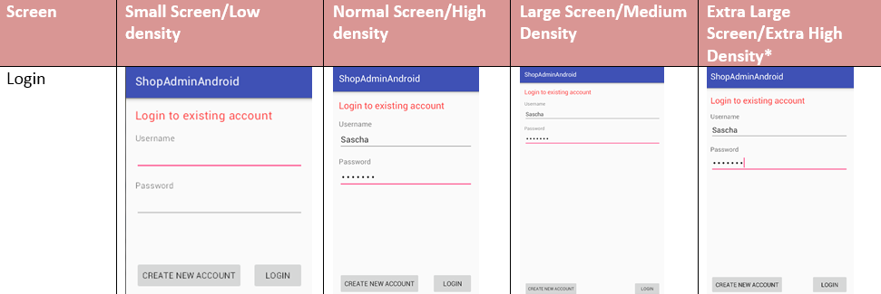
Sprint II - Daily Scrum 15.01.2016
Problem regarding the layouts on various mobile sizes:
Recommendation within Android SDK is to create individual layouts per mobile size.
Next steps:
Another validation with Table Layouts
Focus on normal screen sizes

Slide 47
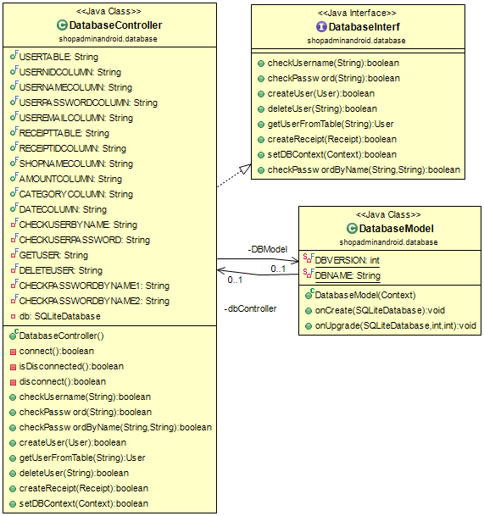
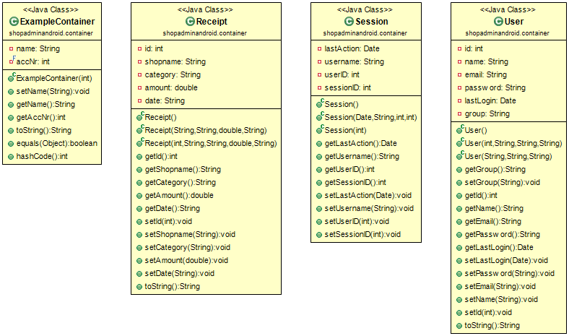
Sprint II - Daily Scrum 15.01.2016
UML Diagrams created:

Slide 48
Sprint II - Daily Scrum 15.01.2016
Conclusions:
Focus on normal screen size as no added value is generated on short hand
Tesseract OCR successfully included into Git-Repository
Functionality needs to be implemented
Still working on velocity so new user stories will be introduced to the sprint
Report Requirements, Corporate Layout

Slide 49
Genesis of ShopAdmin
Vision Establishment 15.11.2015 – 27.11.2015
Timeline
Sprint I 27.11.2015 – 08.01.2016
Sprint II 09.01.2016 – 22.01.2016
Sprint III 22.01.2016 – 05.02.2016
Sprint Planning 22.01.2016
Daily Scrum 29.01.2016

Slide 50
Sprint III – Sprint Planning
Where are we now?
Product Vision
Daily Scrum
Sprint Review
Product Backlog
Actual Phase
User Story 1
Sprint Planning
Sprint
Retrospective
User Story 2
Sprint Backlog
Tasks
Sprint execution
Potentially shippable product increment
User Story 3
User Story 1
User Story 4
User Story 4

Slide 51
Sprint III – Sprint Planning
The Sprint Goal:
Maingoal is to receive the OCR Result from tesseract and start with the Classification
Common view of Burger Navigation
Furthermore smaller implementations regarding reports, sceenflow and automated testing
Sprint Planing
Sprint Backlog
Tasks
User Story 1
User Story 4

Slide 52
Genesis of ShopAdmin
Vision Establishment 15.11.2015 – 27.11.2015
Timeline
Sprint I 27.11.2015 – 08.01.2016
Sprint II 09.01.2016 – 22.01.2016
Sprint III 22.01.2016 – 05.02.2016
Sprint Planning 22.01.2016
Daily Scrum 29.01.2016

Slide 53
Sprint III - Daily Scrum 29.01.2016
Where are we now?
Product Vision
Actual Phase
Daily Scrum
Sprint Review
Product Backlog
User Story 1
Sprint Planning
Sprint
Retrospective
User Story 2
Sprint Backlog
Tasks
Sprint execution
Potentially shippable product increment
User Story 3
User Story 1
User Story 4
User Story 4

Slide 54
Sprint III - Daily Scrum 29.01.2016
Tesseract inclusion and Classifier implemented
OCR-Flow
Mobile Camera
Tesseract
New OCR View
Classifier
Edit View
OCR View
- Temporary View for testing and debugging
Classifier
- Levenstein-Algorithmus

Slide 55
BackUp

Slide 56
SCRUM as an agile project management method was chosen to maximize the value of ShopAdmin
On of the mainly differentiation between SCRUM and the classical project management approaches is its time boxed structure with short and complete iterations:
Time Boxed Cicle
Time Boxed Cicle
Analyse
Design
Analyse
Design
Test
Test
Develop
Delivery
Develop
Delivery

