Slide 1

ShopAdmin
Corporate Guideline

Slide 2

Logo Element: pink pig
ShopAdmin

Slide 3
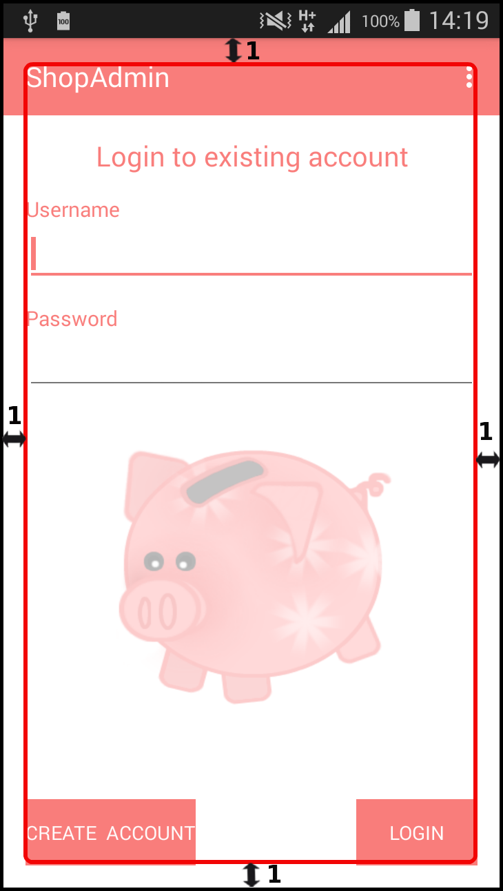
Margin:
1 ↔ min 2 mm
ShopAdmin

Slide 4
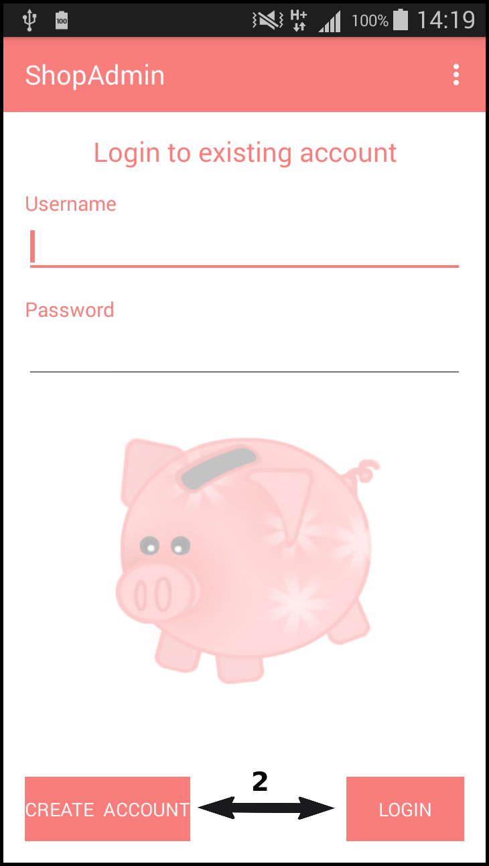
Space between buttons:
2 ↔ min 2 mm
ShopAdmin

Slide 5
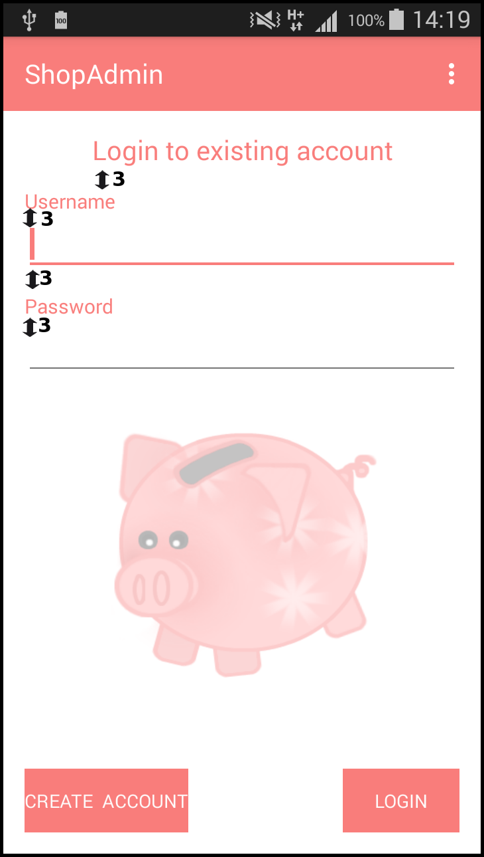
Space between lines:
3 ↔ min 2 mm
ShopAdmin

Slide 6
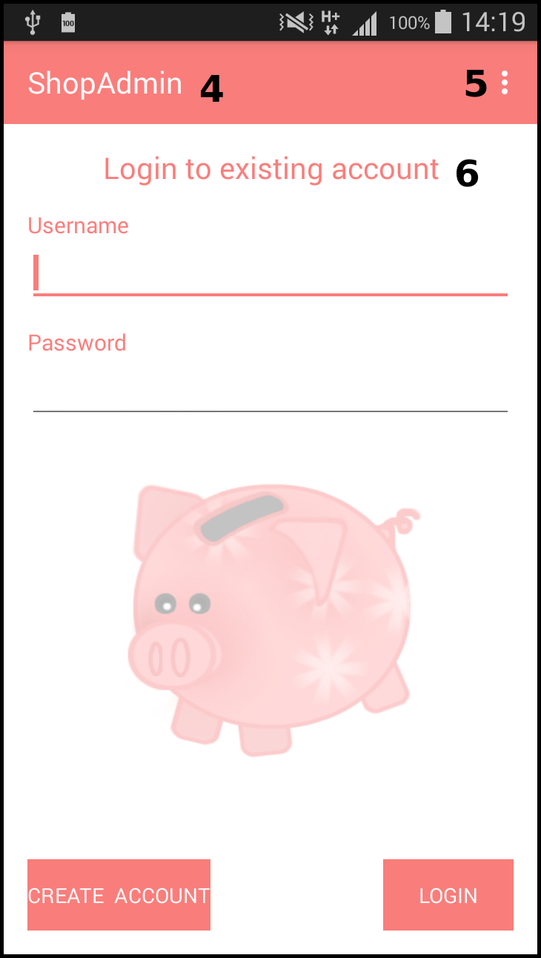
Background: white with logo (pink pig)
Elements:
4 appname
5 settings
6 user orientation
(where are you?)
ShopAdmin

Slide 7
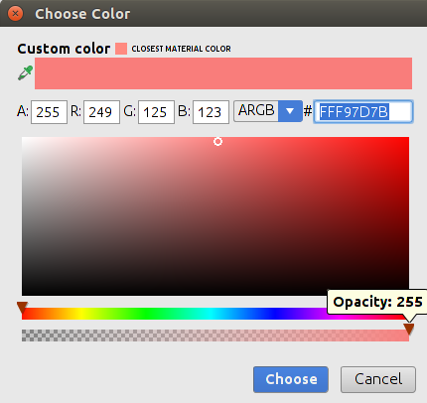
Colors:
- pink
- white
- black
ShopAdmin

Slide 8
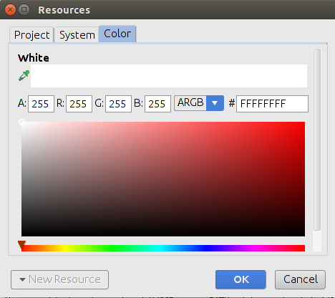
Colors:
- pink
- white
- black
ShopAdmin

Slide 9
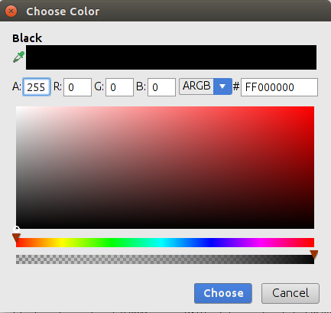
Colors:
- pink
- white
- black
ShopAdmin

Slide 10
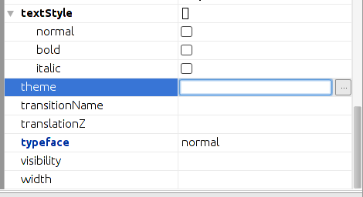
Text size:
- user orientation: 20 dp
- text view 15 dp
- text fields 20 dp
- text size button 60 dp, 20 dp, 15 dp
Type face:
- normal
ShopAdmin

