Slide 1


ShopAdmin Control your expenses with receipt scanner

Slide 2
Content
Approach
Technical Details
Conclusion

Slide 3
Scrum Process
While being agile the development approach of ShopAdmin follows the SCRUM Process
Actual Phase
Product Vision
Daily Scrum
Sprint Review
Product Backlog
User Story 1
Sprint Planing
Sprint
Retrospective
User Story 2
Sprint Backlog
Tasks
Sprint execution
Potentially shippable product increment
User Story 3
User Story 1
User Story 4
User Story 4

Slide 4
Scrum Process
Pitch described by 8 UseCases
In 4 Sprints XXX Backlog Items have been finished
Product Vision
Daily Scrum
Sprint Review
Product Backlog
User Story 1
Sprint Planing
User Story 2
Sprint Backlog
Tasks
Sprint execution
Potentially shippable product increment
User Story 3
User Story 1
User Story 4
User Story 4
Out of 8 UserStories by refinement 101 Backlog Items have been created
Nevertheless a highly suffisticated product has been created

Slide 5
T-Shape Model
The T-Shape and you…
Broad Know-How
Idea:
Many T-Shapes cover all aspects and everybody has base knowledge in all areas
Design
GUI
QS
Testing
SQL
Backend development
Java Servlets
Expert Know-How

Slide 6
T-Shape Model
The T-Shape and you…
Design
Automated Test
Java
Public Relations
Doku
Project
Management with
SCRUM

Slide 7
T-Shape Model
The T-Shape and you…
Automated Test
Design
Automated Test
Java
Public Relations
Doku
Design
Java
Public Relations
Doku
Project
Management with
SCRUM
Project
Management with
SCRUM

Slide 8
T-Shape Model
The T-Shape and you…
Design
Automated Test
Java
Public Relations
Doku
Project
Management with
SCRUM

Slide 9
Content
Approach
Technical Details
Technical Design
Android Details
Receipt Extraction
Conclusion

Slide 10
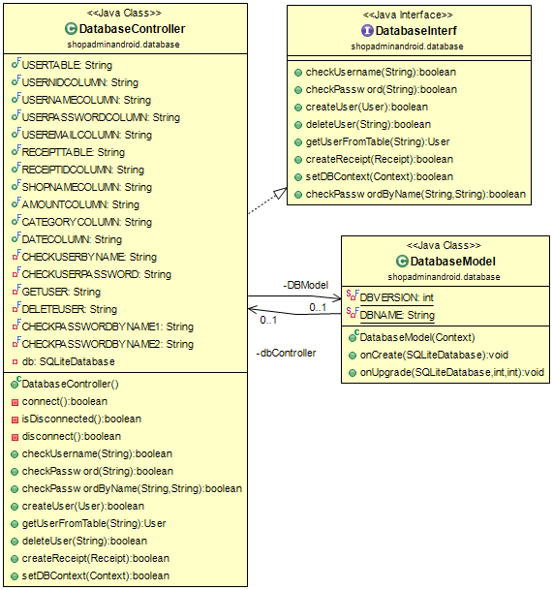
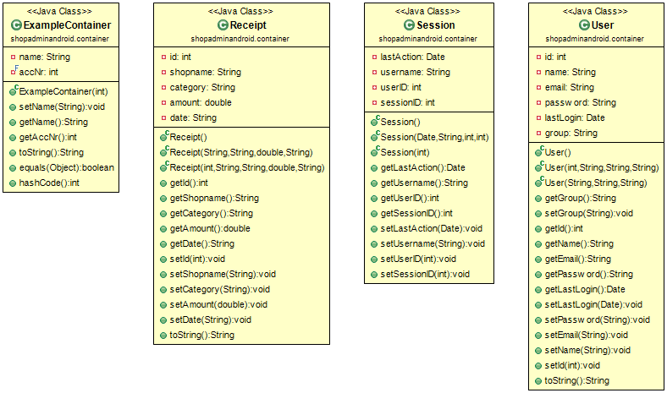
Sprint II - Daily Scrum 15.01.2016
UML Diagrams created:

Slide 11
Sprint I - Daily Scrum 11.12.2015
Redesigned technical architecture:
View
Controller
Model
All activity Classes
One Package
Layout XML
Controller classes for the activities
Separate Packages
Implementations based on commonly defined interfaces
One Static Class for data transfer
Database encapsulated in one class
One Package
Data is transferred with separate Containers
One Package

Slide 12
Content
Approach
Technical Details
Technical Design
Android Details
Receipt Extraction
Conclusion

Slide 13
Planing the first Sprint
Scheme of screens:
Login
Register
Register
Login
Save
Reports
Main
Camera
Edit
Rescan
Chart
Save
Scan
Picture
Edit

Slide 14
Content
Approach
Technical Details
Technical Design
Android Details
Receipt Extraction
Conclusion

Slide 15
Sprint III - Daily Scrum 29.01.2016
Tesseract inclusion and Classifier implemented
OCR-Flow
Mobile Camera
Tesseract
New OCR View
Classifier
Edit View
OCR View
- Temporary View for testing and debugging
Classifier
- Levenstein-Algorithmus

Slide 16
Content
Approach
Technical Details
Technical Design
Android Details
Receipt Extraction
Conclusion

