Slide 1


ShopAdmin Control your expenses with receipt scanner

Slide 2
Content
Live Demo
Approach
Details
Conclusion

Slide 3
Content
Live Demo
Approach
Details
Conclusion

Slide 4
Scrum Process
For the realization of ShopAdmin it was decided to use SCRUM
Product Vision
Daily Scrum
Sprint Review
Product Backlog
User Story 1
Sprint Planing
Sprint
Retrospective
User Story 2
Sprint Backlog
Tasks
Sprint execution
Potentially shippable product increment
User Story 3
User Story 1
User Story 4
User Story 4

Slide 5
Scrum Process
For the realization of ShopAdmin it was decided to use SCRUM
Product Vision
Daily Scrum
Sprint Review
Product Backlog
User Story 1
Sprint Planing
Sprint
Retrospective
User Story 2
Sprint Backlog
Tasks
Sprint execution
Potentially shippable product increment
User Story 3
User Story 1
User Story 4
User Story 4

Slide 6
Scrum Process
Pitch described by 8 Use Cases
Product Vision
Daily Scrum
Sprint Review
Product Backlog
User Story 1
Sprint Planing
Sprint
Retrospective
User Story 2
Sprint Backlog
Tasks
Sprint execution
Potentially shippable product increment
User Story 3
User Story 1
User Story 4
User Story 4

Slide 7
Scrum Process
Product Vision
Daily Scrum
Sprint Review
Product Backlog
User Story 1
Sprint Planing
Sprint
Retrospective
User Story 2
Sprint Backlog
Tasks
Sprint execution
Potentially shippable product increment
User Story 3
User Story 1
User Story 4
User Story 4
Out of 8 User Stories 101 Backlog Items have been created

Slide 8
Scrum Process
In 4 Sprints 39 Backlog Items have been completed
Product Vision
Daily Scrum
Sprint Review
Product Backlog
User Story 1
Sprint Planing
Sprint
Retrospective
User Story 2
Sprint Backlog
Tasks
Sprint execution
Potentially shippable product increment
User Story 3
User Story 1
User Story 4
User Story 4

Slide 9
Scrum Process
Product Vision
Daily Scrum
Sprint Review
Product Backlog
User Story 1
Sprint Planing
Sprint
Retrospective
User Story 2
Sprint Backlog
Tasks
Sprint execution
Potentially shippable product increment
User Story 3
User Story 1
User Story 4
User Story 4
Nevertheless a highly sophisticated product has been created

Slide 10
Responsibilities
Core Competences
Requirements
Implementation
Individual Focuses
Testing
Documentation

Slide 11
Responsibilities
Corporate Design
OCR and Classification
Tanja
Thomas
Core Competences
Requirements
Implementation
Individual Focuses
Testing
Documentation
Activity Development
Architecture Modeling
Katia
Project Management SCRUM Process
Iuliia
Sascha

Slide 12
Content
Live Demo
Approach
Details
Technical Design
Android Details
Receipt Extraction
Conclusion

Slide 13
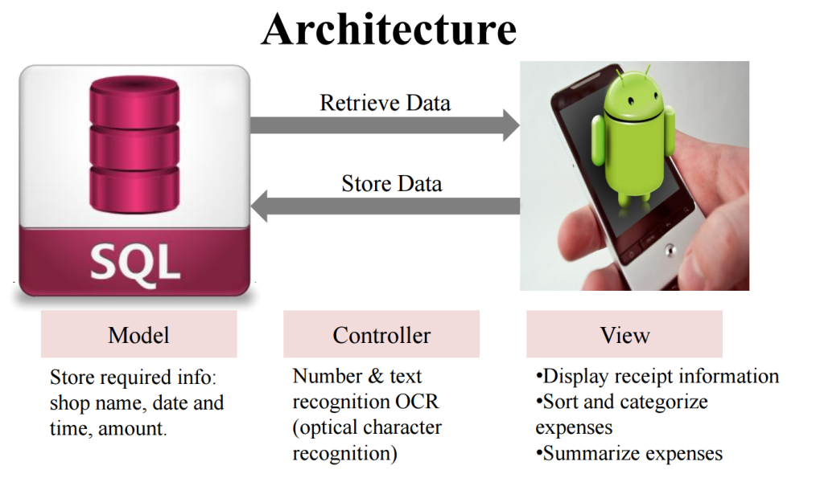
Architecture Overview
How it all began…

Slide 14
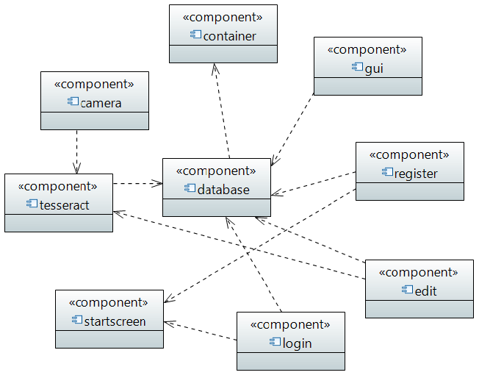
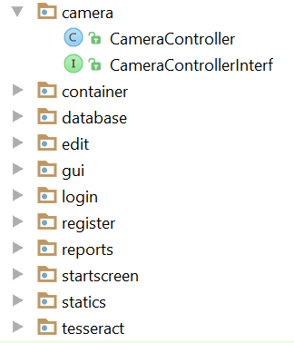
Architecture Overview
How it all began…
Project Structure:
division into 9 components
achieving modularity: interface/implementation
Component Diagram

Slide 15
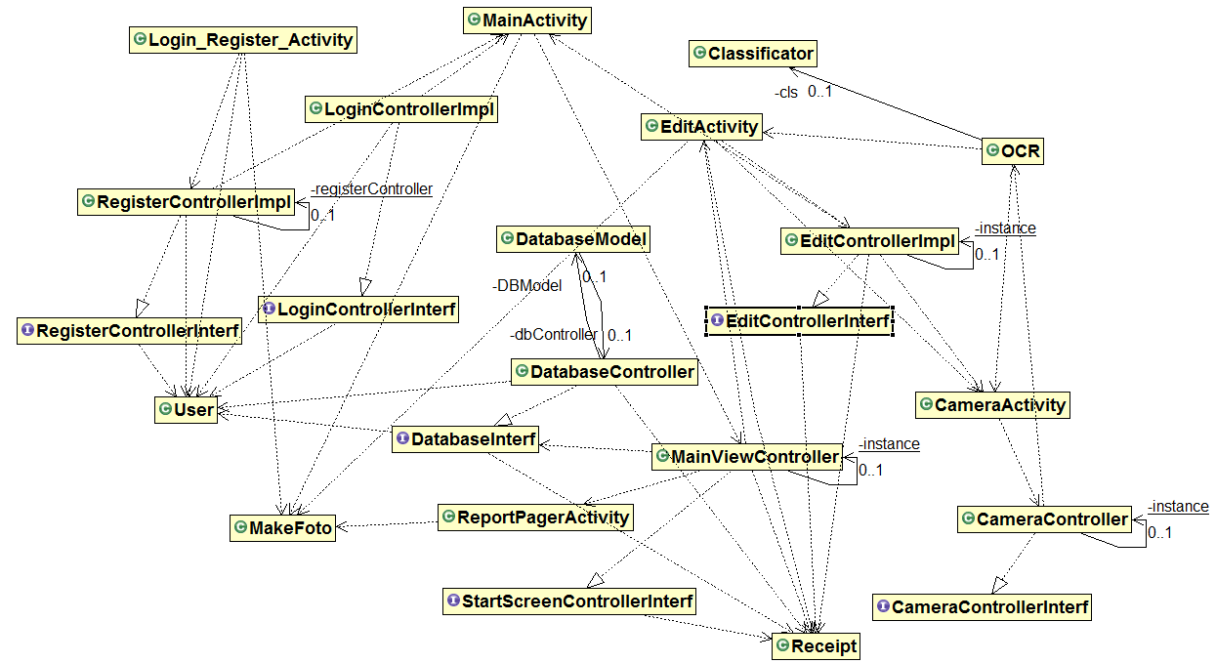
Project structure became more and more complicated…
Architecture: Structure
General Class Diagram

Slide 16
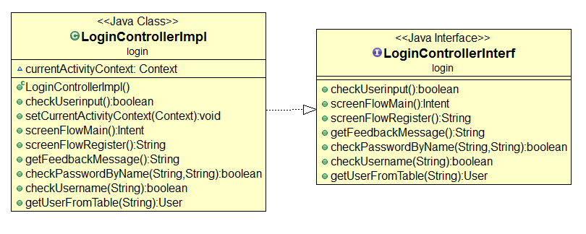
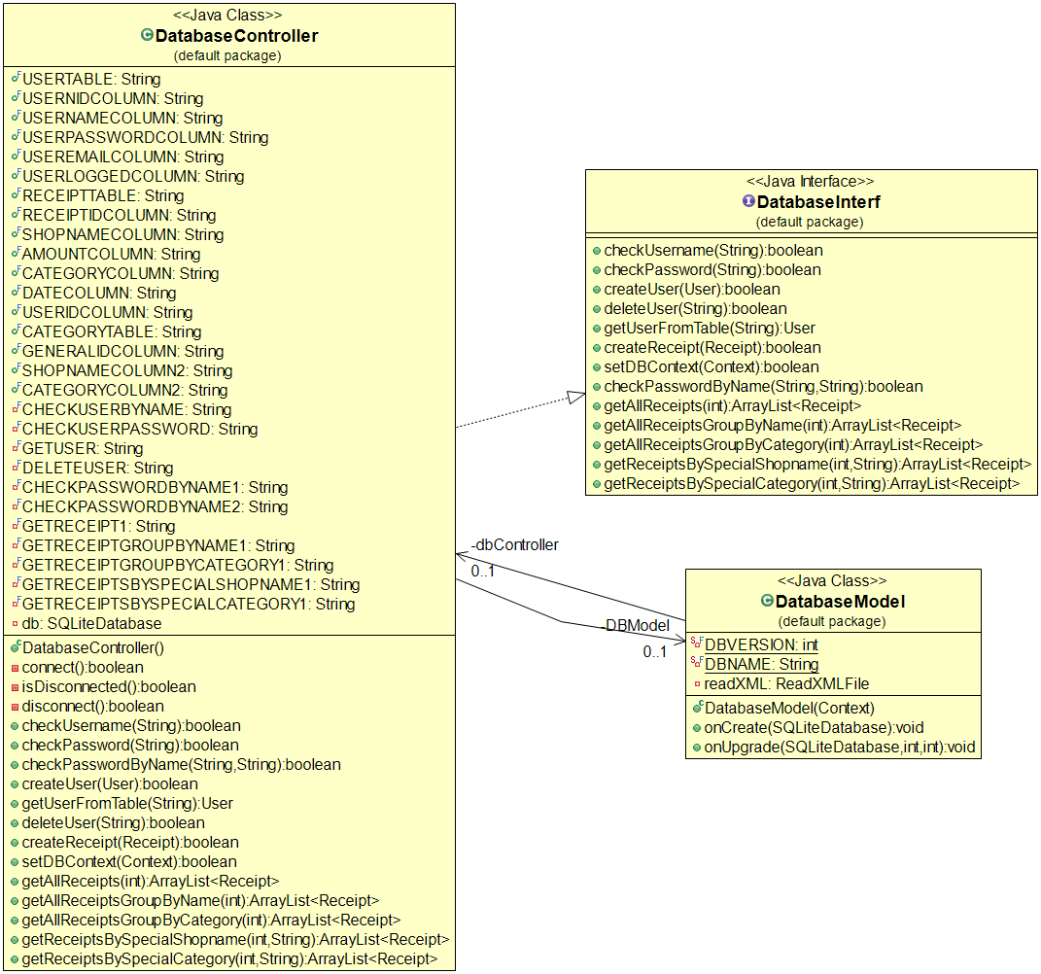
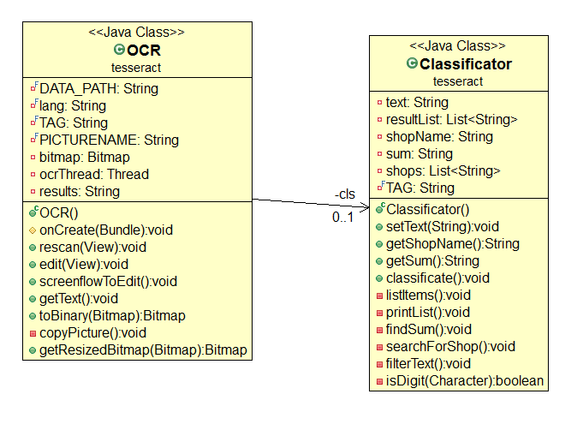
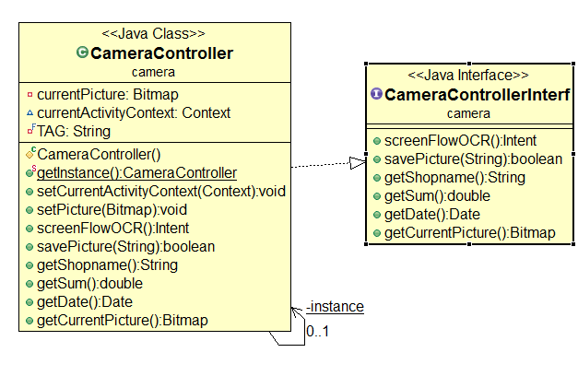
Project structure became more and more complicated…
Architecture: Structure
Expended Class Diagrams

Slide 17
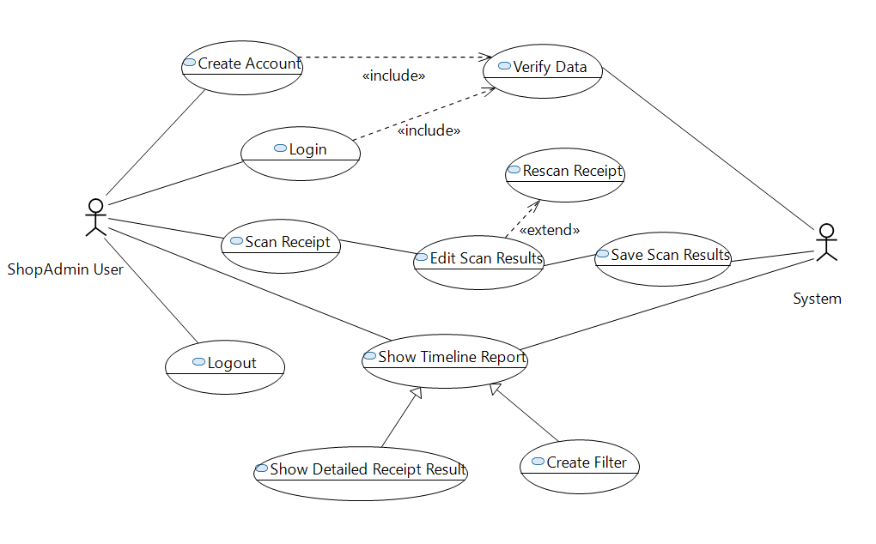
Usecase Diagram
Architecture: Behavior

Slide 18
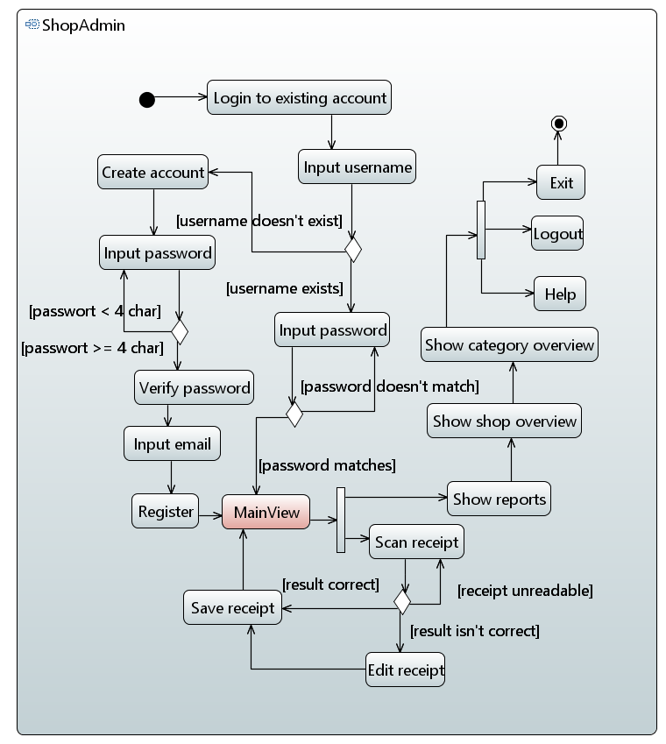
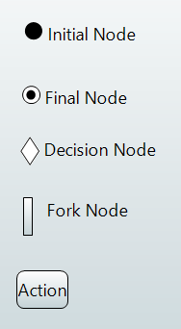
Activity Diagram
Architecture: Behavior
Notation Overview:

Slide 19
Content
Live Demo
Approach
Details
Technical Design
Android Details
Receipt Extraction
Conclusion

Slide 20

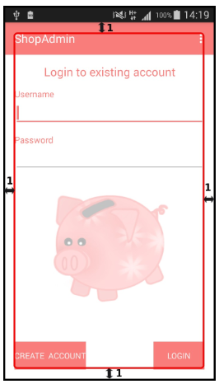
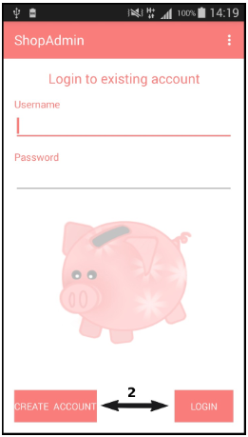
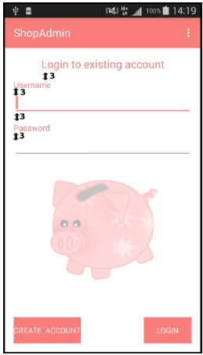
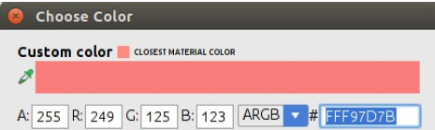
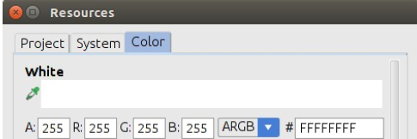
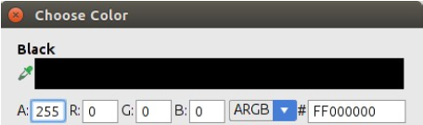
Corporate Design
Colors
Logo: piggybank (background in the app)
Pictures for Menu Help

Slide 21
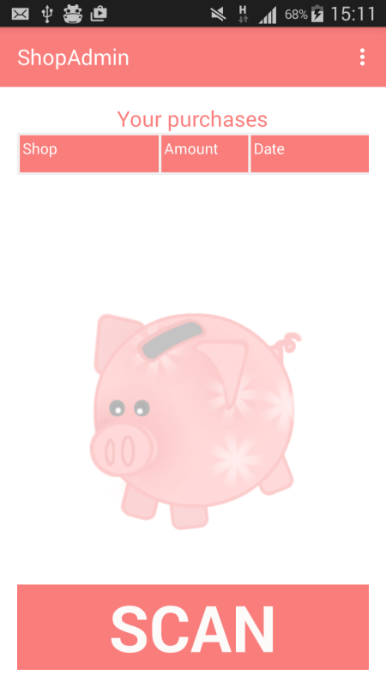
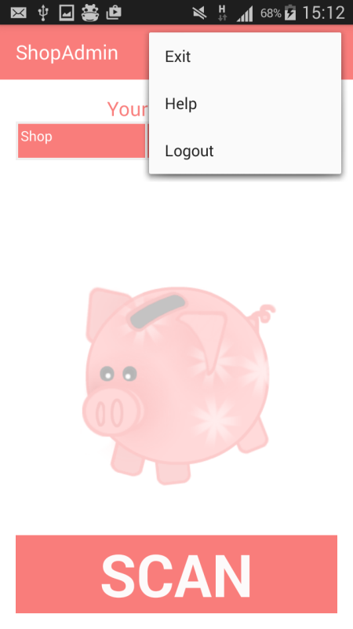
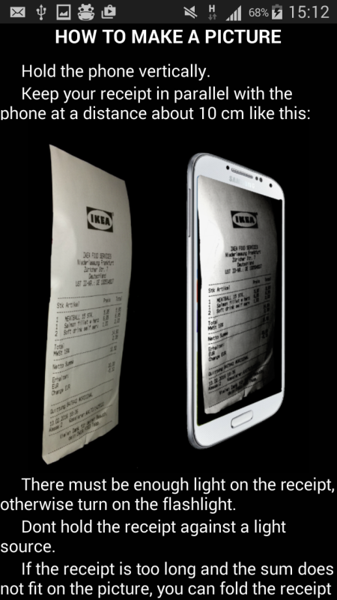
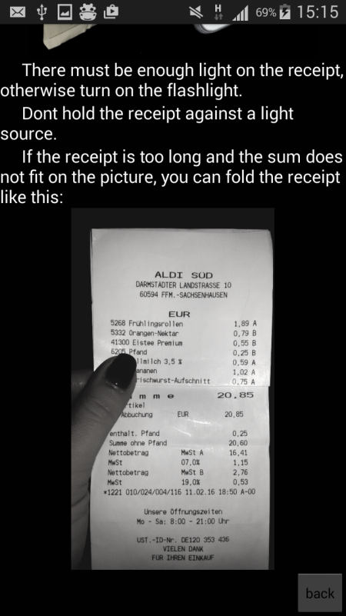
Action Bar with Overflow Menu
Functionality:
Exit
Help

Slide 22
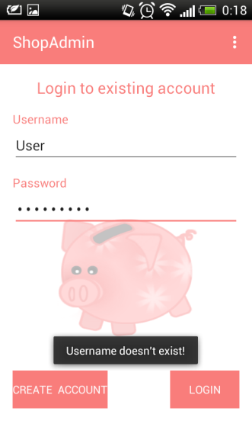
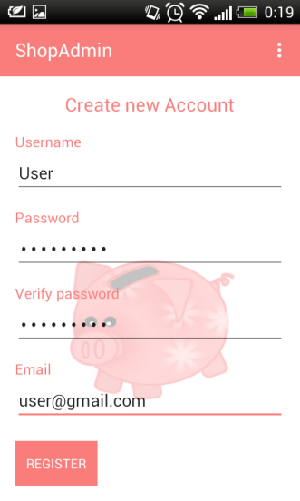
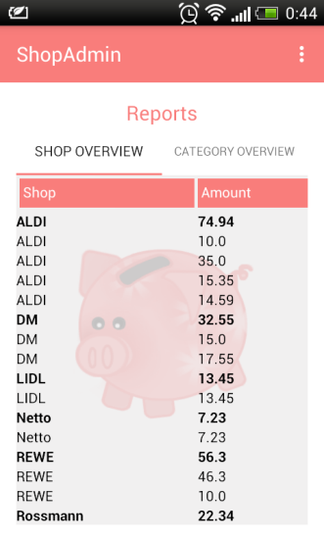
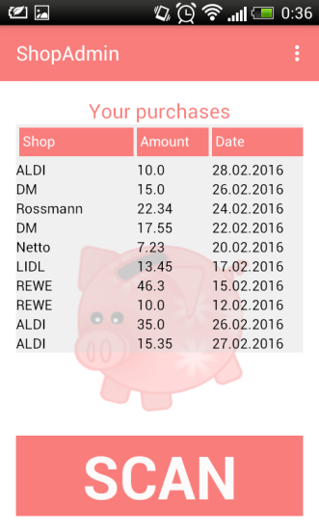
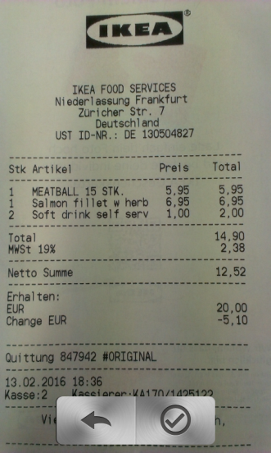
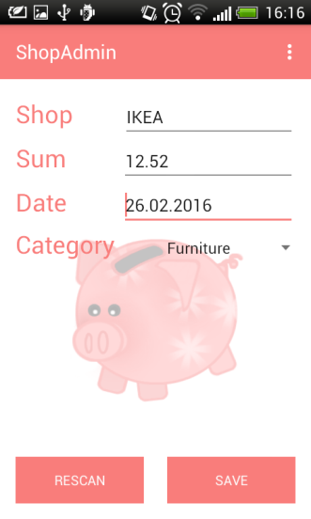
Scheme of Screens

Slide 23
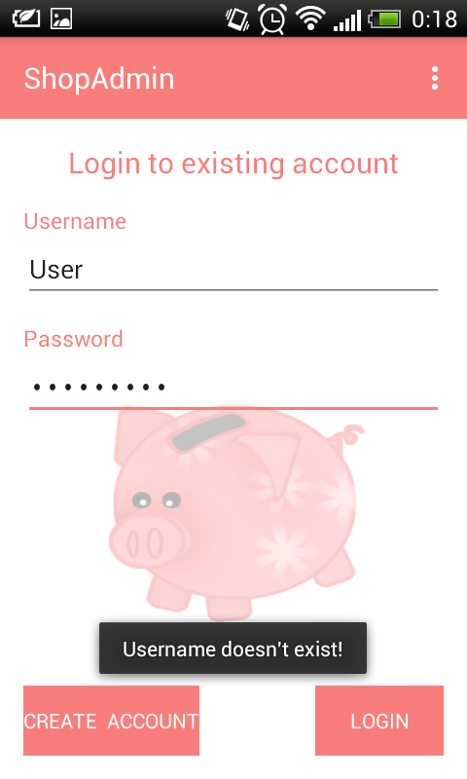

Activity Development
Creation of Register and Login View
Functionality in Register and Login view:
verifications
user name, password, email, complete input
visualize user feedback
save user data in database
hide and show fields in Register view
screen flow to Main view

Slide 24
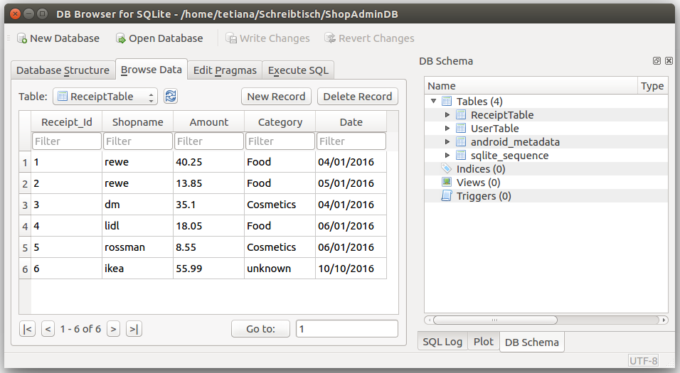
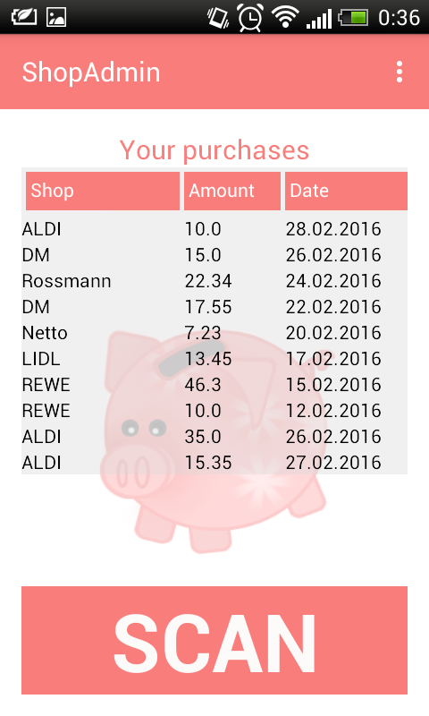

Activity Development
Functionality in Main view
get 20 latest receipts from database
Functionality in Report view
get all receipts grouped by name
get all receipts grouped by category
expand receipts grouped by selected shop name
expand all receipts grouped by selected category

Slide 25
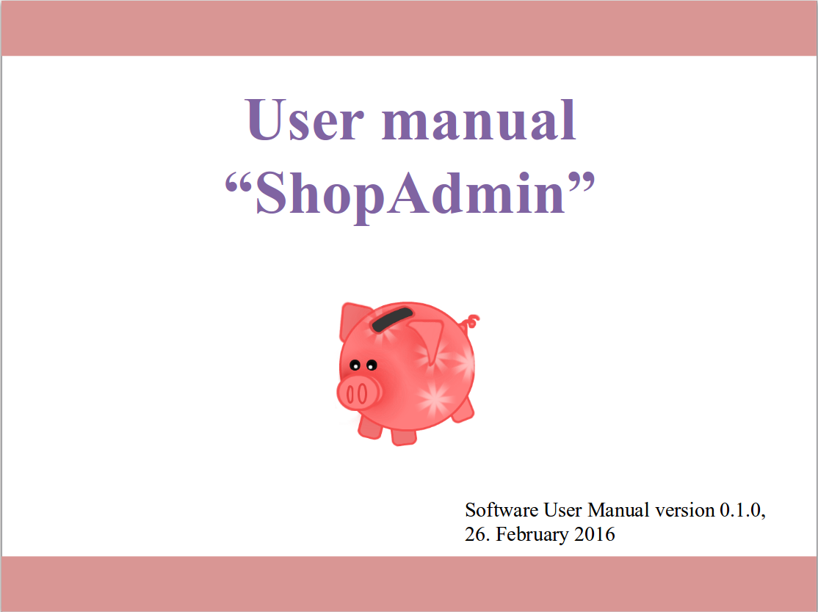
User Manual
User manual in 7 Steps:
Step 1 Registration
Step 2 Login
Step 3 Main view
Step 4 Scan receipt
Step 5 Check results
Step 6 Main view with summary
Step 7 Reports view

Slide 26
Content
Live Demo
Approach
Details
Technical Design
Android Details
Receipt Extraction
Conclusion

Slide 27
Optical Character Recognition
Use camera orientation to rotate picture
Resize image to 2000 x 1200 pixel
Colored image to black and white
Tesseract train language deu_frak

Slide 28
Classification
Pre analysis
Filter insignificant symbols
Combine single letters
Levenstein-algorithm
Post result adaption

Slide 29
Limitations and Issues
Orientation misleading - does not represent picture orientation
Tesseract can not detect bold or large fonts
Shop name classification highly depends on name length
Receipt sum detection is very depending on OCR results

Slide 30
Tests & statistics : How to make the photo
good lighting
flashlight | without flashlight
90% | 85%
bad lighting
flashlight | without flashlight
85 % | 5 %
text style
normal | bold
90% | 1%
folded receipt
no | yes
90% | 30 %

Slide 31
Content
Live Demo
Approach
Details
Conclusion

Slide 32
Forecast to Market
Some Key-functionalities couldn’t be finished during the semester. Major Topics are:
Session handling
Group functionalities
Online Database
Advanced filter possibilities for Reports
Advanced picture processing

Slide 33
ShopAdmin Control expenses app with receipt scanner
Pitch Round-Up
Vision
Whom is it for?
students or young family
Functionality:
Manually enter your outgoing transactions
Scanner auto-extract receipt information such as shop names, data and time, amount
What problems does it solve?
Save time for counting expenses
Challenges:
Using Android for the first time
Implementing Tesseract Library OCR engine

