Slide 2
Typography – hierarchy
36 pt | Headline – M | DB Regular
24 pt | Headline – S | DB Regular
14 pt | Headline – XS | DB Medium
36 pt 14 pt | 12.3% legend | DB Bold DB Regular
12 pt | Body text Lolorem seque nam laborum vel ium hillore provitatem. Exerumquod ma venimus. Estotam qui officident simus. | DB Regular
New ‘DanskeRegular’ fonts
Danske Bold
Danske Medium
Danske Regular
Danske Light
Danske Bold Italic
Danske Medium Italic
Danske Regular Italic
Danske Light Italic

Slide 3
Colour palette
Signature
#002346
Primary
Sand 1
#968C73
Sand 2
#CDC8B4
Sand 3
#EBEBE6
White
#FFFFFF
Blue 1
#003778
Blue 2
#4673C3
Blue 3
#87AAE1
Blue 4
#B9C8E6
Gold 1
#734B1E
Gold 2
#B48C41
Gold 3
#D2AF69
Gold 4
#E1CD91
Copper 1
#733719
Copper 2
#BE643C
Copper 3
#D79673
Copper 4
#EBBEAO
Green 1
#144B37
Green 2
#37A578
Green 3
#73C396
Green 4
#AADCB4
Secondary
Action
#0A5EF0
Caution
#ED6D03
Negative
#D3302F
Positive
#2D782F
Caution Darkmode
#FFD426
Caution Lightmode
#8A5B00
Action

Slide 4
The 12-Grid system and slide margins
1,6 cm
0,8 cm
1,6 cm
1,6 cm
2,09 cm
0,50 cm
1,6 cm

Slide 5
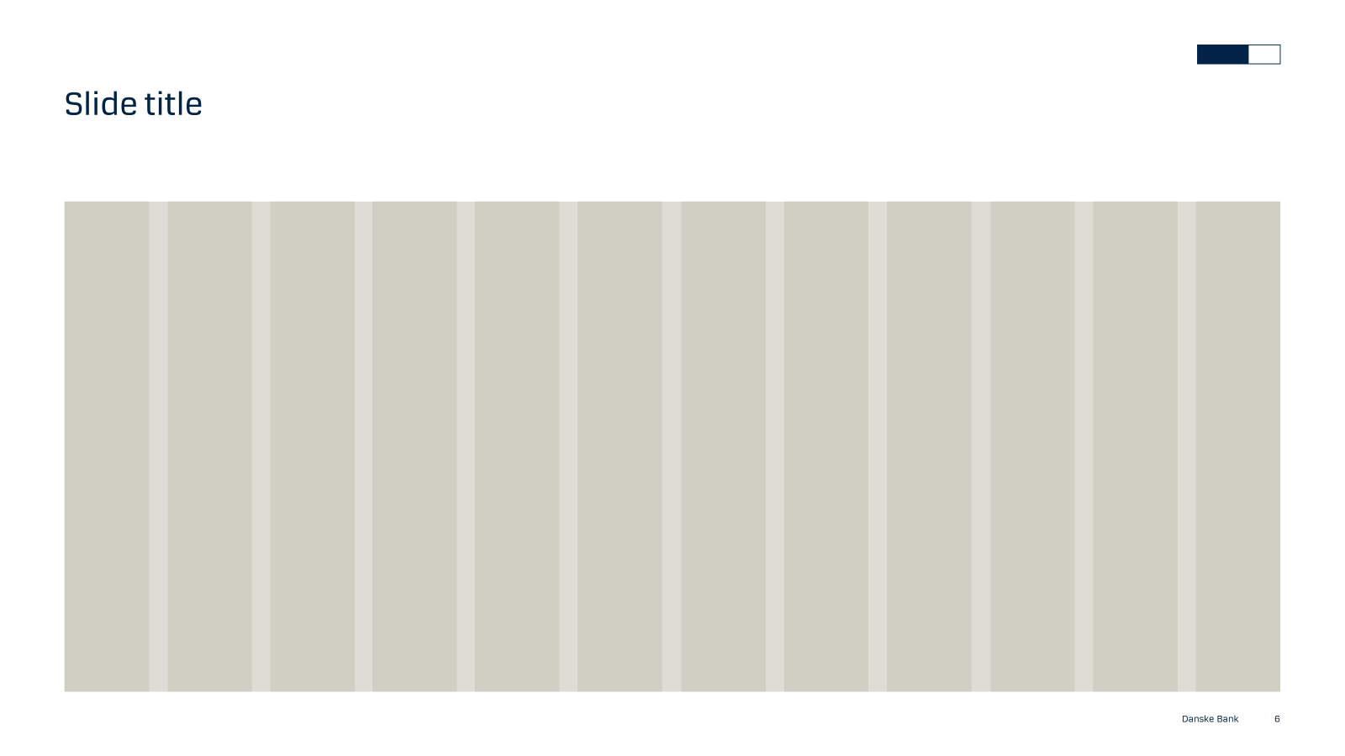
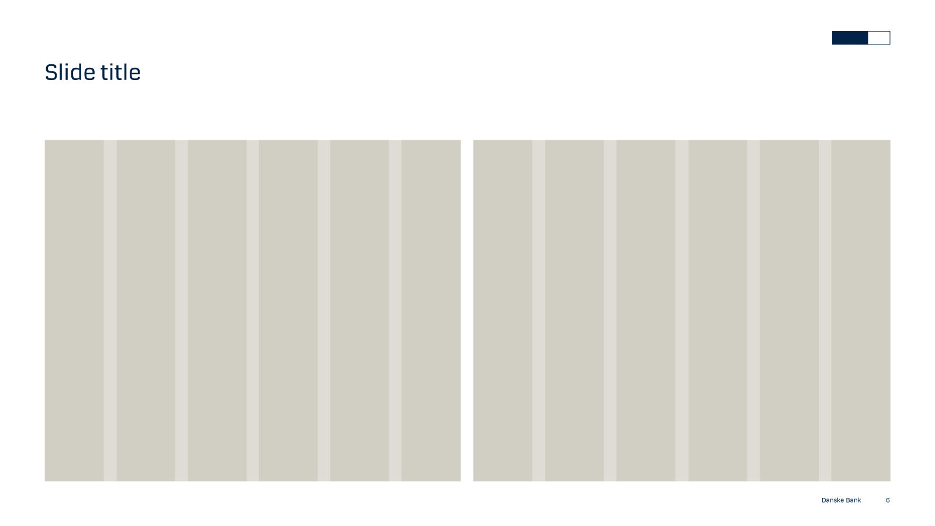
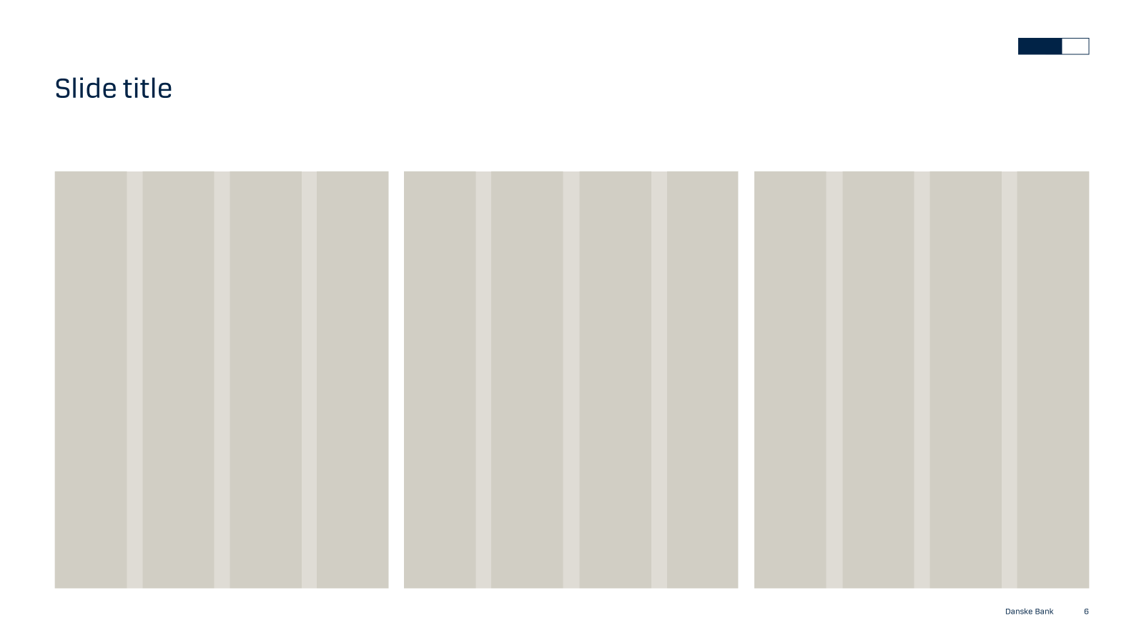

Use the grid-system to organise your content
1 column
2 columns
3 columns
4 columns

