Slide 1


Weight :
Data :
Server
Client 1
Client 2
Client 3

Slide 2
Weight :
Data :
Server
The server starts by selecting a certain number of clients to train the model. The clients train on this model and return the weights associated with the central model.
Client 1
Client 2
Client 3

Slide 3
Weight :
Data :
Server
Client 1
Client 2
Client 3

Slide 4

Weight :
Data :
Server
Client 1
Client 2
Client 3

Slide 5
Weight :
Data :
Server
Client 1
Client 2
Client 3

Slide 6
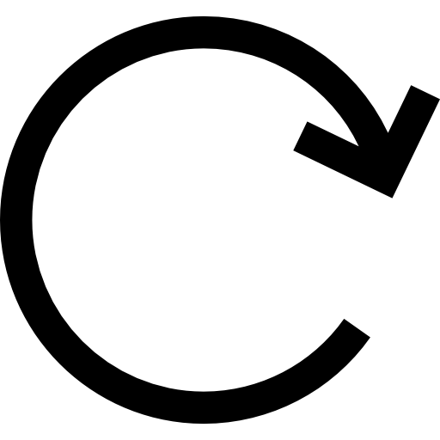
Weight :
Data :
Server
Each client trains with its own data on the model sent by the central server.
Client 1
Client 2
Client 3

Slide 7
Weight :
Data :
Server
Client 1
Client 2
Client 3

Slide 8
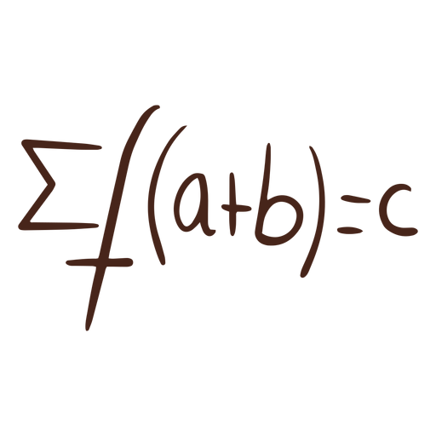
Weight :
Data :
Server
Client 1
Client 2
Client 3

Slide 9
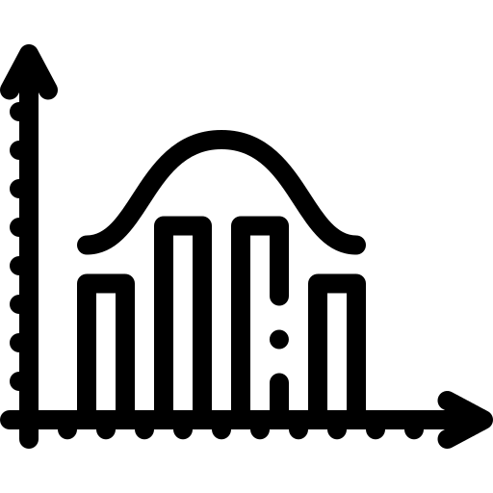
Weight :
Data :
Server
The central server aggregates and averages the points received from the clients to improve the central model.
Client 1
Client 2
Client 3

Slide 10
Weight :
Data :
Server
Client 1
Client 2
Client 3

Slide 11
Weight :
Data :
Server
Client 1
Client 2
Client 3

Slide 12
Weight :
Data :
Server
Client 1
Client 2
Client 3

Slide 13

MNIST database
1000 data points
1000 data points
1000 data points
1000 data points
1000 data points
Client 1
Client 2
Client 3
Client 4
Client 5
Global client

