Slide 1



BASE DE DONNÉES

Slide 2
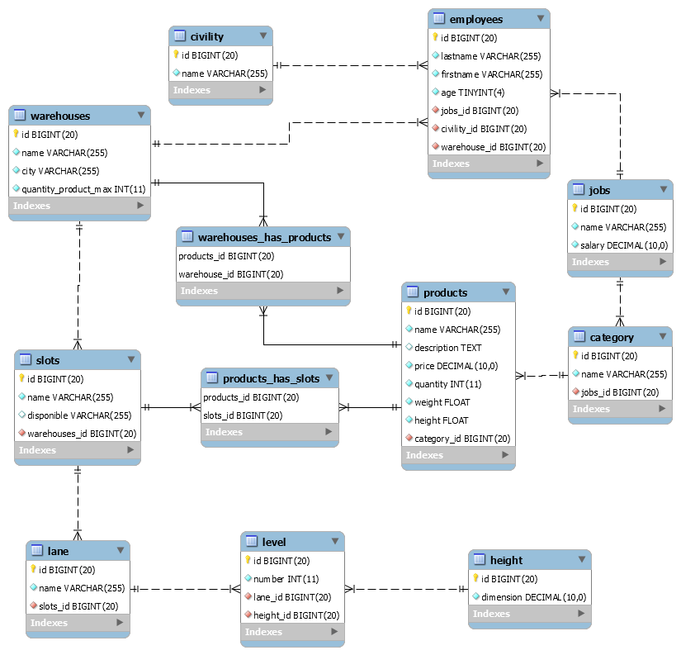
Workbench

Slide 3
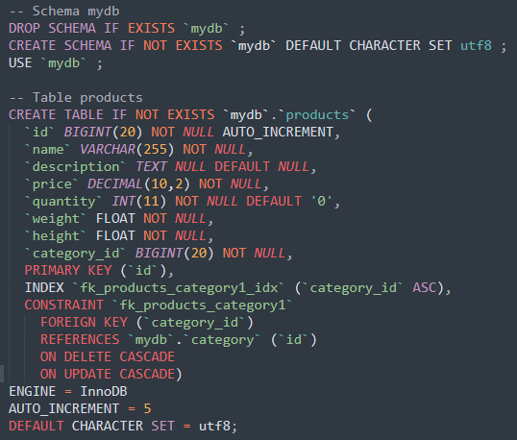
Scripts SQL
Commandes
Types
INDEX
CONSTRAINT
REFERENCES
ON DELETE
ON UPDATE
ENGINE
AUTO_INCREMENT

Slide 4
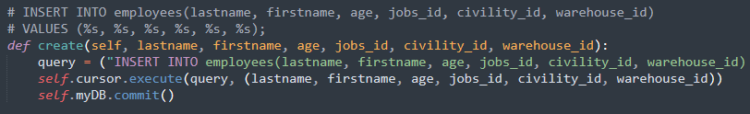
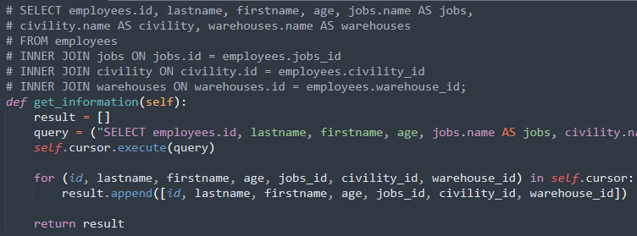
Code
CREATE
CRUD
Create Read Update Delete
READ

Slide 5

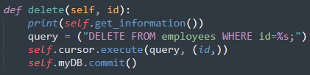
Code
UPDATE
CRUD
Create Read Update Delete
DELETE

Slide 6

Code
Module
mysql.connector

