Slide 1
Project 2 - DMML 17/18
by Yimin Xie, Yantao Shi, Jeong-Eun Choi

Slide 2
Ex.1 - Decision Trees
Goal: compare J48 and ID3
Condition:
Two Classification Datset: diabetes.arff and ionosphere.arff
with only two classes in order to compare the ROC curves (otherwise need to compare all the curves of each classes)
J48 with and without pruning (all other values to default)
ID3 (all values to default)
Use 10x10 CrossValidation (randomness to achieve better result)
Problem: ID3 only takes nomial values
use filter:filters.supervised.attribute.Discretize-Rfirst-last-precision6
additional question: need to use the filtered dataset for J48 and ID3?
we used for both J48 and ID3 filtered data so that we have fixed data to compare with

Slide 3
Ex.1 - Prediction
ID3: The implementation in weka is constructing an unpruned decision tree based on the ID3 algorithm. The core is to apply information gain criteria selection features on each sub-node of the decision tree to construct the decision tree recursively. However, it can not handle missing values and requires nominal attributes to compute. It uses a heuristic for choosing an attribute - attribute with the highest information gain is chosen
J48: The implementation in weka is generating a pruned or unpruned C4.5 decision tree. C4.5 is an improved algorithm of ID3 that can handle missing values and does NOT require nominal attributes to compute. Furthermore, it uses a heuristic for choosing the attribute - it uses the normalized information gain that results from choosing an attribute for splitting the data. The attribute with the highest normalized information gain is chosen
Prediction: since J48 can prune the tree, we expect that the tree of J48 is much smaller than the one from ID3. Moreover, we expect that the heuristic of choosing the attribute with normalized information gain is better than pure information gain. Therefore, even if we use J48 unpruned, the tree will be smaller than the one from ID3. Since we are doing 10x10 cross-validation, the accuracy of J48 will be better since it prevents overfitting through pruning. In case of training set, the accuracy of ID3 will be higher, since it aims to maximize the accuracy to the training data given, while J48 prunes, which would result lower accuracy.
Source: A comparative study of decision tree ID3 and C4.5 (link)

Slide 4
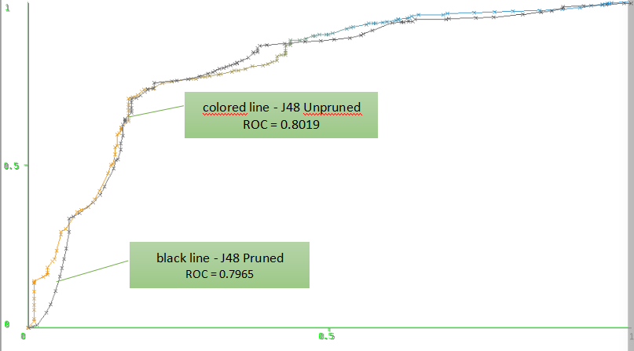
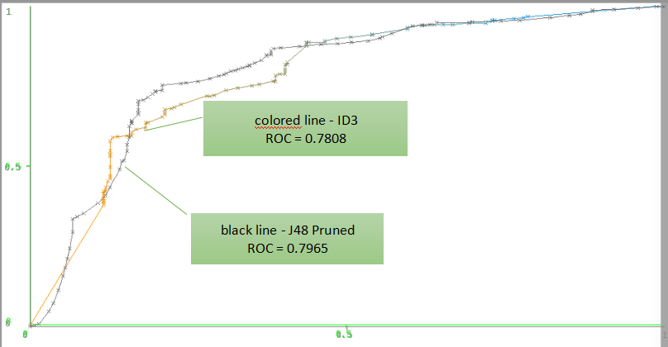
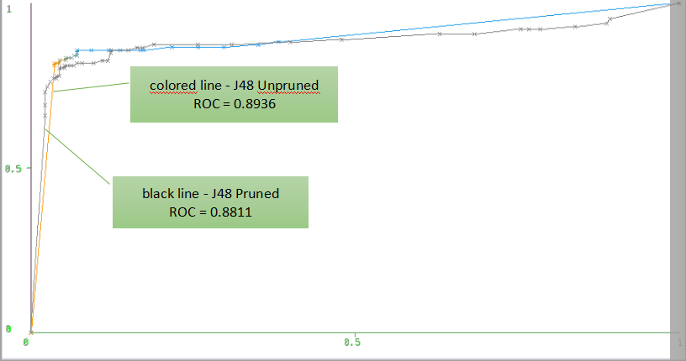
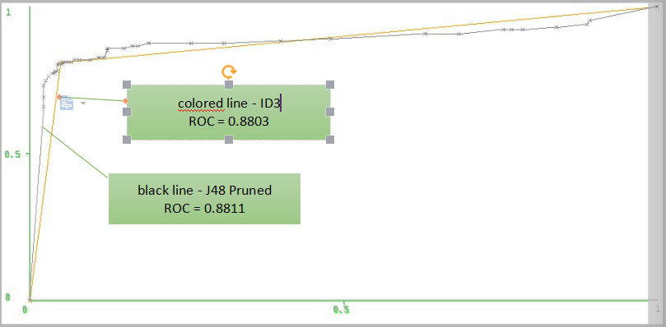
Ex.1 a) - ROC Curves
Fig1. diabetes J48 pruned vs. unpruned
Fig2. diabetes J48 pruned vs. ID3
Fig3. ionosphere J48 pruned vs. unpruned
Fig4. ionosphere J48 pruned vs. ID3

Slide 5
Ex.1 b&c) - Accuracy and Tree
10x10 CV | Accuracy (%) | #Nodes | #Leaves
ionosphere (J48 unpruned) | 90.3134 | 57 | 44
ionosphere (J48 pruned) | 89.4587 | 27 | 21
ionosphere (ID3) | 88.8889 | 89 | 71
diabetes (J48 unpruned) | 76.0417 | 54 | 31
diabetes (J48 pruned) | 77.7344 | 22 | 13
diabetes(ID3) | 76.5625 | 173 | 94
TRAININGSET | Accuracy(%) | #Nodes | #Leaves
ionosphere (J48 unpruned) | 98.2906 | 57 | 44
ionosphere (J48 pruned) | 95.4416 | 27 | 21
ionosphere (ID3) | 100 | 89 | 71
Fig6. J48 & ID3 - TrainingSet
Fig5. J48 & ID3 - 10x10CV

Slide 6
Ex.1 Explanation & Conclusion
For this experiment, we always took the class of “recurrence events” to generate ROC-curves. X-axis stands for 'false positive rate' and Y-axis for 'true positive rate'. So, the area under ROC-curve also represents the accuracy of the algorithm used. The results from J48 unpruned always achieved the biggest area under ROC curve, which matches to our expectation that J48 would reach the higher accuracy than ID3. It is also interesting to compare the curves between pruned and unpruned J48, since you can see how pruning affected the curves (Fig1. and Fig3.). In ID3 we can observe that parts of the curves are quite linear (Fig2. and Fig4.), which might be a reflection of the algorithm ID3. Moreover, we can learn about the dataset. For example, 'ionosphere' can reach quite high rate of true positive rate with relatively low false positive rate(Fig3. and Fig4.). So, this represents that this dataset is already quite suitable (and has suitable attributes) to classify, while for 'diabetes' one might include some other attirbutes (or weight each attribute differently) in order to make it more suitable to classify.
As expected, the trees of ID3 is much bigger than those of J48 either pruned or unpruned.(Fig.5) Of course, pruned J48 generated much smaller tree and lost only small range of accuracy. In case of 'diabetes' it actually reached highest accuracy, which might be a proof of 'preventing overfitting'. When we observe the results of 'training set'(Fig.6), we see that ID3 reached 100% of accuracy. So, ID3 creates a 'full-tree' for a training set it uses which leads to overfitting. It is also interesting to see that once the tree is generated that the trees are NOT being updated which is a important chracteristics of ID3 and J48 (Fig5. and Fig6.)
As a conclusion, ID3 has the tendency of overfitting and creates too large tree. J48 even without pruning generates smaller trees due to better heristics of choosing attributes. However, even if we prune the tree we do not loose a lot of accuracy and sometime gain from 'preventing overfitting' and creates the smallest trees. So, J48 pruned appears to be the best to use.

Slide 7
Ex.2 - NearestNeighbor, k-NN
Goal: test and find which k reaches highest accuracy by using k-NN
Condition:
use k-NN (IBk, with default parameters)
while
use the same dataset from the previous Exercise 1 with the same filter
10x10 Cross Validation

Slide 8
Ex.2 - Prediction
The K-NN uses aTraining Set to predict the value of a variable of interest for each member of a target data set (lazy approach). An object is classified by a majority vote of its neighbors, with the object being assigned to the class most common among its k nearest neighbors. k represents a certain 'distance' like Euclidian distance.
Prediction: If k = 1, then it gurantees an error rate of no worse than twice the minimum achievable error rate given the distirbution of the data. So, k = 1 is more like our baseline. However, if k is too big, this would increase the probabilty of taking unsuitable data into account. Therefore, we assume that k =3 or 5 would be the best k-value, since our datasets are not very big. 'diabetes' has 768 instances and only 9 attributes. 'ionosphere' has only 351 instance and 35 attributes.

Slide 9
Ex.2 - Results & Explanation
 | k = 1 | k = 3 | k = 5 | k = 7 | k = 9 | k = 11
#ionosphere | 94.0171 | 90.5983 | 90.0285 | 89.7436 | 89.4587 | 89.1738
#diabetes | 77.0833 | 76.6927 | 76.8229 | 76.8229 | 75.9115 | 75.2604
Fig7. k-NN results
Different from our expectation, we could achieve the best results from k = 1. Theoretically, if the number of samples is infinite, the bigger the k, the better. In our experment, it appears that the dataset is small so that k = 1 is already good enough and the algorithm is not very sensitive to noise (or there is not much noise in the dataset).

Slide 10
Ex.3 - Regression Trees
Goal: Analyze the results of M5P by testing it on five regression datasets
Condition:
using datasets:auto-price, concrete, housing, stock, wine-quality (no filter used)
using M5P with and without pruning (all other values to default)
using M5P with regression tree and model tree
10 Cross Validation (as instructed)

Slide 11
Ex.3 - Prediction
M5: In weka the M5P implementes base routines for generating M5 Model trees and rules. It can also create a regression tree. M5 “builds tree-based models but, whereas regression trees have values at their leaves, the tres constructed by M5 can have multivariate linear models; these model trees are thus analogous to piecewise linear functions. [...] The advantage of M5 over CART is that model trees are generally much smaller than regresstion trees.”
Regression Trees just have constant fitted mean of the response in each node which is then used for the prediction. Model Trees can fit a regression model within each node of the tree. I.e. it can set the leaf nodes as piecewise linear functions, where piecewise linear means The model consists of multiple linear segments, which is the model tree. The interpretability of the model tree is one of its characteristics superior to the regression tree. In addition, the model tree also has a more accurate prediction accuracy.
There are various of error fuctions that can be used for regression tasks like MAE (Mean Absolute Error) and RMSE (Root Mean Squared Error) MAE is the average magnitude of the errors in a set of predictions without weighting the errors of each individuals. RMSE also measure the magnitude of error but it is the square root of the average of squared differences between prediction and actual observation. Both measurements are indifferent to the direction of erros and lowever values are the better ones. By squaring the errors before they are averaged, it gives higher weight to large errors. Therefore, RMSE is always bigger or equal to MAE, while if MAE = RMSE, all errors have the same magnitude.
Prediction:Overall Model Trees will achieve better accuracy then Regression Trees. The RMSE will always be larger or equal to MAE, however, we predicted that with pruning the RMSE might be lower, since pruning might prevent overfittig effect i.e. smaller magnitude of errors.
Source: Learning with Continous Classes (link)
Source: MAE and RMSE - Which Metric is Better? (link)

Slide 12
Ex.3 Results & Explanation
 | with pruning |  |  |  | without pruning
MeanAverageError(MAE) /RootMeanSquaredError(RMSE) | MAE |  | RMSE |  | MAE |  | RMSE
RegressionTree(RT) /ModelTree(MT) | RT | MT | RT | MT | RT | MT | RT | MT
#1auto-price | 2096.3675 | 1466.5565 | 3336.3692 | 2171.1561 | 2075.0678 | 1403.2007 | 3287.1186 | 2094.5903
#2concrete | 6.7866 | 4.7397 | 8.6751 | 6.3652 | 6.4819 | 4.2748 | 8.3325 | 5.8917
#3housing | 3.2864 | 2.5047 | 4.8185 | 3.7502 | 3.1955 | 2.385 | 4.7203 | 3.7105
#4stock | 1.1874 | 0.6707 | 1.6019 | 0.9429 | 1.1731 | 0.6656 | 1.5874 | 0.9274
#5winequality | 0.5549 | 0.5484 | 0.7211 | 0.7092 | 0.5325 | 0.5147 | 0.6983 | 0.6811
As expected, the Model Tree achieves always better results then Regression Trees. Considering accuracy only without pruning achieved better results. In our experiment accuracy gained by not pruning is higher than can be gained through pruning (by preventing overfitting amd decreasing large errors). However,whether to choose with pruning instead or without depends on the purpose of the regression task. For example when we are predicting auto-prices, large errors on guessing the prices might not be particularly important to consider (bargaining for final price). One might therefore use with pruning so that less resource is required for the tree. For stock or for winequality, one might favor more accuracy and lower large errors, then one would chosse without pruning instead.

