Slide 1

Double-Row Title
You may use up to two rows for your main title
Subtitles, e.g., „KOM Lab Final Presentation – Group 1“
Single-Row Subtitle
Enough place for a nice, descriptive picture!
Your Name(s)
Your Mail Your Supervisor(s)
Don‘t forget to reference your title picture
Picture Reference

Slide 2

Titles Are Written as IEEE Suggests Subtitle: See Below
Correctly using the template
Use the „indent“ buttons on top to get this bullet list correctly formated!
Für die korrekte Formatierung der Aufzählung die Buttons „Listeneinzug“ oben nutzen!
How to write slide titles
As suggested by the IEEE for paper titles (i.e., „title case“)
“Titles are generally capitalized except for words such as a, an, and, as, at, but, by, for, in, nor, of, on, or, the, to and up, which are usually not capitalized unless they are the first or last word of the title”
For presentations on foreign devices…
Export the finished presentation as PowerPoint slideshow (.ppsx) → prevent common issues like different PowerPoint versions or missing fonts and styles
Export the finished presentation as PDF → does not require PowerPoint
The buttons look like this
[KOM19]
Example of a picture reference.
KOM et al.: Widescreen Powerpoint Template for KOM [KOM19]
Example of a footnote reference: You can place your references used on this slide here, in addition to the Sources slide. Remove if not used.

Slide 3
Sources
[KOM19] Multimedia Communications Lab, KOM (2019). Widescreen Powerpoint Template for KOM.
This is an example!

Slide 4
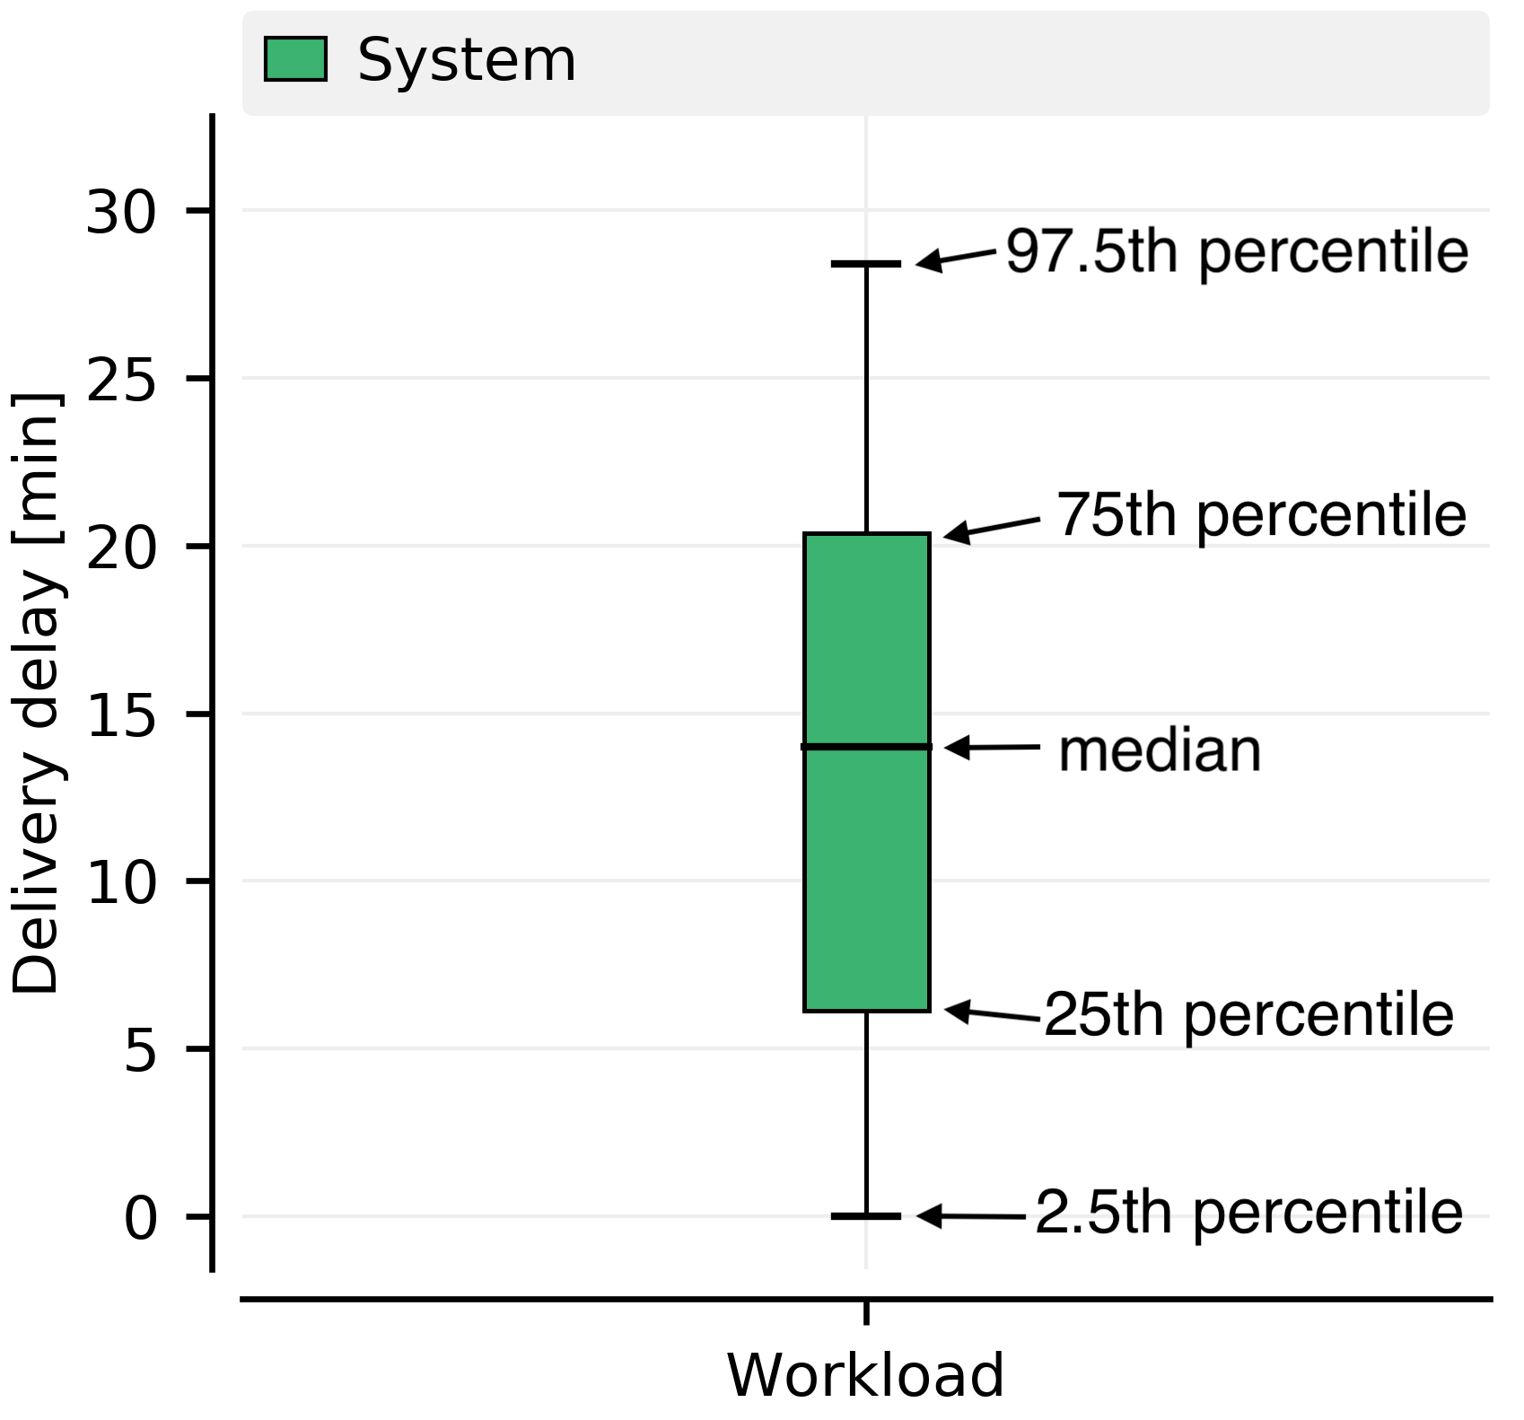
Box Plot Description Backup: „This is a backup slide“
Picture description
Description of a box plot. [KOM19]
Picture reference
KOM et al.: Widescreen Powerpoint Template for KOM [KOM19]
Example of a footnote reference: You can place your references used on this slide here, in addition to the Sources slide. Remove if not used.

