Slide 1
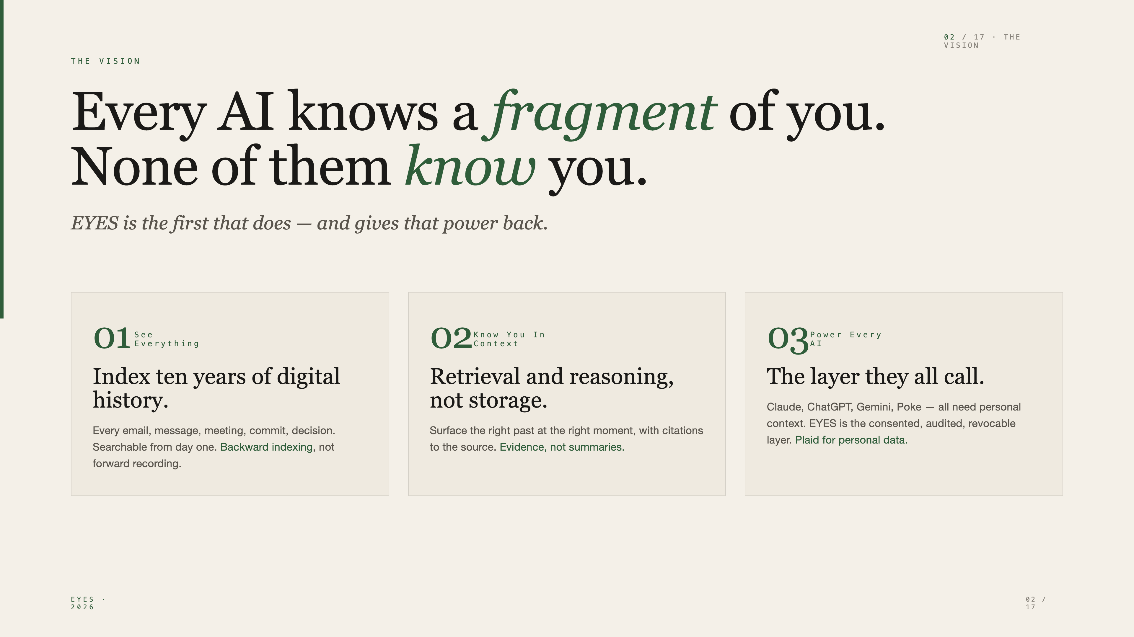
Notes:
This is EYES. We're building the personal context infrastructure that any AI calls. 17 slides, 25 minutes. Happy to go deep wherever you want.

Slide 2

Notes:
Every AI assistant ingests fragments of you. None of them have a unified view, audit trail, or sovereignty controls. The enterprise version of this got SASE, Okta, OneTrust. The individual version got nothing. That's what we're building.

Slide 3
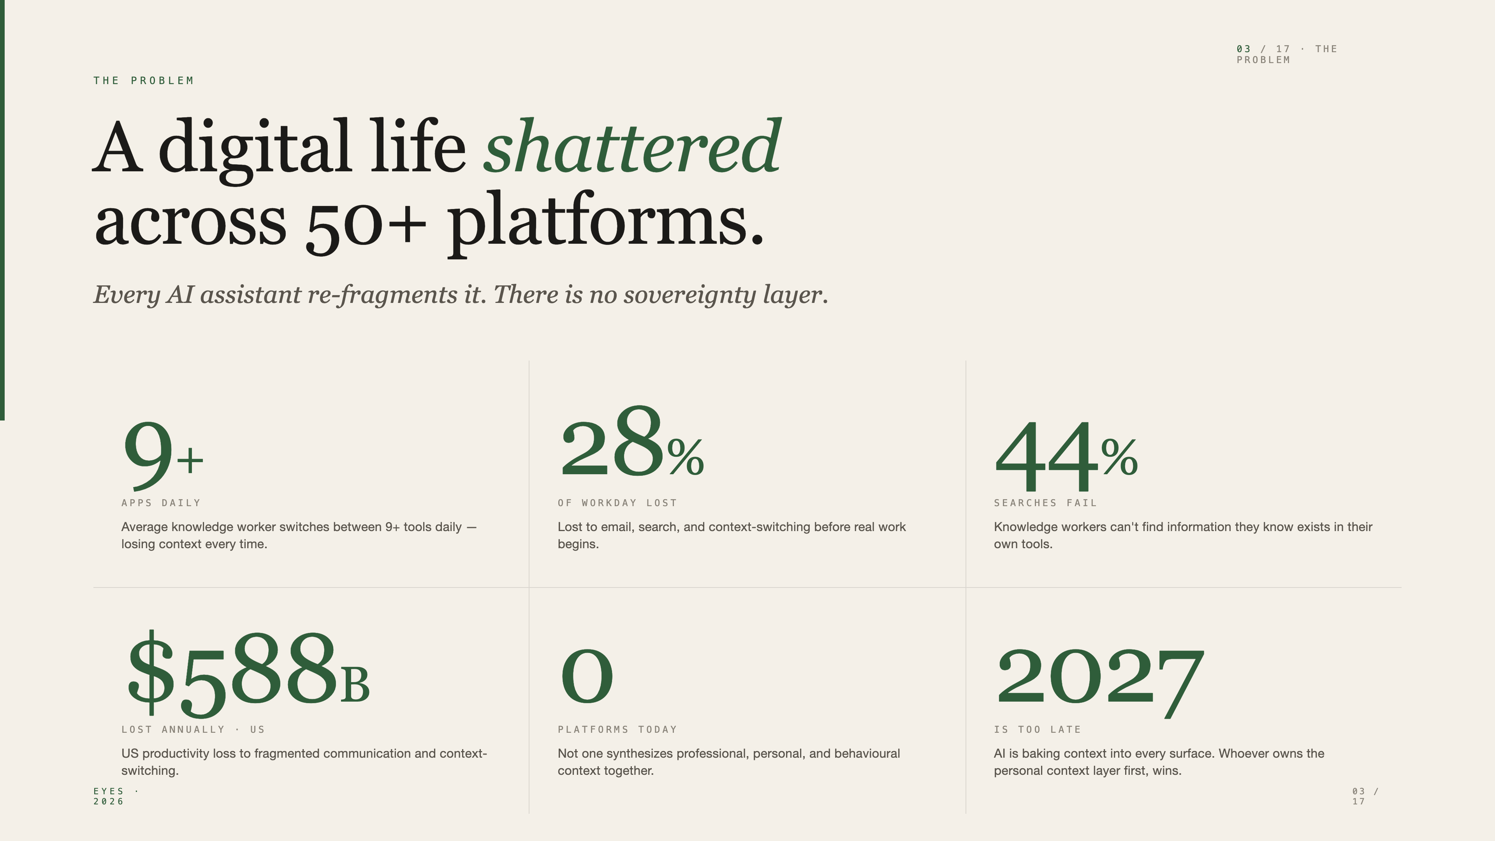
Notes:
$588B problem in the US alone. The pain is daily, the gap is structural, and AI is making it worse — every new AI assistant re-fragments your data again.

Slide 4
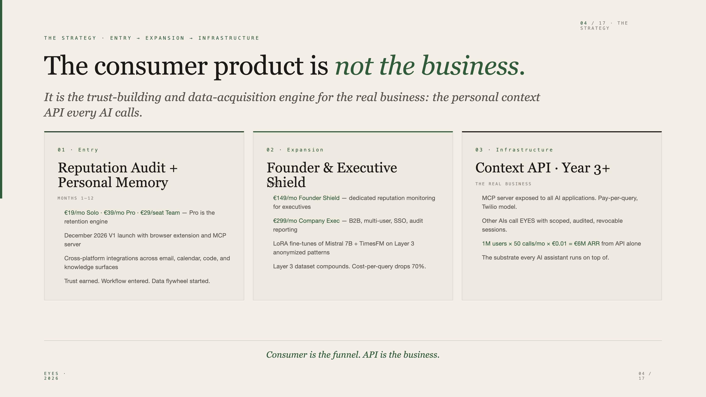
Notes:
Most AI startups compete for consumer attention. We use the consumer product to build the substrate every AI eventually depends on. Consumer gets us the data and the trust. The API layer is the venture-scale outcome.

Slide 5
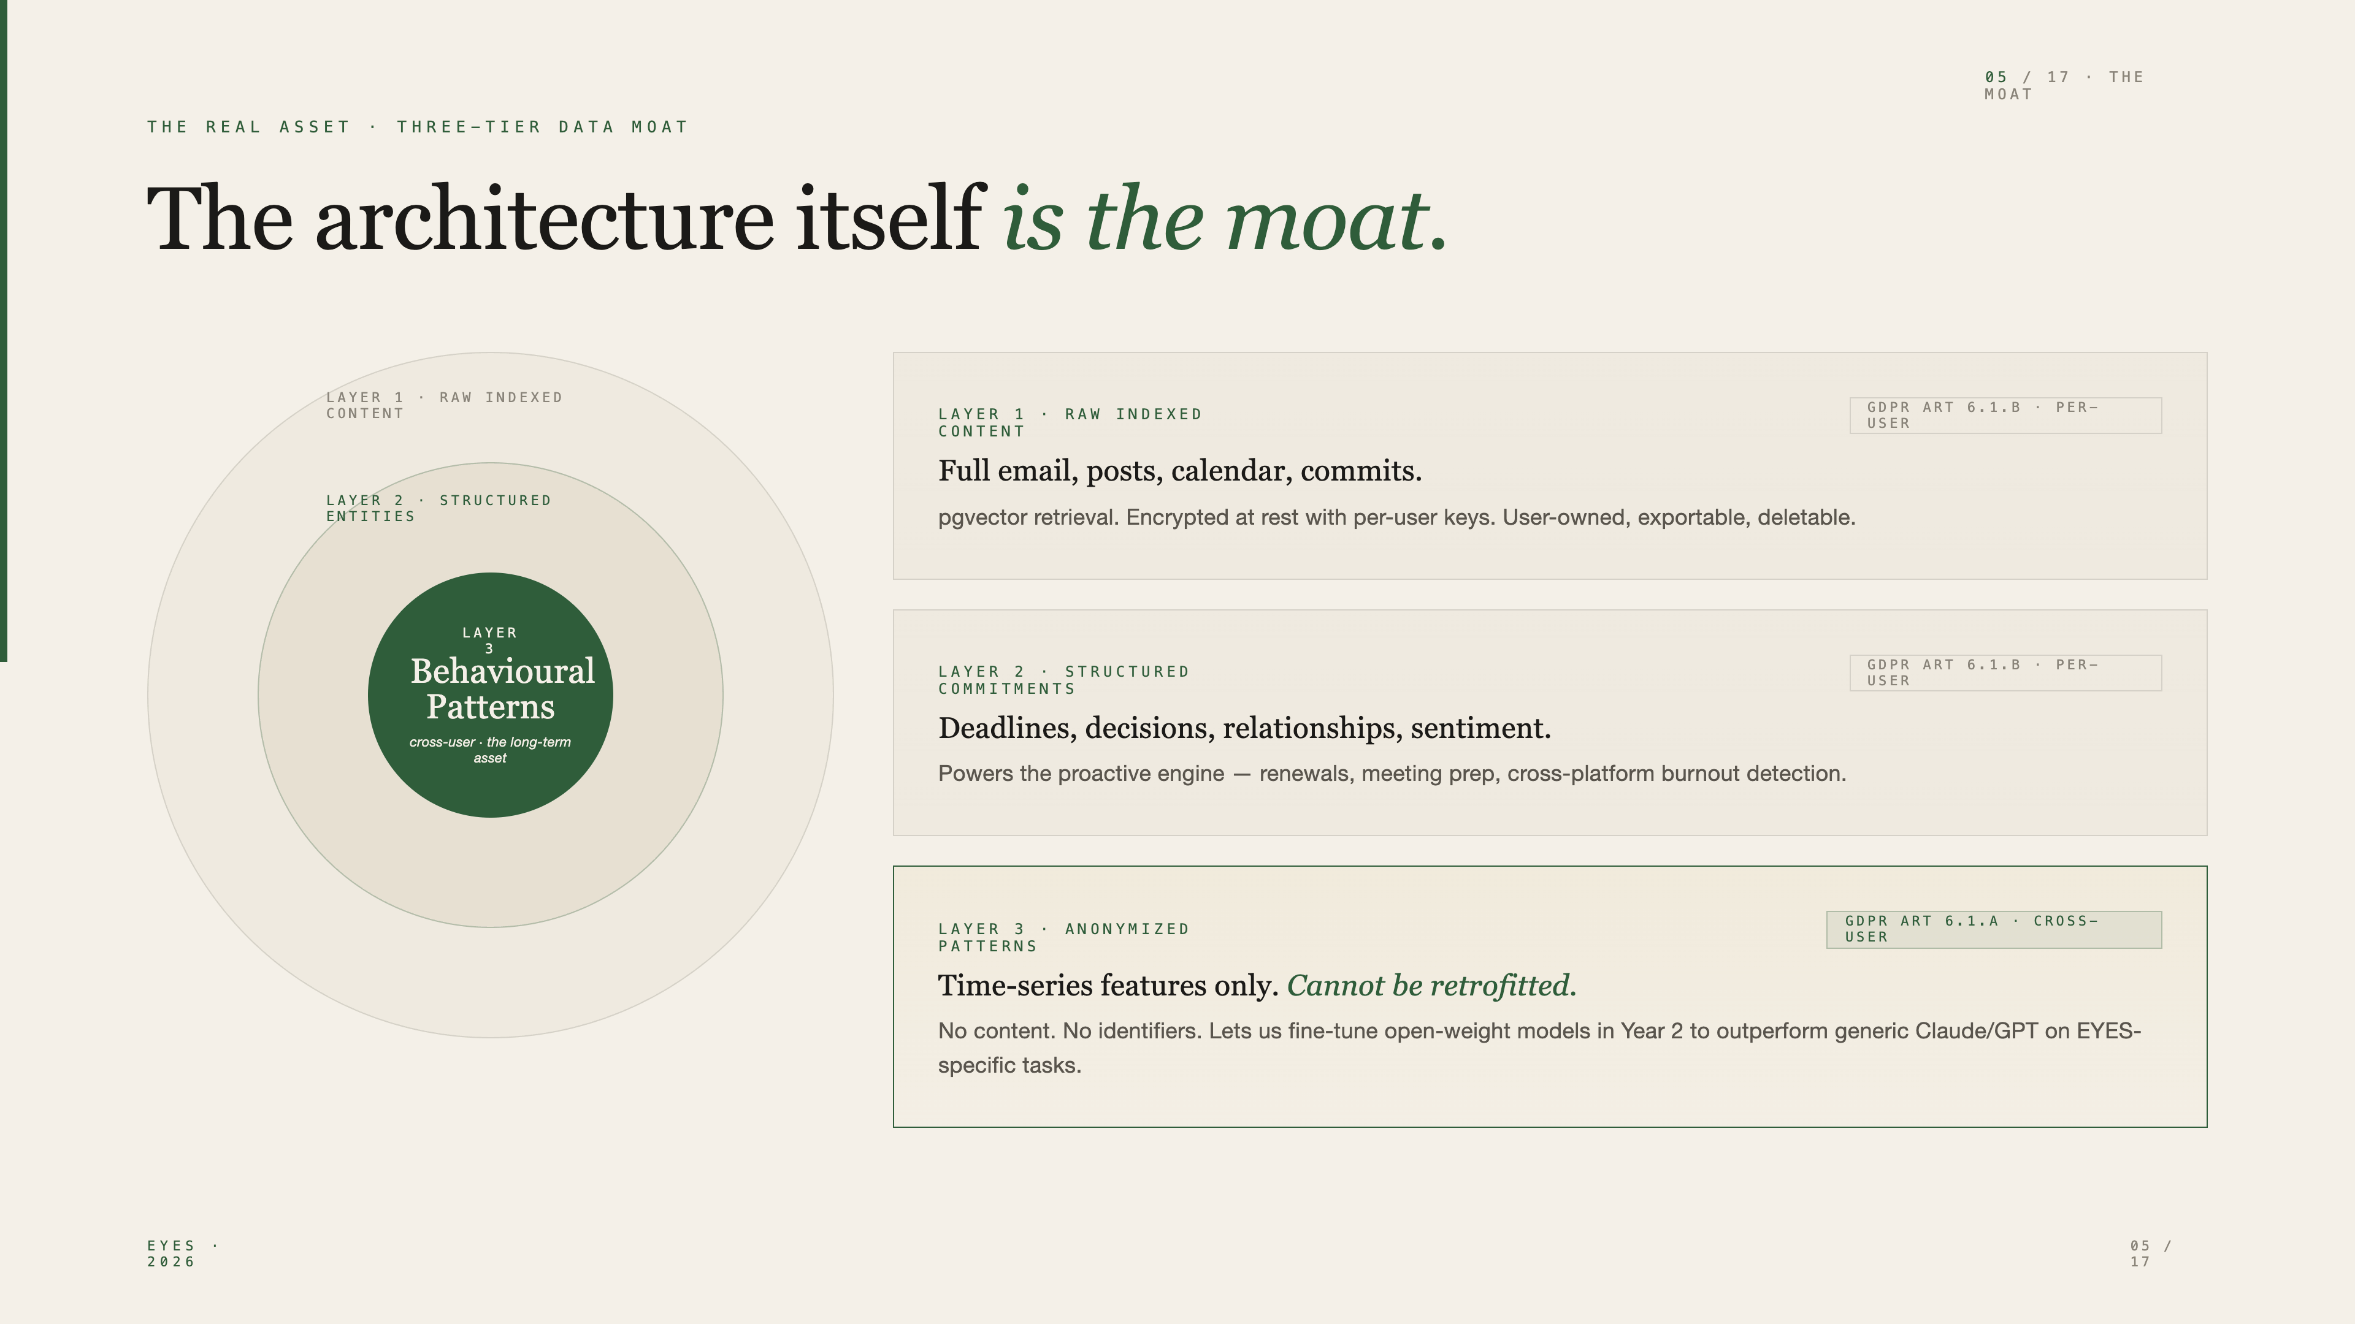
Notes:
Our moat is not the model. The model is Claude and Mistral. Our moat is the three-tier data architecture, the consent infrastructure that goes with it, and the fact that every additional month of user data makes us harder to replace.

Slide 6
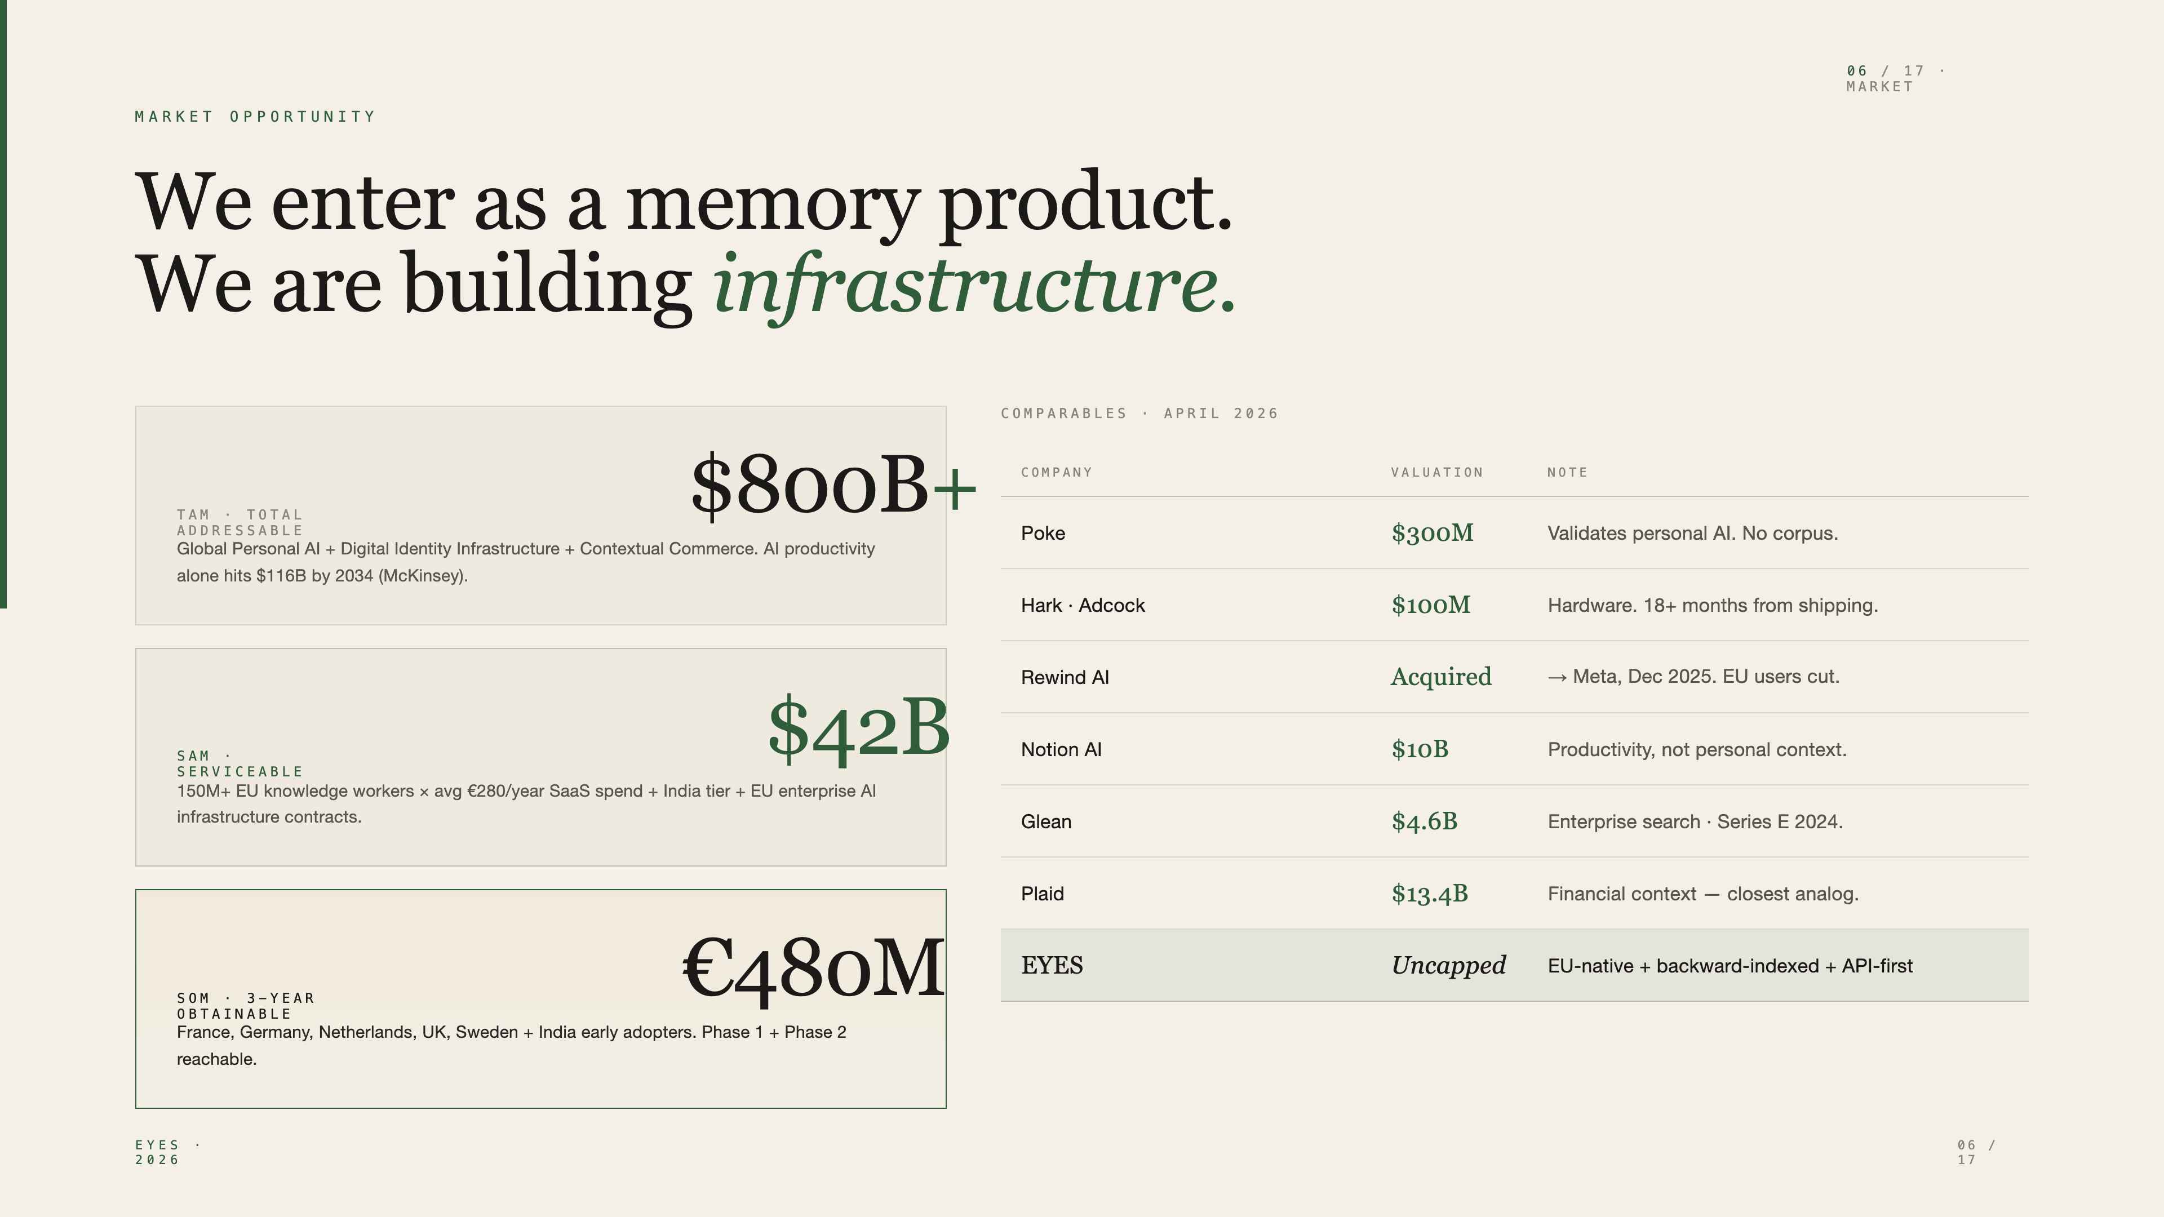
Notes:
$800B long-tail TAM. $42B addressable in EU + India. €480M winnable in 3 years. The closest analog isn't Notion or Glean — it's Plaid. Plaid is what financial context infrastructure looks like. EYES is what personal context infrastructure looks like.

Slide 7
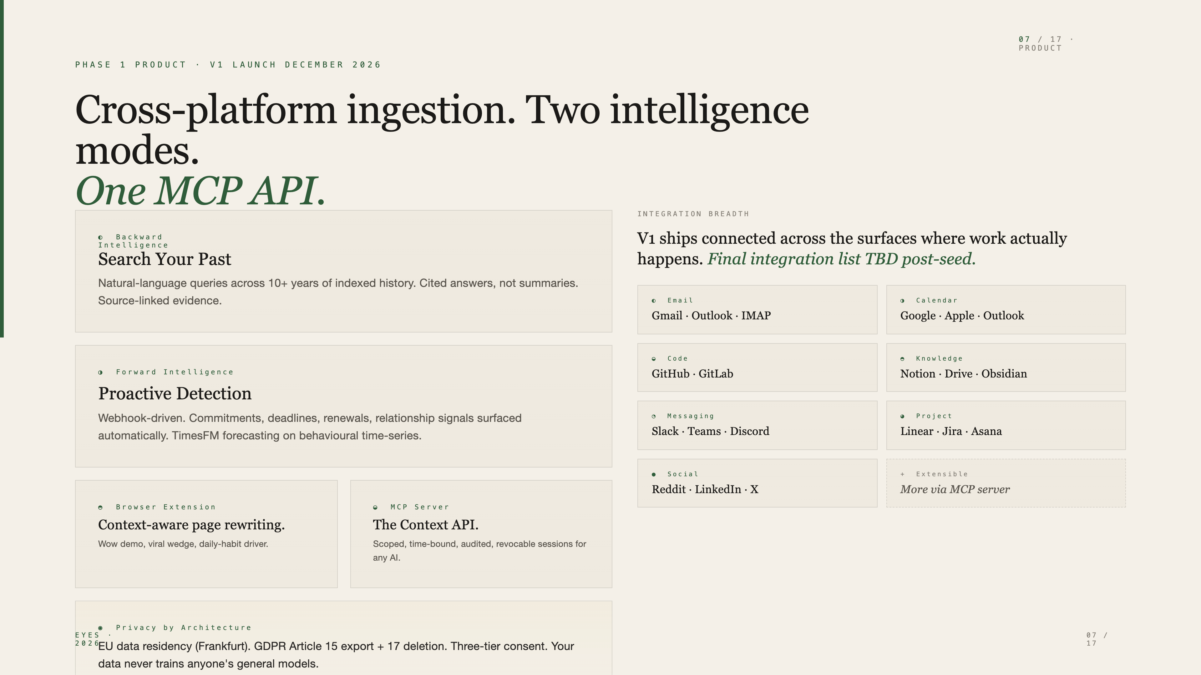
Notes:
Not vaporware. May 10 is a live demo. December 2026 is V1 launch. Five sources at launch, MCP server at launch. By end of Year 2 we're at 8 sources and the API layer has paying integrations.

Slide 8
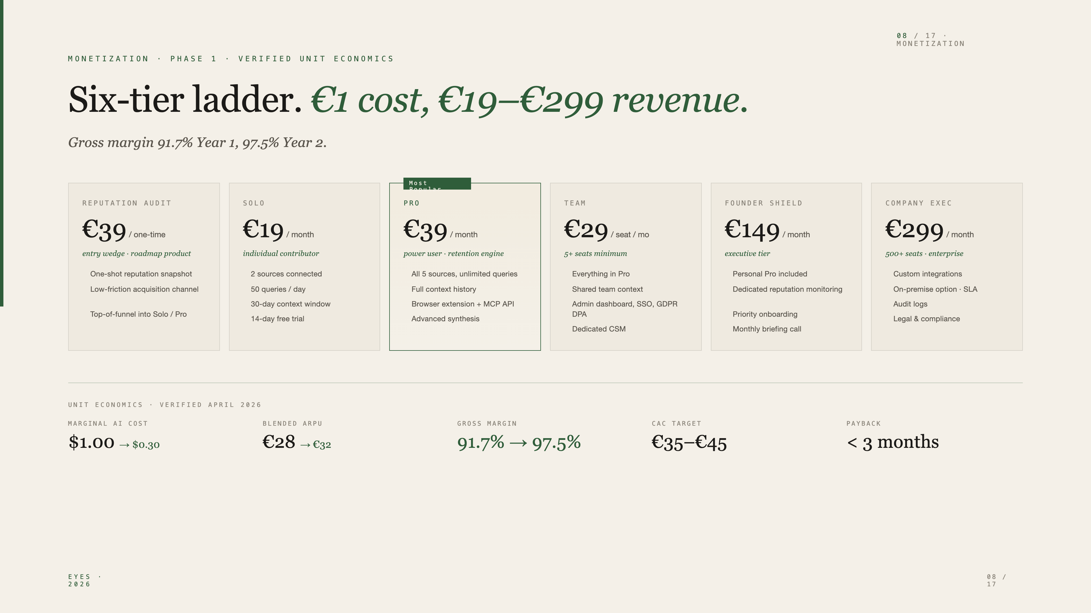
Notes:
Six tiers. €19 Solo and €39 Pro are where retention compounds. €29 Team opens the SaaS motion. €149 Founder Shield and €299 Company Exec are where LTV and the enterprise pipeline live. Margins start at 91% and improve to 97% as we offload to fine-tuned Mistral in Year 2.

Slide 9
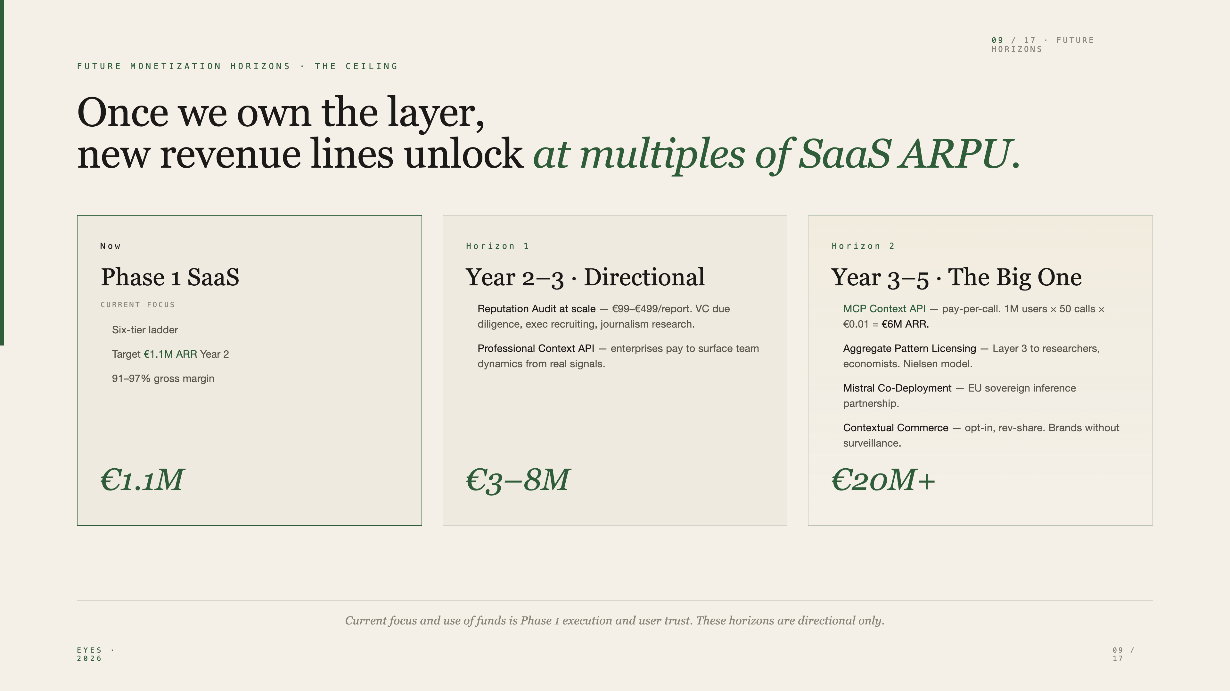
Notes:
Directional, not committed — this shows the ceiling. The MCP context API alone, at modest scale, is a €6M ARR line. The Layer 3 licensing line is what makes this venture-scale rather than a SaaS lifestyle business.

Slide 10
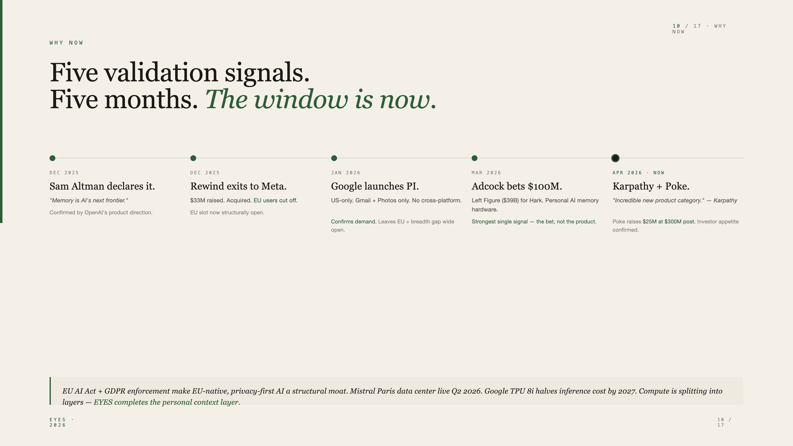
Notes:
Five independent signals in five months. None coordinated. This is what category formation looks like. The question isn't whether someone builds this — it's whether the EU-native, GDPR-first, three-tier-architected version is built first by us or by someone else.

Slide 11
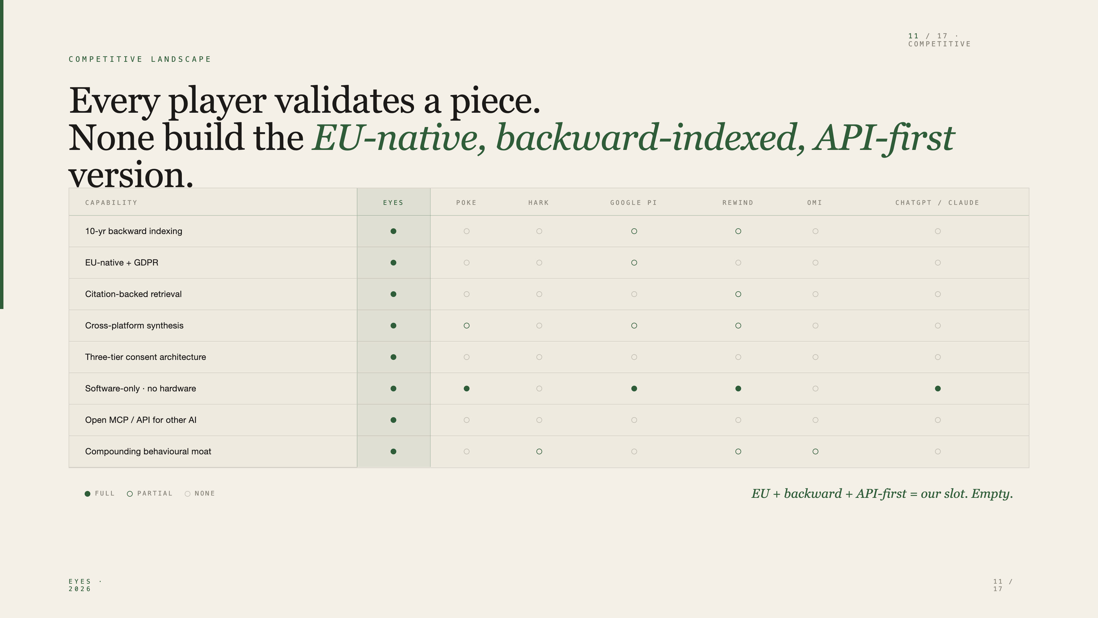
Notes:
Poke is the closest comparable — $300M post-money, US-only, no corpus. Hark is hardware-only, 18 months out. Google PI is US + Gmail + Photos only. The intersection of EU-native, backward-indexed, software-only, API-exposed — that's empty. That's our slot.

Slide 12
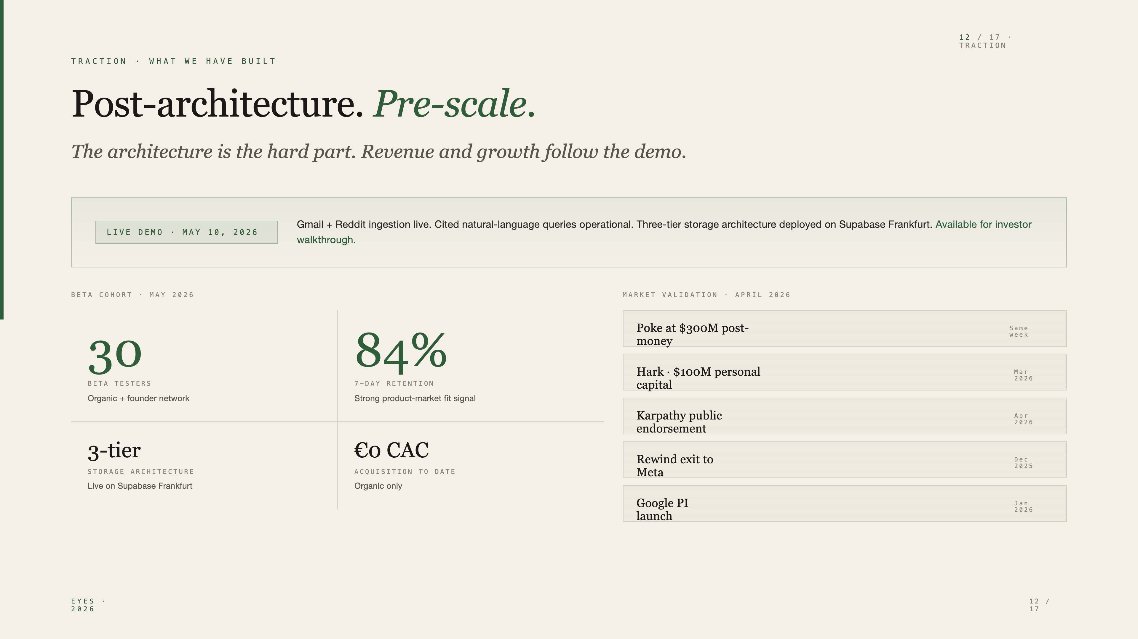
Notes:
30 beta testers, 84% 7-day retention, organic only. The architecture — which is the hard part of building this — is live and demo-able. Five validation signals in the last five months tell you the category is forming.

Slide 13
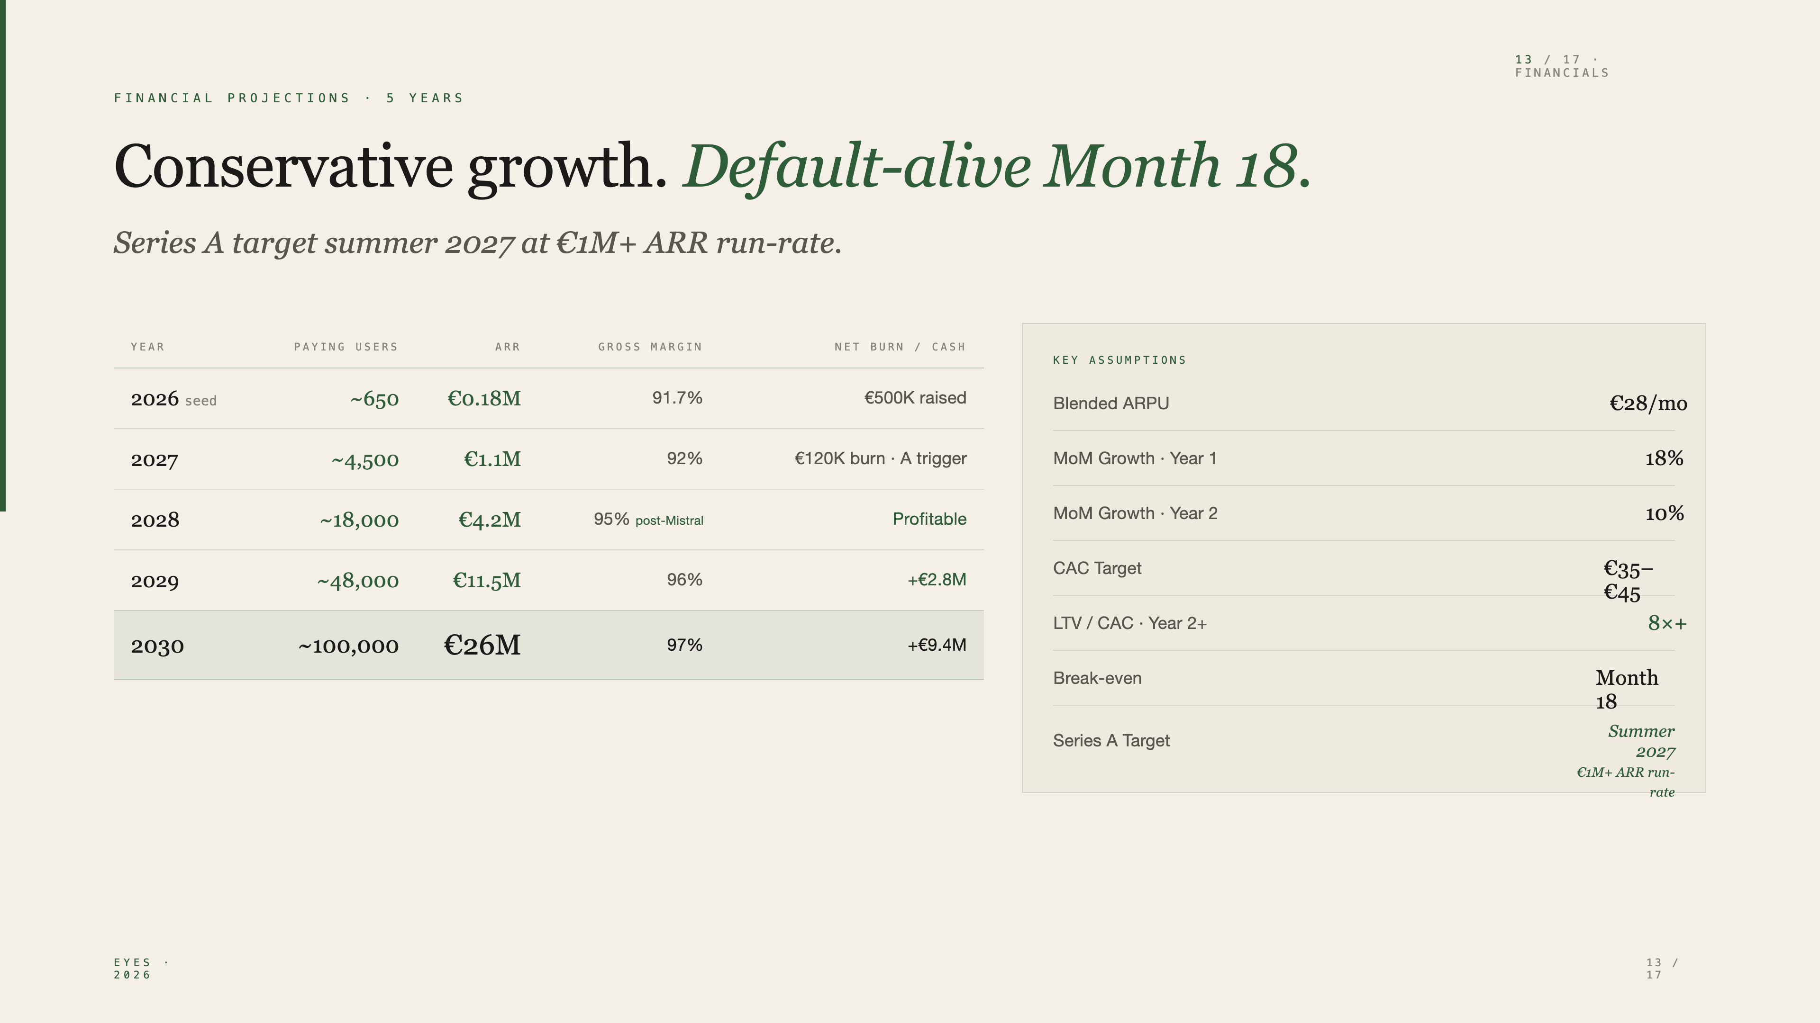
Notes:
€0.18M ARR Year 1 conservative. €26M ARR Year 5 base case. The Mistral fine-tune in Year 2 takes gross margin from 92% to 95% and structurally lowers Series A risk. Series A summer 2027 at €1M+ ARR run-rate — standard EU SaaS metrics for that round size.

Slide 14
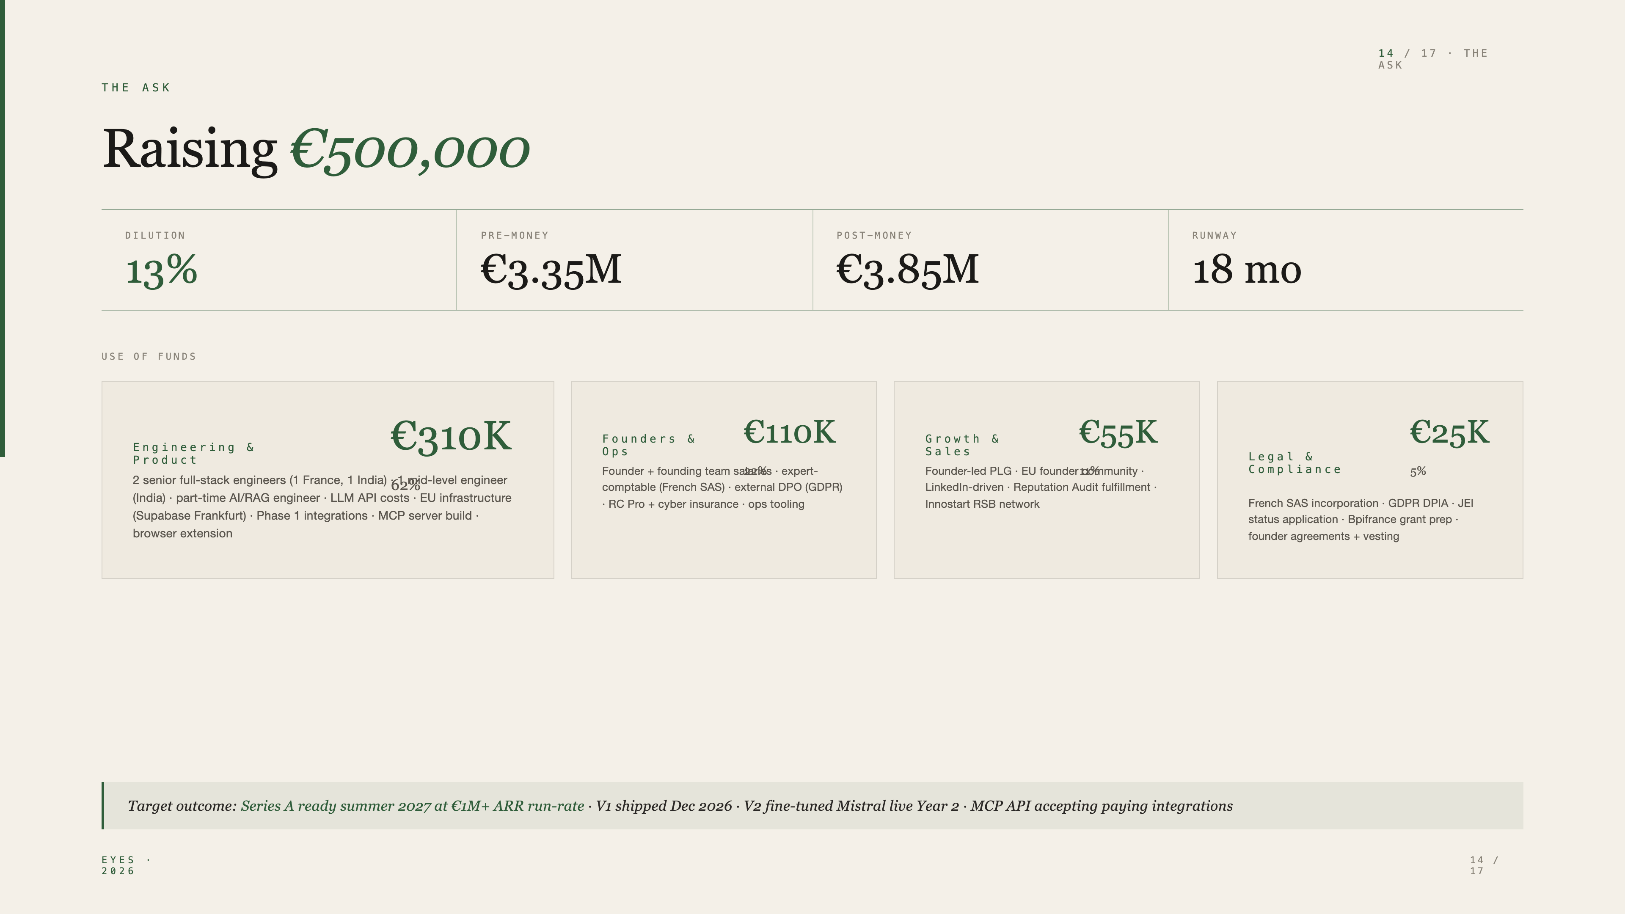
Notes:
€500K, 13% dilution, €3.35M pre-money. 18-month runway. Default alive Month 18. Series A target summer 2027 at €1M+ ARR run-rate. Investors are here for the asymmetric upside on the API layer.

Slide 15
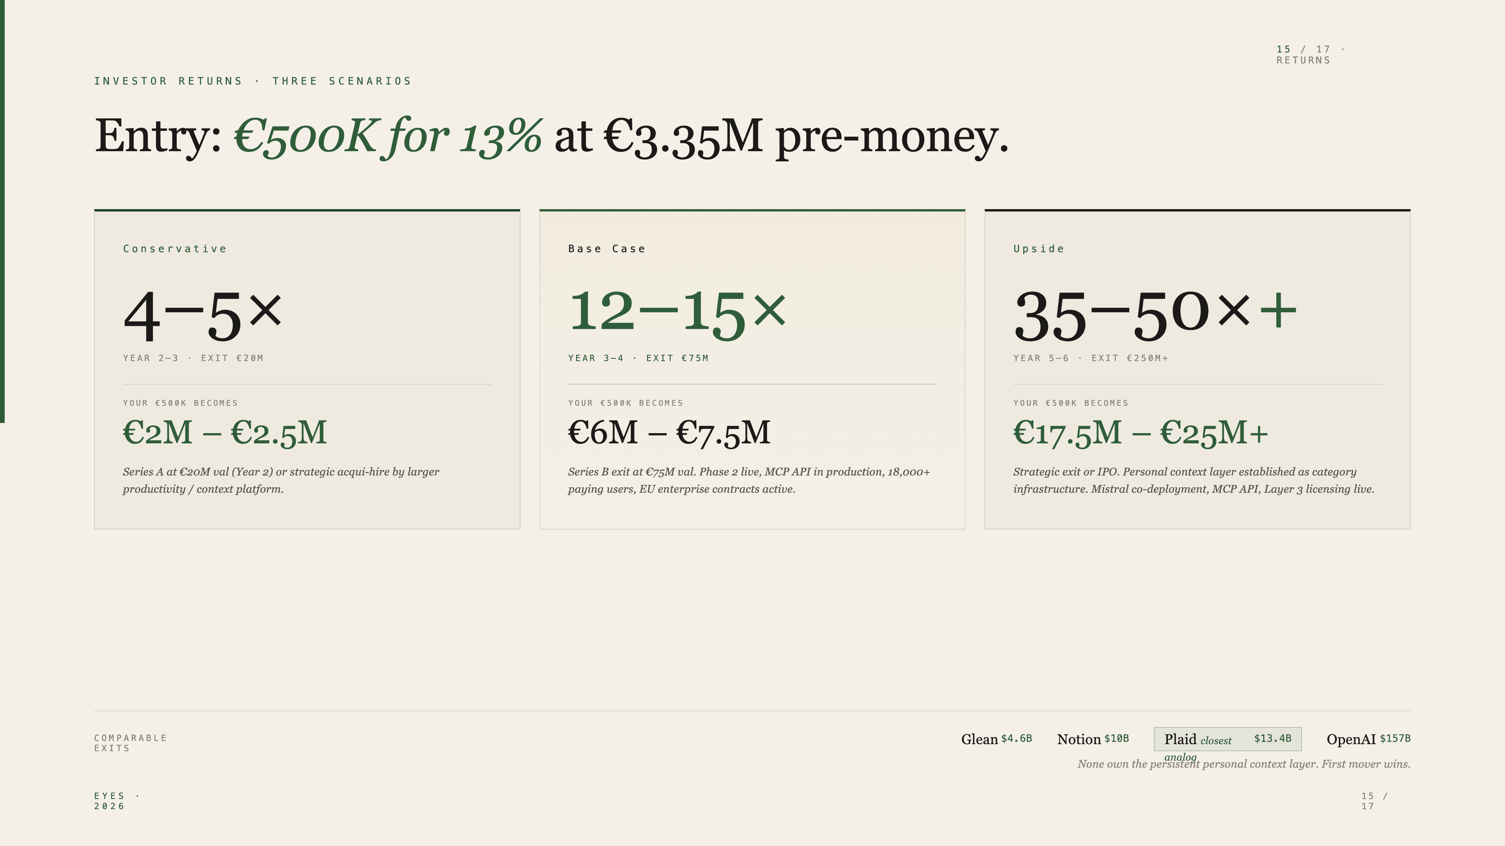
Notes:
Conservative is 4–5× in 2–3 years — acqui-hire or Series A secondary. Base case is 12–15× in 3–4 years — Series B exit at category leader status. Upside is 35–50× at category infrastructure exit.

Slide 16
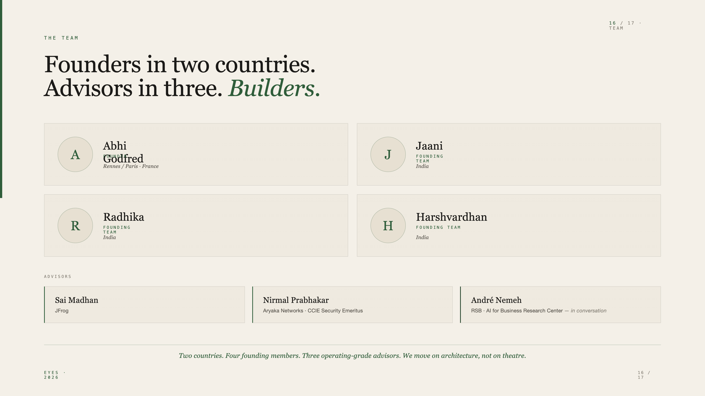
Notes:
Four founding team members across France and India. Three advisors with operating depth — Aryaka security, JFrog ML security, RSB AI research. Roles formalise post-close.

Slide 17
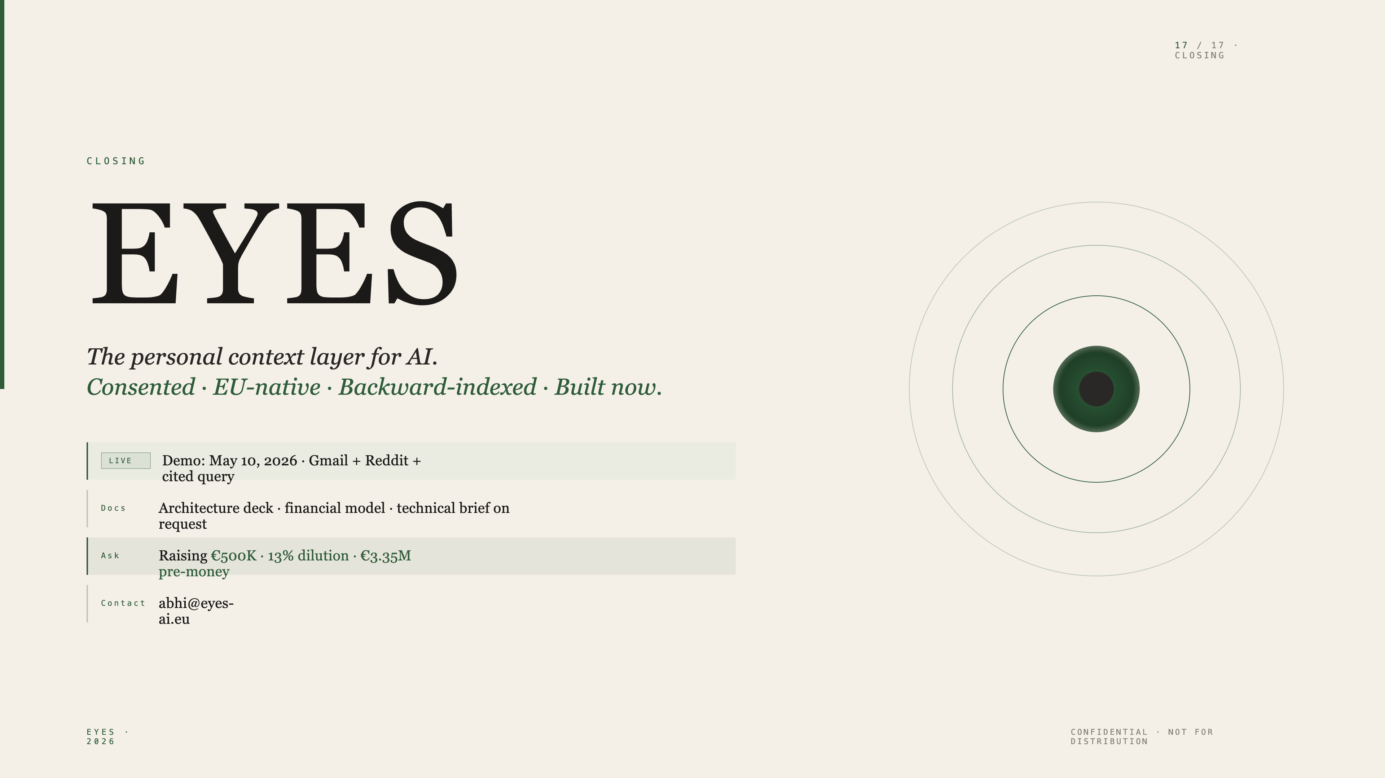
Notes:
Three things to take with you. One: Five validation signals in five months means the category is forming this quarter. Two: EU-native + backward-indexed + API-first is structurally empty. Three: €500K at 13% dilution gets you in at €3.35M pre on a thesis comparables suggest is venture-scale.

