Slide 1
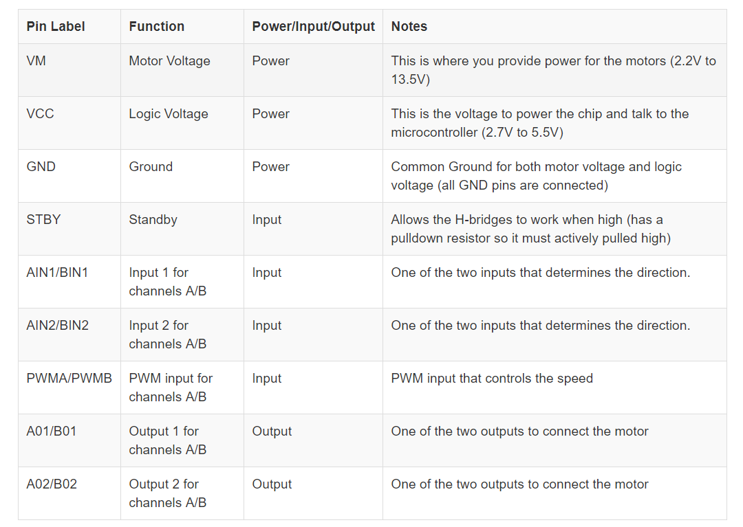
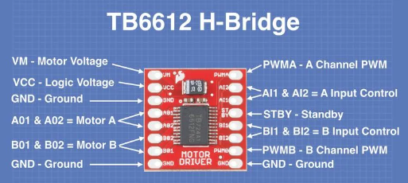
Notes:
We have the TB6612 H-Bridge,
Let’s figure out what PINS we need: PWM – 1 PWM OUTPUT to the Nano
AIn1, AIn2 – 2 Digital Output to the Nano
AOut1, AOut2 – Connect to the Motor
Ground on the Nano
Power: VM Motor Voltage connects to the 5V on the Nano
Standby – Connects to the VCC
VCC – Connects to the Vin on the Nano

Slide 2
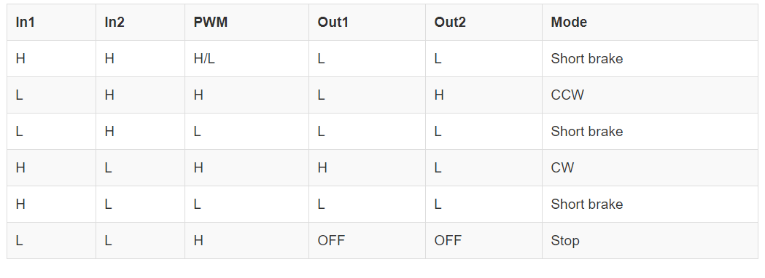
Functions:
forward(int speed)
reverse(int speed)
break()
drive(int speed, int duration) -> calls forward/reverse
Notes:
What is the range for speed? [0-255]
void forward(int speed) (if you have a class) or void forward(int In1, int In2, int PWM, int speed) {
digitalWrite(In1, HIGH);
digitalWrite(In2, LOW);
analogWrite(PWM, speed);
}
void drive(int speed, int duration)
{ digitalWrite(Standby, HIGH); // Turn the motor on
if (speed >= 0) forward(speed);
else reverse(-speed);
delay(duration)
}

