Slide 1
Scalable BLE Cluster Fingerprinting for High-Density IoT Environments
Johanna Bieri
Master Thesis: End Presentation
Supervisor: Katharina Müller

Slide 2
Content
Thesis Motivation and Goals
Target Groups
Data and Labeling
Model Selection
Results
Conclusions
Future Work
Q&A

Slide 3
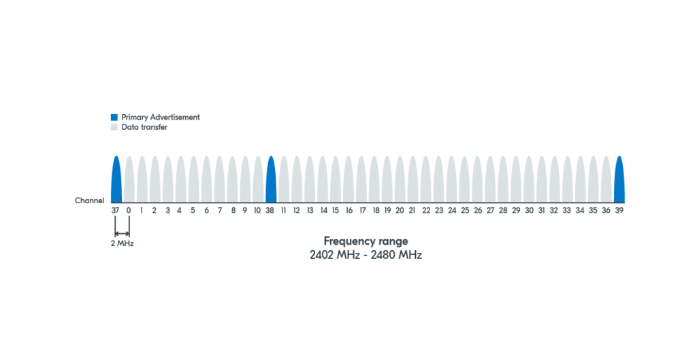
Thesis Motivation and Goals
1 - Thesis Motivation and Goals
Bluetooth devices are ubiquitous
Bluetooth Low Energy (BLE)
Used for device discovery and connection initiation
Transmitted over public advertising channels → Significant privacy concerns
Investigation of Generalizability:
RQ1: Can the method reliably distinguish clusters of previously unseen devices from the same ecosystem?
RQ2: Can the method reliably distinguish clusters of previously unseen devices from a different ecosystem?
RQ3: Does the number of devices within the target group affect the method’s ability to identify it?
BLE primary advertising channels (blue)
Image from NordicSemi
https://sp-ao.shortpixel.ai/client/to_webp,q_glossy,ret_img,w_1201/https:/ /academy.nordicsemi.com/wp-content/uploads/2023/03/blefund_less1_ad_channels.png

Slide 4
Target Groups
2 - Target Groups
Manufacturer | Group | Device Type | Devices
Samsung | Group 1* | smartphone tracker wireless earbuds | 1x Galaxy S23 1x SmartTag 1x Galaxy Buds2 Pro
 | Group 2 | smartphone tracker | 1x Galaxy S22+ 1x SmartTag+
 | Group 3 | smartphone tracker wireless earbuds | 1x Galaxy S22+ 1x SmartTag+ 1x Galaxy Buds FE
Apple | Group 1 | tablet tracker wireless earbuds | 1x iPad 1x AirTag 1x AirPods Pro
* from J. Meier,“Clustered Fingerprinting and Tracking in High-Density Internet of Things (IoT) Environments,”Master’s thesis, University of Zurich, Zurich, Switzerland, July 2025.

Slide 5
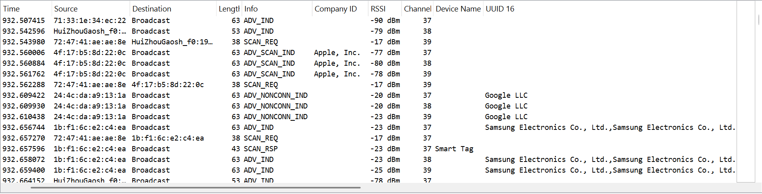
Data and Labeling
3 - Data and Labeling
Image of Wireshark UI

Slide 6
Model Selection
4 - Model Selection
Supervised modeling:
Random Forest (RF)
Multi-Layer Perceptron (MLP)
Stochastic Gradient Descent (SGD)
Unsupervised modeling:
KMeans
BisectingKMeans
Birch

Slide 7
Experiment 1: Samsung Ecosystem (RQ1)
5 - Results

Slide 8
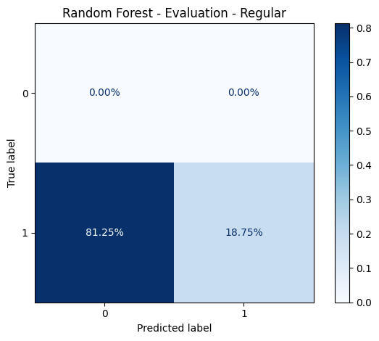
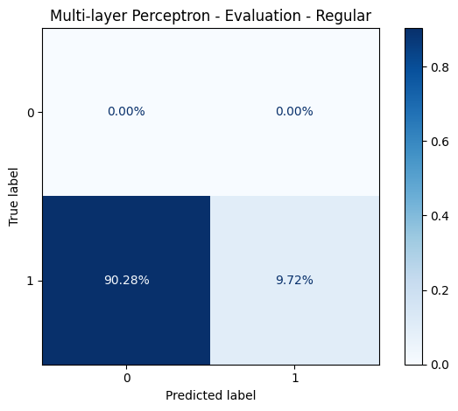
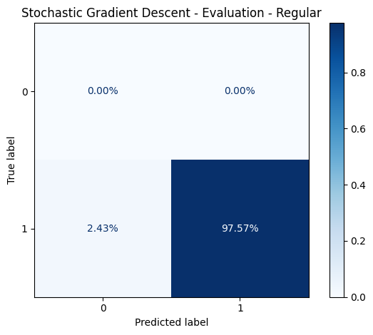
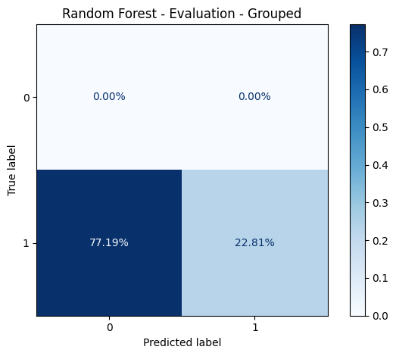


Experiment 1: Samsung Interference-free Dataset (Group 3)
5 - Results
R
G
→ The SGD model showed the best performance on the isolated Samsung dataset with an accuracy of 97.57%

Slide 9
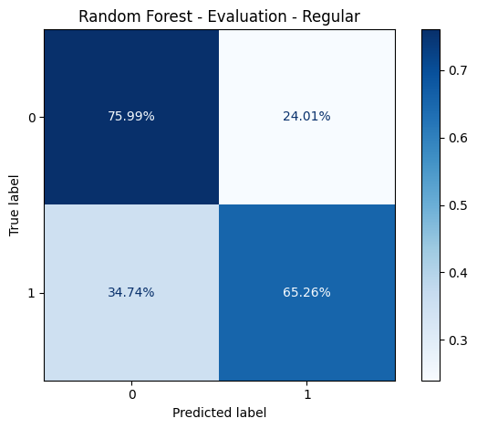
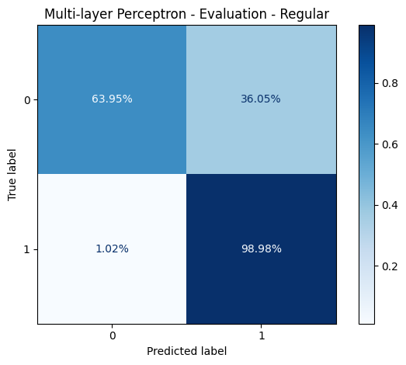
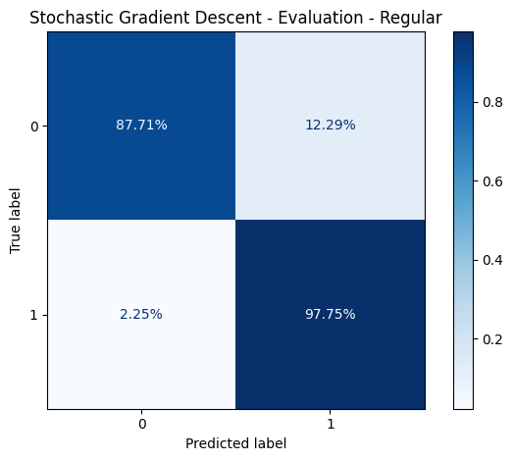
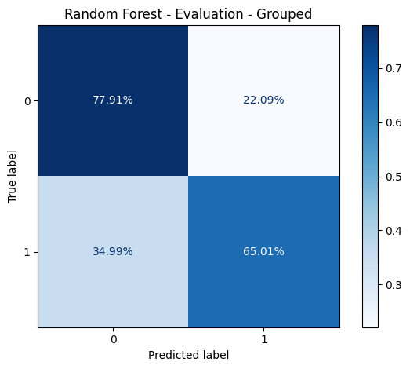
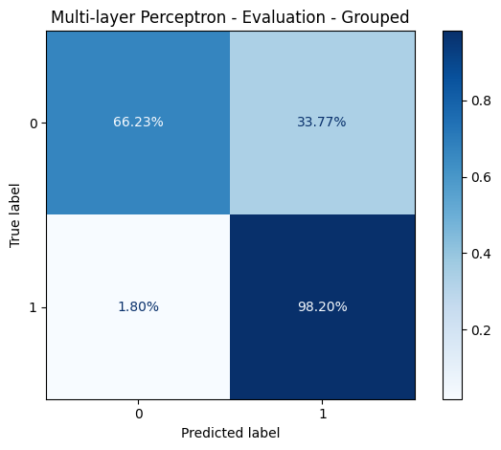

Experiment 1: Samsung High-density Dataset (Group 3)
5 - Results
R
G
→ The SGD model showed the best overall accuracy on the high-density Samsung dataset with 88% overall accuracy

Slide 10
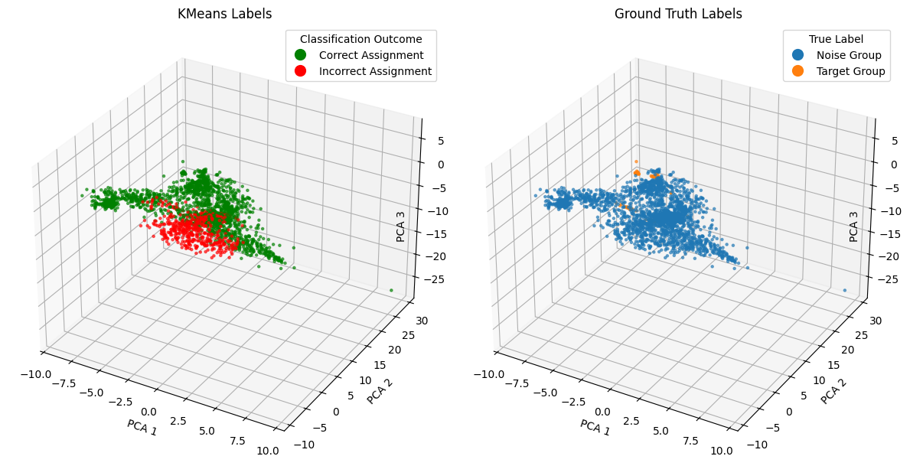
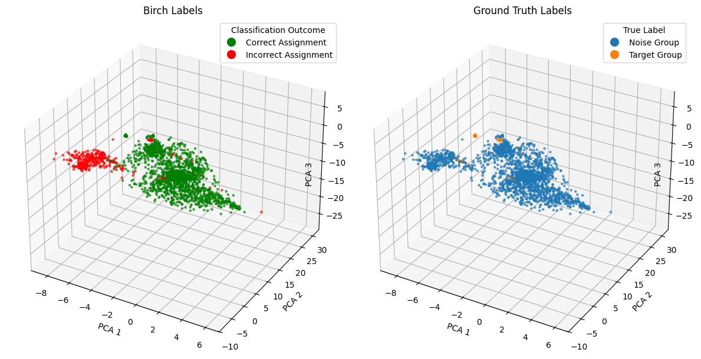
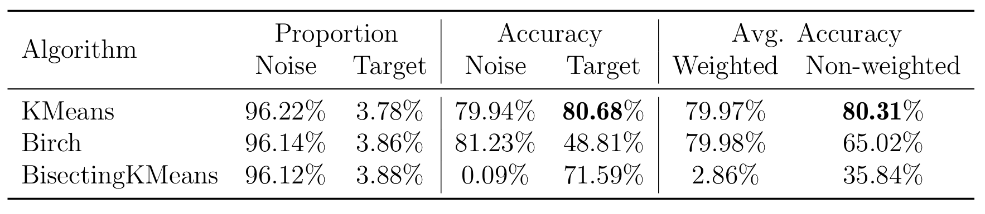
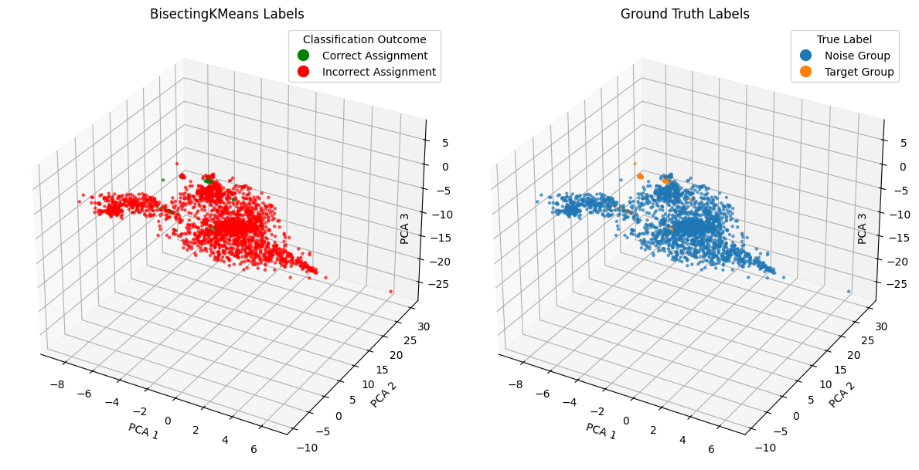
Experiment 1: Samsung High-density Dataset (Group 3)
5 - Results
KMeans
Birch
BisectingKMeans
→ The KMeans algorithms showed the best target group accuracy on the high-density Samsung dataset

Slide 11
Experiment 2: Apple Ecosystem (RQ2)
5 - Results

Slide 12
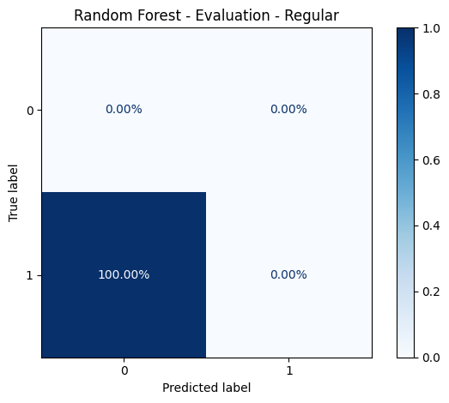





Experiment 2: Apple Interference-free Dataset (Samsung-trained Models)
5 - Results
R
G
None of the models recognized the Apple target group in an interference-free environment
Fingerprint is specific to Samsung devices

Slide 13
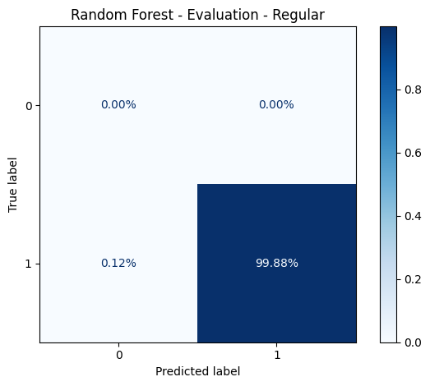





Experiment 2: Apple Interference-free Dataset (Apple-trained Models)
5 - Results
R
G
→ All three models recognized the Apple target group in an interference-free environment with near-perfect accuracy

Slide 14


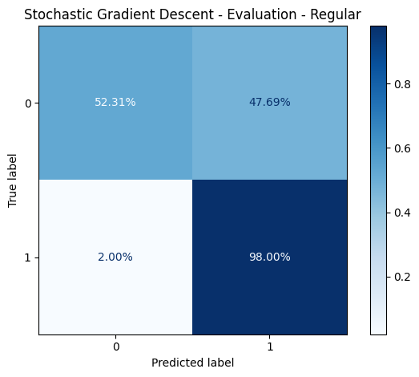

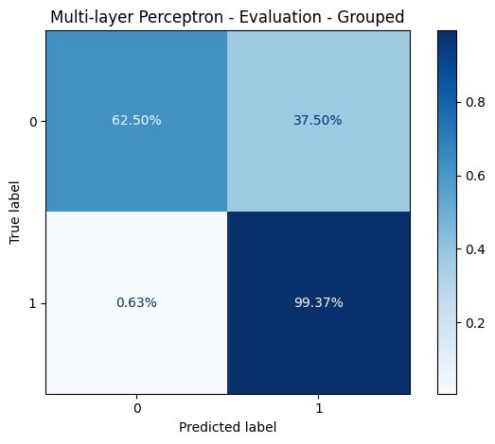

Experiment 2: Apple High-density Dataset (Apple-trained Models)
5 - Results
R
G
→ All three models have high target group accuracy but low noise accuracy → The MLP had the highest overall accuracy of 63%

Slide 15
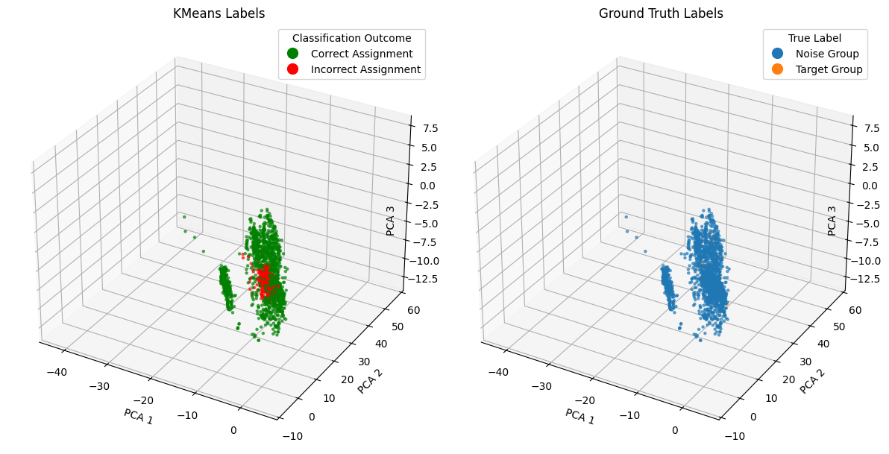
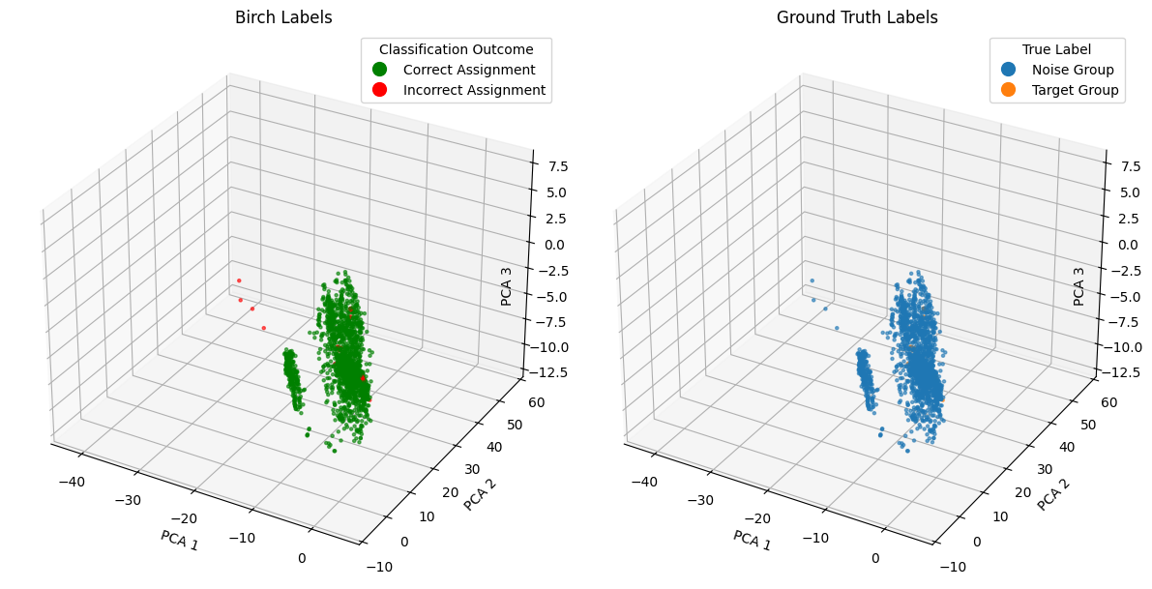
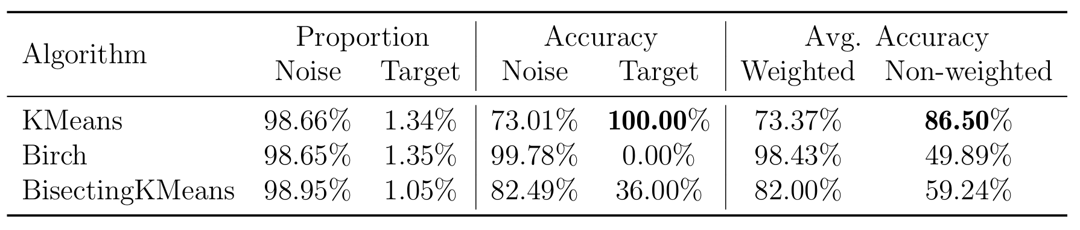
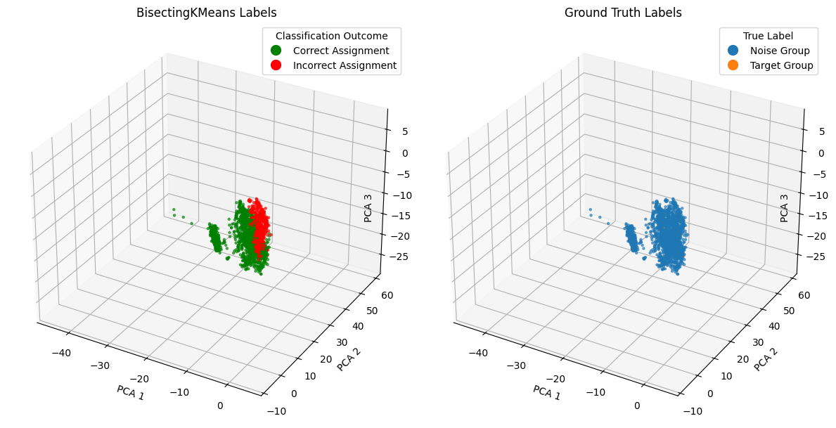
Experiment 2 - Apple High-density Dataset
5 - Results
KMeans
Birch
BisectingKMeans
→ The KMeans algorithm showed the best overall accuracy on the high-density Apple dataset

Slide 16
Experiment 3: Target Group Size (RQ3)
5 - Results

Slide 17
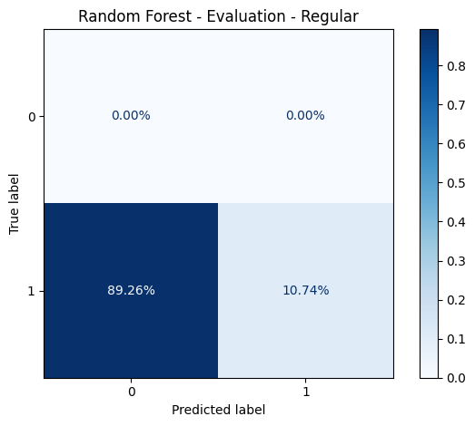


Experiment 3: Target Group Size
5 - Results
2 Devices 1x Galaxy S22+ phone 1x Galaxy SmartTag+
3 Devices 1x Galaxy S22+ phone 1x Galaxy SmartTag+ 1x Galaxy Buds FE
→ The results show no clear tendency towards one target group size

Slide 18
Conclusions
6 - Conclusions
RQ1: Can the method reliably distinguish clusters of previously unseen devices from the same ecosystem?
Only SGD with 88% and KMeans with 87% achieved decently high accuracies
RQ2: Can the method reliably distinguish clusters of previously unseen devices from a different ecosystem?
Without retraining on target ecosystem: No
With retraining on target ecosystem: Target group accuracy is high (avg. acc. ~99%), but noise classification shows room for improvement (avg. acc. ~57%)
This is limited to the Apple ecosystem and this specific device configuration
RQ3: Does the number of devices within the target group affect the method’s ability to identify it?
Results indicate that there is no effect
Limited to these specific device configurations
More experiments are necessary to give a definite answer

Slide 19
Future Work
7 - Future Work
Improve performance with Apple devices
Examine generalizability to previously unseen Apple devices
Further investigate the effect of the target group size
Develop combined model that works for several ecosystems
Investigate generalizability to ecosystems beyond Samsung and Apple

Slide 20
Thank you for your attention. Questions and feedback are welcome.
8 - Q&A

Slide 21
Backup Slides

Slide 22
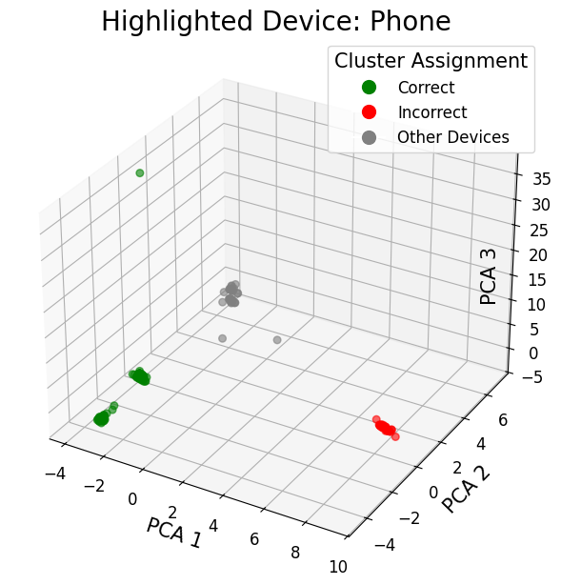
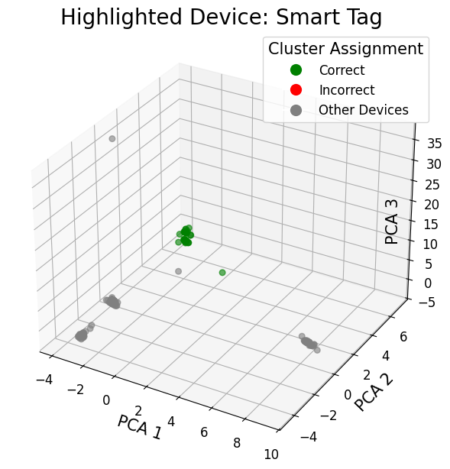
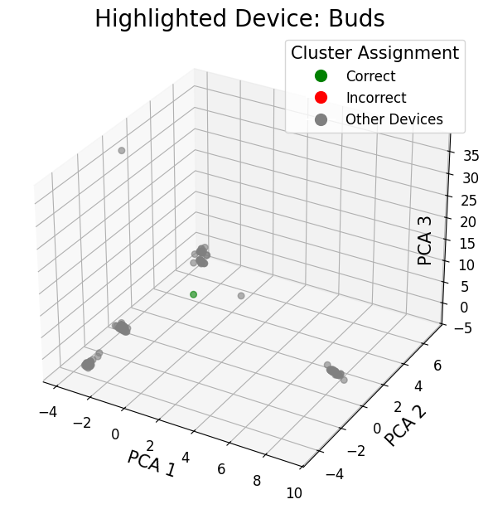
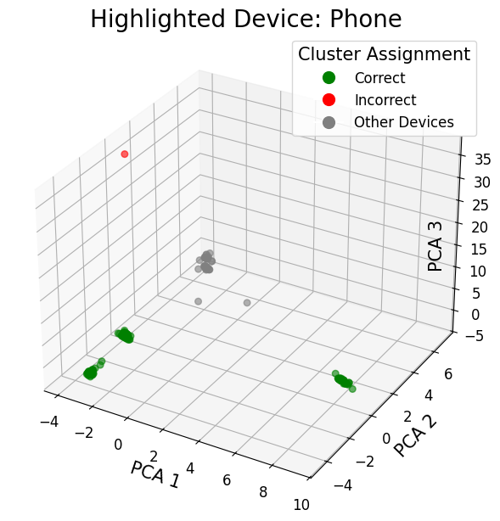
Experiment 1: Samsung Interference-free Dataset (Group 3)
KMeans / BisectingKMeans
Birch
→ The Smart Tag and Buds formed tight cluster and were 100% correctly assigned → The more numerous phone samples were fragmented and not all correctly assigned

Slide 23
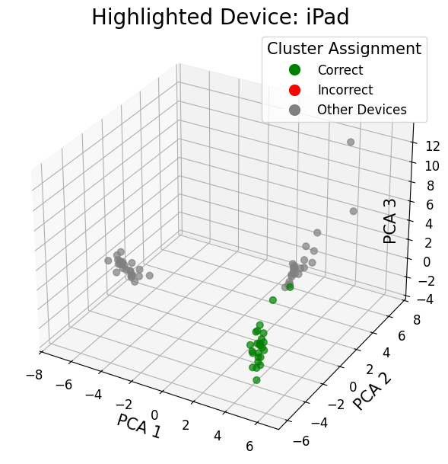
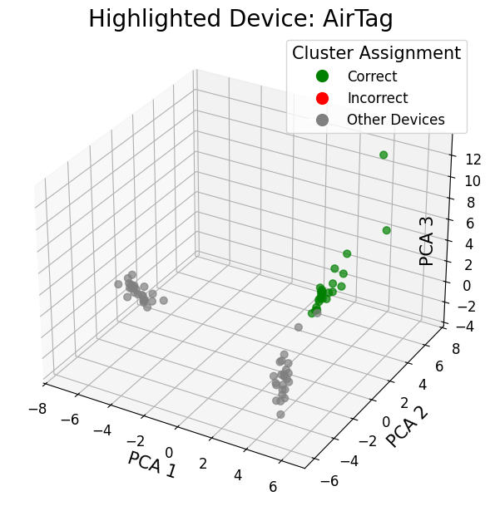
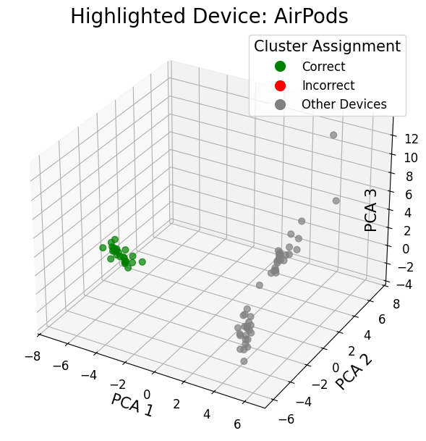
Experiment 2: Apple Interference-free Dataset
KMeans / Birch / BisectingKMeans
→ All three clustering algorithms can perfectly recover the device cluster of the Apple target group

Slide 24
Comparison to Joel Meier’s results
Model | Metric | Samsung High-Density |  | Apple High-Density
 |  | Joel | Johanna
RF | Recall Target | 89.89% | 65.26% | 99.20%
 | Recall Noise | 96.61% | 75.99% | 56.07%
 | Overall Accuracy | 96% | 77% | 57%
MLP | Recall Target | 94.98% | 98.98% | 99.31%
 | Recall Noise | 86.22% | 63.95% | 62.02%
 | Overall Accuracy | 87% | 66% | 63%
SGD | Recall Target | 88.39% | 97.75% | 98.00%
 | Recall Noise | 95.11% | 87.71% | 52.31%
 | Overall Accuracy | 94% | 88% | 54%

Slide 25
Samsung vs. Apple supervised results
Model | Metric | Isolated |  | High-Density
 |  | Samsung | Apple | Samsung | Apple
RF | Recall Target | 18.75% | 99.88% | 65.26% | 99.20%
 | Recall Noise | - | - | 75.99% | 56.07%
 | Overall Accuracy | 18.75% | 99.88% | 77% | 57%
MLP | Recall Target | 9.72% | 96.12% | 98.98% | 99.31%
 | Recall Noise | - | - | 63.95% | 62.02%
 | Overall Accuracy | 9.72% | 96.12% | 66% | 63%
SGD | Recall Target | 97.57% | 99.43% | 97.75% | 98.00%
 | Recall Noise | - | - | 87.71% | 52.31%
 | Overall Accuracy | 97.57% | 99.43% | 88% | 54%

Slide 26
Samsung vs. Apple unsupervised results
Samsung high-density dataset
Apple high-density dataset

Slide 27
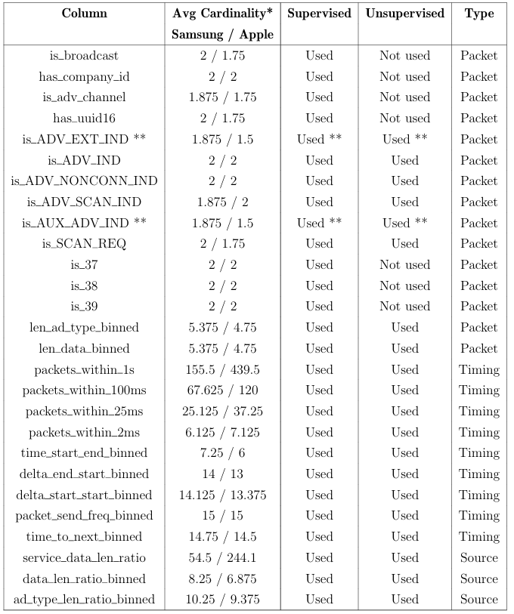
Feature List

