Slide 1
Scalable BLE Cluster Fingerprinting for High-Density IoT Environments
Johanna Bieri
Master Thesis: Midterm Presentation
Supervisor: Katharina Müller

Slide 2
Content
Thesis Motivation
Technical Background
Thesis Goals
Preceding Master Thesis (Joel Meier, 2025): Approach & Results
My Approach
Next Steps
Q&A

Slide 3
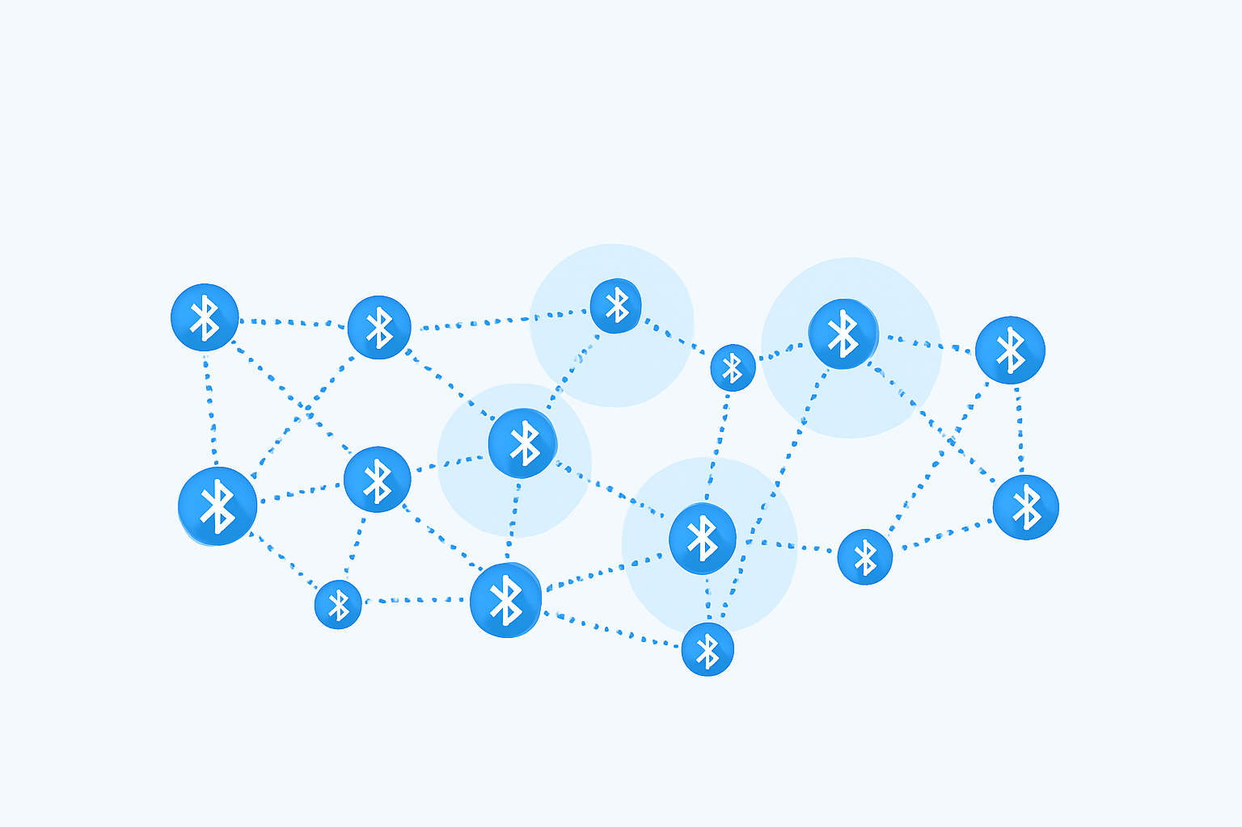
Thesis Motivation
1 - Thesis Motivation
Bluetooth devices are ubiquitous
Bluetooth Low Energy (BLE)
Used for device discovery and connection initiation
Transmitted over public channels → Significant privacy concerns
→ Generalizability: Can we reliably identify device cluster of different ecosystems?
→ Scalability: What happens if we have two or more groups consisting of the same devices?
Image generated by GPT-5
Heinrich et al., 2022, AirGuard- Protecting Android Users From Stalking Attacks By Apple Find My Devices

Slide 4
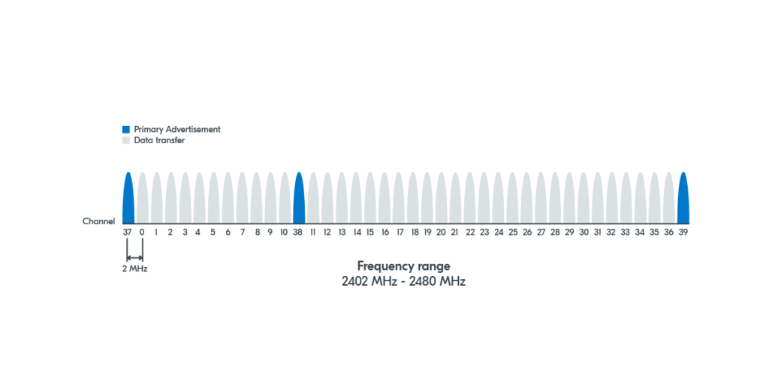
BLE Introduction
2 - Technical Background
Bluetooth Low Energy
Low energy consumption due to:
Low data rate
Small packet size
BLE operates on 40 channels
3 primary advertising channels: 37, 38, 39
37 secondary advertising channels
Image from NordicSemi
https://sp-ao.shortpixel.ai/client/to_webp,q_glossy,ret_img,w_1201/https://academy.nordicsemi.com/wp-content/uploads/2023/03/blefund_less1_ad_channels.png

Slide 5
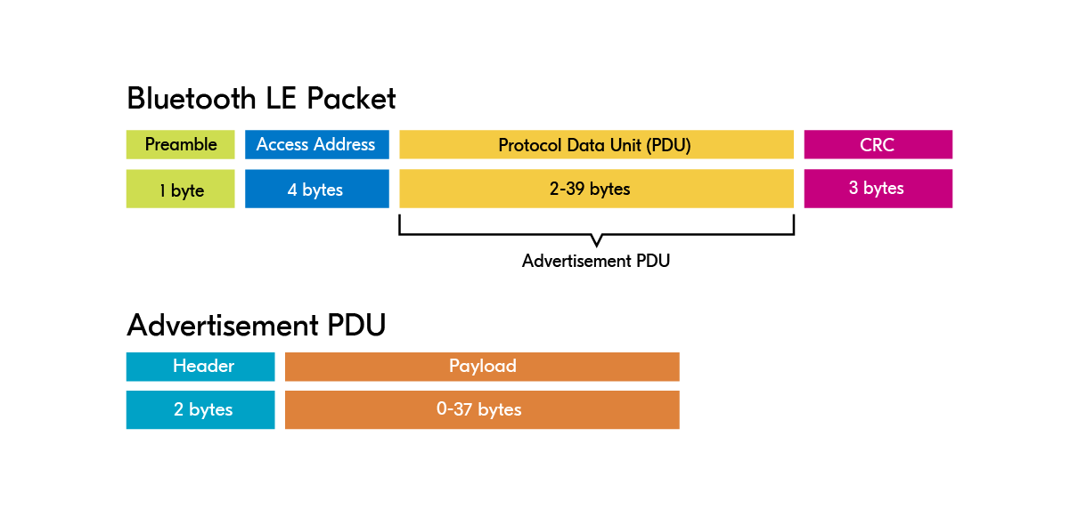
Bluetooth LE Advertisement Packet Structure
2 - Technical Background
Image from NordicSemi
https://academy.nordicsemi.com/courses/bluetooth-low-energy-fundamentals/lessons/lesson-2-bluetooth-le-advertising/topic/advertisement-packet/

Slide 6
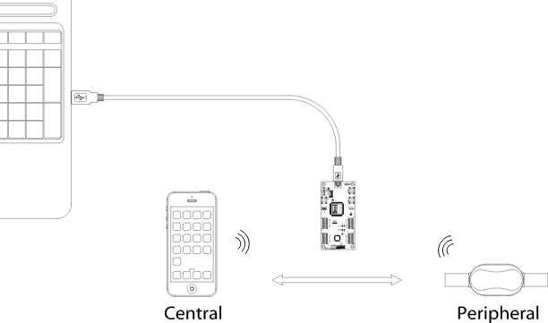

Dataset Generation
2 - Technical Background
Laptop as capturing device:
nRF Sniffer attached via USB
Wireshark and BLE plugin running
BLE devices:
Target device group (same ecosystem within group)
Connected via Bluetooth
Data extraction:
Select relevant columns (based on preceding thesis)
Extract as .csv from Wireshark
Wireshark
Sniffer
Image from NordicSemi
https://academy.nordicsemi.com/courses/bluetooth-low-energy-fundamentals/lessons/lesson-6-bluetooth-le-sniffer/topic/nrf-sniffer-for-bluetooth-le/

Slide 7
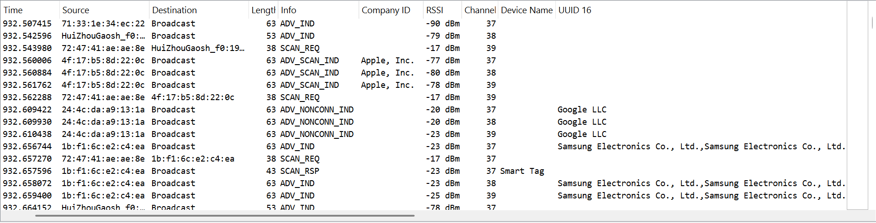
Wireshark Example Data
2 - Technical Background
Image of Wireshark UI

Slide 8
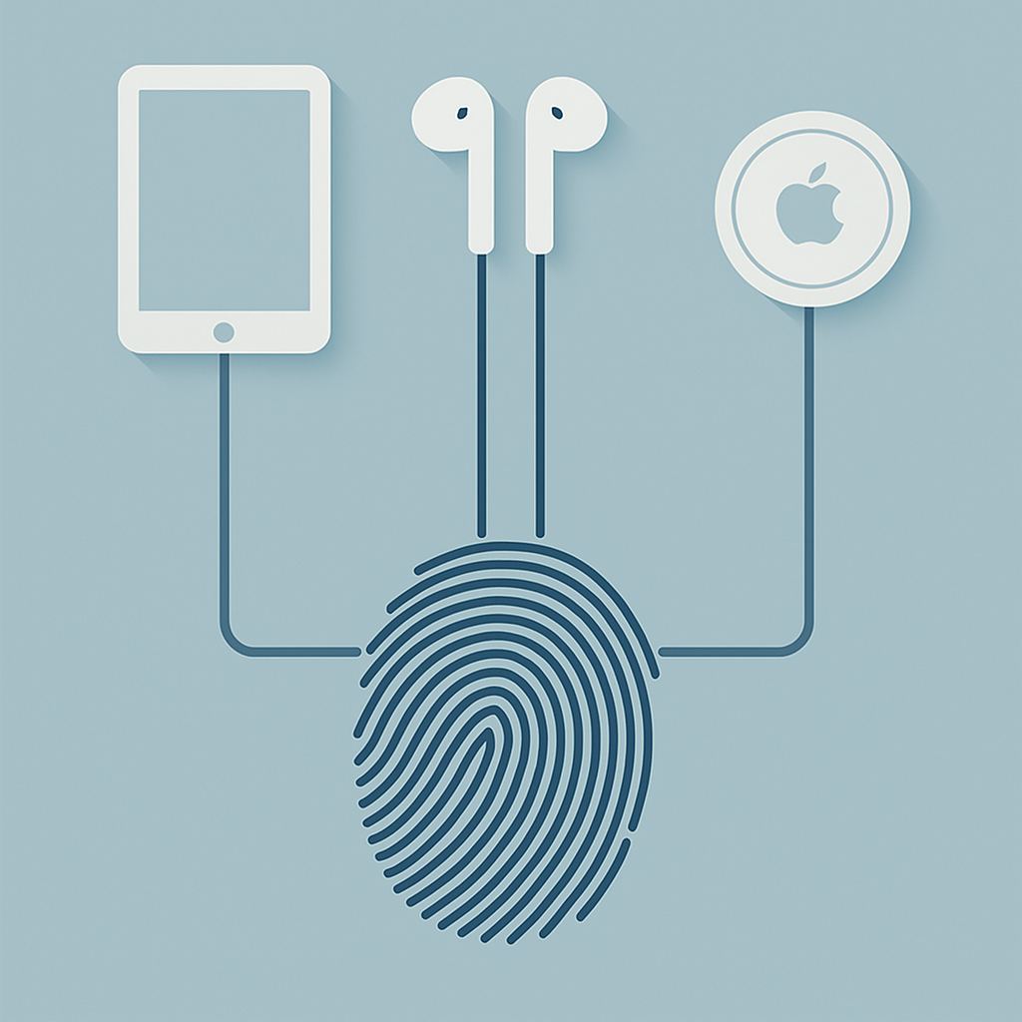
Fingerprinting
2 - Technical Background
Unique characteristics in a device’s communication behavior
Here: fingerprint of group when connected
Can be done for different kinds of network traffic
Here: for BLE
→ Use to train ML models
Image generated by GPT-5

Slide 9
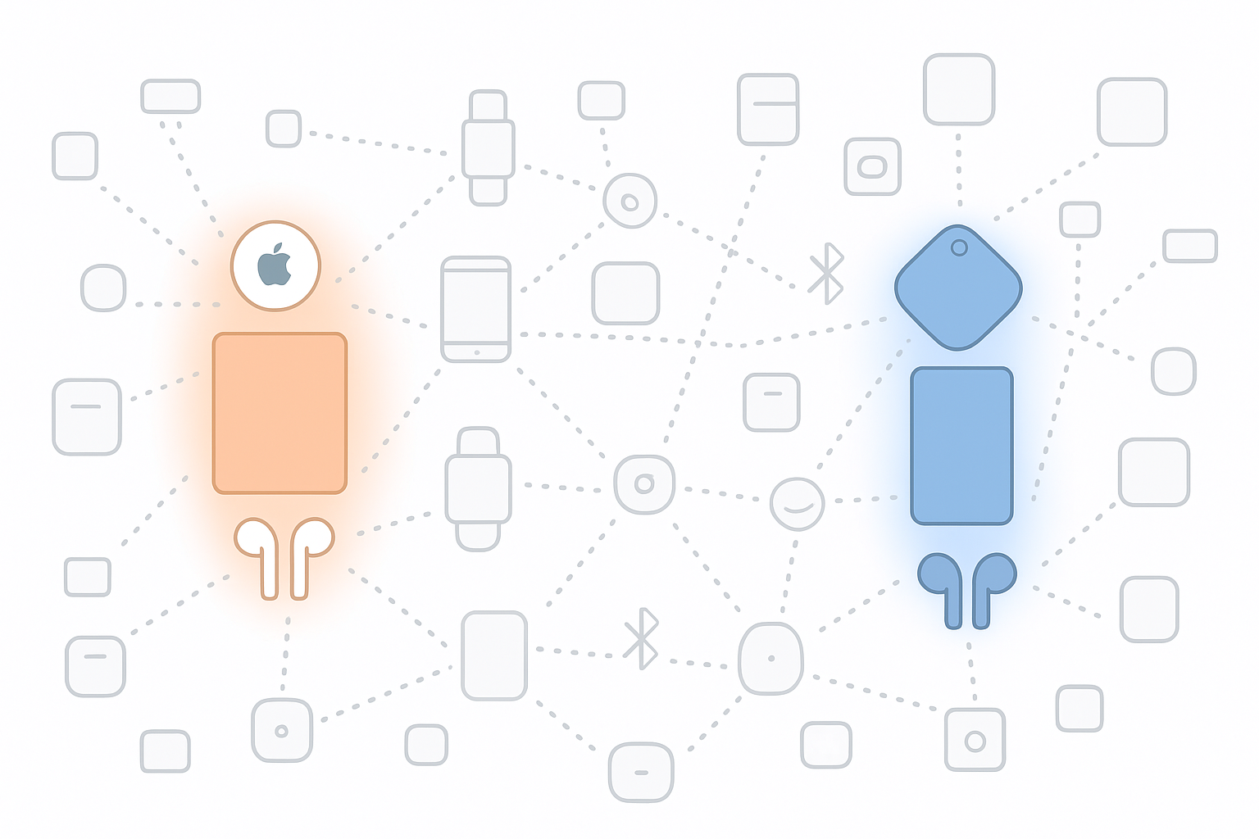
Thesis Goals
3 - Thesis Goals
Generate datasets for groups of connected BLE devices (recorded together)
For different ecosystems
Create a fingerprint of that device group and evaluate it on pre-trained models
Retrain models to improve performance on new datasets
Evaluate the models in high-density environments to test their robustness
Image generated by GPT-5

Slide 10
Preceding Master Thesis by Joel Meier (2025) - Approach
4 - Preceding MT Joel Meier
Trained ML models for a target group consisting of three Samsung devices (smartphone, earphones, smart tag)
Supervised modeling: Random Forest, Multi-Layer Perceptron, Stochastic Gradient Descent
Unsupervised modeling: Kmeans, BisectingKMeans, Birch
Demonstrated that models can identify the device cluster even in noisy environments
Baseline work for my thesis

Slide 11
Preceding Master Thesis by Joel Meier (2025) - Results
4 - Preceding MT Joel Meier
Joel’s model selection:
Supervised Modeling
Random Forest
Multi-Layer Perceptron
Stochastic Gradient Descent
Trained on medium density dataset (recorded in apartment)
Unsupervised Modeling (cluster algorithms)
KMeans (bottom-up)
BisectingKMeans (top-down)
Birch

Slide 12
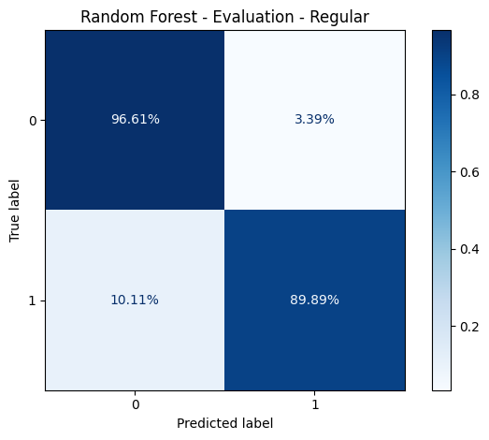
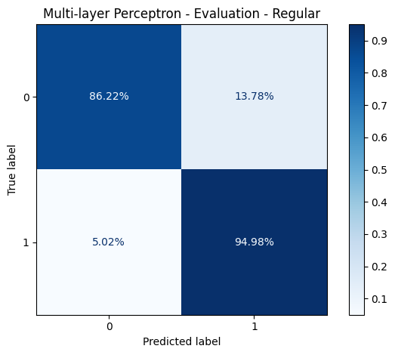
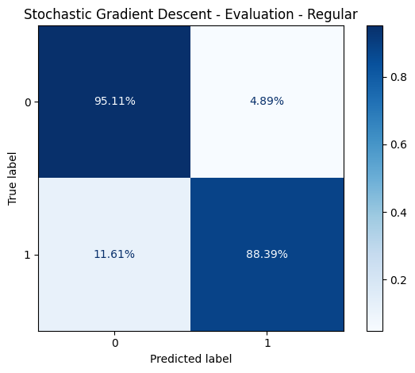
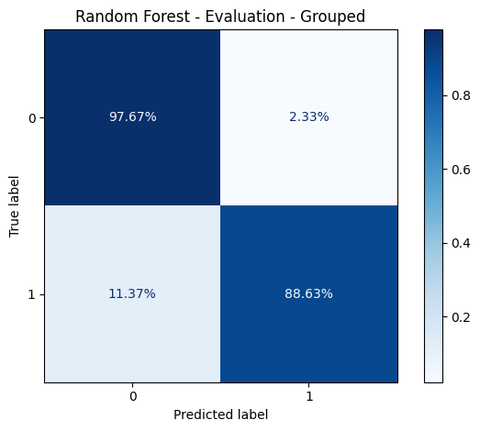


Results MT Joel Meier Supervised Models
4 - Preceding MT Joel Meier

Slide 13
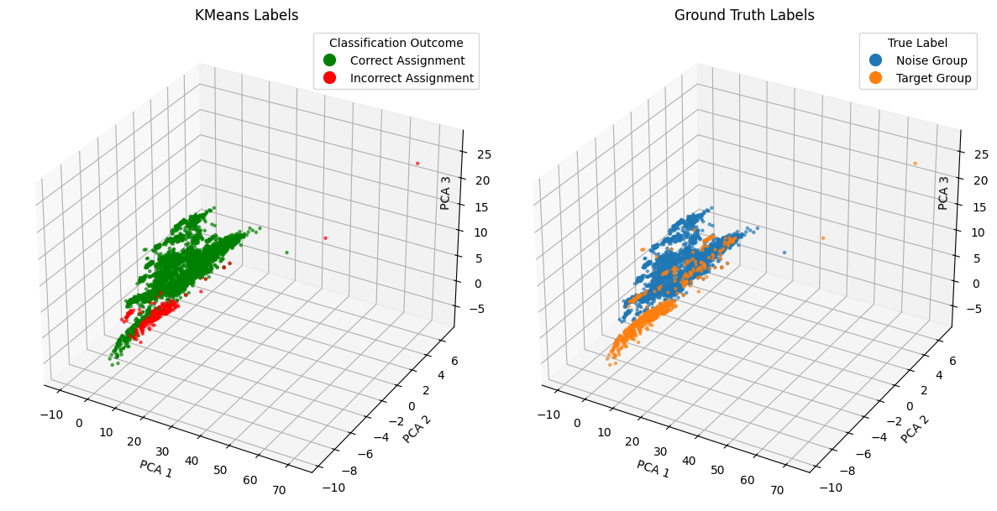
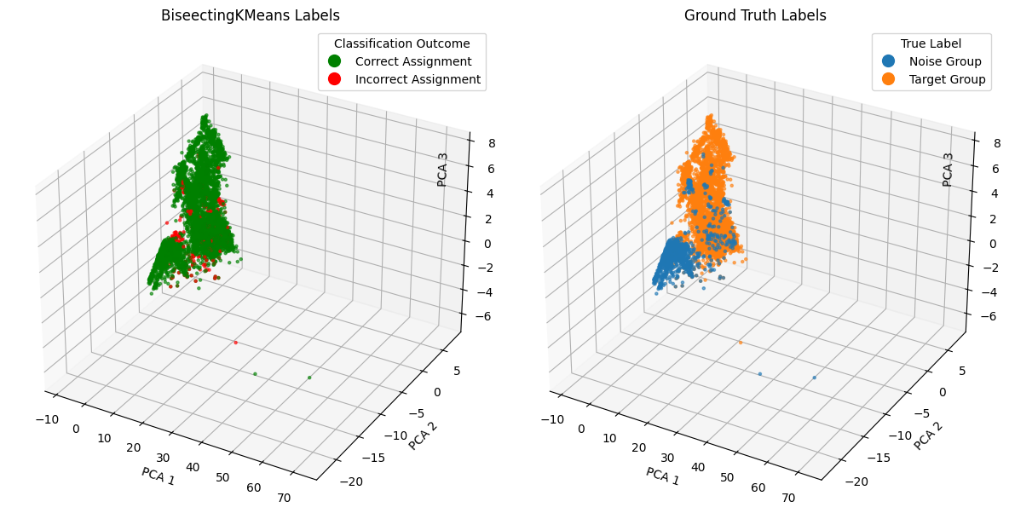
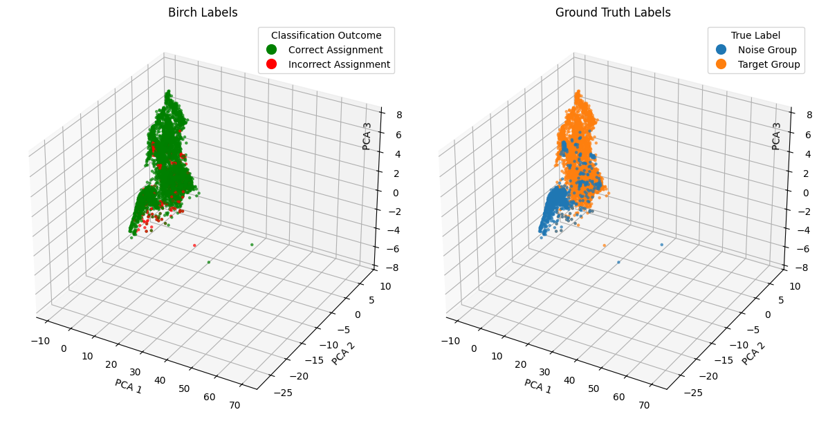
Results MT Joel Meier Unsupervised Models
4 - Preceding MT Joel Meier

Slide 14
My Approach
5 - My Approach
Feasibility Testing
Generate new datasets
Samsung setup: Galaxy S22 smartphone, Smart Tag, (Galaxy Buds FE)
Apple setup: iPad, AirPods Pro, AirTag
Different density: Isolated (basement), Medium-density (apartment), High-density (uni)
Evaluate isolated datasets with existing models (no retraining)
Hypotheses:
Models will show limited performance on Samsung dataset, same ecosystem but different devices and device number
Models will perform poorly on Apple dataset, because trained with Samsung devices only
Based on the first results: either focus on generalizability or scalability first

Slide 15
Results MT Joel Meier - High-Density Dataset (Uni) Supervised Models
5 - My Approach

Slide 16
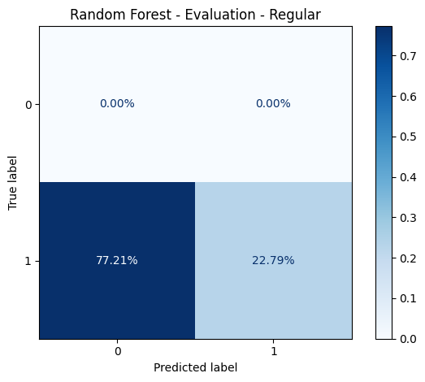
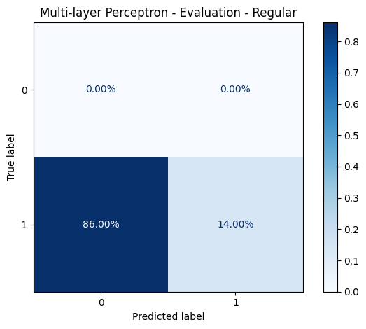
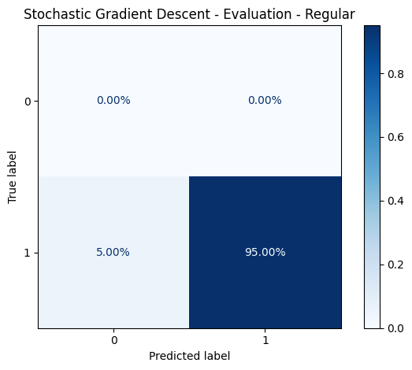
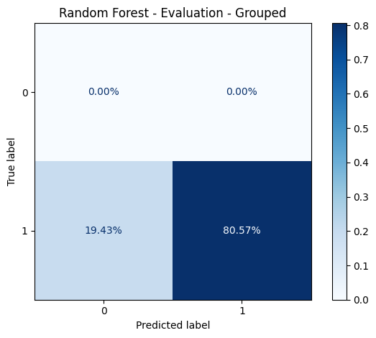


Evaluation Samsung Setup without Interference (Basement) Supervised Models
5 - My Approach

Slide 17
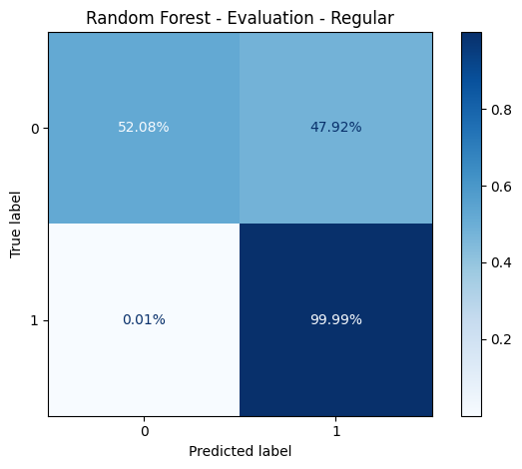
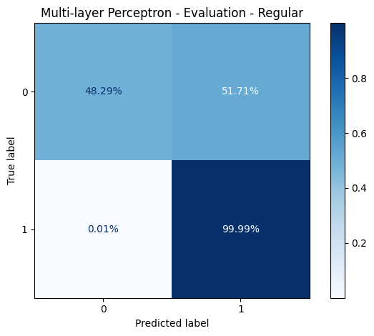
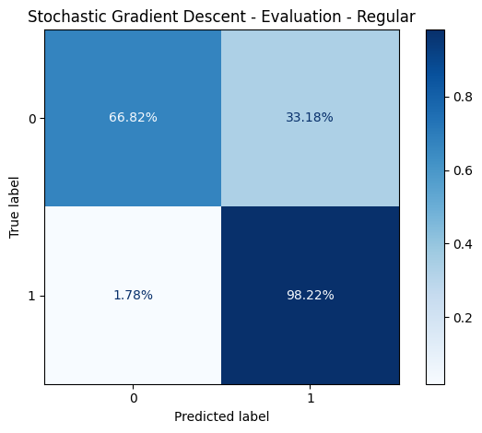

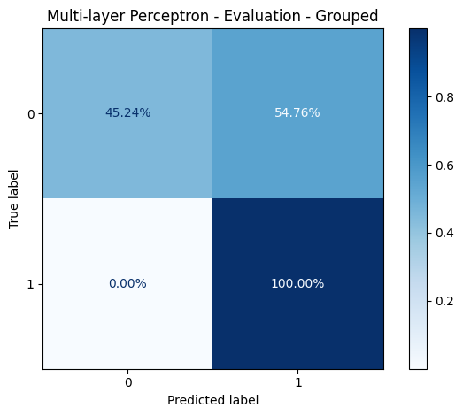

Evaluation Samsung Setup with Medium Interference (Apartment) Supervised Models
5 - My Approach

Slide 18
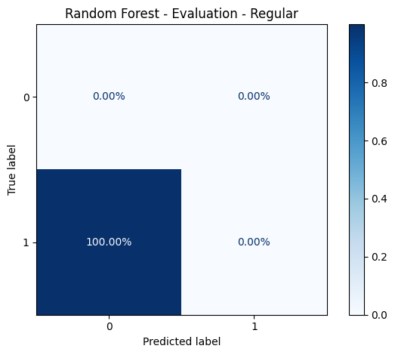





Evaluation Apple Setup without Interference (Basement) Supervised Models
5 - My Approach

Slide 19
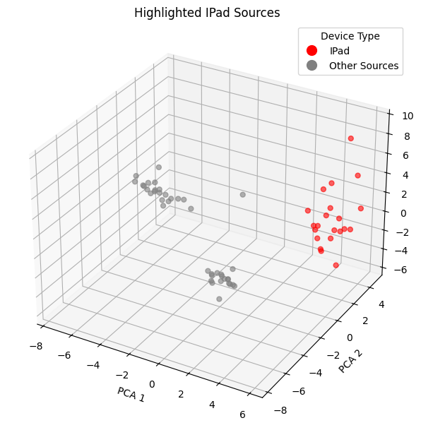
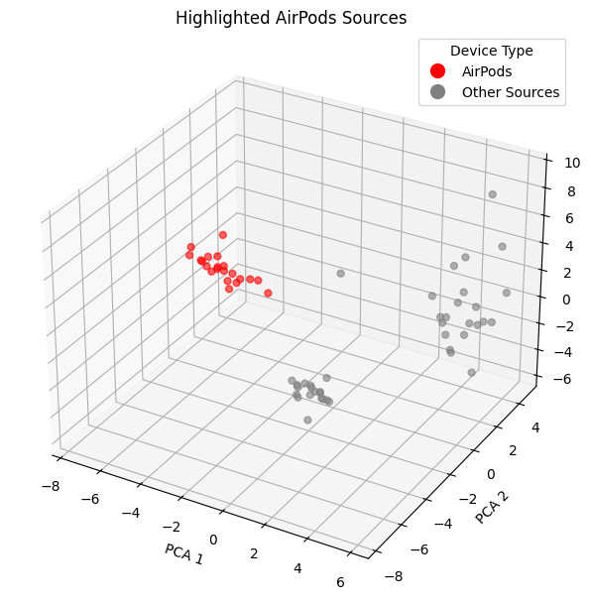
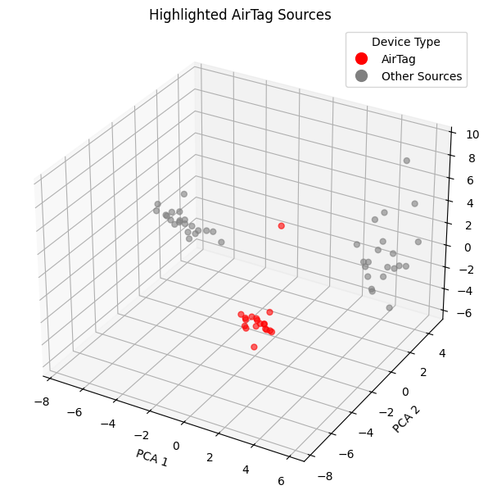
Bonus - Interesting Observation with Apple Group
5 - My Approach

Slide 20
Next Steps
6 - Next Steps
Investigate importance of number of devices:
Joel’s target group consisted of 3 devices → current Samsung setup has 2
Generate a new Samsung dataset with 3 devices: phone, smart tag, and buds
Evaluate with existing model
Generalizability:
Train new models to only perform well for Apple ecosystem or retrain existing models to also perform well for clusters consisting of Apple devices
Retrain existing models to work for clusters of mixed ecosystems
Scalability:
Record two identical setups at the same time
Evaluate with pre-trained models, retrain if necessary

Slide 21
Thank you for your attention. Questions and feedback are welcome.
7 - Q&A

