Slide 1
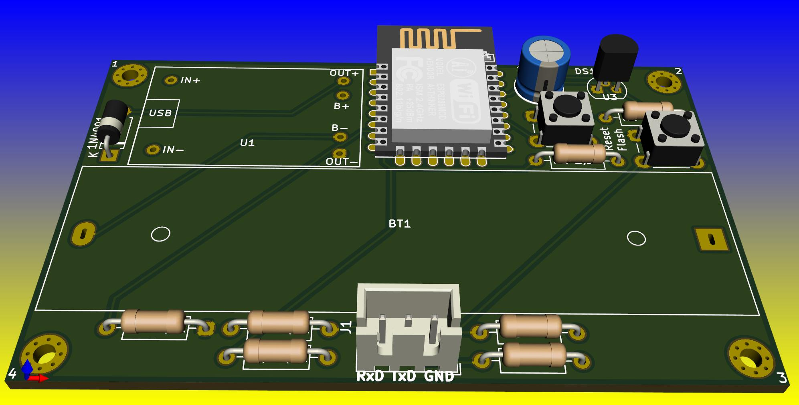

MQTT
MQTT
Grafana
MQTT
InfluxDB
MQTT
MQTT Broker Plugin ioBroker
MQTT
MQTT
MQTT
MQTT

