Slide 1
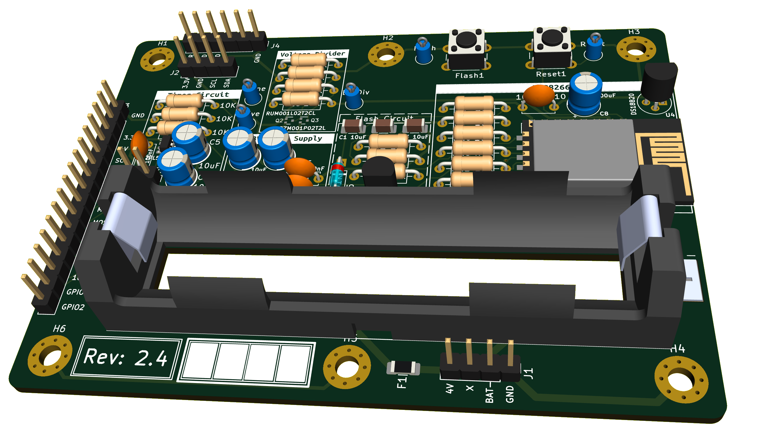

MQTT
MQTT
Grafana
MQTT
InfluxDB
MQTT
Telegraf
MQTT
MQTT Broker
(mosquitto)
MQTT
MQTT
MQTT

