Slide 1

User Data Analysis
Thomas Terziu
https://www.freepik.com/free-vector/simple-blue-gradient-background-vector-business_30087790.htm#fromView=keyword&page=1&position=1&uuid=1705b63f-19ea-4a29-bb1d-41e407aa7f80

Slide 2
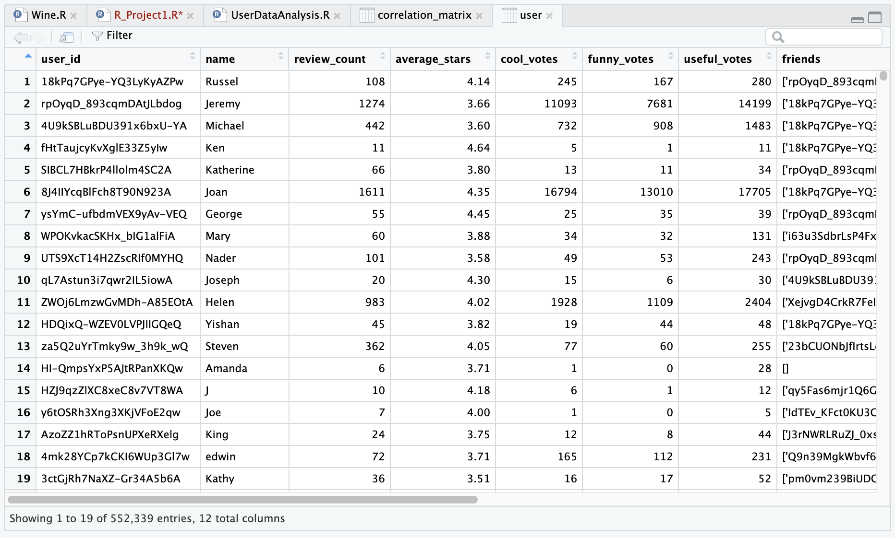
Data Overview
Data gathered from Users of Yelp
Data Includes
552,339 Entries
12 columns of data
6 are numerical
Terziu, Thomas. User Data. 26 November 2024.

Slide 3
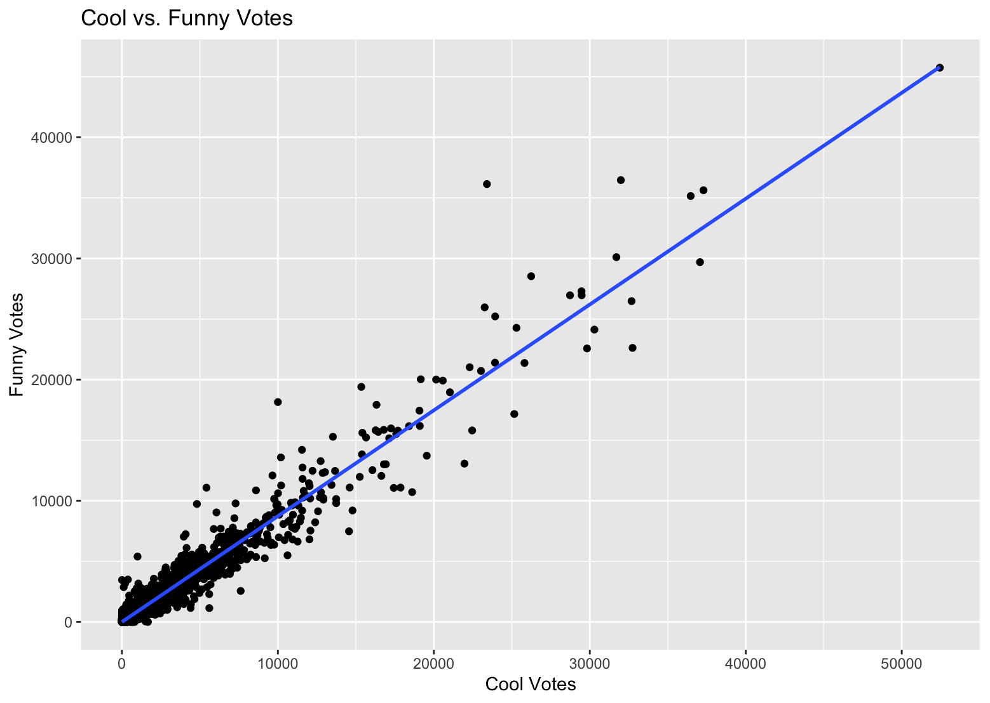
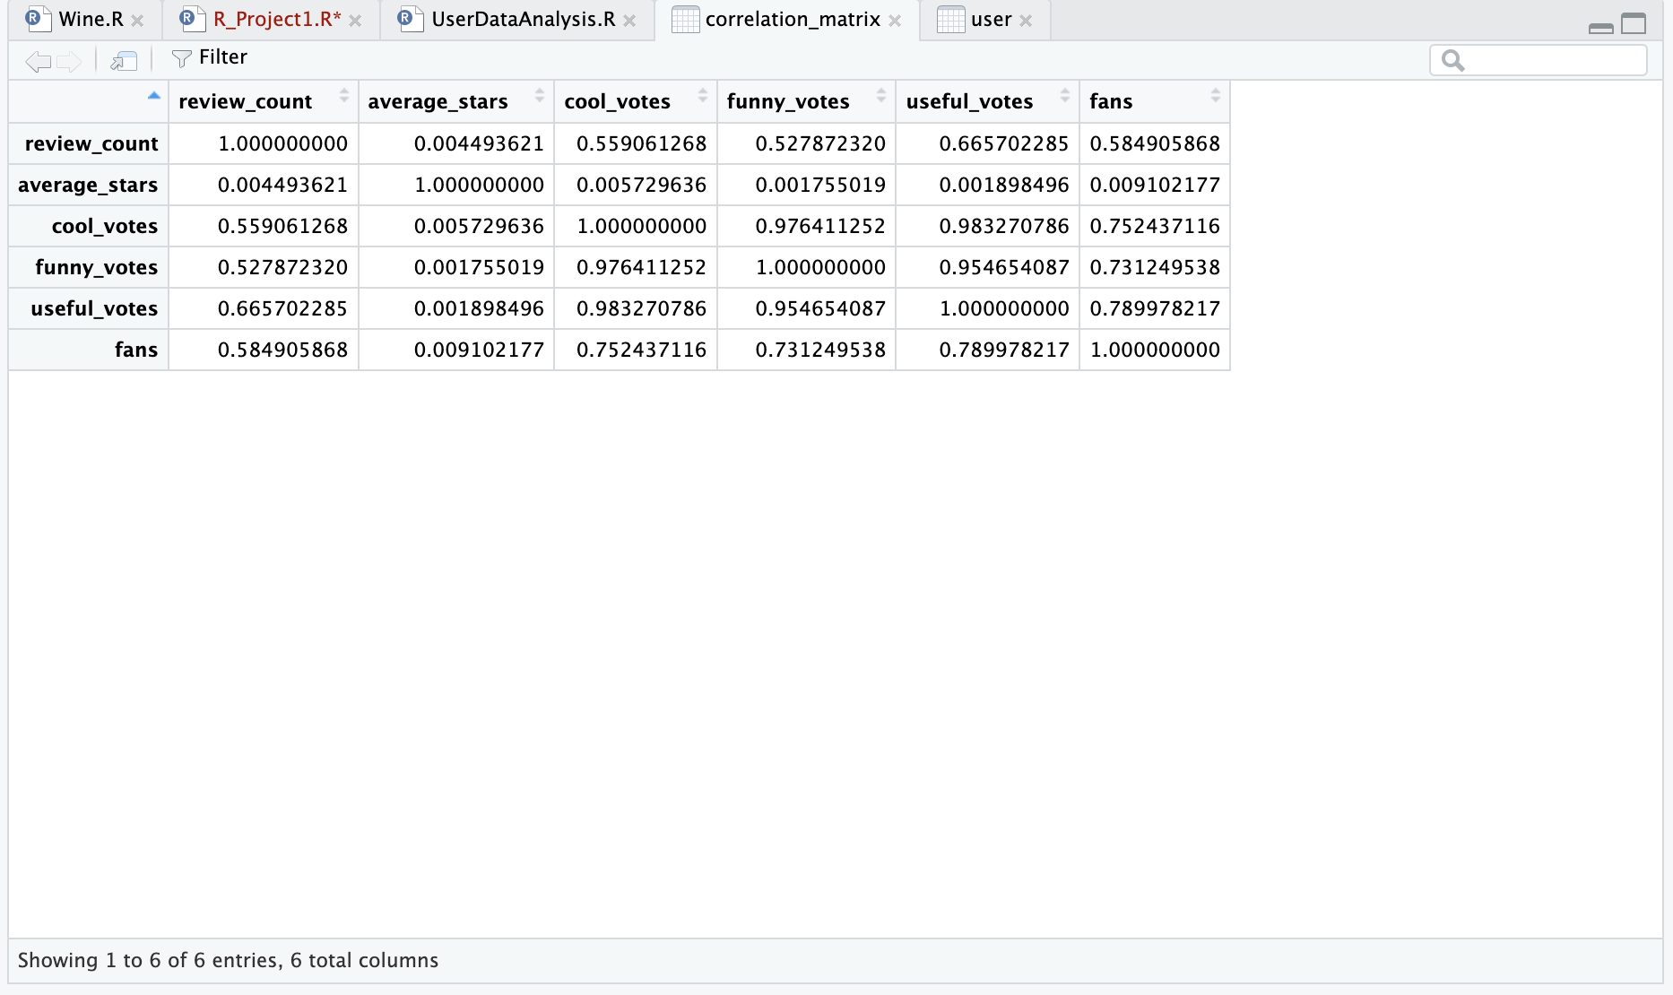
Data Analysis
“Create Elegant Data Visualisations Using the Grammar of Graphics.” Create Elegant Data Visualisations Using the Grammar of Graphics •, ggplot2.tidyverse.org/. Accessed 26 Nov. 2024.
“Create Elegant Data Visualisations Using the Grammar of Graphics.” Create Elegant Data Visualisations Using the Grammar of Graphics •, ggplot2.tidyverse.org/. Accessed 26 Nov. 2024.

Slide 4
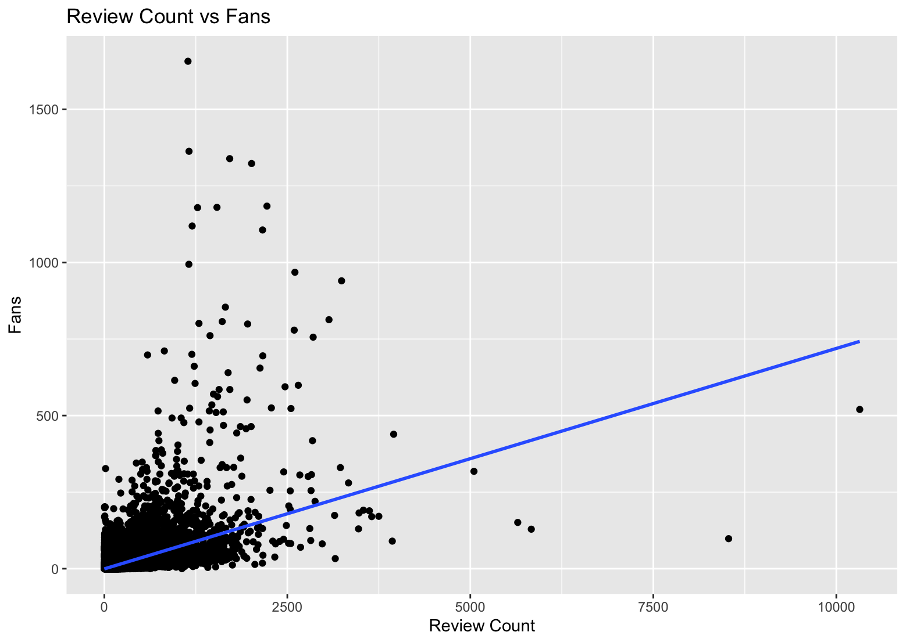

Slide 5
Work Cited
“Create Elegant Data Visualisations Using the Grammar of Graphics.” Create Elegant Data Visualisations Using the Grammar of Graphics •, ggplot2.tidyverse.org/. Accessed 26 Nov. 2024.
“Create Elegant Data Visualisations Using the Grammar of Graphics.” Create Elegant Data Visualisations Using the Grammar of Graphics •, ggplot2.tidyverse.org/. Accessed 26 Nov. 2024.

