Slide 1
SDTL Embedded in ProvONE

Slide 2
Background
Prov+ProvONE provides a general data model for describing provenance relations
C2Metadata provides low-level metadata about commands (interchangeable with a line in a source file)
The general idea is to
1. Come up with a sensible model of command-level executions in ProvONE
2. Embed command-level SDTL into the correct ProvONE objects

Slide 3
Part I:ProvONE Representation

Slide 4
Vocab
ProvOne:Program – Objects that represent anything executable
Examples:
Script files
Executable lines in a script
ProvOne:Port – Objects that represent input & output from a program
Examples:
Output of a csv file
Creation of a variable
Usage of a variable

Slide 5
Representing the Script File
Script files are represented as objects of type provone:Program
The @id should follow standard URI rules. This may be a local file, or a URI pointing to where the file can be found on the web
The minimum representation of the script file is shown below
{
"@id": "file://my_script.R",
"@type": "provone:Program",
}

Slide 6
Representing Commands
Commands are represented as objects with the provone:Program type.
Provone:Program has a recursive relation with other objects that are of type provone:Program : provone:hasSubProgram
provone:hasSubProgram allows the linking of the individual commands back to the parent script file.
In the example below, note that the commands are in a flat array structure
Also note that I’m using hash fragments for the identifiers because individual commands are likely to not be resolvable online
{ {
"@id": "file://my_script.R", “@id”: “#command_1”,
"@type": "provone:Program", “@type”: “provone:Program”,
"provone:hasSubProgram": [ }
{"@id": "#command_1"},
{"@id": "#command_2"},
{"@id": "#command_3"},
]
}

Slide 7
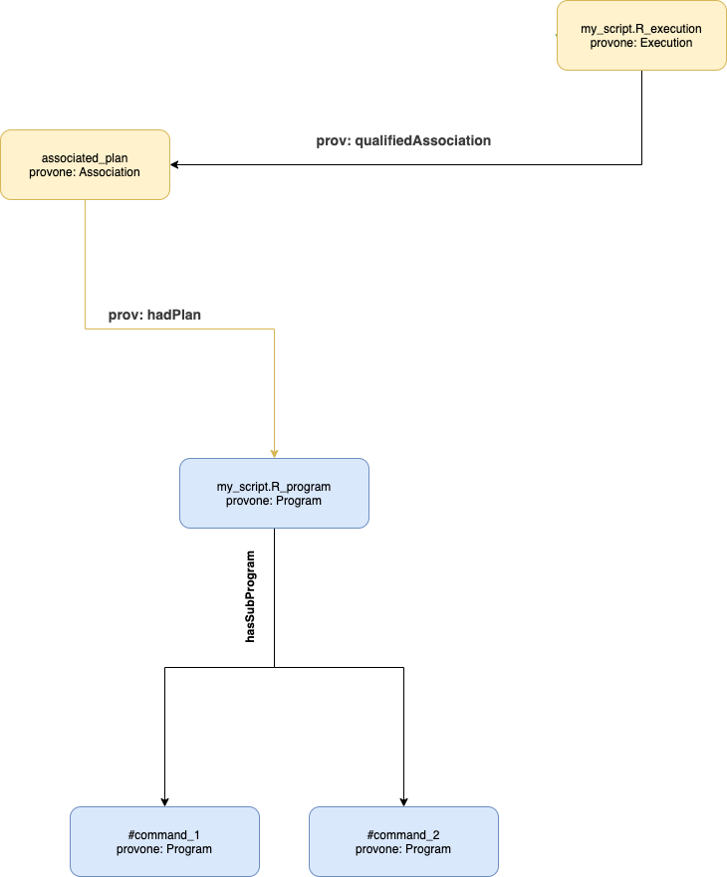

Slide 8
Representing Command Input & Output
Output/results from a command are represented with objects of type provone:Port
These connect to the program objects with the relations
provone:hasOutPort – For showing that the port was a result from a Program
provone:hasInPort – For showing that the port is used by a Program
{
“@id”: “#command_1_outport”,
“@type”: “provone:Port”
}

Slide 9
Representing Chained Output & Input
Sometimes the output of one command may be used as input to another
The Provone:Channel type is used to connect two related provone:Port objects
{
“@id”: “#shared_data_channel”,
“@type”: “provone:Channel”
}
{
“@id”: “#command_1_outport”,
“@type”: “provone:Port”
“provone:connectsTo”: “#shared_data_channel”
}

Slide 10
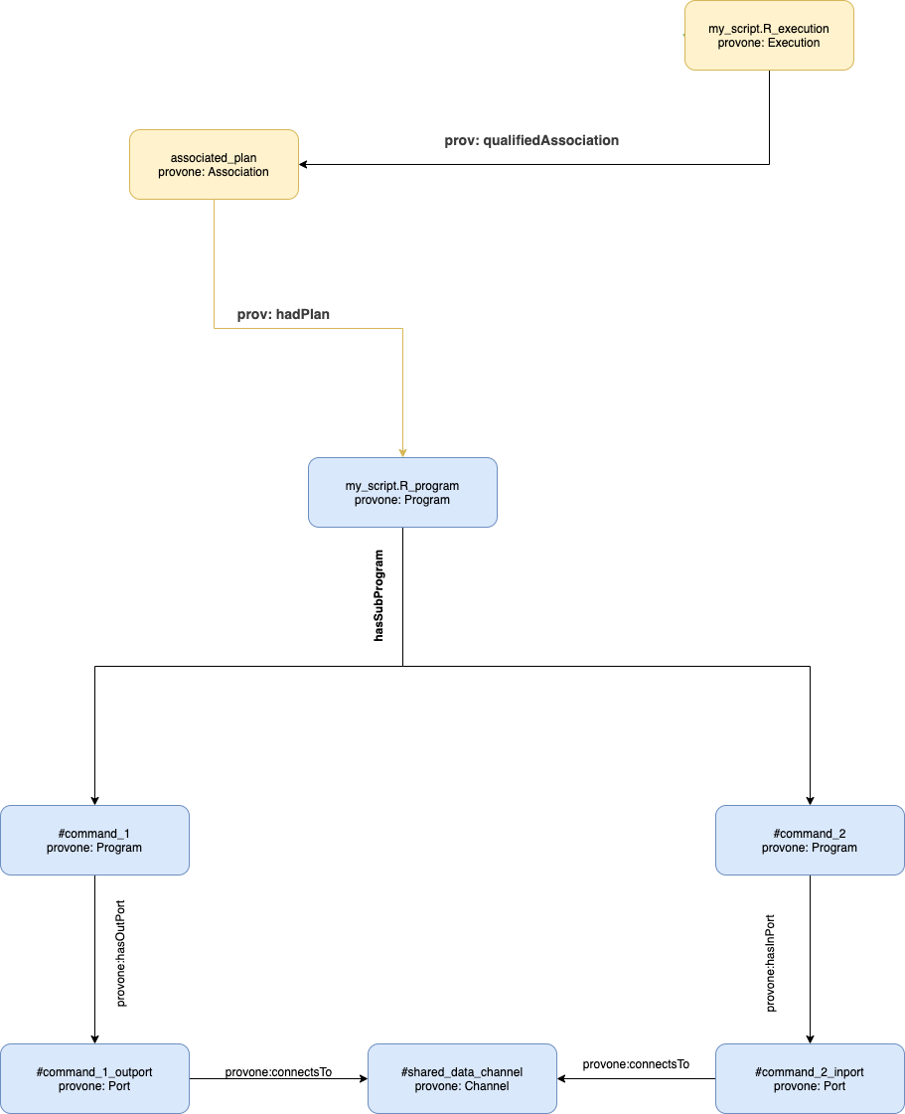

Slide 11
Part II: Embedding SDTL

Slide 12
Embedding File-Level Metadata
The first chunk of SDTL is metadata about the file that was given to the parser
This information naturally goes with the top level provone:Program object.
{
"@id": "file://my_script.R",
"@type": "provone:Program",
”sdtl:sourceLanguage": "spss",
"sdtl: scriptMD5": "631de6aaf22bd758017ed29b3f6cff25",
"sdtl: sourceFileSize": 51,
"sdtl: lineCount": 2,
.
.
}

Slide 13
Embedding Command Information
Contains the SDTL sourceInformation, variable, and expression fields
{
“@id”: “#command_1_outport”,
“@type”: “provone:Port”
”sdtl:$type": "Compute",
"sdtl:command": "compute",
"sdtl:sourceInformation": {}
.
.
.
}

Slide 14
Embedding Variable Information
Part of the overall command metadata involves information about the variable
This is placed in the command’s associated provone:Port
{
“@id”: “#command_1_outport”,
“@type”: “provone:Port”
“provone:connectsTo”: “#shared_data_channel”,
"variable": {
"$type": "VariableSymbolExpression",
"variableName": "median_age"
},
"expression": {
"$type": "NumericConstantExpression",
"value": "35",
"numericType": "int"
}
}

Slide 15
The methods described in the presentation should be able to cover most use cases
General Algorithm:
Create prov representation
Map the SDTL sections into the appropriate prov objects
Model for execution of commands?
Allows for linking between ports and concrete objects on the filesystem
More examples on GitHub
https://github.com/ThomasThelen/sdtl-provone

