Slide 1
DOMAIN UNDERSTANDING · DATA EXPLORATION
Understanding Normal and DoS traffic
What do the flows tell us?
Explore first. Define the detection task from the evidence.
109,353
13
15.0%
recorded flows
selected features
DoS-labeled flows
Combined dataset · No model fitting · 31 October 2026
UNSW-NB15 • Data exploration
01
Notes:
Purpose: explain the domain, work and findings from 01-exploration.ipynb. The combined CSV contains 109,353 records, 93,000 Normal and 16,353 DoS (14.9543%). Labels are supplied by the dataset and are used for descriptive comparison. No train/test split, detector training, threshold tuning or predictive evaluation has been performed. These proportions are properties of the selected laboratory benchmark, not operational attack prevalence. Source: content/normal_dos.csv and the current exploration notebook.

Slide 2
PROBLEM CONTEXT
One row summarizes a network exchange
DoS threatens service availability. Heavy traffic can also be legitimate.
Packets + bytes sent
Source
Destination
Packets + bytes returned
Duration · packet rate · time between packets
One flow can look unusual; this view does not measure a server outage.
UNSW-NB15 • Data exploration
02
Notes:
A packet is a unit of network communication; the flow record summarizes packets observed in the two directions. A flow may be one-sided, and a long logical session can be split across records. DoS can consume bandwidth, connection-handling capacity or application resources, preventing legitimate users from accessing a service. False alerts waste analyst time and inappropriate blocking can interrupt useful traffic; missed attacks can prolong disruption. These inputs lack payloads and server-availability measurements. Sources: CISA, https://www.cisa.gov/sites/default/files/publications/understanding-and-responding-to-ddos-attacks_508c.pdf ; Argus manual, https://openargus.org/oldsite/man/man1/ra.1.pdf ; UNSW dataset description, https://research.unsw.edu.au/projects/unsw-nb15-dataset .

Slide 3
FEATURE UNDERSTANDING
13 features describe four aspects of a flow
Type
Volume
Protocol · service · state
Packets and bytes in each direction
Speed
Timing
Packet rate · directional loads
Duration · directional packet gaps
Features were selected for their network meaning—not by a fitted model.
UNSW-NB15 • Data exploration
03
Notes:
The supplied loader chooses 3 categories (proto, service, state), 4 directional volume features (spkts, dpkts, sbytes, dbytes), 3 speed features (rate, sload, dload) and 3 timing features (dur, sinpkt, dinpkt). Duration is seconds; rates are packets/s; loads bits/s; timing gaps ms. State is protocol-dependent; service "-" means unidentified/unspecified. TCP, UDP, routing and diagnostic protocols have different normal behavior. The loader omits TTL and loss-related fields to focus on traffic behavior rather than routing/OS environment; that is a domain-driven rationale, not experimentally proven optimal feature selection. Historical protocol codes and the unresolved state "no" are documented in skills/DOMAIN_NOTES.md and categorical_value_dictionary.csv. Labels are excluded from predictors.

Slide 4
WORK PERFORMED
We followed the class exploration approach
1
2
3
4
Inspect
Plot
Compare
Define
Meaning, units, missing values
Histograms and simple scatterplots
Normal vs DoS; then within protocol
A task the data can support
Raw measurements first. Simple plots. Explain the observations before modeling.
UNSW-NB15 • Data exploration
04
Notes:
The approach follows the statistical temperature notebook 01b and the raw-data exploration in engine notebook 07a: inspect variables, draw histograms, use zooms, plot pairs of variables, compare conditions, and return to individual examples. Mean/std and median/quantiles are examined because skewed traffic can make averages misleading. We checked dtypes, missing/infinite/negative values, zeros, repeats and conflicting labels. All descriptive statistics use the complete combined data; selected scatterplots use a reproducible sample of 2,000 rows with seed 42. Plot zooms do not remove data. The notebook uses no detector or decision threshold. Classroom methods are linked in skills/COURSE_SOURCES.md.

Slide 5
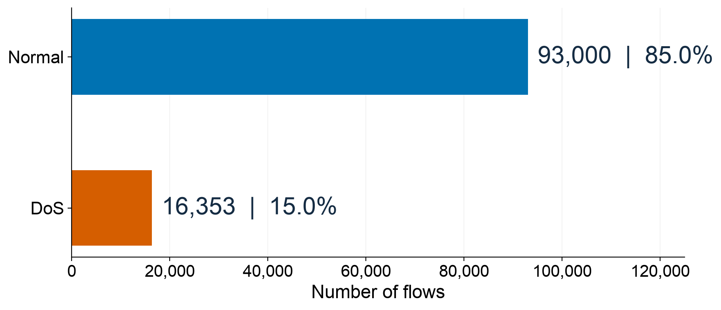
DATASET
Most records are Normal; about 15% are labeled DoS
This is a Normal/DoS subset of a laboratory dataset.
UNSW-NB15 • Data exploration
05
Notes:
The original smaller training/testing files were combined for this exploration at the user’s request. We retained only Normal and DoS, with 93,000 and 16,353 rows respectively; all other attack families were excluded. Their original boundaries are not used as an experiment in this phase. No performance estimate is derived from these labels. The official UNSW description documents laboratory generation with normal activity and synthetic contemporary attacks. Therefore the 15% attack mixture must not be presented as real-world frequency. Source: content/normal_dos.csv; UNSW website and Moustafa & Slay (2015).

Slide 6
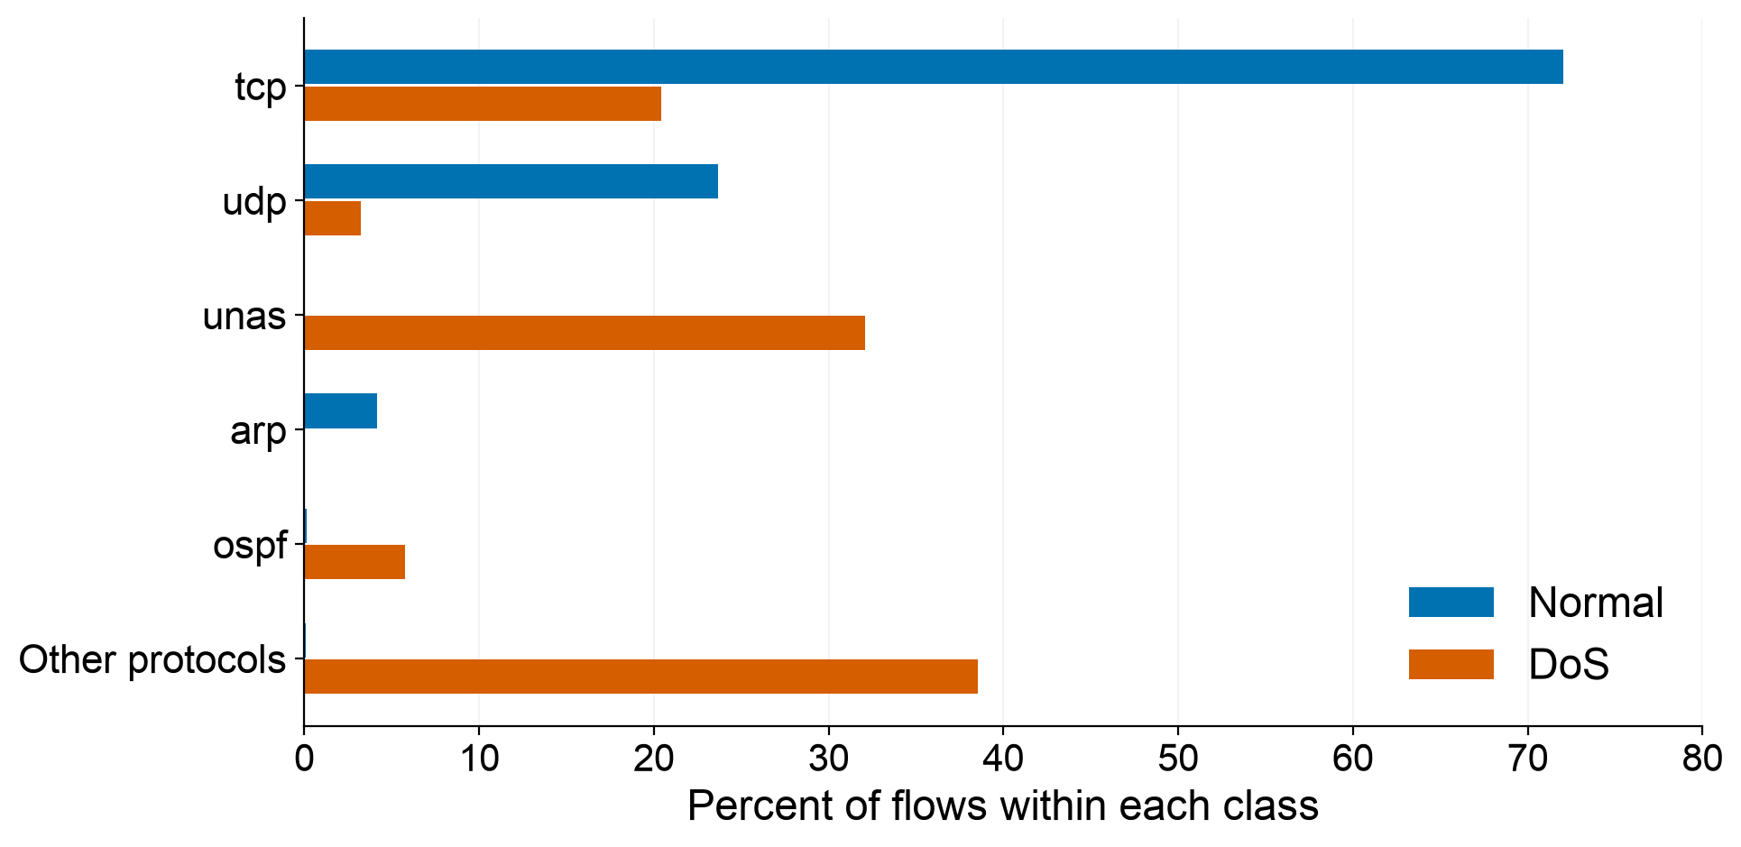
FINDING 1
Normal and DoS use different protocol mixtures
126
protocol names
with no Normal
examples here
Each color totals 100%. “Other protocols” includes every remaining name.
UNSW-NB15 • Data exploration
06
Notes:
Each series is normalized by its own class total, not by the number of flows of a specific protocol. For example, about 72.0% of Normal records use TCP, while about 20.4% of DoS records use TCP. This does not mean that 20.4% of TCP traffic is DoS. The plot shows TCP, UDP, unas, ARP, OSPF and all 128 remaining labels grouped as Other; the full blue and orange series each sum to 100%. There are 133 observed protocol labels; 126 have no Normal examples in this subset and account for 70.6% of DoS records. This is incomplete normal coverage and a possible laboratory/exporter shortcut, not evidence that these protocols are intrinsically malicious. unas is an unnamed-protocol exporter fallback. Source: recomputed crosstab on content/normal_dos.csv, same calculation as notebook categories.

Slide 7
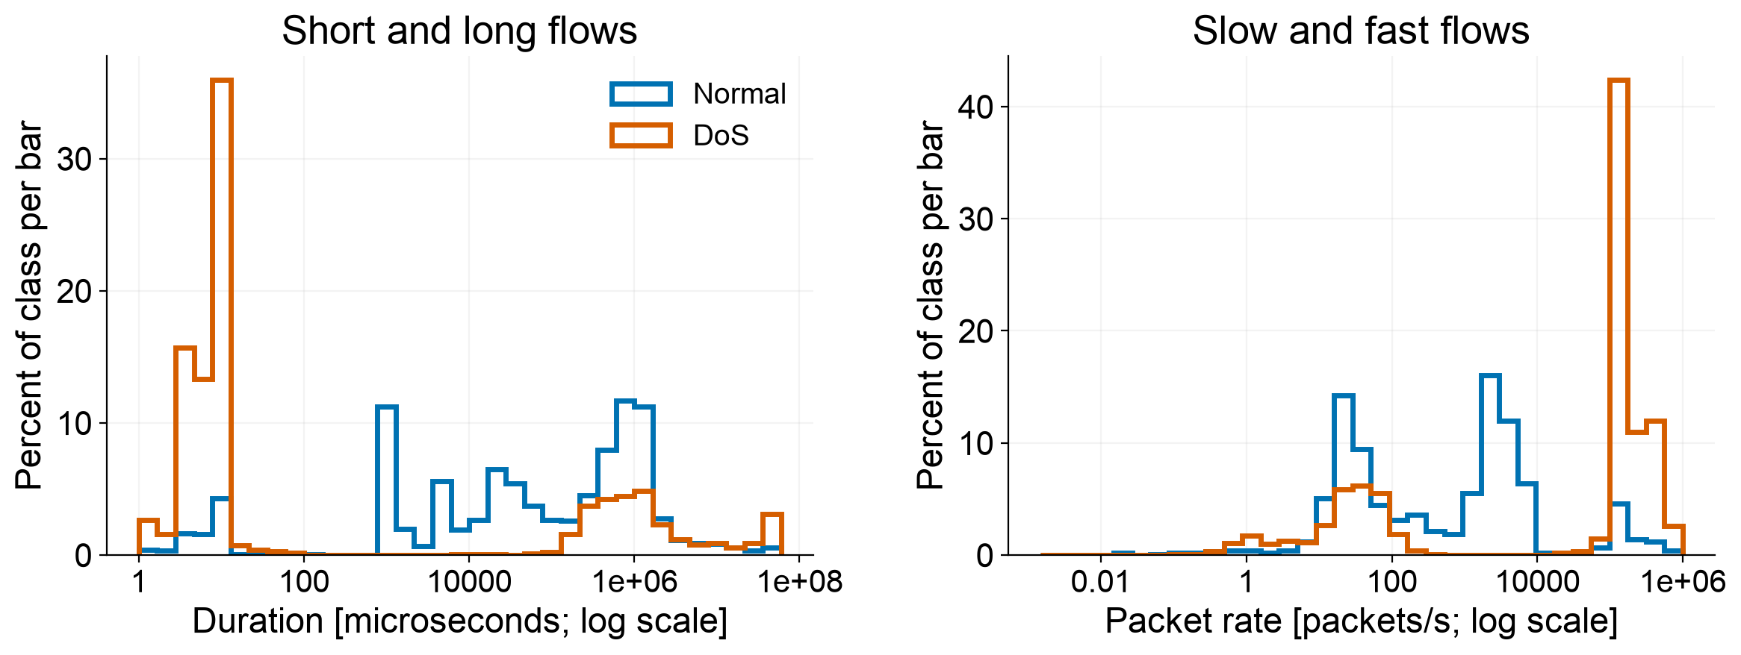
FINDING 2
Short flows can still have high packet rates
Median DoS flow: 9 microseconds · 2 source packets
Positive values only · zeros are counted separately in the notebook
A high rate over a tiny interval does not prove sustained flooding.
UNSW-NB15 • Data exploration
07
Notes:
These are the notebook histogram calculations redrawn for projection. X axes are logarithmic but labeled with actual values; duration is converted to microseconds. Y shows percent of the entire class per logarithmic bin, making the class shapes comparable. Only strictly positive values can appear on log axes. Zero duration: Normal 3.81%, DoS 0.067%; zero rate: Normal 3.79%, DoS 0.813%; they remain in the dataset. The DoS median is 9 microseconds, compared with Normal 53.9385 milliseconds. DoS mean duration is about 2.45 seconds: the long tail makes the mean and median differ. For two packets separated by 10 microseconds, one observed interval gives about 100,000 packets/s, although the record contains only two packets. We do not infer overall server traffic or outages from this number. Source: notebook numerical distributions and local CSV.

Slide 8
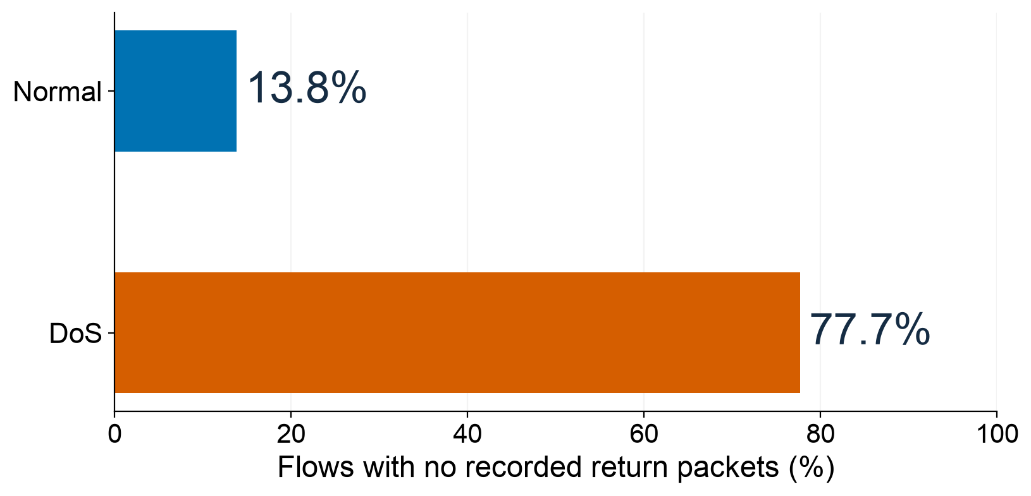
FINDING 3
DoS often has no recorded return packets
One-way traffic also occurs in Normal flows. Read it with the protocol.
UNSW-NB15 • Data exploration
08
Notes:
The event is dpkts == 0, calculated over each class separately, using all rows. It occurs in about 77.7044% of DoS and 13.8161% of Normal records. Zero return bytes coincide with zero return packets in this selected dataset, so these are not two independent pieces of evidence. One-way traffic can be normal for some protocols or reflect what was captured/exported. OSPF and ARP examples demonstrate why the condition alone is not a universal attack rule. An absence of observed return packets is not the same as a proved failed application response or a server outage. Source: notebook zero-value section and content/normal_dos.csv.

Slide 9
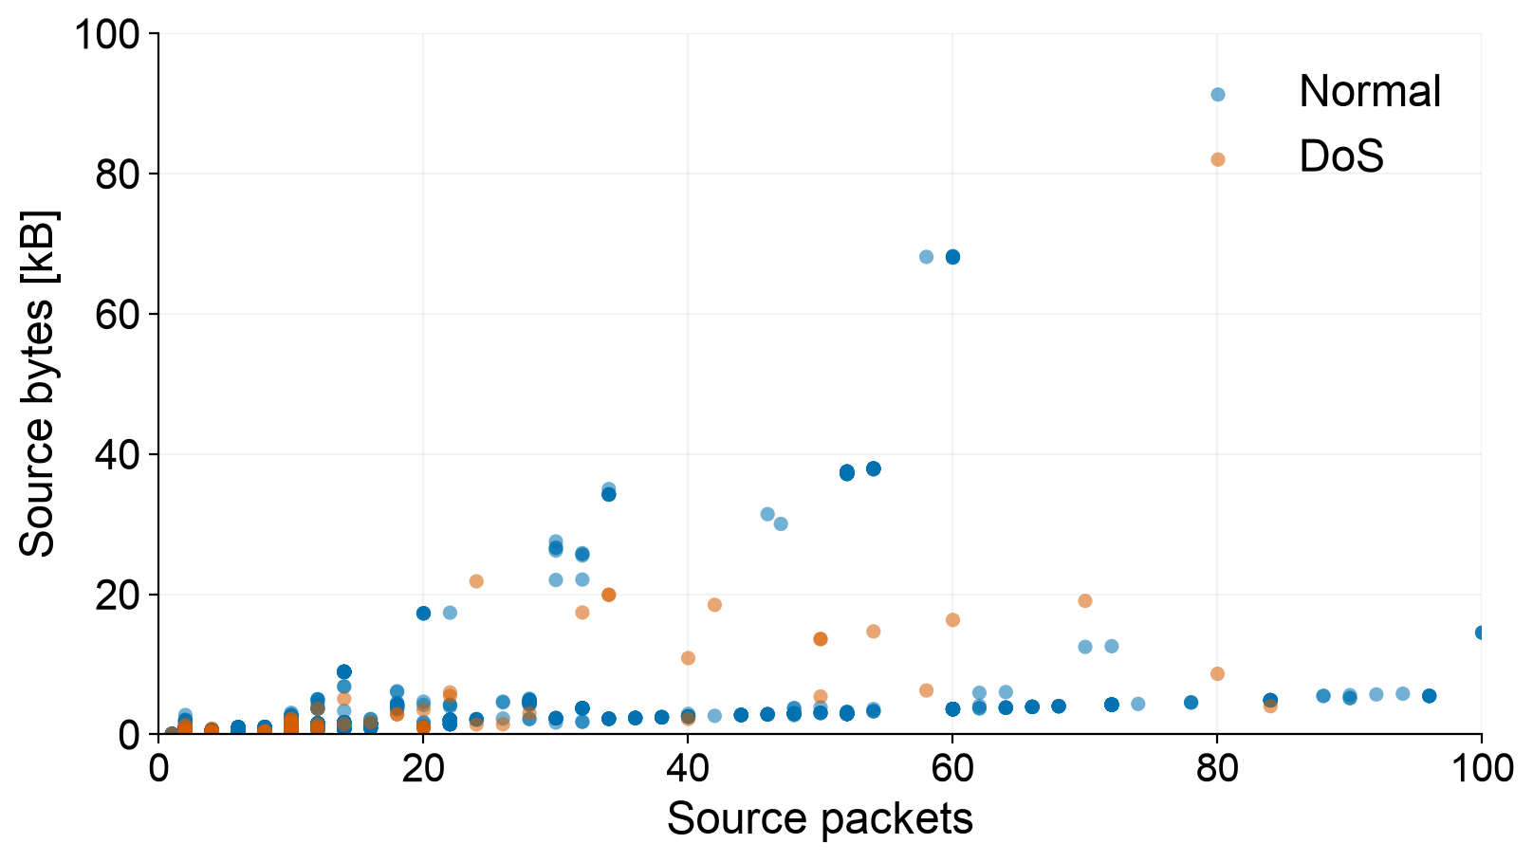
RELATIONSHIPS
Read packet counts and byte counts together
Each dot
is one flow.
Normal and DoS
patterns overlap.
A flow can be unusual in a relationship even when each value looks ordinary.
UNSW-NB15 • Data exploration
09
Notes:
This is one of the feature-against-feature scatterplots requested by the user, not a correlation heatmap. It uses the same reproducible sample of 2,000 records, seed 42. Blue/Orange indicate supplied labels. The view zooms to <=100 source packets and <=100kB source transaction bytes; all statistics and source records are retained. Source bytes include exported transaction data, not purely application payload. Sending more packets often goes with more bytes, but packet sizes vary and groups overlap. The figure is descriptive; no regression line, anomaly score or decision boundary is fitted. The notebook shows full-range plots and reports the percentage inside each close-up. We avoid a mirrored second copy of this pair to keep the slide clear.

Slide 10
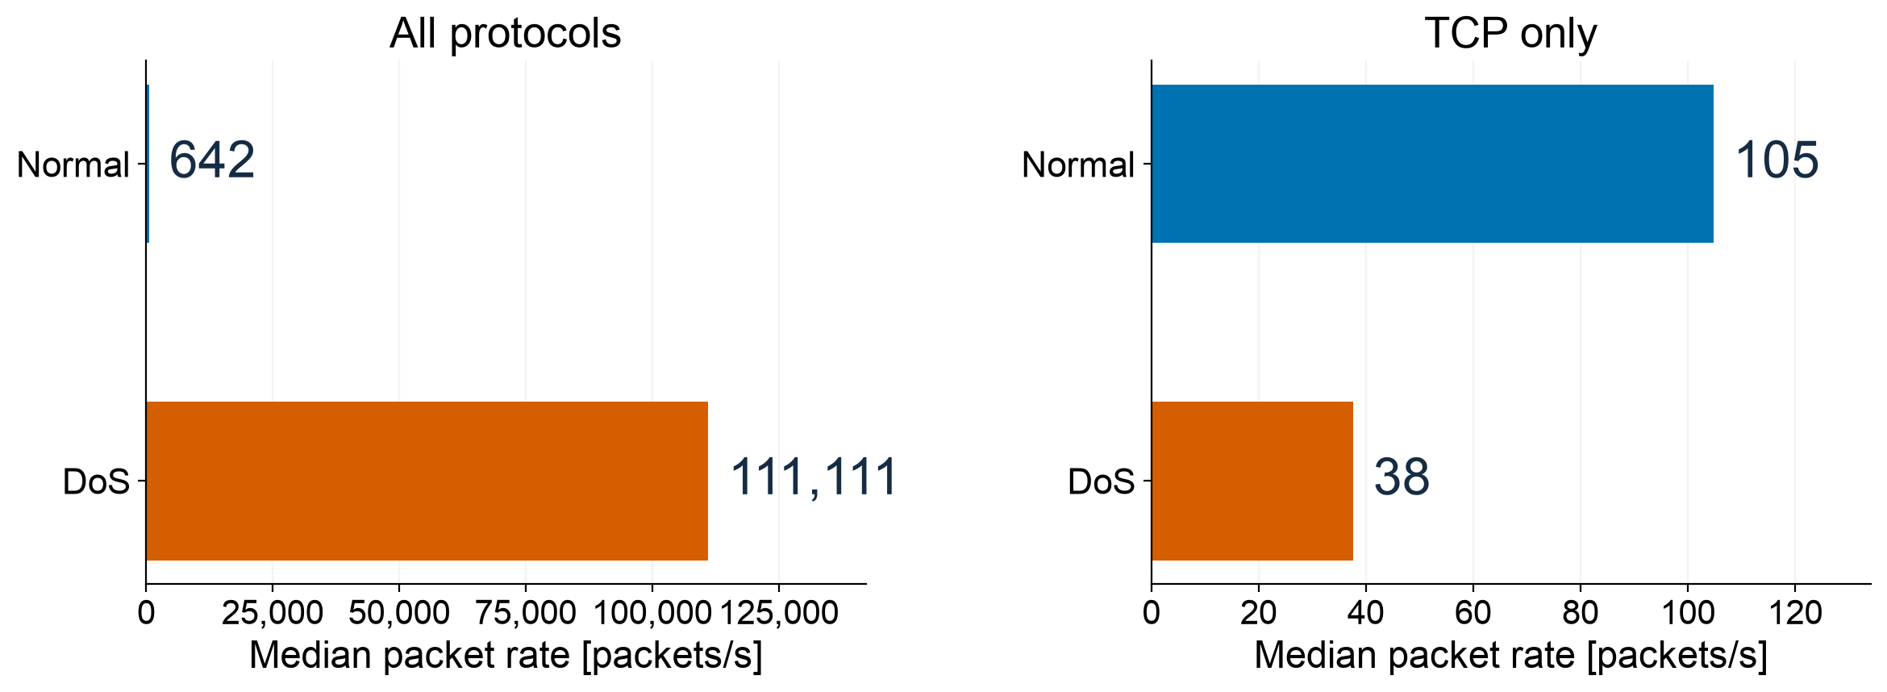
FINDING 4
The rate comparison changes inside TCP
Compare similar traffic before defining what looks unusual.
Different axis ranges. In each panel, compare Normal with DoS.
UNSW-NB15 • Data exploration
10
Notes:
These are medians of all relevant records, not fitted estimates. Across all protocols, Normal median rate is 642.3257 packets/s and DoS is 111,111.1072. Within TCP, Normal is 104.7915 and DoS 37.6784. Thus the direction of the comparison reverses when the protocol is held fixed. The panels use different x-axis limits deliberately and the values are printed directly; do not compare bar lengths across panels. This illustrates the class lesson from bearing temperature versus ambient temperature and the single/two-state machine examples: context can explain the raw measurement. It does not prove a causal protocol effect. Future analysis should compare flows within relevant protocol/service/state populations. Source: notebook rate_medians table.

Slide 11
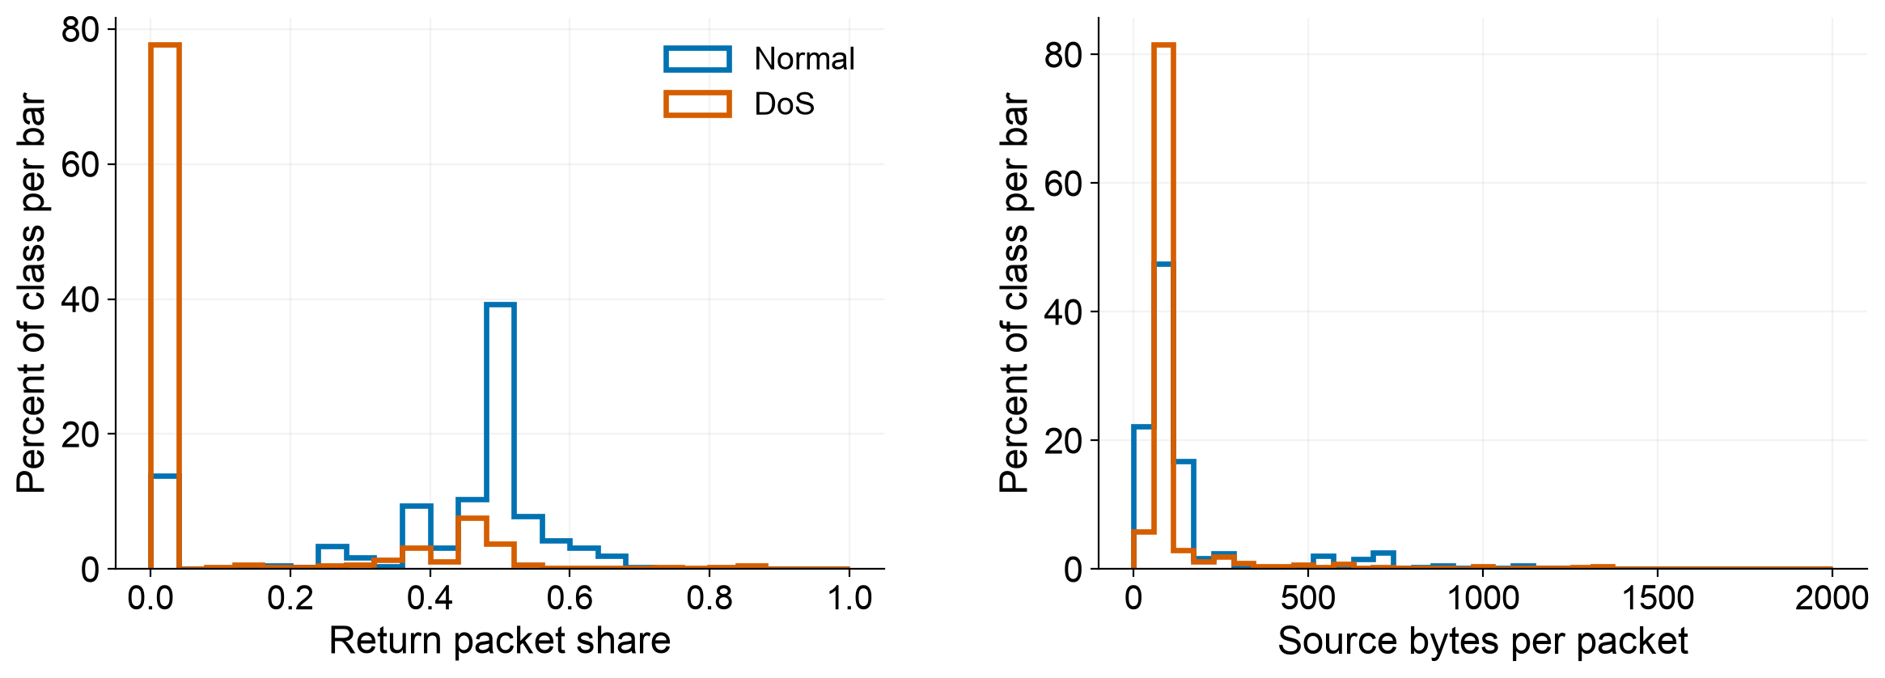
FEATURE UNDERSTANDING
Two summaries make the flow easier to read
Return share = returned packets / all packets
Mean bytes = source bytes / source packets
These are new views of existing measurements—not new raw information.
UNSW-NB15 • Data exploration
11
Notes:
Both candidates are derived solely from the original selected features, never labels. Return packet share is dpkts/(spkts+dpkts): 0 means no recorded return packets; 0.5 equal directional counts. The packet sum describes this flow record, not the number of flows or connections across a time window. Mean source bytes per packet is sbytes/spkts; transaction bytes are not payload alone. Zero denominators would be left undefined. Here all spkts are >=1. Histogram Y is percentage of the entire class per bin; no fitted probability is implied. Source bytes-per-packet display uses 0–2,000 and is a display zoom; undefined/outside counts are documented in the notebook. These transformations make patterns easier to explain and have not been shown to improve a detector. Source: notebook extra-features section.

Slide 12
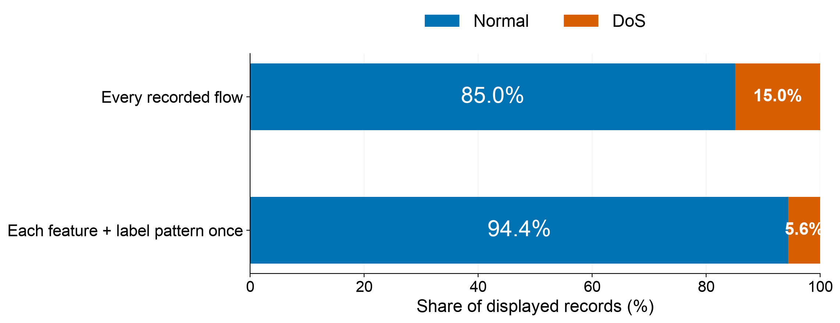
DATA QUALITY
Repeated measurements change the picture
0 missing values · 26,869 rows repeat the same selected measurements.
A comparison only: we did not remove repeated records.
UNSW-NB15 • Data exploration
12
Notes:
The first bar uses all observed records. The second counts each feature-plus-label combination once, leaving 77,873 Normal combinations and 4,635 DoS combinations; DoS share changes from 14.9543% to 5.6176%. Identical predictor vectors with both labels occur once per label in the second view. This is not a recommended automatic cleaning step or a revised prevalence estimate. Repetition might reflect repeated behavior, quantization, export processing or duplicated rows; these columns cannot distinguish the explanations. We retain every record in the current dataset. Missing values, negative numerical values and nonfinite numerical values are all zero in the selected CSV, but that does not resolve repeated observations or annotation ambiguity. Source: notebook data-quality checks, recomputed from the local CSV.

Slide 13
INFORMATION LIMITS
The same measurements can have different labels
24 identical measurement patterns occur with both labels.
Normal
DoS
Protocol: udp | State: INT
Source packets: 2 | Return packets: 0
Duration: 9 microseconds
Source bytes: 78 | Return bytes: 0
Protocol: udp | State: INT
Source packets: 2 | Return packets: 0
Duration: 9 microseconds
Source bytes: 78 | Return bytes: 0
All 13 selected measurements match. Extra context is missing.
UNSW-NB15 • Data exploration
13
Notes:
The example is the most frequently repeated conflicting predictor vector, selected transparently by group size. All 13 feature values match between at least one Normal and one DoS row; the slide shows only selected fields for readability. The specific vector has proto udp, service -, state INT, dur 0.000009, spkts 2, dpkts 0, sbytes 78, dbytes 0, rate 111111.1072, sload 34666664.0, dload 0, sinpkt 0.009, dinpkt 0.0. There are 24 conflicting vectors covering 782 rows overall. A deterministic rule using only these 13 measurements cannot separate the opposite labels for those identical inputs. This does not prove the labels are wrong: absent context or annotation ambiguity are possible. Ratios of the same inputs cannot restore missing information. Source: notebook repeated-measurement audit; exact equality verified during deck generation.

Slide 14
TASK FORMULATION
Find flows that differ from similar normal traffic
Which recorded flows deserve
a security analyst’s attention?
One flow
Traffic context
Analyst review
The unit we can inspect
Protocol · service · state
An alert is a lead to investigate
Cross-flow floods need timestamps and host identifiers that are absent here.
UNSW-NB15 • Data exploration
14
Notes:
Formal scope: identify individual exported network-flow records whose behavior differs from comparable legitimate patterns represented in this Normal/DoS subset; investigate alignment with the supplied DoS labels. Inputs are the selected 13 features and optional explainable deterministic summaries. The labels are separate and were used openly during exploration. Normal traffic has multiple contexts, and some categories have no Normal coverage. Later work could learn normal behavior from Normal examples; this deck does not claim success of any detector. Cross-flow collective attacks cannot be reconstructed without trustworthy timestamps, host/destination identifiers and observation coverage; server logs/resource metrics would support actual availability claims. A labeled DoS record need not be a statistical outlier. Future evaluation must consider false alerts, missed attacks, category shortcuts, repeats and label conflicts. No fitting, threshold selection, train/test experiment or future-attack accuracy is presented.

Slide 15
SOURCES
Evidence and definitions
UNSW-NB15
Moustafa & Slay (2015) · dataset description
Network fields
Argus ra manual · packet, byte, timing and state definitions
DoS context
CISA · Understanding and responding to DDoS attacks
Class methods
Temperature notebook 01b · engine exploration 07a
Our analysis
01-exploration.ipynb · content/normal_dos.csv
UNSW-NB15 • Data exploration
15
Notes:
Primary sources: Moustafa, N. and Slay, J. (2015), UNSW-NB15: a comprehensive data set for network intrusion detection systems, MilCIS 2015, linked from the official dataset page. Argus ra manual physical pages 5 and 16 define units and protocol-dependent state. CISA guidance provides availability/resource-exhaustion context. The complete protocol/service/state glossary with primary references is in skills/DOMAIN_NOTES.md and categorical_value_dictionary.csv. Class references: references/WPI_AnoDet_01b_AD_statistical_solution.ipynb; references/WM_AnDet_07a_PCA_AE_NCMAPSS.ipynb; single/two-state OCSVM/Isolation Forest machine examples. All numerical findings were recomputed from content/normal_dos.csv to build this deck. Slide charts redraw selected current notebook plots for projection-sized text; no additional model is fitted. Original source data and notebook are not modified by this generator.

