Slide 1

Introduction to bone marrow aspiration
Dr. Hemo, UCF COM

Slide 2
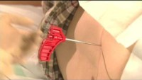

bone marrow aspiration video
Warning. The procedure in this video may be disturbing to some viewers.

Slide 3
Bone marrow aspiration video

Slide 4
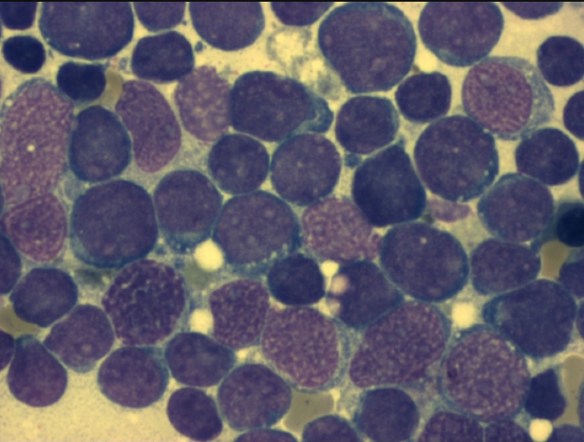
Polling Question 1 Which of the following is the most favorable prognosis for this disease?
hypodiploidy
t(14;18)
t(11q;23)
t(8,14)
t(9;22)
t(12;21)

Slide 5
Polling Question 1 Which of the following is the most favorable prognosis for this disease?

