Slide 1


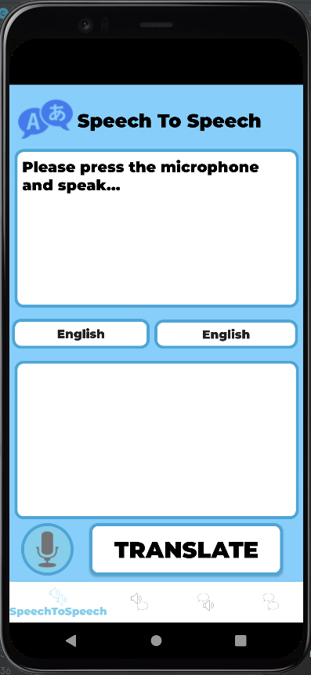
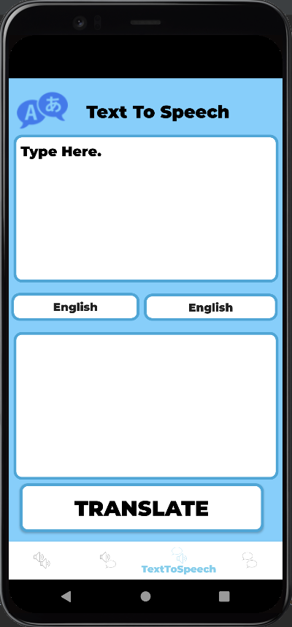
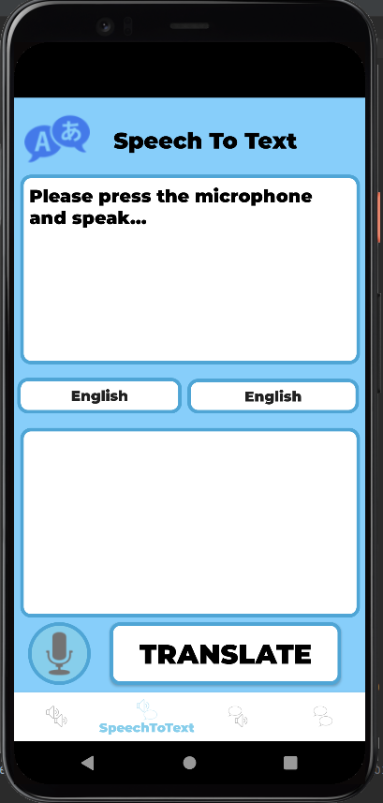
Language Translator
Thomas Sadler – 2101179
As part of the CE881 module

Slide 2
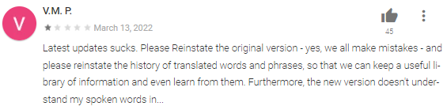
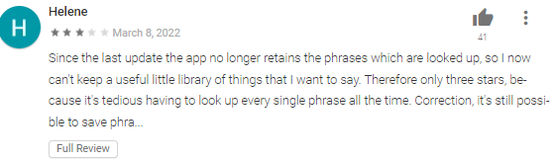
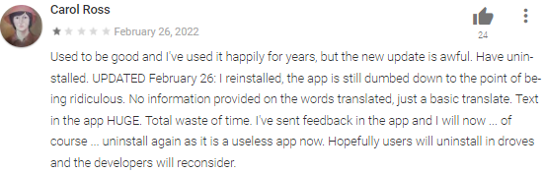
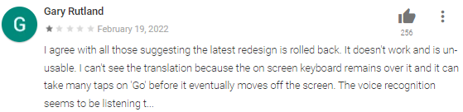
The problem
Have you ever been on holiday?
Have you ever had to move to a new country?
Have you ever run into someone who can’t speak the same language as you?
Have you ever struggled to learn a new language?
Why not google translate?
Continuous Complaints
Too overcomplicated
Symbols and text too big or too small
Glitchy / Full of bugs
App breaking updates
And many more…

Slide 3
The solution
Vibrant Colour Scheme
Other Capabilities
- Keyboard input
Text to speech output in selected language
- Fast compile times
Simplistic layout
Glitch Free
Multi-language text translation
Voice Recognition
Clear symbols and text
Efficient Navigation
I’m implementing the best parts google has to offer, without the bad
Disclaimer: Requires stable Wi-Fi connection

Slide 4
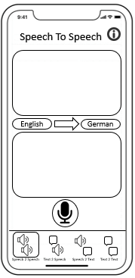
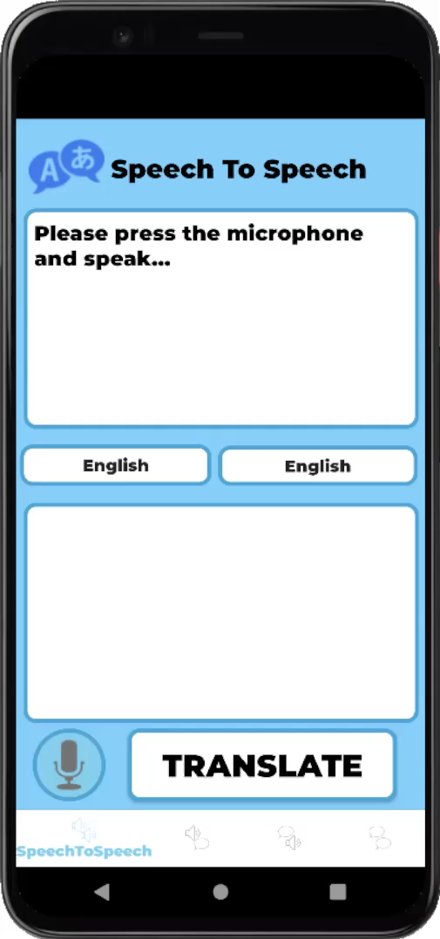
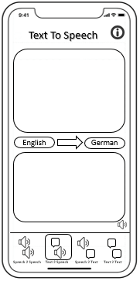
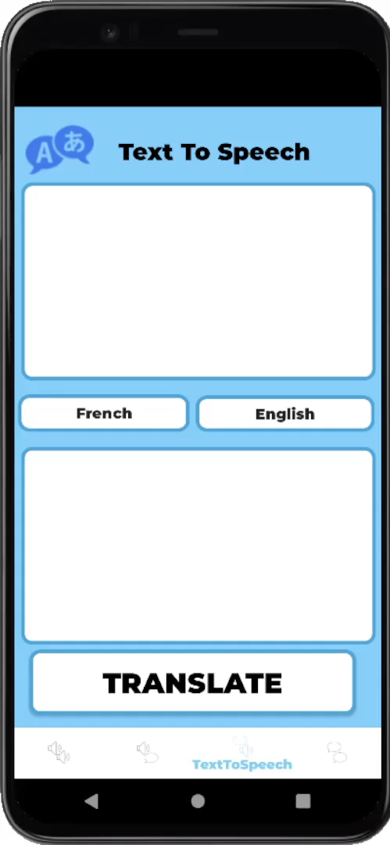
Demonstration
S2S → Press Microphone Button → Speak → Choose Languages → Click Translate
T2S → Type message into first box → Choose Languages → Click Translate
Design Differences:
No information screen
Button for translation
Text to speech is automatic

