Slide 1
iFly Res
Presented By,
Thomas George
S4 MCA (LE)
Roll No : 53
Product Owner,
Associate Prof Ms. Sandhya R
Scrum Master,
Asst Prof Ms. Anjali Sankar

Slide 2
ABSTRACT
iFly Res, a next generation airline passenger services platform is designed to provide airlines with greater business flexibility and operational efficiency. Born out of a need for a more dynamic PSS system in the aviation industry, iFly Res features a customer-centric design that can seamlessly manage changing business models - from low cost to hybrid operations. Powered by a Rules Engine that allows system configuration to meet your exact requirements, it not only ensures higher productivity and operational ease but also reduced vendor dependence.iFly departure control system(DCS) is a comprehensive solution providing integrated management of airport flight departure control and check-in functions. It supports various processes related to check-in, boarding, baggage handling and seat assignment of passengers. The solution also efficiently manages the flight-related control required to completely automate the departure functions. Additionally and increasingly, a DCS for some city-pair sectors may also interface with immigration control for visa, immigration and passenger no-fly watchlists.

Slide 3
As an update we plan to add two additional featuresto this application
1)APIS (Advanced Passenger Information System) passenger(pax) report
Two days before from the departure of flight the data in the departure control system (DCS) such as pnr(passenger name record),passport id ,and visa details are be send to immigration department of both origin and destination country they will check the given details in their systems if any problem find in the passenger details they change the status of Passenger. But in check in system the status is view as an icon in each security affected pnr (passenger name record).It is difficult, time consuming to find such passenger and take action from large passenger list of that flight. By this report we can easly find thesecurity affected passengers from large list also we can take action to that pnr(passenger name record) we can find affected passenger by searching flight no and sort the passengers by same criteria and make an action to that whole passengers by a single step.

Slide 4
2)Seat discrepancy finding report
The airline seat reservation is done by several ways such as by an travelingagent, auto assign by system at check in time, and customer reserved seat at booking time.The booking process are done by different system maybe in different location .So there is a chance of Seat discrepancy by mishandling and database concurrency issues this make many problem such as same seat for more than one passenger .It is very difiicult and time consuming to find where is the problem occurred .By making this report we can easy root out issues

Slide 5
Developing Platform
Front End : JSP
Back End : Oracle weblogic 12c
Developing Language : Java
IDE : Eclipse

Slide 6
Modules
ckeckin-AIPS Report view and Action
Seat discrepancy finding

Slide 7
Feasibility Study
Feasibility Study is an assessment of the practicality of a proposed project or system. An estimate is made of whether the identified candidate needs may be satisfied using our recent software and hardware technologies. The study will decide if the proposed application will be cost effective, from the business point of view and it can be developed in the existing budgetary. The feasibility study should be relatively sharp and quick .The gesture should inform the decision of whether to go ahead with a more detailed analysis.
If there is project risk then the feasibility of producing the quality software is reduced .The study is done in three phases.
Operational Feasibility
Technical Feasibility
Economical Feasibility

Slide 8
Operational Feasibility
Proposed iFly Res are beneficial only if they can be turned into information systems that will meet the organization’s operating requirements.
Operational feasibility is termed as how the difficulties that Check In officer, Travel agent, Gust user during operating this system can be removed.
There was no difficulty in implementing the software and the proposed system is so effective, user friendly, functionally reliable so that the users in the company will find that the new system reduces the hard steps.

Slide 9
Technical Feasibility
In this system technical feasibility is done as different steps. The term technical feasibility is termed as whether the currently available hardware and software is apt for working of the project iFly Res.
The applicatin will works on windows operating system also intract with api using web browser.This is the way which I have adopted for doing the operational feasibility

Slide 10
Economical Feasibility
Economic justification is generally the “Bottom Line” consideration that includes cost benefit analysis, long term corporate income strategies, impact on other profit centers or products; cost of resources needed for development and potential market growth .When we consider the case of economical feasibility I have compared the developing cost of the system with company’s expenditure. If and only if its comparatively low then only we can say the system is economically feasible. When we take the case of system cost we not only compare the expenditures but also the time that have spent, transportation cost if any etc are also been compared with this. And the total cost is compared with the company’s expenditure.

Slide 11
Burn Down Chart
6hour/Day
1 Week = 30 hour
2 Week = 1 Sprint, i.e. 60 hour
Total Week = 12
Total Sprint = 6
Total Hours = 360

Slide 12
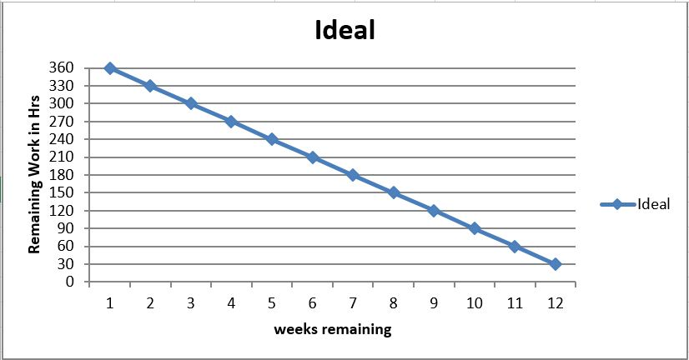
Burn Down Chart

Slide 13
UML DIAGRAMS

Slide 14
Use case Diagram

Slide 15
Activity Diagram

Slide 16
THANK YOU

